Slide 1

Operation Research Credit Hours = 3 by Dr. Wazir Muhammad Laghari Email: wazirlaghari@buetk.edu.pk
Electrical Engineering Department
Balochistan University of Engineering and Technology
Khuzdar

Slide 2
Lecture Tentative Plan
Lecture No | Description
Lecture: 01 | Formulation and analysis of probabilistic models in operations research
Lecture: 02 | Poisson processes
Lecture: 03 | Renewal processes Markov chains
Lecture: 04 | Queuing theory
Lecture: 05 | Markovian decision processes
Lecture: 06 | Time series analysis
Lecture: 07 | Application areas reliability
Lecture: 08 | Traffic flows Production and inventory
Recommended Books
C. Richard Cassady, Joel A. Nachlas, Probability Models in Operations Research
Wayne L. Winston, Introduction to Probability Models: Operations Research

Slide 3
Operation Research / Operational Research / Quantitative Techniques for Management / Quantitative Analysis for Management /
Operation
Research
means to investigate something or to test something or To investigate or To review.
means a thing that is ready to use or in a working condition.

Slide 4
Operation Research
We all are doing operational research in daily life to make better decision for our profit or for maximizing our profit.
You can purchase something and than you compare it.
Each industry apply the operational research to maximize the profit.
Operation research also helps us to develop a model for decision making.

Slide 5
Mathematical Model
Deterministic Model
Probabilistic Model

Slide 6
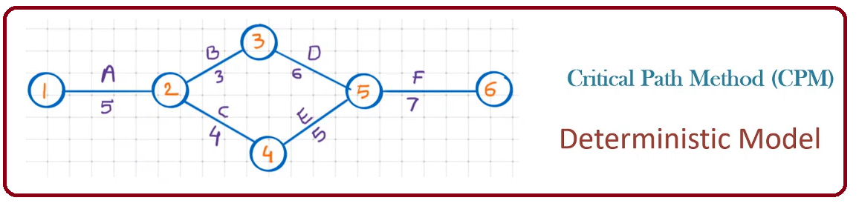
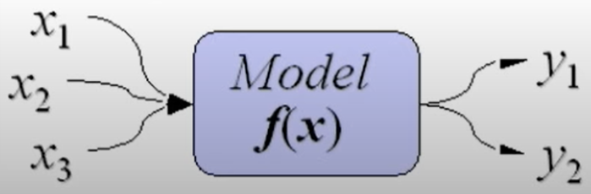
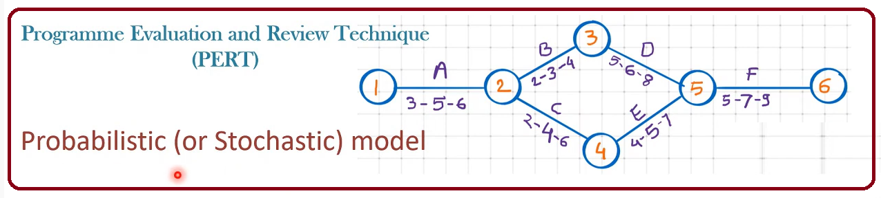
Deterministic Versus Probabilistic Model
Such models assume conditions of complete certainty and perfect knowledge.
Such models can assume different values with given probability.

Slide 7
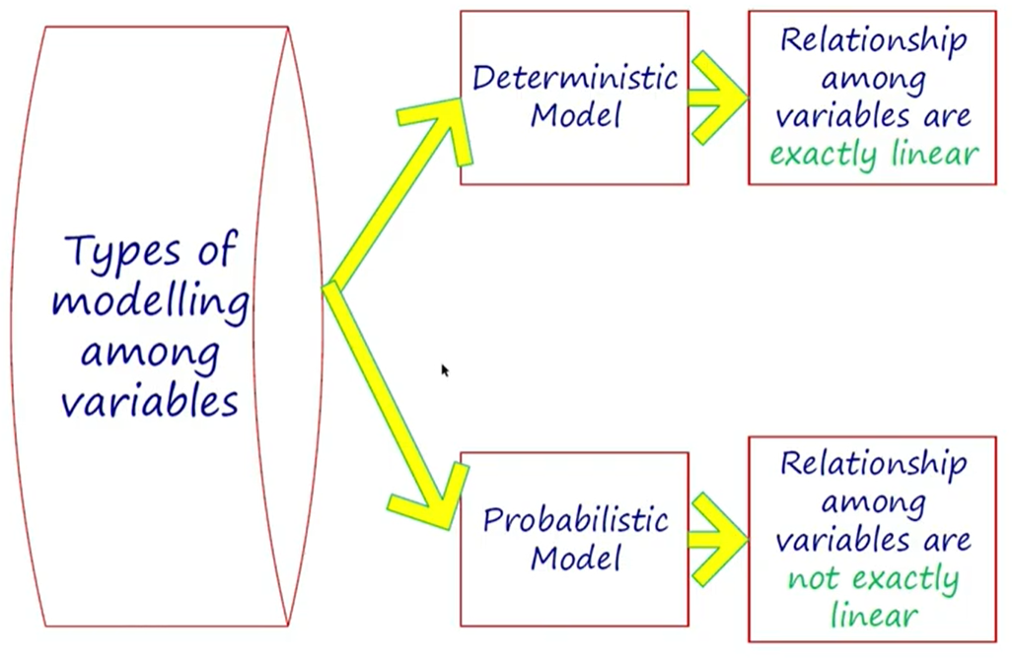
Deterministic Versus Probabilistic Model

Slide 8
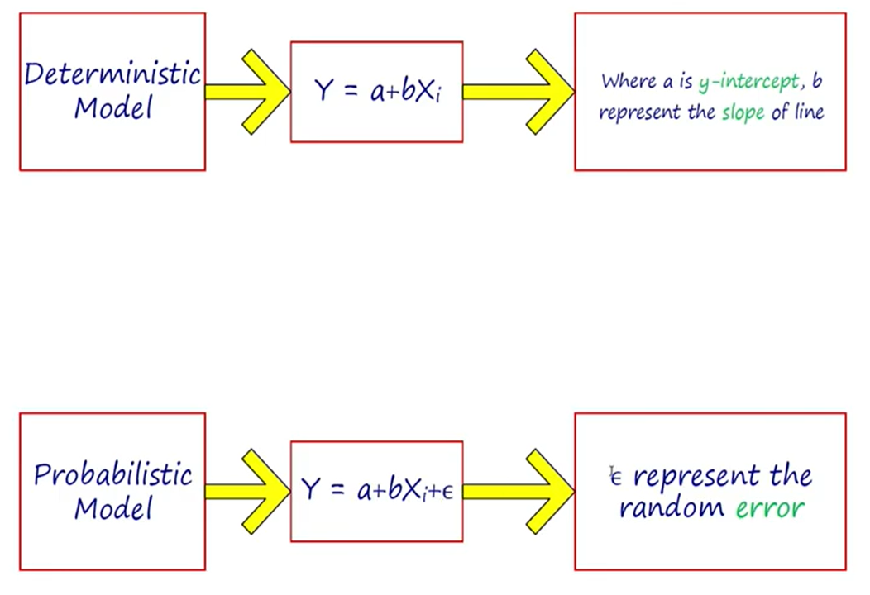
Deterministic Versus Probabilistic Model

Slide 9
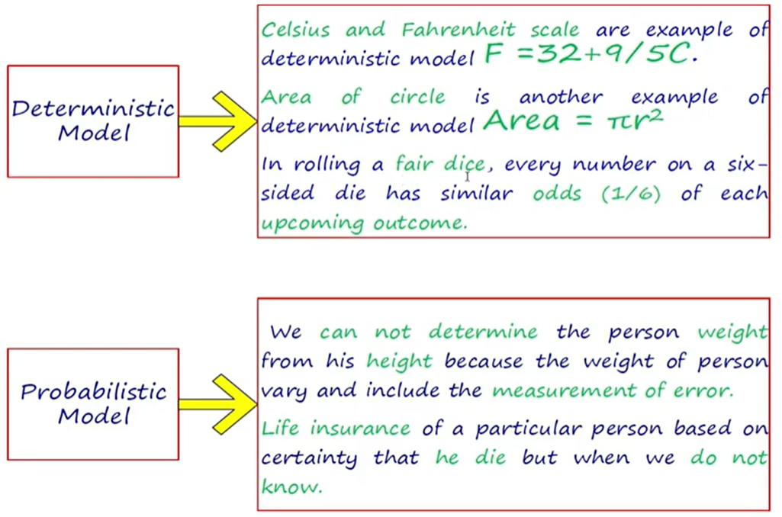
Deterministic Versus Probabilistic Model
Suppose 10 person height is 6 feet and weight should be 70 kg. It is not necessary every person having height 6 feet and its weight is 70 kg

Slide 10
Probability (Calculated Guess)
Probability is the branch of mathematics concerning numerical descriptions of how likely an event is to occur, or how likely it is that a proposition is true.
The probability of an event is a number between 0 and 1, where, roughly speaking, 0 indicates impossibility of the event and 1 indicates certainty.
The higher the probability of an event, the more likely it is that the event will occur. A simple example is the tossing of a fair (unbiased) coin.
Since the coin is fair, the two outcomes ("heads" and "tails") are both equally probable; the probability of "heads" equals the probability of "tails"; and since no other outcomes are possible, the probability of either "heads" or "tails" is 1/2 (which could also be written as 0.5 or 50%).

Slide 11

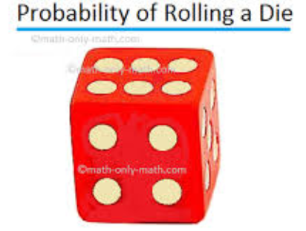
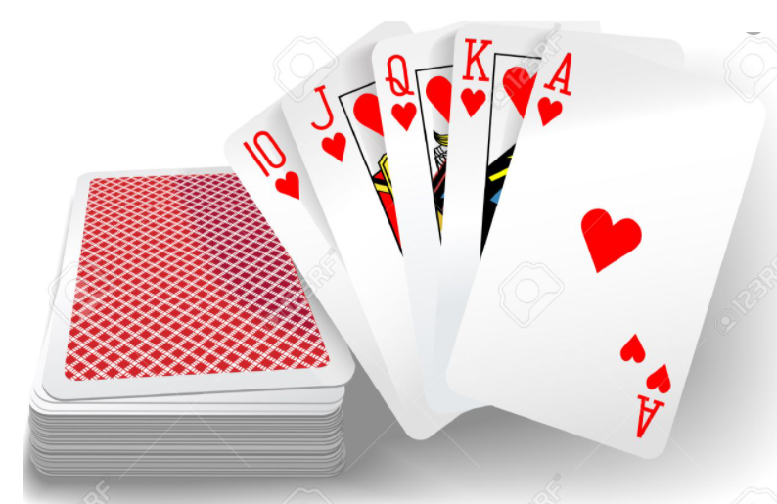
Observation or Measurement And Experiment or Random Experiment
Suppose a coin is tossed once and the up face is recorded. The recorded is called an observation or measurement.
The process of making observation is called an Experiment.
Tossing a coin, rolling a die and drawing a card from a deck are all examples of random experiments.

Slide 12
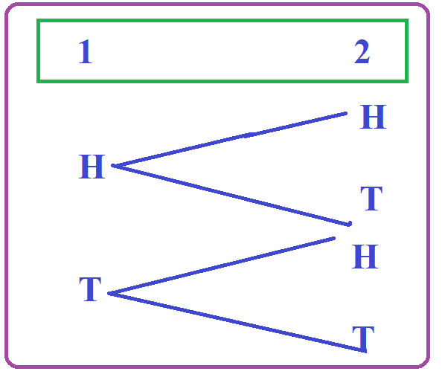
Sample Space
The sample space is the set of all possible outcomes in an experiment.
Example:
Tossing a coin: the sample space is {H, T}.
Tossing a two coin: the sample space is {HH, HT, TH, TT}
Rolling a Die : the sample space is {1,2,3,4,5,6}
S = {HH, HT, TH, TT}

Slide 13
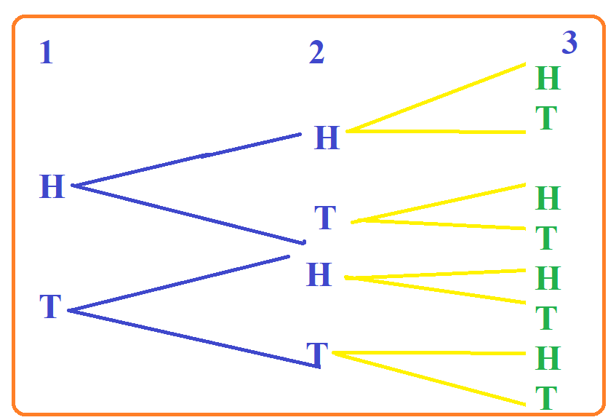
Example: Flip a coin 3 times. List the sample space.
S = {HHH, HHT, HTH, HTT, THH, THT, TTH,TTT}

Slide 14



Sample Space of 1 Kid in Line {Boy, Girl}
Sample Space of 2 Kids in Line {Boy Boy, Boy Girl, Girl Boy, Girl Girl }
Sample Space of 3 Kids in Line {BBB, …. GGG}
Formula of Sample Space = 2^{S}

Slide 15
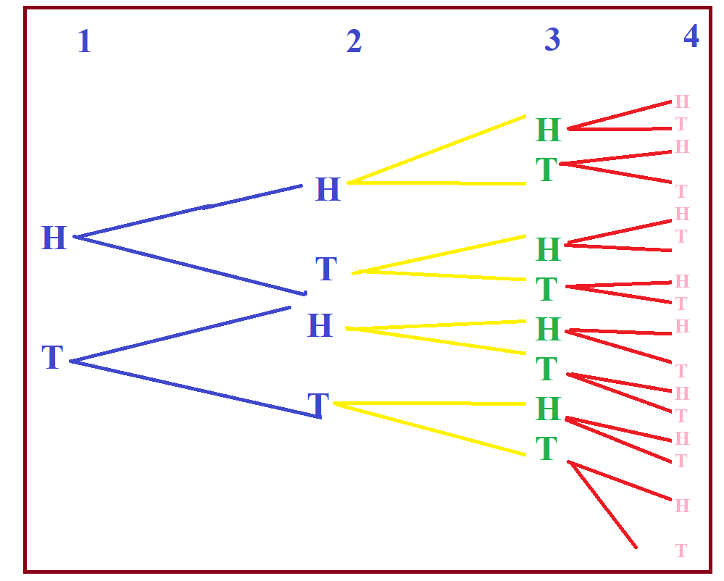
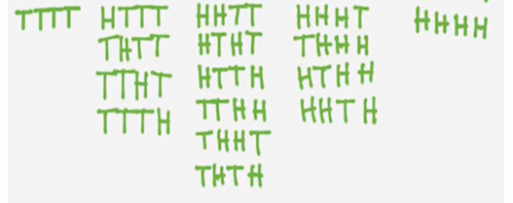
Example: Flip a coin 4 times. List the sample space.

Slide 16
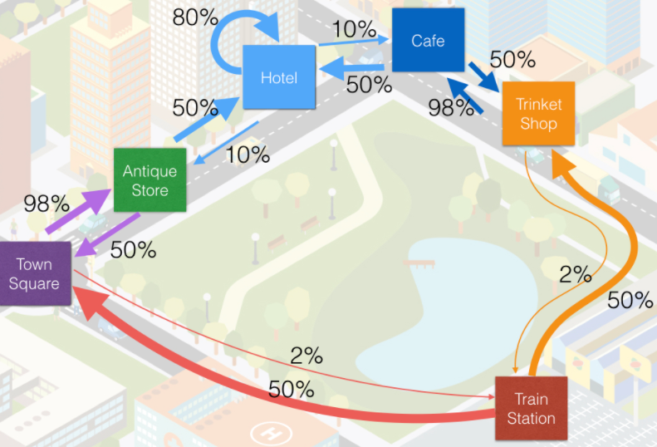
Markov Chain
Markov Chain is a random process in which the occurrence of future (next) state depends on the immediately (current) preceding sate it is known as Markov Chain Or Process
State: A state is a condition or location of an object in the system at specific or time is known as state.
Behavior of consumers in terms of their brand (state because check different brands) loyalty and switching pattern.
System = Market Place
Any Machine use to made or manufacture a product, we also sue Markov Chain.

Slide 17
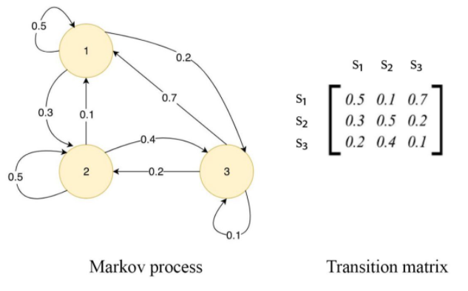
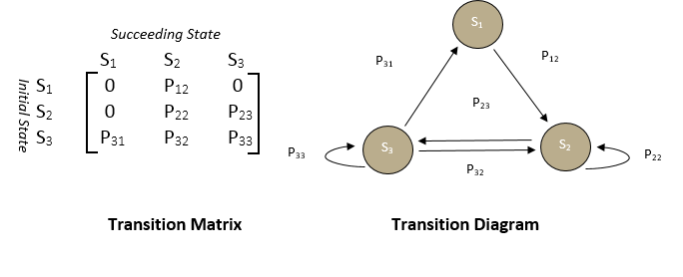

Slide 18
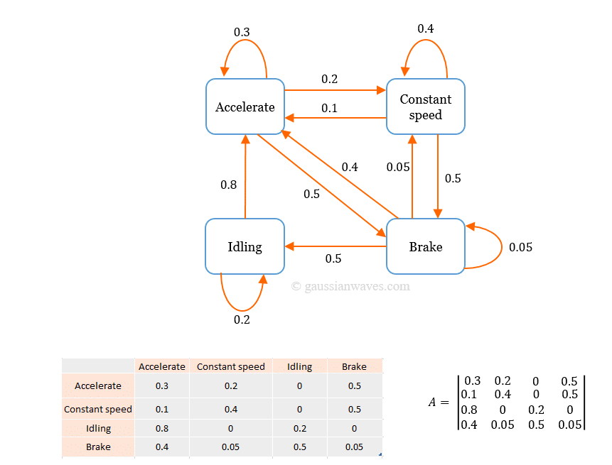

Slide 19
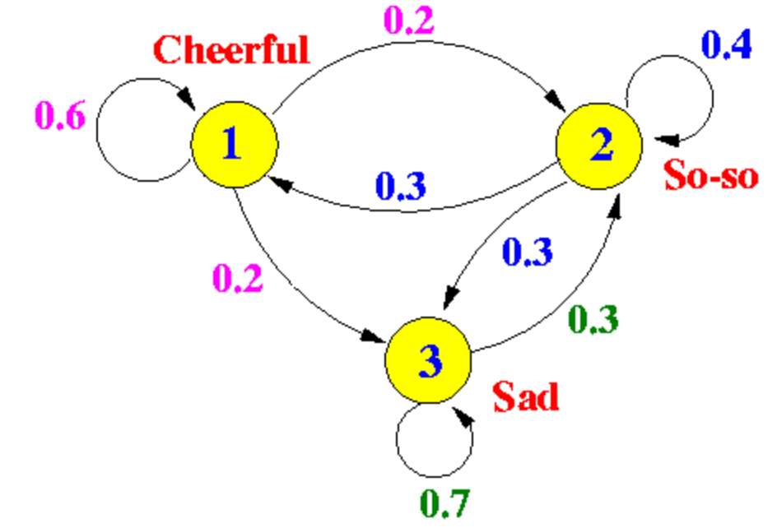
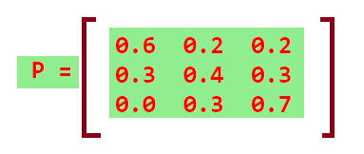

Slide 20
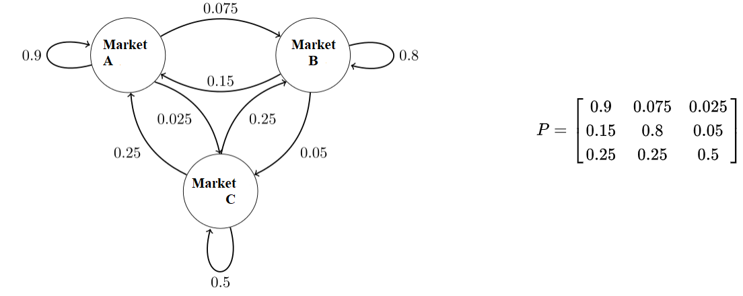

Slide 21
THE END

