Slide 1
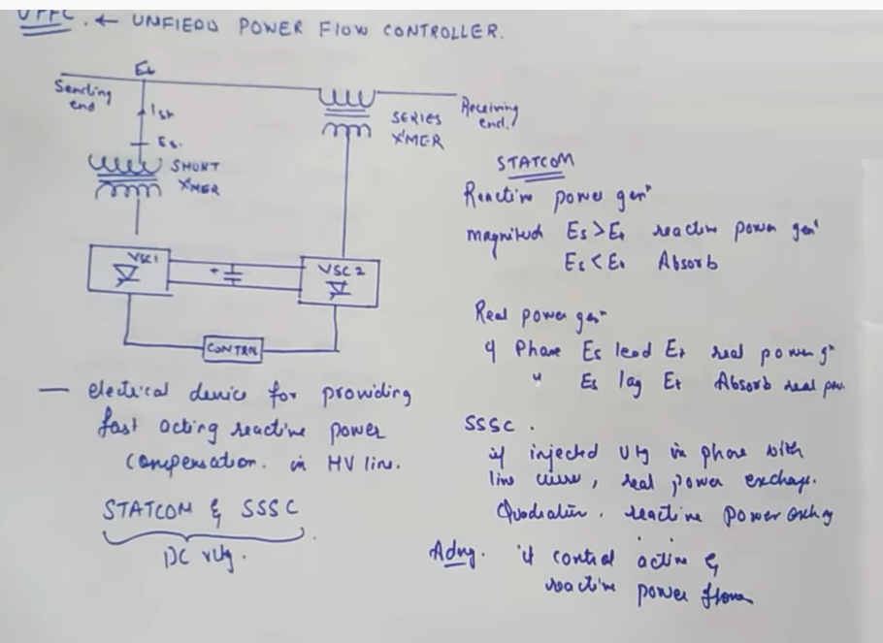

Slide 2
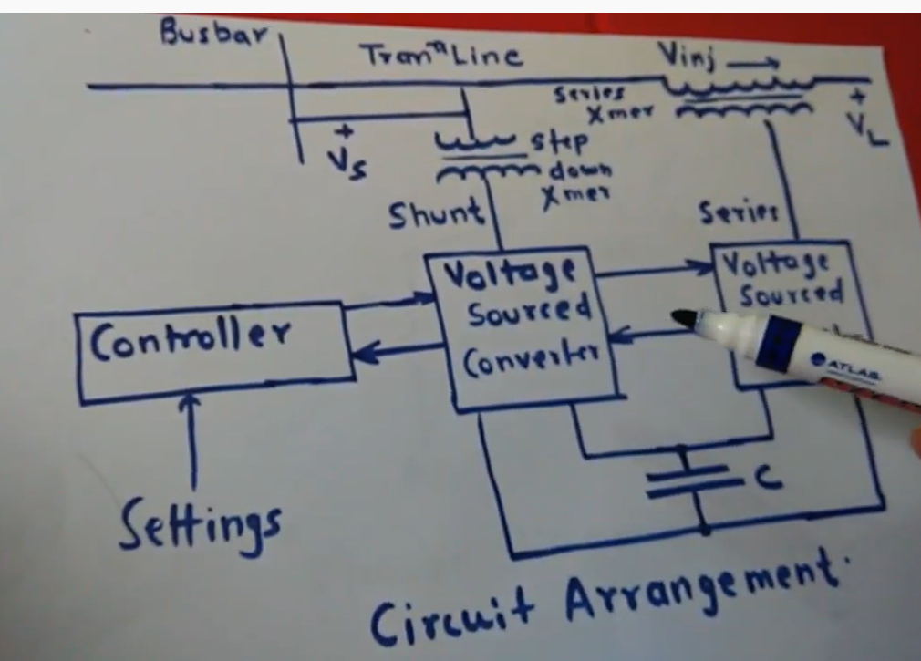

Slide 3
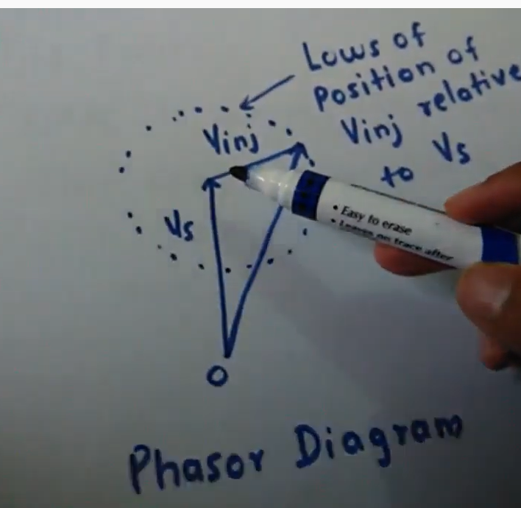

Slide 4
UPFC (UNIFIED POWER FLOW CONTROLLER)
UPFC is a complete compensator.
This compensator can function in any of the compensating mode.

Slide 5
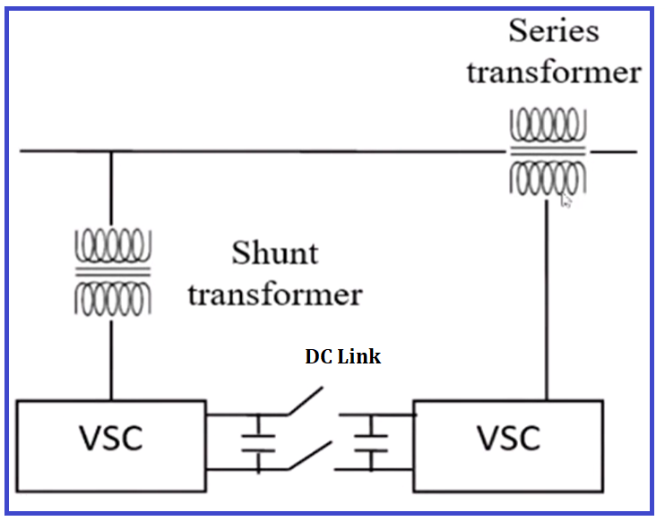
UPFC (UNIFIED POWER FLOW CONTROLLER)
This is one of the major and having unique characteristics that is also named as Unified Power Flow Controller (UPFC).
It control all the parameters of the Transmission lines which influence the power flow.
Power flow is influenced by the sending end or receiving end voltage, impedance and angle of the at which the power is flowing through the line.
It consists of two voltage source converters, it absorb or supply or maintains the voltage independently, the line does not affect the supply or absorb that is the unique characteristics of voltage source converters.
There are two voltage source converters.
One is connected in series with T.L through the series TF And other VSC is connected in parallel with by shunt T/F with TL.
And the DC link of both the voltage source converters are connected by a switch.
If switch is open than UPFC working independent as STATCOM or it can be working as SSSC.
If switch is closed than it work as UPFC.
That is the main advantages of UPFC.

Slide 6
ADVANTAGES OF UPFC
UPFC is devised for the Real-Time control and dynamic compensation of AC transmission system.
Also, it is capable of capable of controlling all the parameters that effect power flow.
The parameters which effect the power flow are voltage, angle and impedance of the T.L (V, δ, X) either simultaneously or selectively.
Simultaneously or selectively means you can control the voltage and angle simultaneously or if you want to control only the angle control that.
OR you control all three parameters simultaneously.
Earlier FACTS devices like TCSC or SVC they could only control X (Impedance ), voltage parameter is controlled by STATCOM and Angle parameter is controlled by Series compensator, but UPFC has the characteristics to control all the three parameters simultaneously or independently.

Slide 7
ADVANTAGES OF UPFC
It has the unique feature of injecting voltage at any phase angle. In case of Impedance based FACTS we can add or inject the voltage at the quadrature or in phase.
But in UPFC inject the voltage at any phase angle from 0 to 360 degree.
It can independently control real power, but earlier technique you know real power always flow with reactive power.
With DC common link open, it can be operated as SSSC or STATCOM independently.

Slide 8
ADVANTAGES OF UPFC
Voltage regulation can be achieved continuously with variable in-phase and anti-phase voltage injection.
Reactive power control can be achieved by injecting series voltage in-quadrature with line current, equivalent to capacitive or inductive impedance compensation.
Phase Angle Regulation can be achieved by injecting series voltage with the desired phase angle, without changing the magnitude of the line voltage.
Separate source/sink is not required for real power exchange, so real power can be exchange or it can be supplied or it can be absorbed if you have a voltage source.

Slide 9
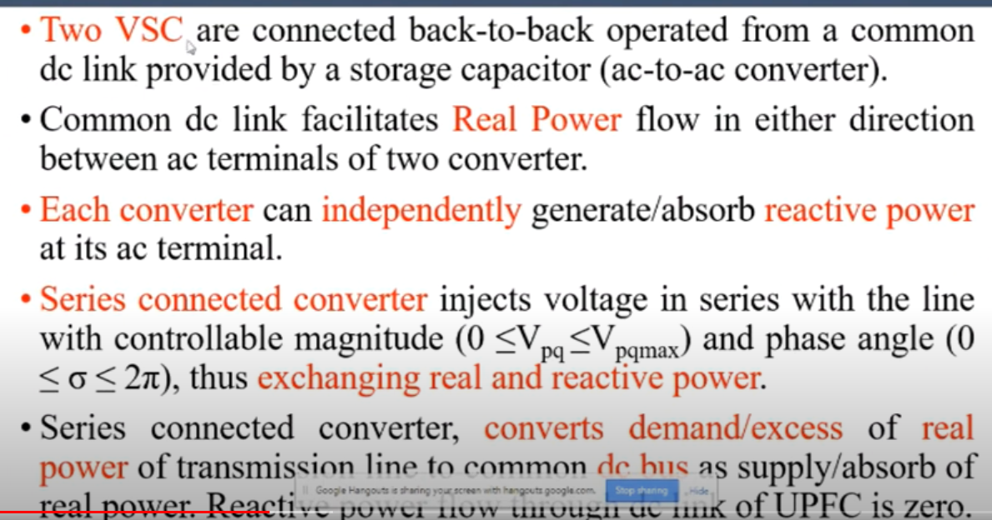
WORKING PRINCIPLE OF UPFC
Two VSC are connected back-to-back operated from a common DC link provided by a storage capacitor (ac-to-ac converter)

Slide 10
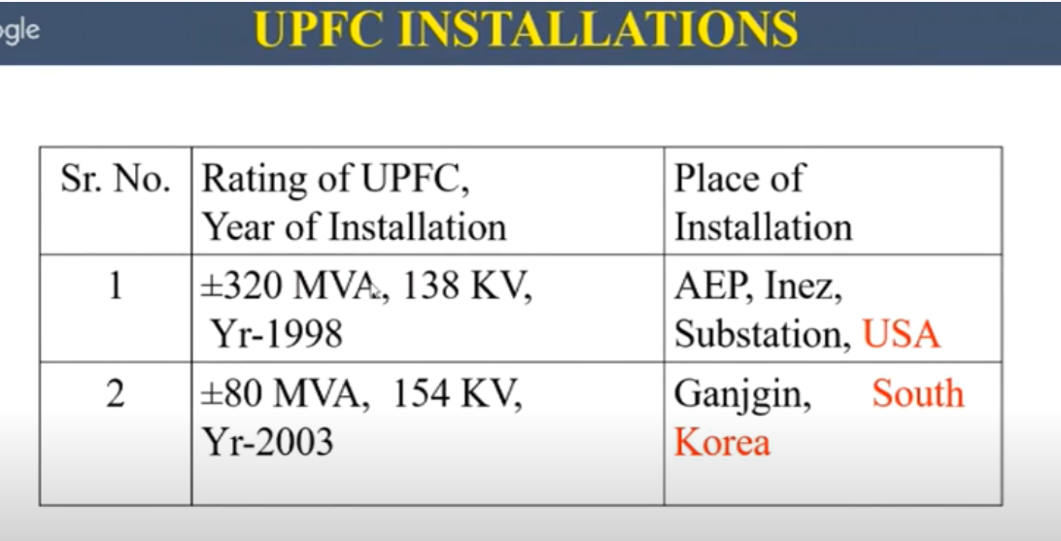
DISADVANTAGES OF UPFC
Two VSCs are required, and VSC especially for the transmission voltage level have very high cost.
So the total cost of UPFC is higher as compared to other FACTS devices, this cost including all installation costs and energy production costs etc.
Its cost per KVAR is very high means cost of generation of KVAR is very high.
There is no competition in UPFC manufacturers and hence procurement, and installation is an exclusive monopoly of the supplier.
There are only 2 installations of UPFC around the world due to its high cost, as compared of SVC, TCSC, and STATCOM.

Slide 11
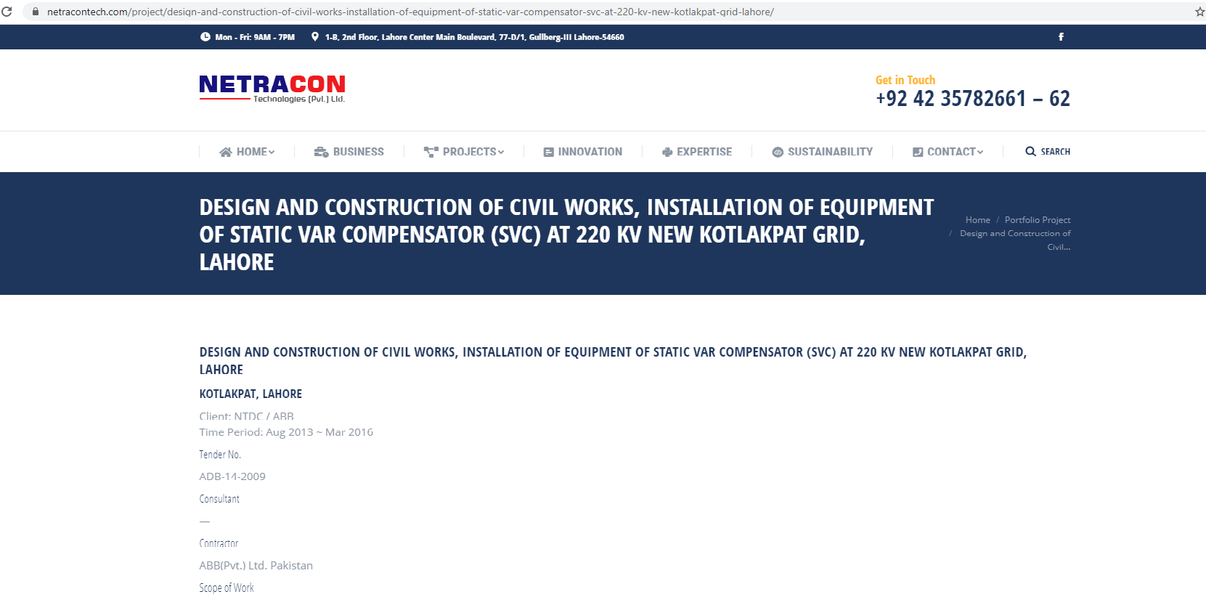
INSTALLATION OF SVC COMPENSATOR AT 220 KV NEW KOTLAPAT GRID, LAHORE, PAKISTAN
DESIGN AND CONSTRUCTION OF CIVIL WORKS, INSTALLATION OF EQUIPMENT OF STATIC VAR COMPENSATOR (SVC) AT 220 KV NEW KOTLAKPAT GRID, LAHORE,
Equipment : SVC
Client: NTDC / ABB Time Period: Aug 2013 ~ Mar 2016
Tender No.
ADB-14-2009
Consultant
—
Contractor
ABB(Pvt.) Ltd. Pakistan
Similarly the subproject namely installation of SVC at Quetta has been deleted from Tranche-II and shifted against future Tranche in MFF
[1] https://netracontech.com/project/design-and-construction-of-civil-works-installation-of-equipment-of-static-var-compensator-svc-at-220-kv-new-kotlakpat-grid-lahore/
[2] https://www.adb.org/sites/default/files/project-document/75883/37192-033-pak-emr-01.pdf

Slide 12
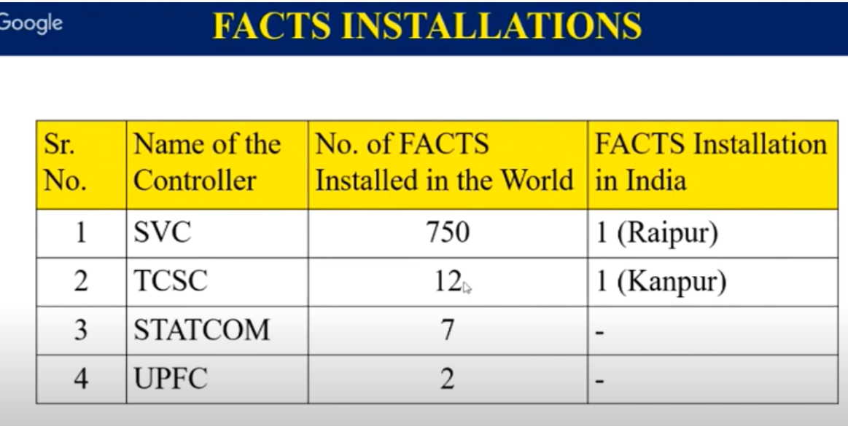

Slide 13
UPFC
Abbreviation of UPFC is the Unified Power Flow Controller (UPFC).
It is used for Power Flow purpose, but not used for Power Quality purpose.
For Power Quality control purpose, we used UPQC (unified power quality conditioner).
This concept was proposed in 1991.
The UPFC was devised for the real-time control and dynamic compensation of AC transmission systems.
It is versatile device because it control the power, it control the phase angle and it control all the solution which you required.
The UPFC can control, simultaneously or selectively, all the parameters affecting power flow in the transmission line (i.e., voltage, impedance and phase angle).

Slide 14
UPFC
It can independently control both the real and reactive power flow in the line, because active power cannot be control by the shunt compensation and also series compensation independently cannot control the flow of active and reactive power.
In UPFC it is possible to decouple the Active and Reactive power.
UPFC is the interconnected FACTS device of STATCOM (Shunt part) with SSSC (Series part).

Slide 15
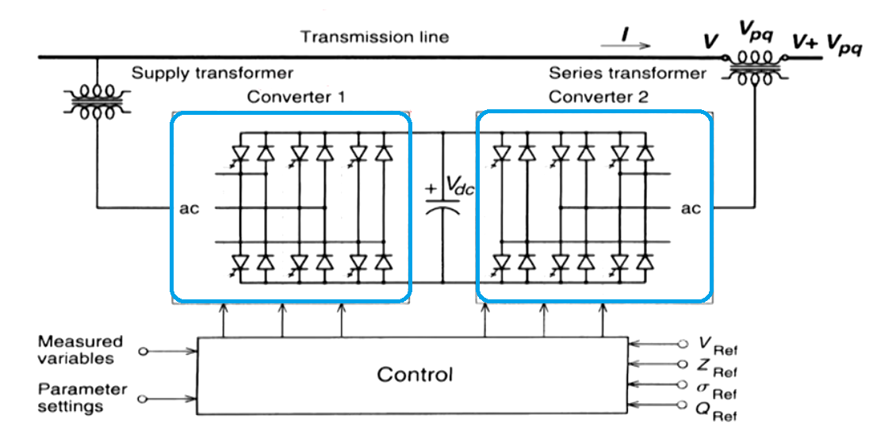
UPFC
For practical implementation purposes, the UPFC consists of two voltage sourced converters.
It is the back-to-back converters, labeled as “Converter 1” (shunt) and “Converter2” (series) as shown in the Figure, are operated from a common dc link provided by a dc storage capacitor.
This arrangement functions as an ideal ac-to-ac power converter in which the real power can freely flow in either direction between the ac terminal of two converters.
Each converter can independently generate (or absorb) reactive power at its own ac output terminal.
Converter 2 (series) provides the main function of the UPFC by injecting a voltage V_{pq} with controllable magnitude V_{pq} and phase angle ρ in series with the line via an insertion transformer.

Slide 16
UPFC
A unified power flow controller (UPFC) is an electrical device for providing fast-acting reactive power compensation on high-voltage electricity transmission networks. It uses a pair of three-phase controllable bridges to produce current that is injected into a transmission line using a series transformer.^{[1]} The controller can control active and reactive power flows in a transmission line.
Unified Power Flow Controller (UPFC), as a representative of the third generation of FACTS devices, is by far the most comprehensive FACTS device,^{[2]} in power system steady-state it can implement power flow regulation, reasonably controlling line active power and reactive power, improving the transmission capacity of power system, and in power system transient state it can realize fast-acting reactive power compensation, dynamically supporting the voltage at the access point and improving system voltage stability, moreover, it can improve the damping of the system and power angle stability.
The UPFC uses solid state devices, which provide functional flexibility, generally not attainable by conventional thyristor controlled systems. The UPFC is a combination of a static synchronous compensator (STATCOM) and a static synchronous series compensator (SSSC) coupled via a common DC voltage link.^{[3]}
The main advantage of the UPFC is to control the active and reactive power flows in the transmission line. If there are any disturbances or faults in the source side, the UPFC will not work. The UPFC operates only under balanced sine wave source. The controllable parameters of the UPFC are reactance in the line, phase angle and voltage. The UPFC concept was described in 1995 by L. Gyugyi of Westinghouse.^{[4]} The UPFC allows a secondary but important function such as stability control to suppress power system oscillations improving the transient stability of power system.

