Slide 1

Operation Research Credit Hours = 3 by Dr. Wazir Muhammad Laghari Email: wazirlaghari@buetk.edu.pk
Electrical Engineering Department
Balochistan University of Engineering and Technology
Khuzdar

Slide 2
Lecture Tentative Plan
Lecture No | Description
Lecture: 01 | Formulation and analysis of probabilistic models in operations research
Lecture: 02 | Poisson processes
Lecture: 03 | Renewal processes Markov chains
Lecture: 04 | Queuing theory
Lecture: 05 | Markovian decision processes
Lecture: 06 | Time series analysis
Lecture: 07 | Application areas reliability
Lecture: 08 | Traffic flows Production and inventory
Recommended Books
C. Richard Cassady, Joel A. Nachlas, Probability Models in Operations Research
Wayne L. Winston, Introduction to Probability Models: Operations Research

Slide 3
Operation Research / Operational Research / Quantitative Techniques for Management / Quantitative Analysis for Management /
Operation
Research
means to investigate something or to test something or To investigate or To review.
means a thing that is ready to use or in a working condition.

Slide 4
Operation Research
We all are doing operational research in daily life to make better decision for our profit or for maximizing our profit.
You can purchase something and than you compare it.
Each industry apply the operational research to maximize the profit.
Operation research also helps us to develop a model for decision making.

Slide 5
Mathematical Model
Deterministic Model
Probabilistic Model

Slide 6
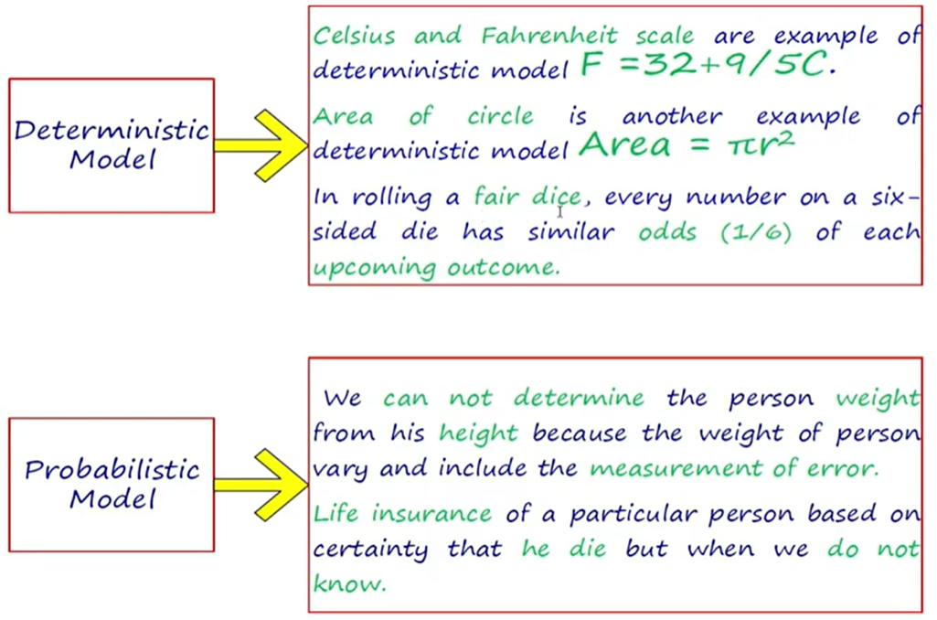
Deterministic Versus Probabilistic Model
Suppose 10 person height is 6 feet and weight should be 70 kg. It is not necessary every person having height 6 feet and its weight is 70 kg

Slide 7
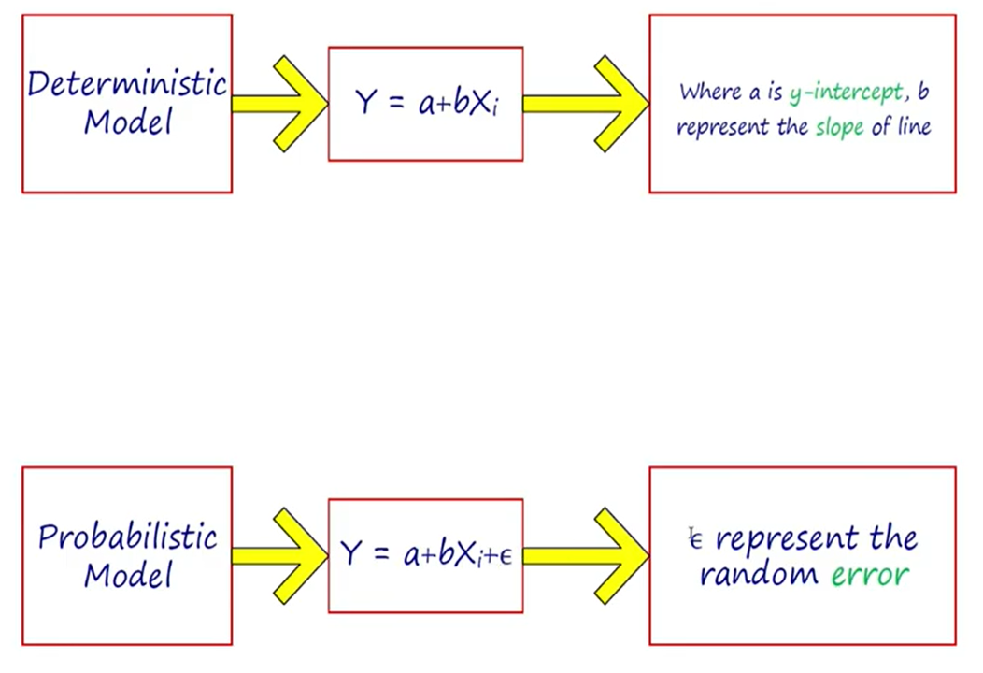
Deterministic Versus Probabilistic Model

Slide 8
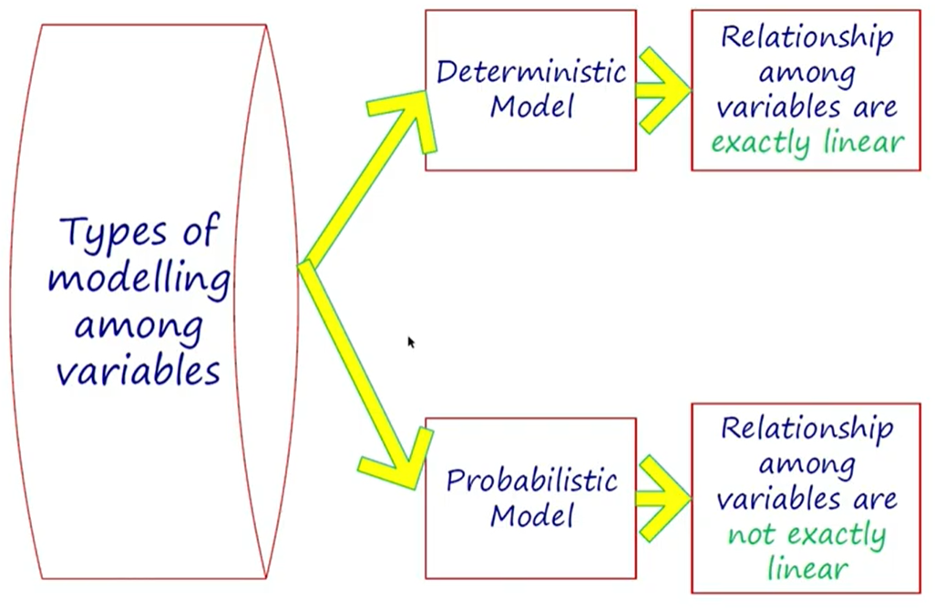
Deterministic Versus Probabilistic Model

Slide 9
Probability (Calculated Guess)
Probability is the branch of mathematics concerning numerical descriptions of how likely an event is to occur, or how likely it is that a proposition is true.
The probability of an event is a number between 0 and 1, where, roughly speaking, 0 indicates impossibility of the event and 1 indicates certainty.
The higher the probability of an event, the more likely it is that the event will occur. A simple example is the tossing of a fair (unbiased) coin.
Since the coin is fair, the two outcomes ("heads" and "tails") are both equally probable; the probability of "heads" equals the probability of "tails"; and since no other outcomes are possible, the probability of either "heads" or "tails" is 1/2 (which could also be written as 0.5 or 50%).

Slide 10

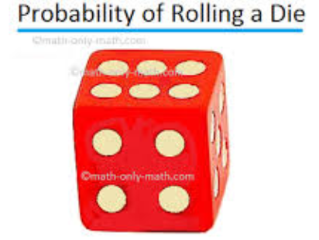

Observation or Measurement And Experiment or Random Experiment
Suppose a coin is tossed once and the up face is recorded. The recorded is called an observation or measurement.
The process of making observation is called an Experiment.
Tossing a coin, rolling a die and drawing a card from a deck are all examples of random experiments.

Slide 11
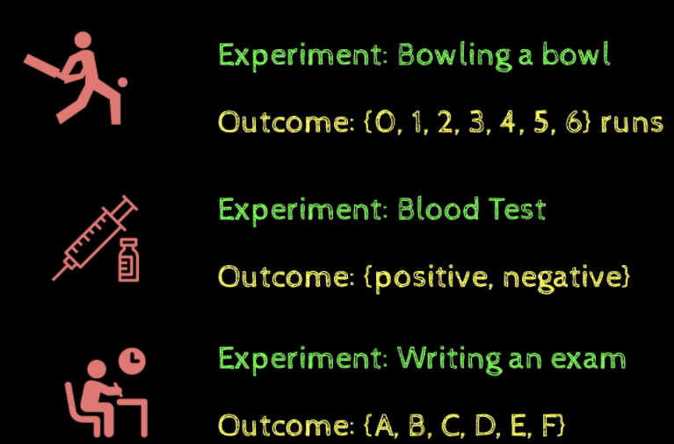
Experiment , Trial And Outcome
Experiment is any action, process or phenomenon whose result (outcome) is subject to uncertainty is called an Experiment.
Each repetition of an experiment is called as a Trial
An outcome is a result of an experiment is called Outcome.

Slide 12
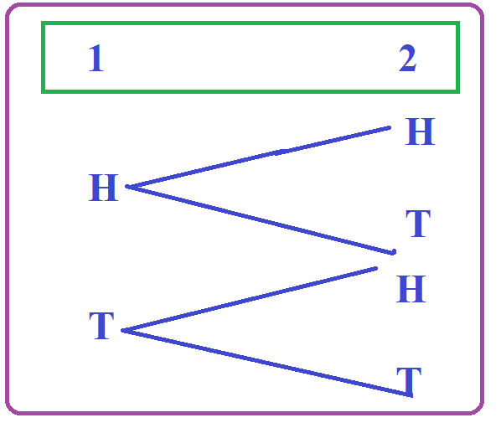
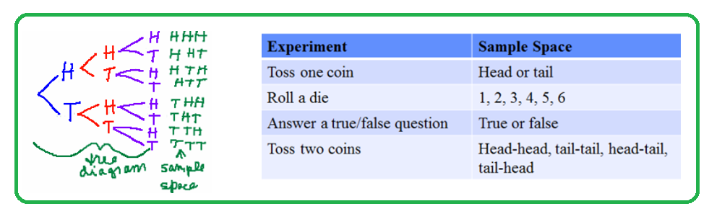
Sample Space
The sample space is the set of all possible outcomes in an experiment.
Example:
Tossing a coin: the sample space is {H, T}.
Tossing a two coin: the sample space is {HH, HT, TH, TT}
Rolling a Die : the sample space is {1,2,3,4,5,6}
S = {HH, HT, TH, TT}

Slide 13
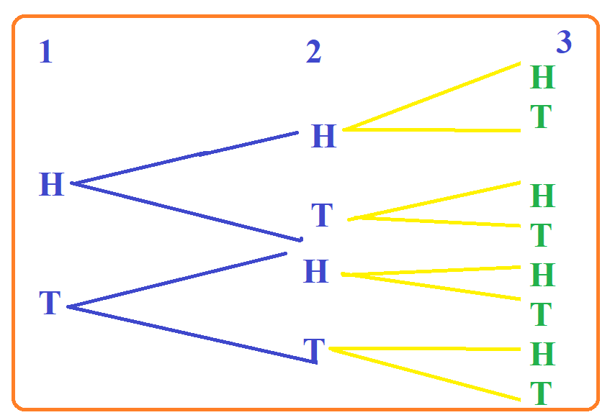
Example: Flip a coin 3 times. List the sample space.
S = {HHH, HHT, HTH, HTT, THH, THT, TTH,TTT}

Slide 14



Sample Space of 1 Kid in Line {Boy, Girl}
Sample Space of 2 Kids in Line {Boy Boy, Boy Girl, Girl Boy, Girl Girl }
Sample Space of 3 Kids in Line {BBB, …. GGG}
Formula of Sample Space = 2^{S}

Slide 15
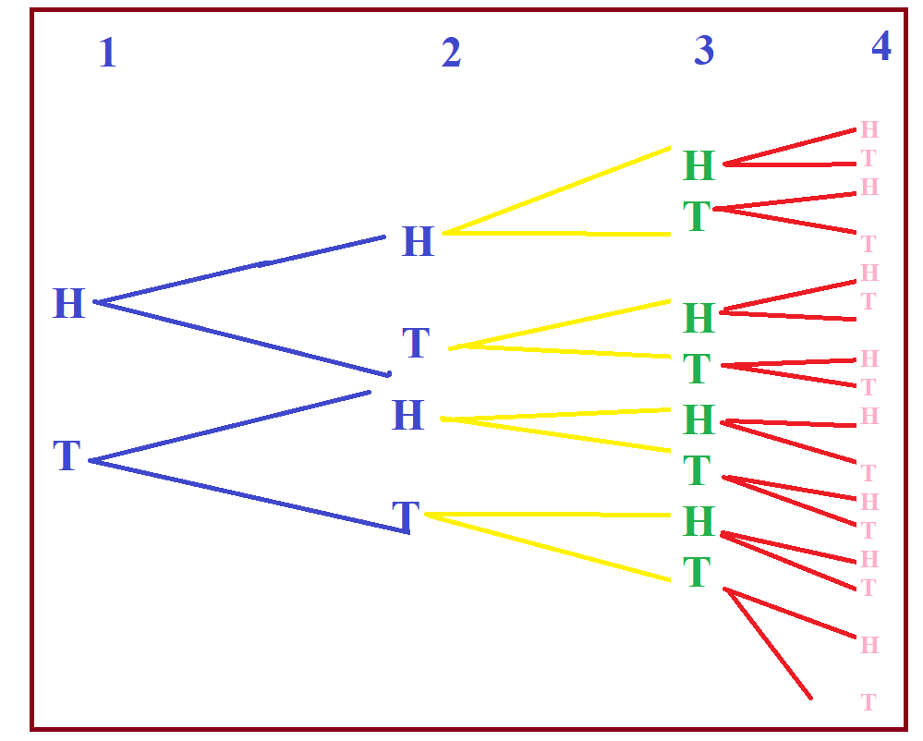
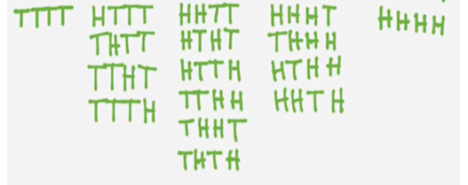
Example: Flip a coin 4 times. List the sample space.

Slide 16
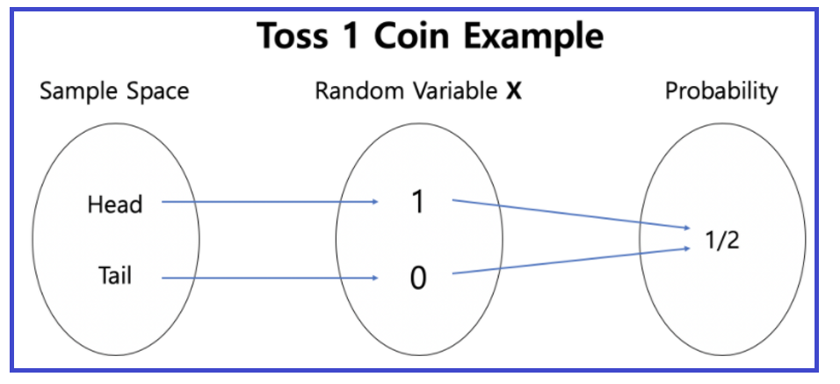
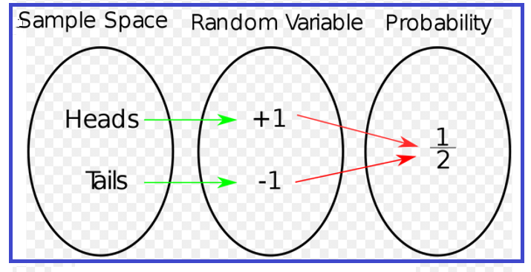
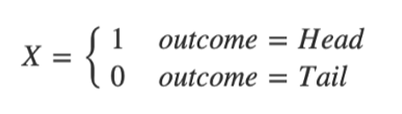
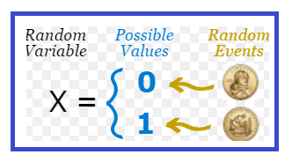
Random Variable
A Random Variable assigns a numerical value to the outcomes in the sample space of a random phenomena.
A Random Variable is a set of possible values from a random experiment. OR
It is a variable whose possible values are numerical outcomes of random phenomena.
It is denoted by capital X.

Slide 17
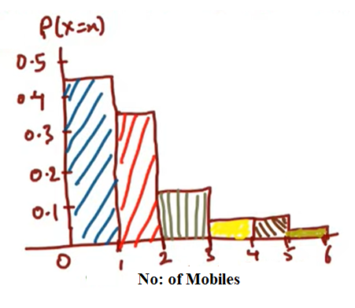
Q: Suppose a Company want to increase the sell of their Mobiles
No: of (X) Cell/Mobile Phones, X = Random Variable | Customers | Prob P(X=x), x=no: of values
1 | 450 | 450/1000 = 0.45
2 | 340 | 340/1000 = 0.34
3 | 110 | 110/1000 = 0.11
4 | 40 | 40/1000 = 0.04
5 | 40 | 40/1000 = 0.04
6 | 20 | 20/1000 = 0.02
Total | 1000 | 1
Q: What are the probability that out of 1000 customers buy more than 4 cell phones?
$P\left(X>4\right)=P\left(X=5\right)+P\left(X=6\right)=0.04+0.02=0.06$ = 1000* 0.06 = 60 customers
Q: What are the probability that out of 1000 customers buy more than 2 cell phones?
$P\left(X>2\right)=P\left(X=3\right)+P\left(X=4\right)+P\left(X=5\right)+P\left(X=6\right)=0.11+0.04+0.04+0.02=0.21$ = 1000* 0.21 = 210 customers
Q: What are the probability that out of 1000 customers buy more than 1 cell phones?
$P\left(X>1\right)=P\left(X=2\right)+P\left(X=3\right)+P\left(X=4\right)+P\left(X=5\right)+P\left(X=6\right)=0.34+0.11+0.04+0.04+0.02=0.55$ = 1000* 0.55 = 550 customers

Slide 18
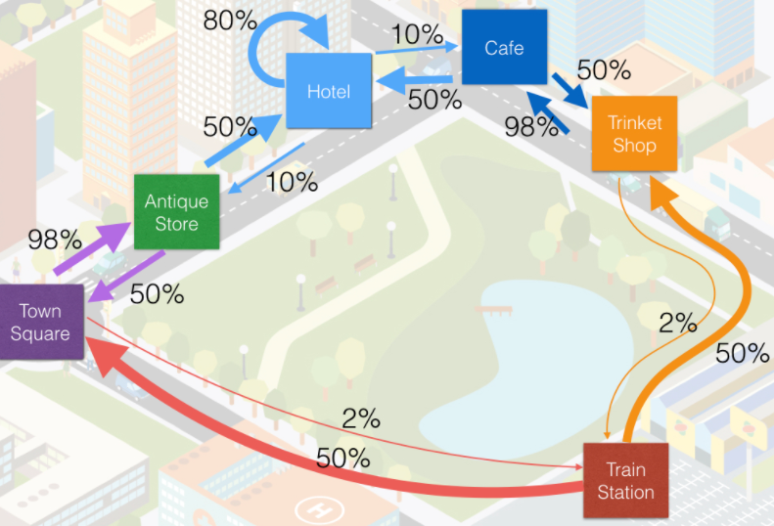
Markov Chain
Markov Chain is a random process in which the occurrence of future (next) state depends on the immediately (current) preceding sate it is known as Markov Chain Or Process
State: A state is a condition or location of an object in the system at specific or time is known as state.
Behavior of consumers in terms of their brand (state because check different brands) loyalty and switching pattern.
System = Market Place
Any Machine use to made or manufacture a product, we also sue Markov Chain.

Slide 19
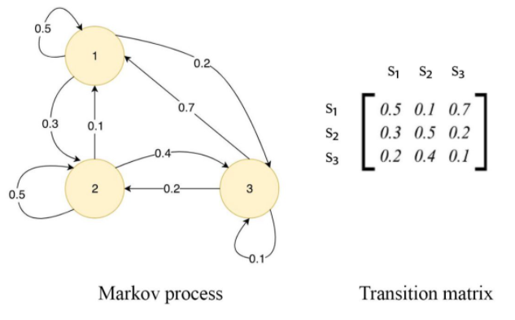
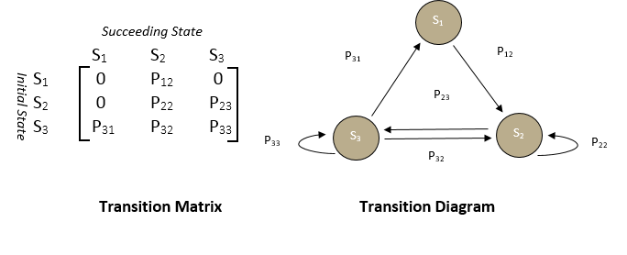
In Each state
Self Loop + Out arrow = 1, but not count incoming arrow

Slide 20
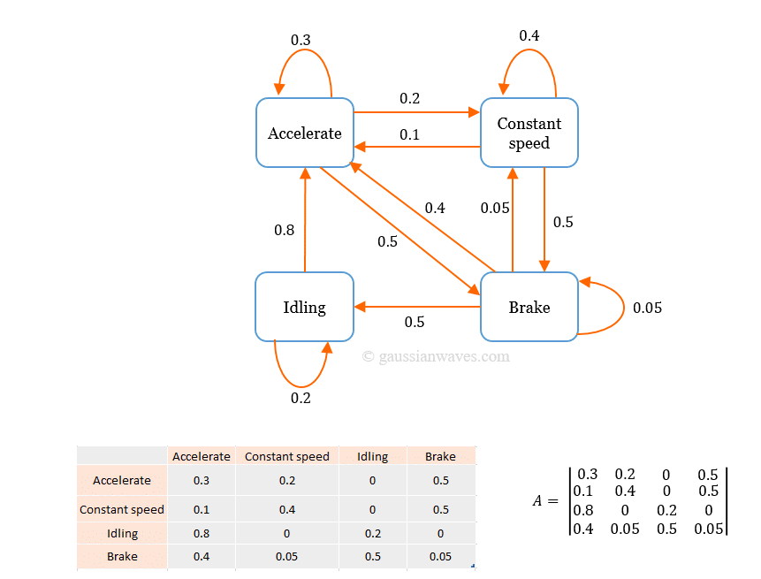
In Each state
Self Loop + Out arrow = 1, but not count incoming arrow

Slide 21
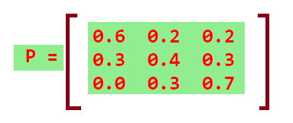
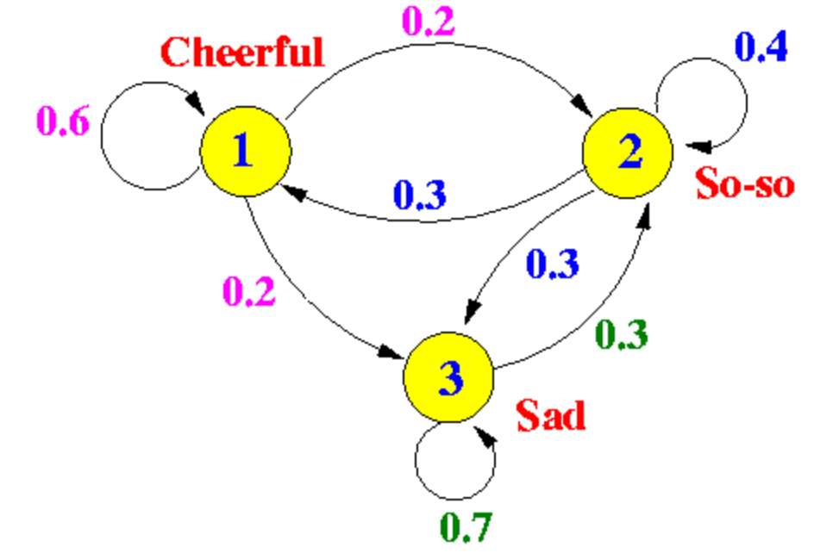
In Each state
Self Loop + Out arrow = 1, but not count incoming arrow

Slide 22
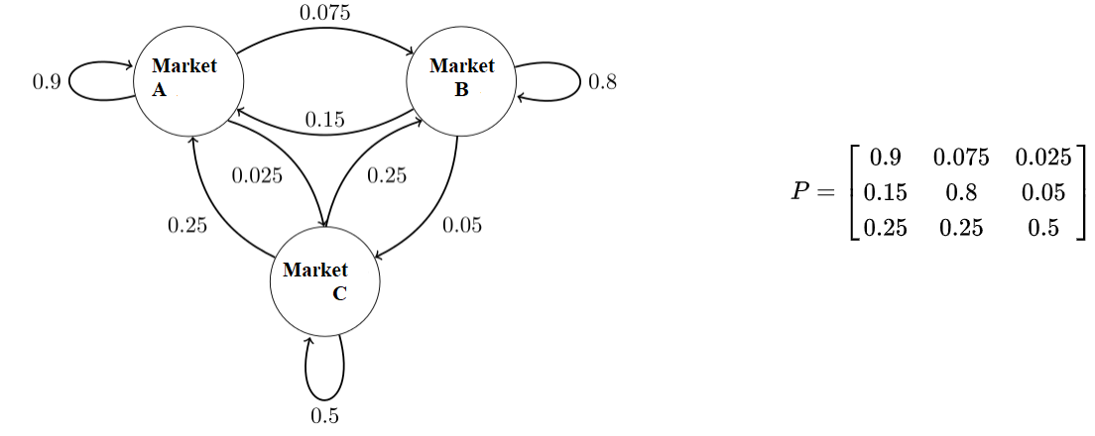
In Each state
Self Loop + Out arrow = 1, but not count incoming arrow

Slide 23
Stochastic Process

Slide 24
Stochastic Process
Any process changes with respect to time is known as Stochastic Process.
Stochastic Process is a probabilistic type model, in which the current state of a process depend all its previous state.
It is a family of random variable
Uses:
To examine and predict the behavior of consumers in terms of their brand loyalty and switching patterns to other brands.
Usually constructed in terms of transition probabilities.
Used to study the stock market price movements

Slide 25
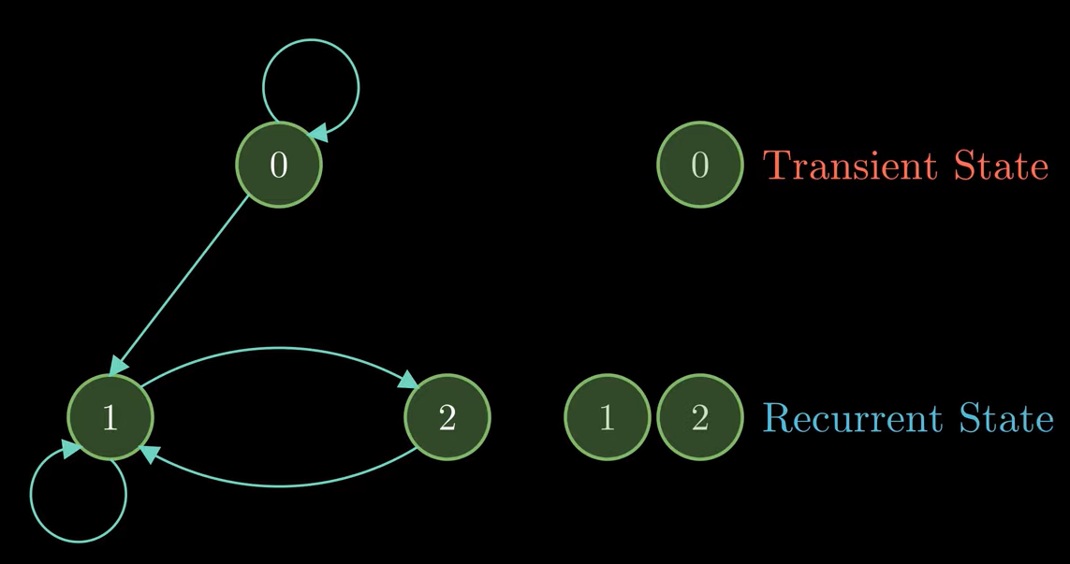
Recurrent State and Transient State
A state is said to be recurrent if, any time that we leave that state, we will return to that state in the future.
A state is said to be Transient if, any time that we leave that state, we will not return to that state in the future.

Slide 26
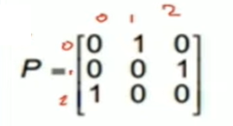
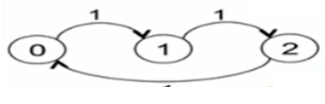
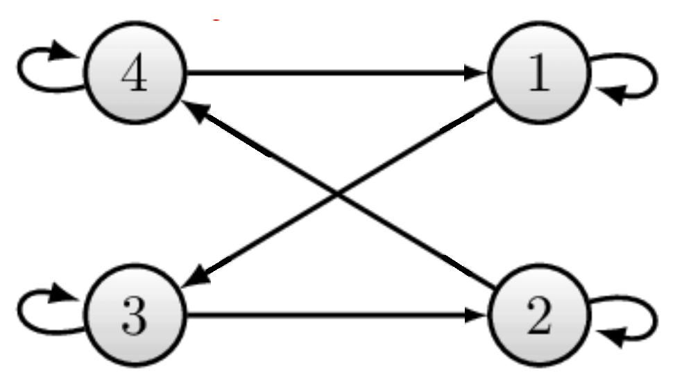
Irreducible And Not Irreducible Markov Chain
A Markov Chain is said to be irreducible if every state communicate with every other state, otherwise it is called as Not Irreducible.
Q: Check whether Markov Chain is Irreducible or Not Irreducible
Irreducible (original sate always
count as reachable)
C(0) = {0,1,2}
C(1) = {0,1,2}
C(2) = {0,1,2}
Irreducible (original sate always
count as reachable)
C(1) = {1,2,3,4}
C(2) = {1,2,3,4}
C(3) = {1,2,3,4}
C(4) = {1,2,3,4}

Slide 27
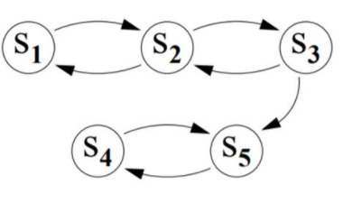
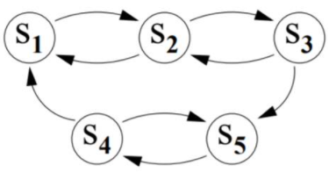
Irreducible And Not Irreducible Markov Chain
Q: Check whether Markov Chain is Irreducible or Not Irreducible
Not Irreducible (original sate always count as reachable)
C(S1) = {S1,S2,S3,S4,S5}
C(S2) = {S1,S2,S3,S4,S5}
C(S3) = {S1,S2,S3,S4,S5}
C(S4) = {S4,S5}
Irreducible (original sate always
count as reachable)
C(S1) = {S1,S2,S3,S4,S5}
C(S2) = {S1,S2,S3,S4,S5}
C(S3) = {S1,S2,S3,S4,S5}
C(S4) = {S1,S2,S3,S4,S5}
C(S5) = {S1,S2,S3,S4,S5}

Slide 28
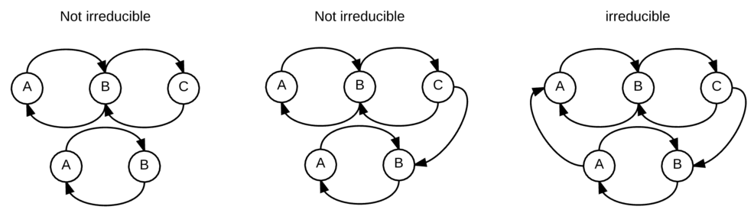
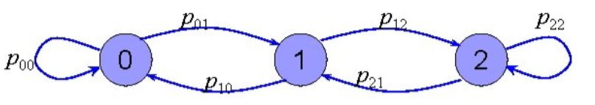
Irreducible And Not Irreducible Markov Chain
Irreducible Markov Chain

Slide 29
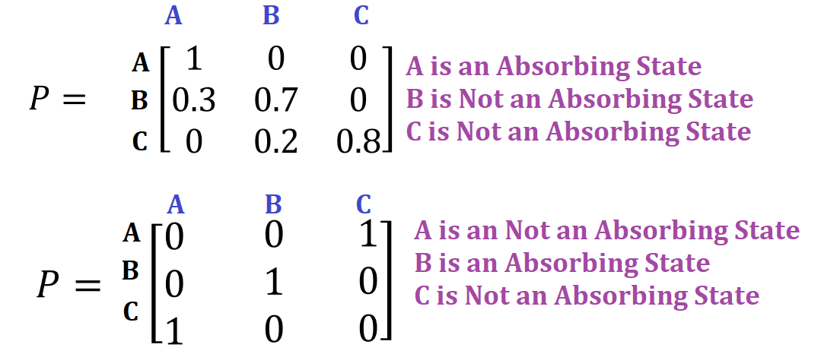
Absorbing Markov Chains
A state in a Markov Chain is called an Absorbing state if once the state is entered than it is impossible to leave.
Q: Identify any Absorbing States for the following Transition Matrices
A
C
B

Slide 30
THE END

