Slide 1
Production And Inventory

Slide 2
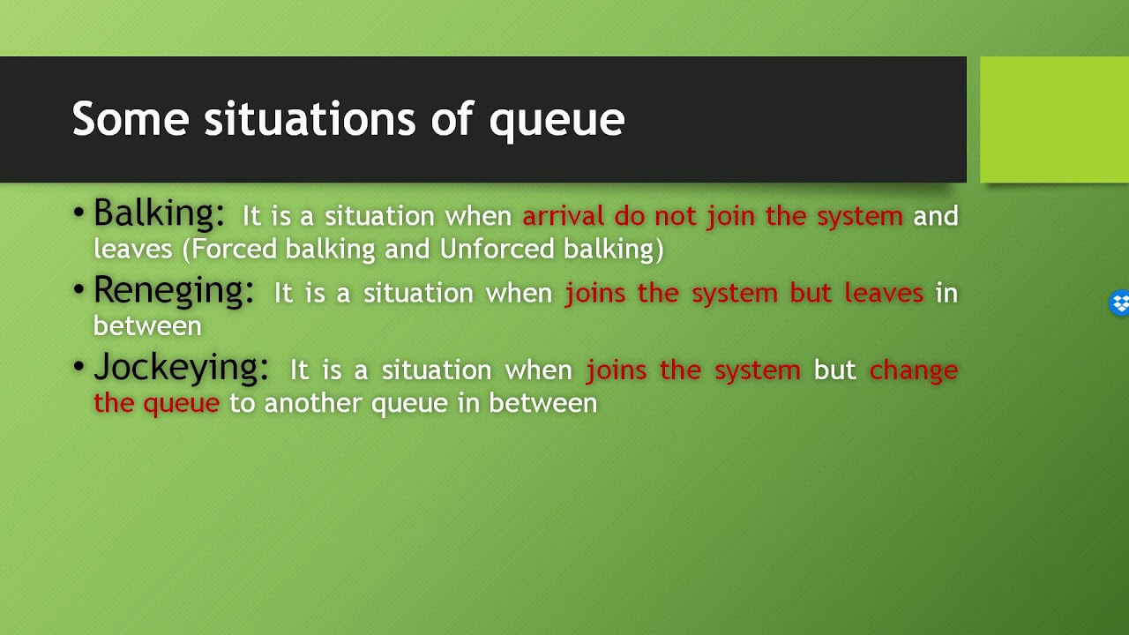

Slide 3
Production
Production is the process by which raw materials and other inputs are converted into finished products is known as Production
Production Management
It is the process of Planning, organizing, directing and controlling the activities of Production is called as Production Management.

Slide 4
Objectives of Production Management
Main Objectives / Ultimate Objectives.
* Right Quantity, Right Quality, Time.
2) Intermediate Objectives.
* Machinery and Equipment.
* Materials Management.
* Manpower Allocation.
* Manufacturing Services.

Slide 5
Function of Production Management
Quantity and Cost Control.
Production Control.
Production Planning.
Right Production Capacity.
Right Process.
Right Selection of Product and Design.
Maintenance and replacement of Machinery.

Slide 6

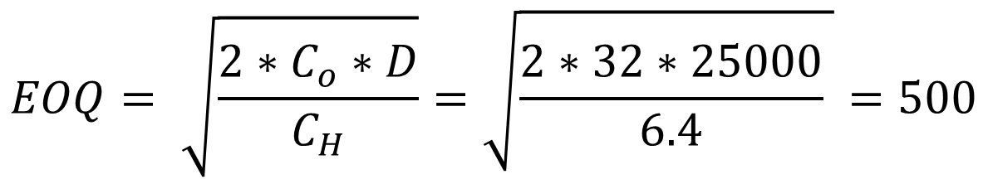




A company purchase a raw material with purchasing cost is 16 Rs. Company whole year requirement or demand is 25000 units, holding cost is 6.4 per unit for one year. The ordering cost is 32 Rs. Find out the Economic Order Quantity (EOQ?)
DATA
$$P_{C}=16 Rs$$
$$D=25000 units$$
$$C_{H}=6.4$$
$$C_{o}=32 Rs$$
$$EOQ= \sqrt{\frac{2∗C_{o}∗D}{C_{H}}}=\sqrt{\frac{2∗32∗25000}{6.4} }=500$$
$$EOQ=?$$

