Slide 1
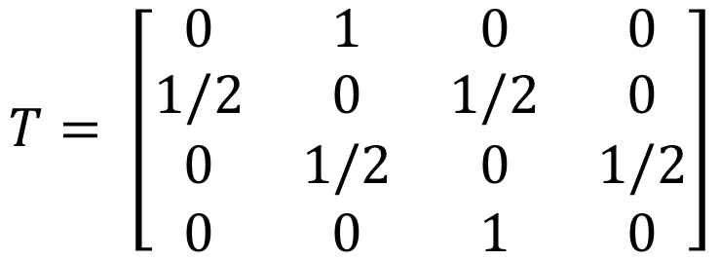
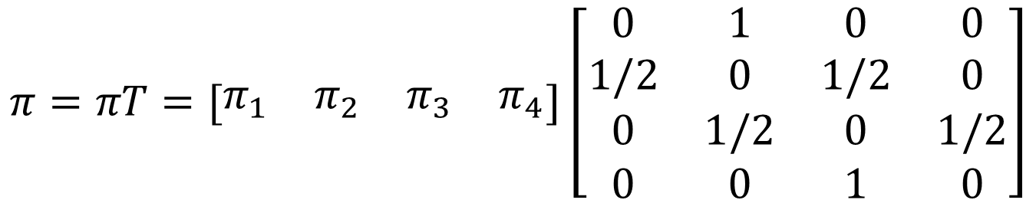

Q: Find the Stationary Distribution of Markov Chain
$$T= \left[\begin{matrix}0 & 1 & 0 & 0 \\ 1/2 & 0 & 1/2 & 0 \\ 0 & 1/2 & 0 & 1/2 \\ 0 & 0 & 1 & 0\end{matrix}\right]$$
SOLUTION:
$$Suppose π=[\begin{matrix}π_{1} & π_{2} & π_{3} & π_{4}\end{matrix}]$$
$$π= πT (1)$$
$$π=πT=[\begin{matrix}π_{1} & π_{2} & π_{3} & π_{4}\end{matrix}]\left[\begin{matrix}0 & 1 & 0 & 0 \\ 1/2 & 0 & 1/2 & 0 \\ 0 & 1/2 & 0 & 1/2 \\ 0 & 0 & 1 & 0\end{matrix}\right]$$

Slide 2

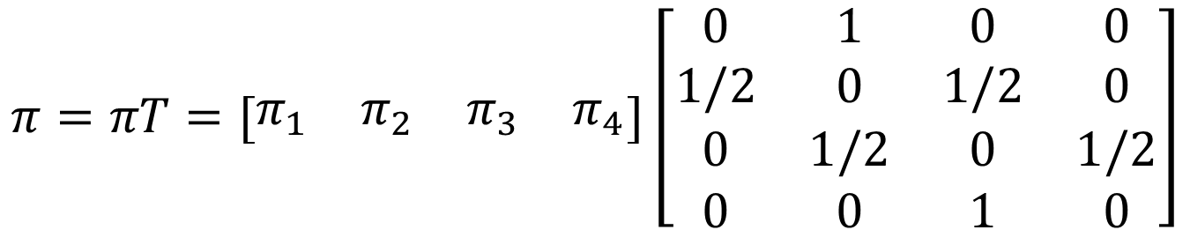
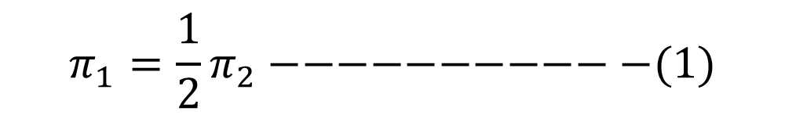
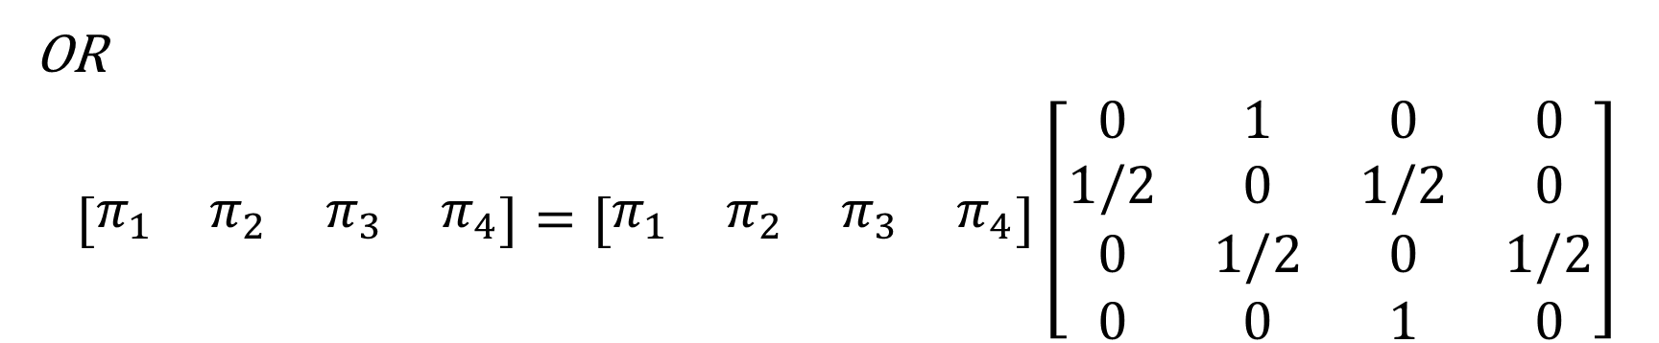
$$π=πT=[\begin{matrix}π_{1} & π_{2} & π_{3} & π_{4}\end{matrix}]\left[\begin{matrix}0 & 1 & 0 & 0 \\ 1/2 & 0 & 1/2 & 0 \\ 0 & 1/2 & 0 & 1/2 \\ 0 & 0 & 1 & 0\end{matrix}\right]$$
OR
$$[\begin{matrix}π_{1} & π_{2} & π_{3} & π_{4}\end{matrix}]=[\begin{matrix}π_{1} & π_{2} & π_{3} & π_{4}\end{matrix}]\left[\begin{matrix}0 & 1 & 0 & 0 \\ 1/2 & 0 & 1/2 & 0 \\ 0 & 1/2 & 0 & 1/2 \\ 0 & 0 & 1 & 0\end{matrix}\right]$$
$$π_{1}=0+\frac{1}{2}π_{2}+0+0$$
$$π_{1}=\frac{1}{2}π_{2}−−−−−−−−−−−(1)$$

Slide 3
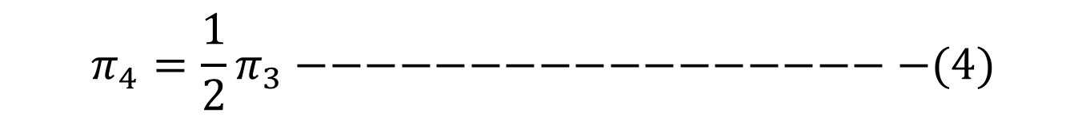
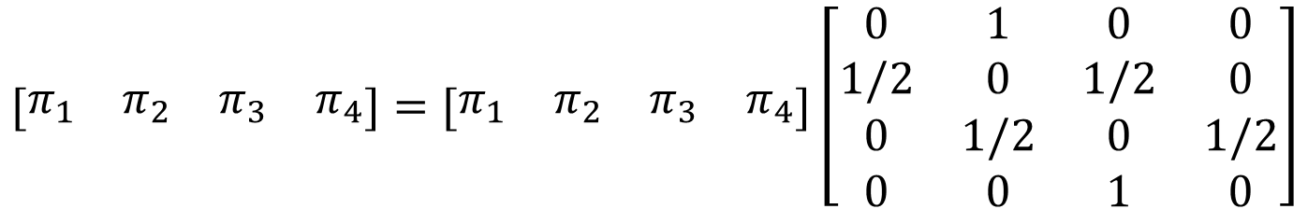




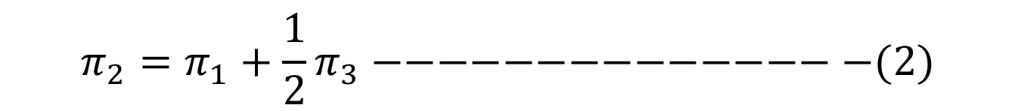
$$[\begin{matrix}π_{1} & π_{2} & π_{3} & π_{4}\end{matrix}]=[\begin{matrix}π_{1} & π_{2} & π_{3} & π_{4}\end{matrix}]\left[\begin{matrix}0 & 1 & 0 & 0 \\ 1/2 & 0 & 1/2 & 0 \\ 0 & 1/2 & 0 & 1/2 \\ 0 & 0 & 1 & 0\end{matrix}\right]$$
$$π_{2}=π_{1}+0+\frac{1}{2}π_{3}+0$$
$$π_{2}=π_{1}+\frac{1}{2}π_{3}−−−−−−−−−−−−−−−(2)$$
$$π_{3}={0+\frac{1}{2}π}_{2}+0+π_{4}$$
$$π_{3}={\frac{1}{2}π}_{2}+π_{4} −−−−−−−−−−−−−−(3)$$
$$π_{4}={0+0+\frac{1}{2}π}_{3}+0$$
$$π_{4}={\frac{1}{2}π}_{3}−−−−−−−−−−−−−−−−−−(4)$$

Slide 4
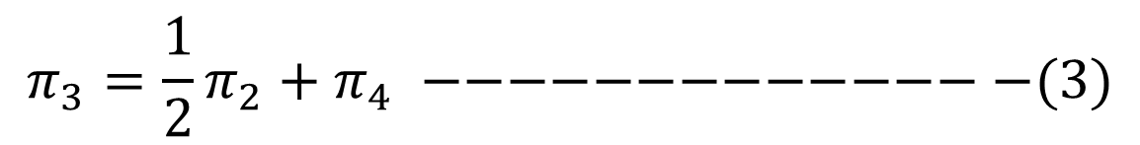

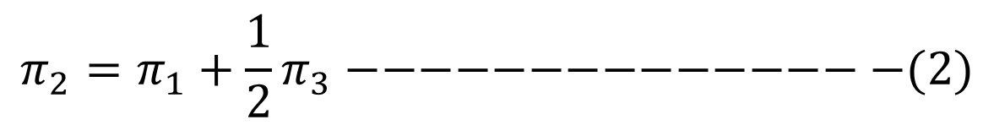

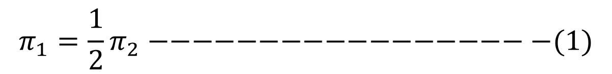
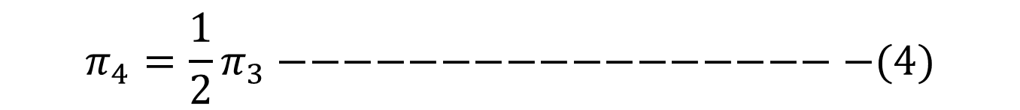
$$π_{1}=\frac{1}{2}π_{2}−−−−−−−−−−−−−−−−−−(1)$$
$$π_{2}=π_{1}+\frac{1}{2}π_{3}−−−−−−−−−−−−−−−(2)$$
$$π_{3}={\frac{1}{2}π}_{2}+π_{4} −−−−−−−−−−−−−−(3)$$
$$π_{4}={\frac{1}{2}π}_{3}−−−−−−−−−−−−−−−−−−(4)$$
$$From equation \left(1\right), we get$$
$$π_{2}={2π}_{1}$$
$$Put the value ofπ_{2} in equation \left(2\right), we get$$
$$π_{2}=π_{1}+\frac{1}{2}π_{3}↔{2π}_{1}=π_{1}+\frac{1}{2}π_{3}↔π_{1}=\frac{1}{2}π_{3}↔{2π}_{1}=π_{3}$$

Slide 5


$$π_{1}=\frac{1}{2}π_{2}−−−−−−−−−−−−−−−−−−(1)$$
$$π_{2}=π_{1}+\frac{1}{2}π_{3}−−−−−−−−−−−−−−−(2)$$
$$π_{2}={2π}_{1}$$
$$π_{3}={\frac{1}{2}π}_{2}+π_{4} −−−−−−−−−−−−−−(3)$$
$$π_{4}={\frac{1}{2}π}_{3}−−−−−−−−−−−−−−−−−−(4)$$
$$π_{3}={2π}_{1}$$
$$Put the value ofπ_{2} andπ_{3} in equation \left(3\right), we get$$
$$π_{3}={\frac{1}{2}π}_{2}+π_{4}↔{2π}_{1}={\frac{1}{2}(2π}_{1})+π_{4}↔π_{4}=π_{1}↔π_{4}=π_{1}$$

Slide 6

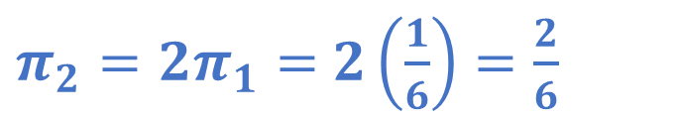

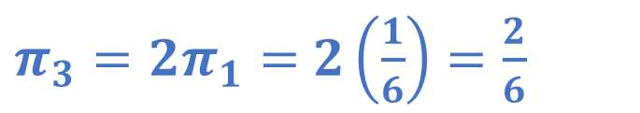




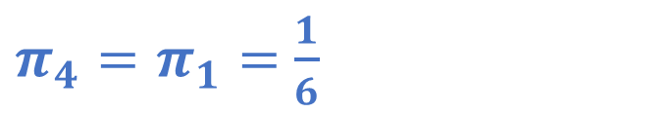
$$π_{1}=\frac{1}{2}π_{2}−−−−−−−−−−−−−−−−−−(1)$$
$$π_{2}=π_{1}+\frac{1}{2}π_{3}−−−−−−−−−−−−−−−(2)$$
$$π_{2}={2π}_{1}$$
$$π_{3}={\frac{1}{2}π}_{2}+π_{4} −−−−−−−−−−−−−−(3)$$
$$π_{4}={\frac{1}{2}π}_{3}−−−−−−−−−−−−−−−−−−(4)$$
$$π_{3}={2π}_{1}$$
$$π_{4}=π_{1}$$
$${π_{1}+π_{2}+π_{3}+π}_{4}=1$$
$${π_{1}+{2π}_{1}+{2π}_{1}+π}_{1}=1$$
$$π_{1}=\frac{1}{6}$$
$π_{3}={2π}_{1}=$ $2\left(\frac{1}{6}\right)=\frac{2}{6}$
$π_{2}={2π}_{1}=$ $2\left(\frac{1}{6}\right)=\frac{2}{6}$
$π_{4}=π_{1}=$ $\frac{1}{6}$

Slide 7
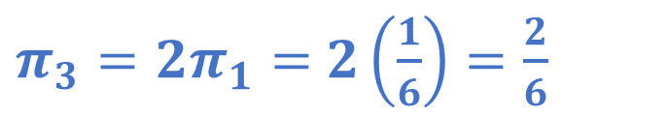



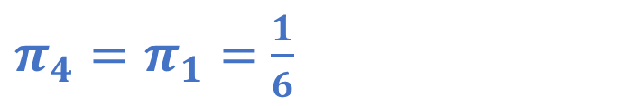
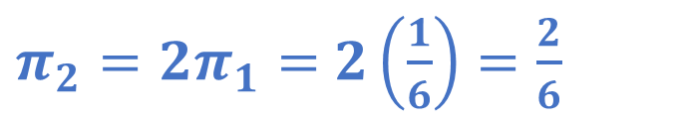
$$π_{1}=\frac{1}{6}$$
$π_{3}={2π}_{1}=$ $2\left(\frac{1}{6}\right)=\frac{2}{6}$
$π_{2}={2π}_{1}=$ $2\left(\frac{1}{6}\right)=\frac{2}{6}$
$π_{4}=π_{1}=$ $\frac{1}{6}$
$$[\begin{matrix}π_{1} & π_{2} & π_{3} & π_{4}\end{matrix}]=\left[\begin{matrix}\frac{1}{6} & \frac{2}{6} & \frac{2}{6} & \frac{1}{6}\end{matrix}\right]$$
$$Check$$
$$\frac{1}{6}+\frac{2}{6}+\frac{2}{6}+\frac{1}{6}=1$$

