Slide 1
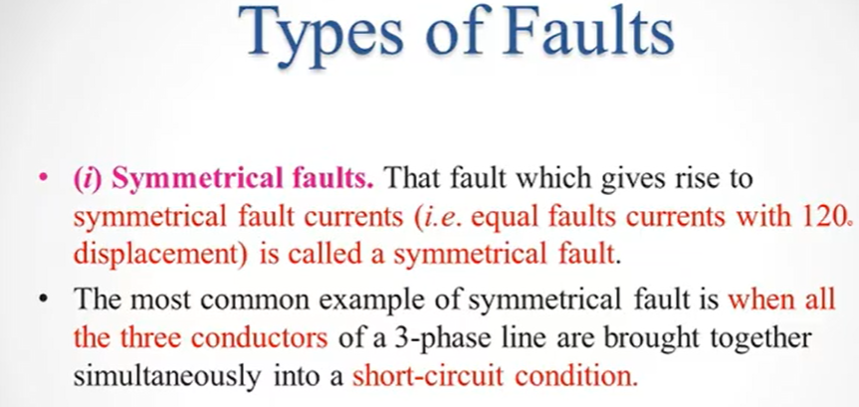

Slide 2
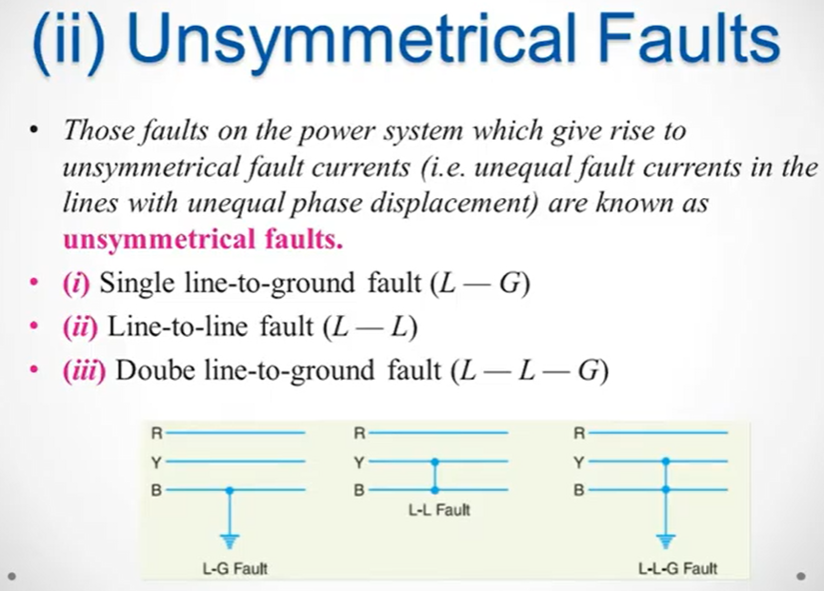

Slide 3
Single Line TO Ground Fault
In this case any line of 3-phase is short is called as Single-Line-To-Ground Fault

Slide 4
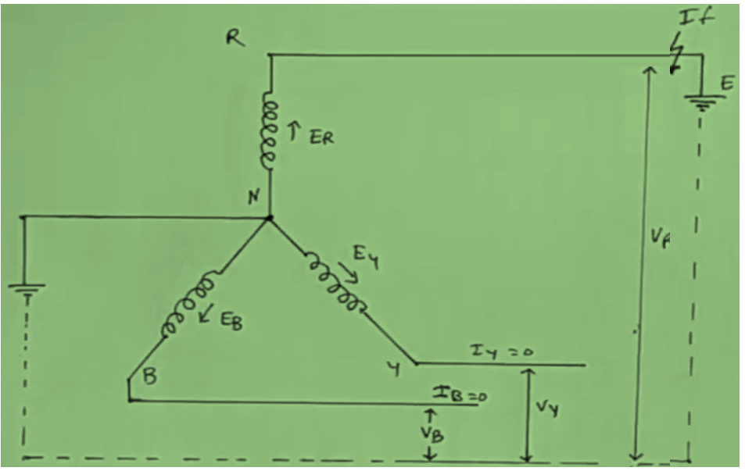
https://www.youtube.com/watch?v=zY7zKS3i4K0
In this Figure Fault occur on Red phase, and than R-phase is short with ground

Slide 5
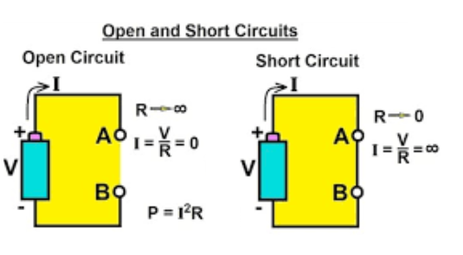
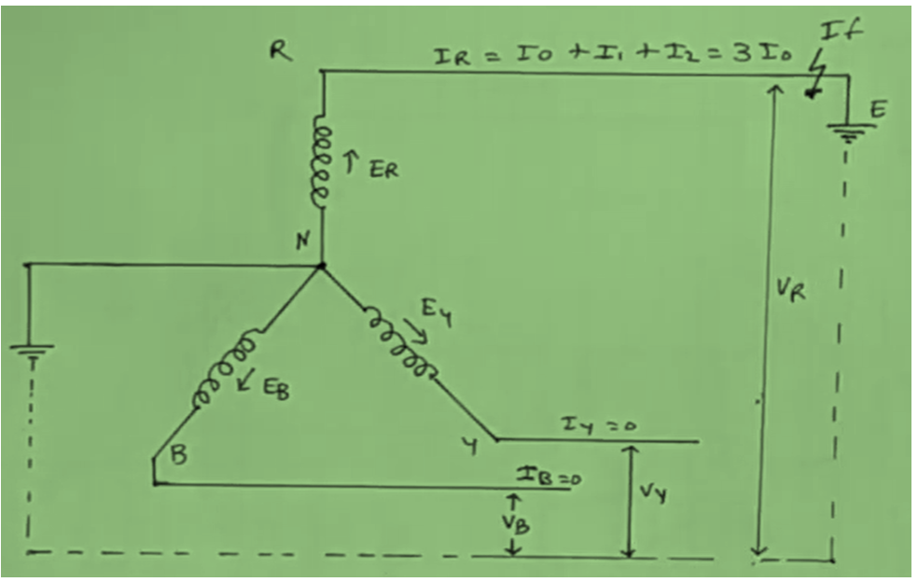
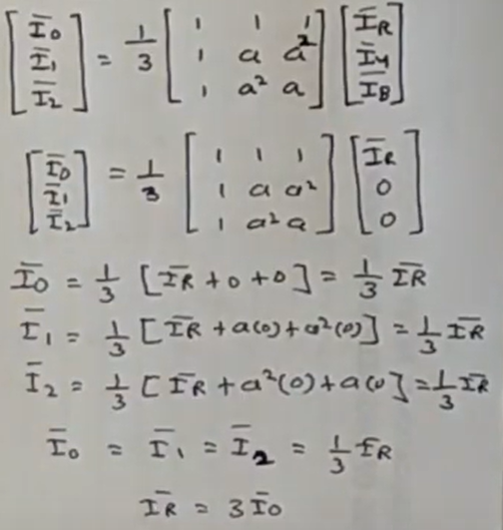
Short circuit occur at R-Phase, than current is infinity and voltage of V_{R} is = 0
EMF of R-Phase
EMF of Y-Phase
EMF of B-Phase
Sequence components zero, +ve and –ve components
These both line are open, so current can not flow, so I_{y} = 0 and I_{B} = 0

Slide 6
