Slide 1
SEQUENCE NETWORKS
Chapter -10
Power System Analysis by
Hadi Saadat

Slide 2
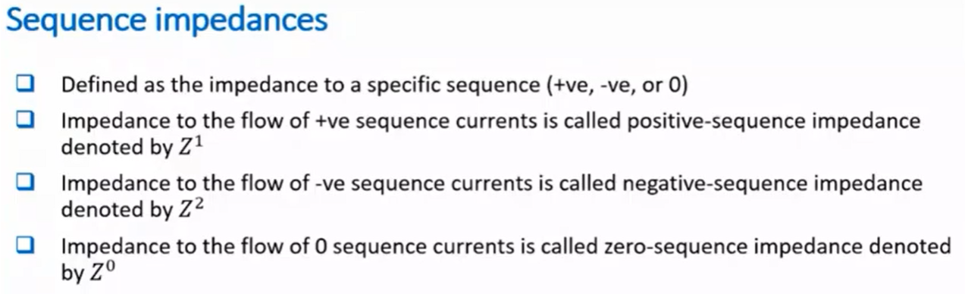

Slide 3
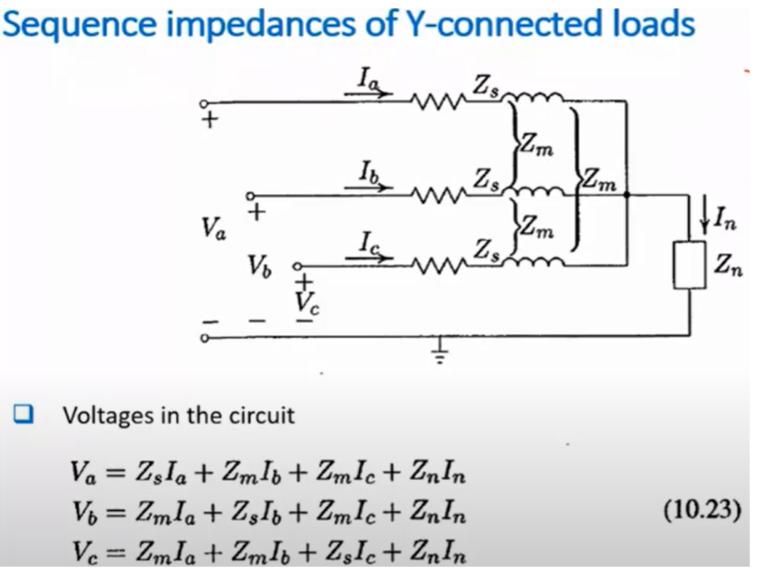
Mutual Induction or mutual coupling such as Transformer or Transmission Line cases
So we take voltage with a reference in this case we used ground as a reference
Self impedance coupling

Slide 4
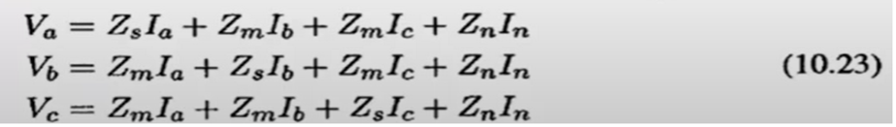
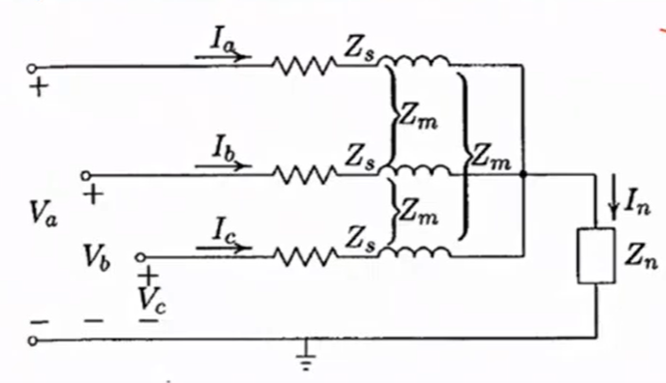
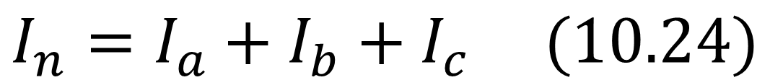

$$Using KCL$$
$$I_{n}={I_{a}+I_{b}+I}_{c} (10.24)$$
$$Put the value in equation (10.23)$$
$V_{a}=Z_{s}I_{a}+$ $Z_{m}I_{b}+Z_{m}I_{c}+Z_{n}({I_{a}+I_{b}+I}_{c})$
$V_{b}=Z_{m}I_{a}+$ $Z_{s}I_{b}+Z_{m}I_{c}+Z_{n}({I_{a}+I_{b}+I}_{c})$
$V_{c}=Z_{m}I_{a}+$ $Z_{m}I_{b}+Z_{s}I_{c}+Z_{n}({I_{a}+I_{b}+I}_{c})$

Slide 5
$V_{a}=Z_{s}I_{a}+$ $Z_{m}I_{b}+Z_{m}I_{c}+Z_{n}({I_{a}+I_{b}+I}_{c})$
$V_{b}=Z_{m}I_{a}+$ $Z_{s}I_{b}+Z_{m}I_{c}+Z_{n}({I_{a}+I_{b}+I}_{c})$
$V_{c}=Z_{m}I_{a}+$ $Z_{m}I_{b}+Z_{s}I_{c}+Z_{n}({I_{a}+I_{b}+I}_{c})$
$V_{a}=Z_{s}I_{a}+$ $Z_{m}I_{b}+Z_{m}I_{c}+Z_{n}I_{a}+Z_{n}I_{b}+Z_{n}I_{c}$
$V_{a}={(Z}_{s}{+Z_{n})I}_{a}+$ ($Z_{m}{+Z_{n})I}_{b}+{(Z}_{m}{+Z_{n})I}_{c}$
$V_{b}=Z_{m}I_{a}+$ $Z_{s}I_{b}+Z_{m}I_{c}+Z_{n}I_{a}+Z_{n}I_{b}+Z_{n}I_{c}$
$V_{b}={(Z}_{m}{+Z_{n})I}_{a}+$ $(Z_{s}+Z_{n})I_{b}+{(Z_{m}+Z_{n})I}_{c}$
$V_{c}=Z_{m}I_{a}+$ $Z_{m}I_{b}+Z_{s}I_{c}+Z_{n}I_{a}+Z_{n}I_{b}+Z_{n}I_{c}$
$V_{c}={(Z}_{m}{+Z_{n})I}_{a}+$ $(Z_{m}+Z_{n})I_{b}+{(Z_{s}+Z_{n})I}_{c}$

Slide 6
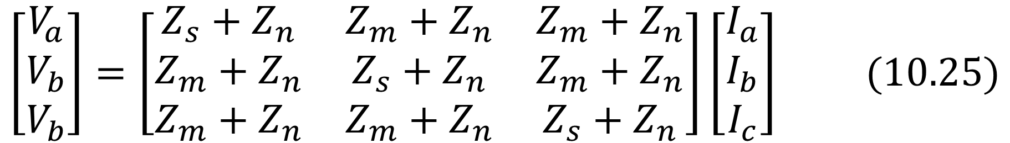
$V_{a}={(Z}_{s}{+Z_{n})I}_{a}+$ ($Z_{m}{+Z_{n})I}_{b}+{(Z}_{m}{+Z_{n})I}_{c}$
$V_{b}={(Z}_{m}{+Z_{n})I}_{a}+$ $(Z_{s}+Z_{n})I_{b}+{(Z_{m}+Z_{n})I}_{c}$
$V_{c}={(Z}_{m}{+Z_{n})I}_{a}+$ $(Z_{m}+Z_{n})I_{b}+{(Z_{s}+Z_{n})I}_{c}$
Convert these equations into matrix forms
$$\left[\begin{matrix}V_{a} \\ V_{b} \\ V_{b}\end{matrix}\right]=\left[\begin{matrix}Z_{s}+Z_{n} & Z_{m}+Z_{n} & Z_{m}+Z_{n} \\ Z_{m}+Z_{n} & Z_{s}+Z_{n} & Z_{m}+Z_{n} \\ Z_{m}+Z_{n} & Z_{m}+Z_{n} & Z_{s}+Z_{n}\end{matrix}\right]\left[\begin{matrix}I_{a} \\ I_{b} \\ I_{c}\end{matrix}\right] (10.25)$$
Write in Compact form
$$V^{abc}={Z^{abc}I}^{abc} (10.26)$$

Slide 7



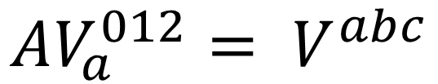
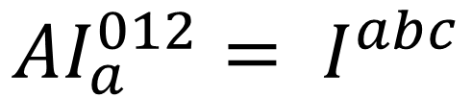
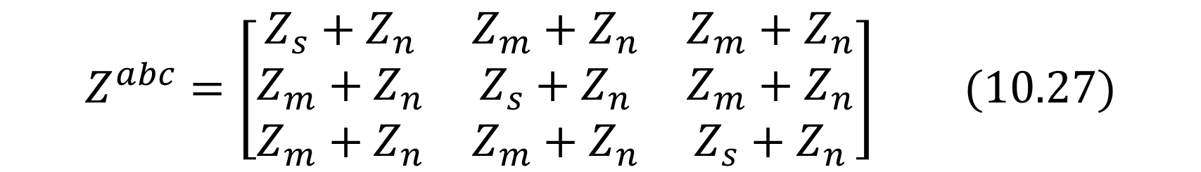
Convert these equations into matrix forms
$$Z^{abc}=\left[\begin{matrix}Z_{s}+Z_{n} & Z_{m}+Z_{n} & Z_{m}+Z_{n} \\ Z_{m}+Z_{n} & Z_{s}+Z_{n} & Z_{m}+Z_{n} \\ Z_{m}+Z_{n} & Z_{m}+Z_{n} & Z_{s}+Z_{n}\end{matrix}\right] (10.27)$$
$$V^{abc}={Z^{abc}I}^{abc} (10.26)$$
Now convert equation (10.26) of each phasor domain vector into corresponding symmetrical components.
$${AV}_{a}^{012}= V^{abc}$$
$$V^{abc}={Z^{abc}I}^{abc}$$
$${AV}_{a}^{012}={Z^{abc}AI}_{a}^{012} (10.28)$$
$${AI}_{a}^{012}= I^{abc}$$

Slide 8
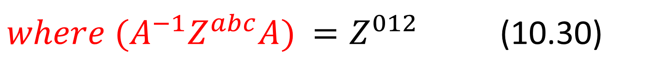
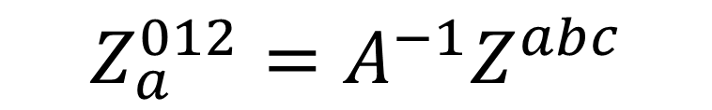
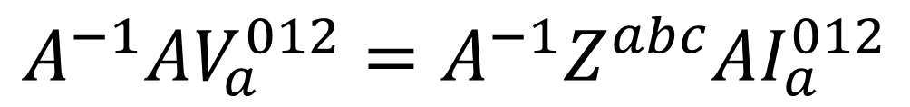
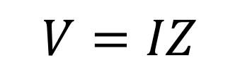

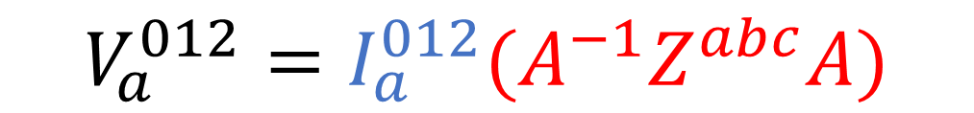
Multiply A⁻¹ on both sides with equation (10.28)
$${A^{−1}AV}_{a}^{012}=A^{−1}{Z^{abc}AI}_{a}^{012}$$
$${AV}_{a}^{012}={Z^{abc}AI}_{a}^{012} (10.28)$$
$V_{a}^{012}=A^{−1}{Z^{abc}AI}_{a}^{012} (10.29)$
$$Z_{a}^{012}=A^{−1}Z^{abc}$$
$$V_{a}^{012}=I_{a}^{012}{(A}^{−1}Z^{abc}A)$$
$$V=IZ$$
${where (A}^{−1}Z^{abc}A)$ ${=Z}^{012}$ (10.30)

Slide 9
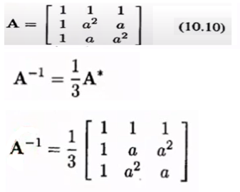
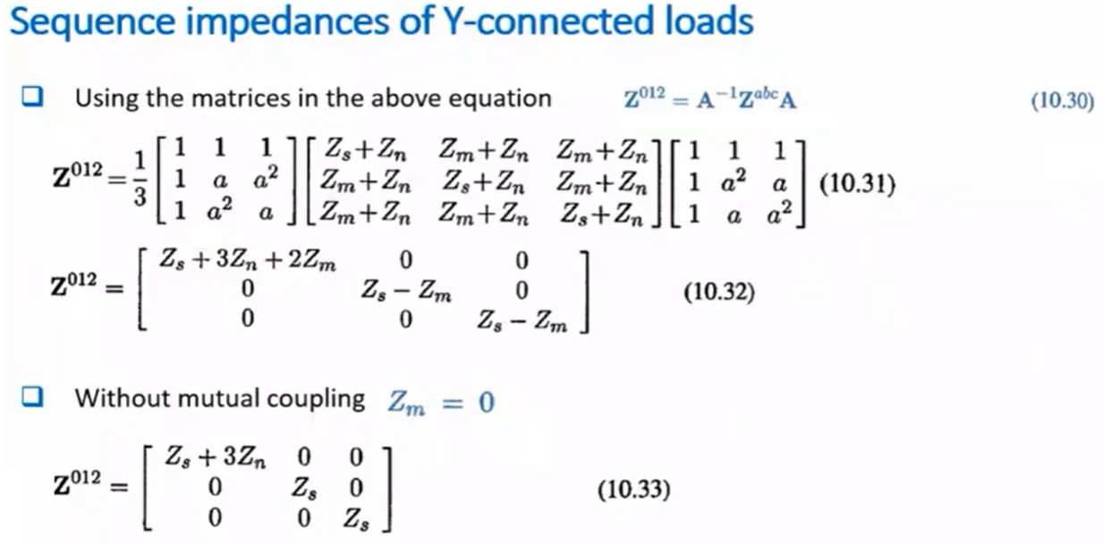
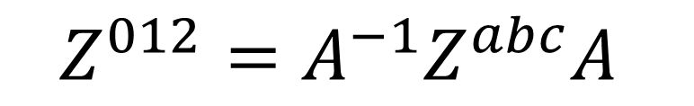
Put values in equation (10.30)
$$Z^{012}=A^{−1}Z^{abc}A$$
Observed principal diagonal available and off diagonal all are zeros
If not mutual coupling between them, then Z_{m} = 0

Slide 10
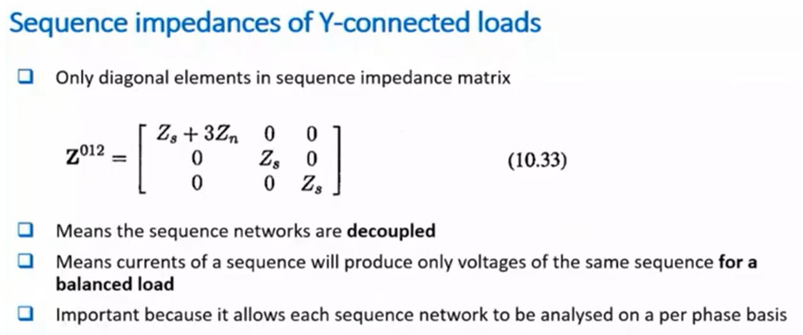

Slide 11
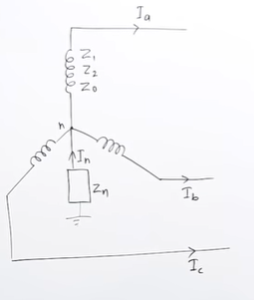
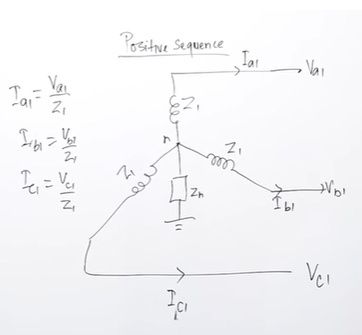
Sequence Network of Three Phase Load

Slide 12
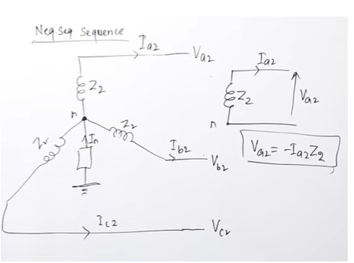
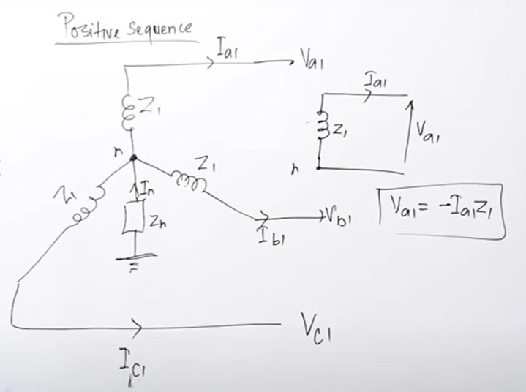
Sequence Network of Three Phase Load
In positive sequence Neutral Current is zero
Now we draw per phase equivalent circuit
-ve due to opposite polarity

Slide 13
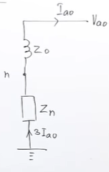
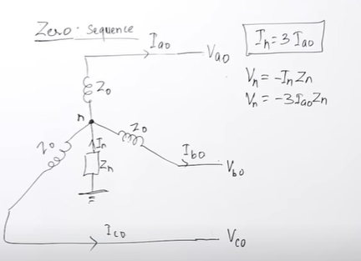
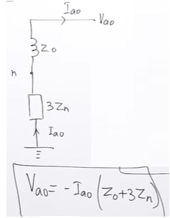
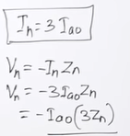
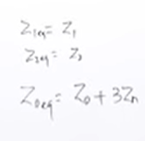
Sequence Network of Three Phase Load
Per-phase
But current is same, in this value of current is different
Sequence impedances of Delta Load, first we convert Delta into Star than use this notations
Sequence impedances of Star Load

Slide 14
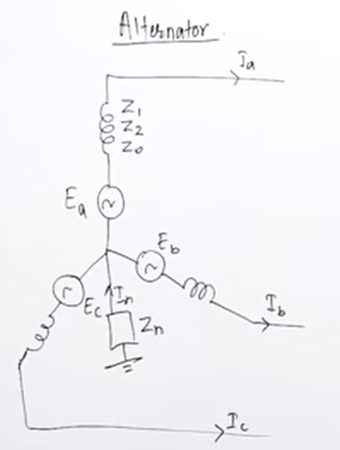
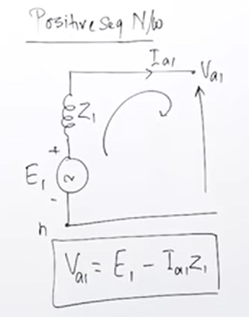
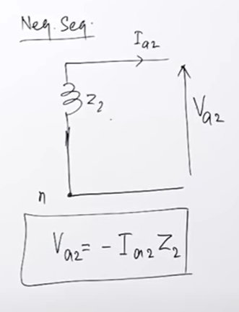
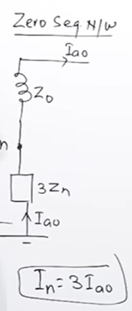
Sequence Network of Alternator
Negative and zero sequences EMF is not available

Slide 15
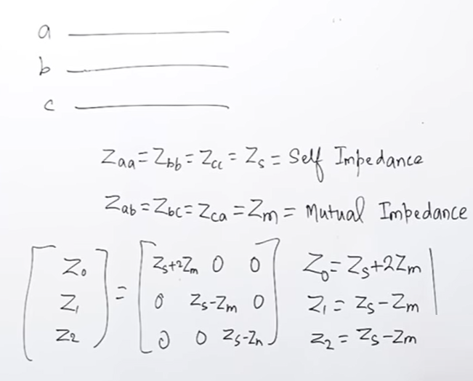
Sequence Network of Transmission Line

