Slide 1
Signals and System
Dr. Wazir Muhammad Laghari
Electrical Engineering Department
BUET, Khuzdar

Slide 2
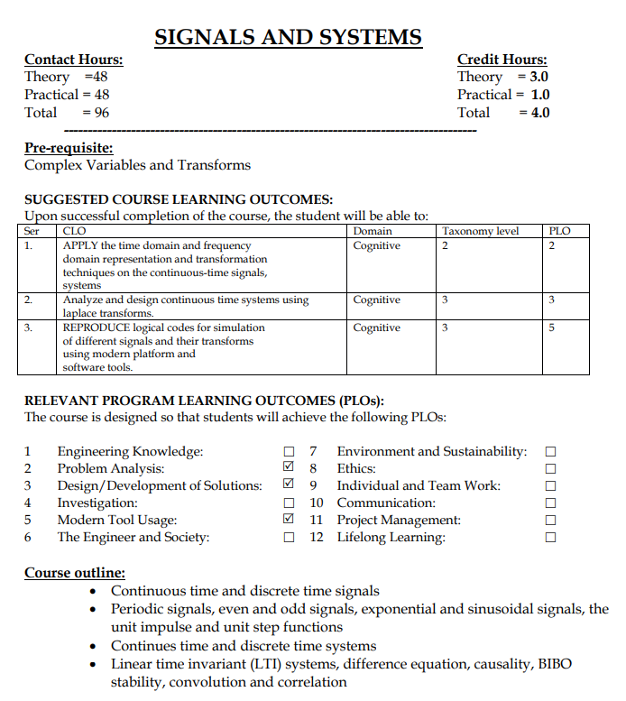
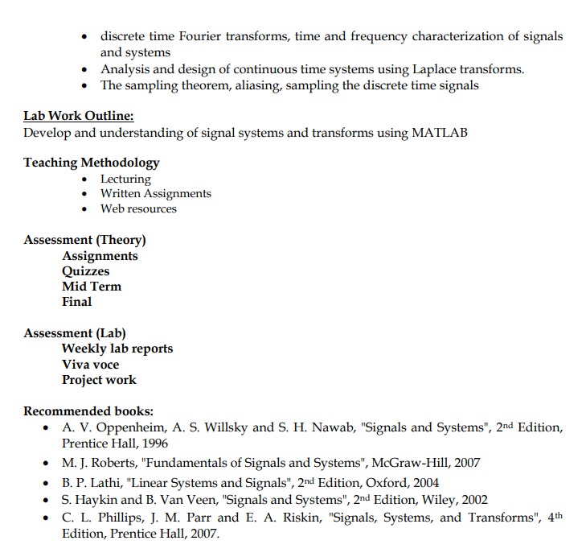

Slide 3
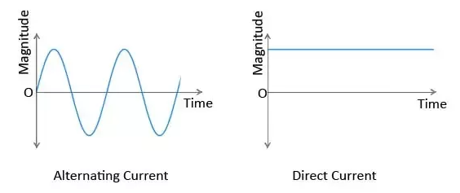
Signal
Signal is a dependent of function of one or more independent variable.
Signal is a function of independent variable
F (x₁ , x₂ , . . . x_{n})
Signal Not a Signal
Independent variables
Signal

Slide 4
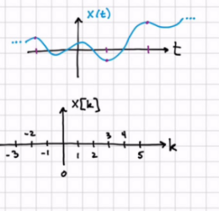
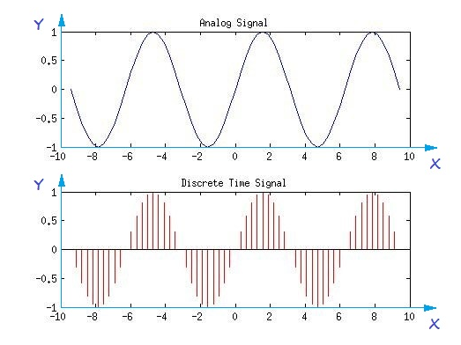
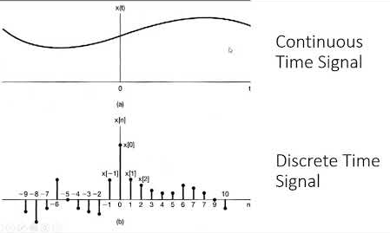
Continuous Versus Discrete Time Signal

Slide 5
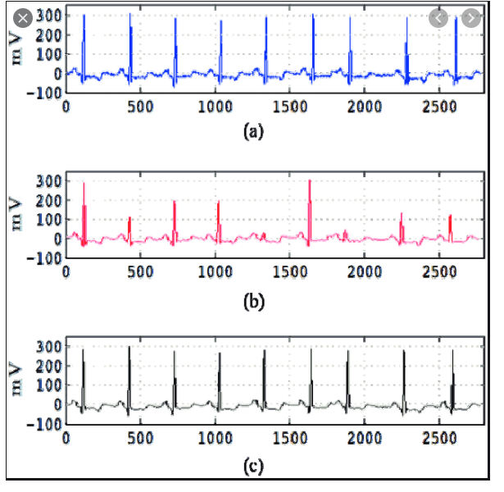
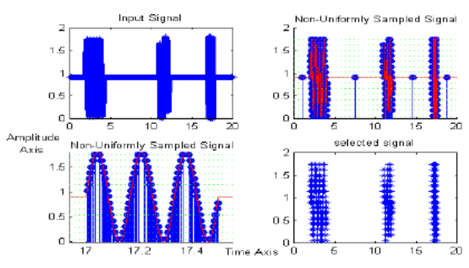
Uniformly And Non-Uniformly Sampled Signal

Slide 6
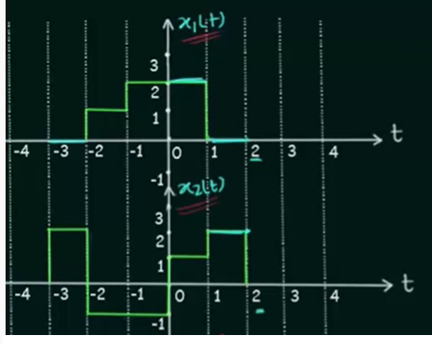
Addition of Continuous-Time Signals

Slide 7
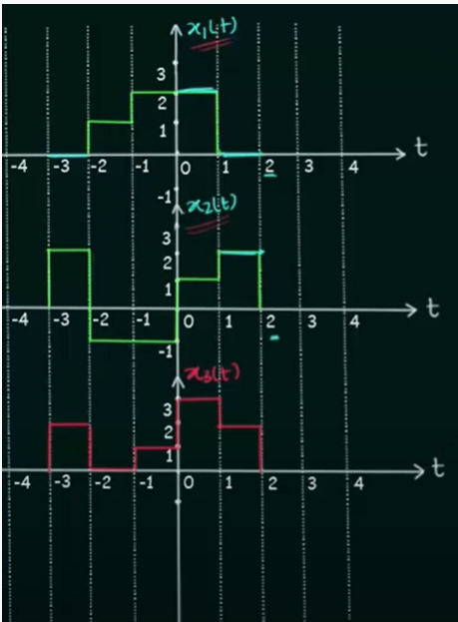
Addition of Continuous-Time Signals

Slide 8
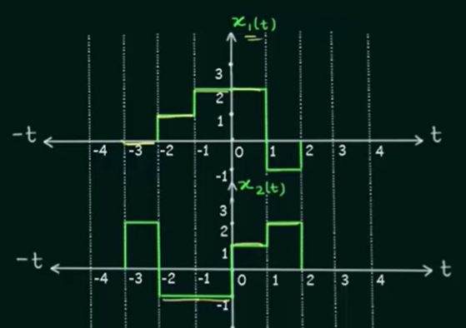
Multiplication of Continuous-Time Signals

Slide 9
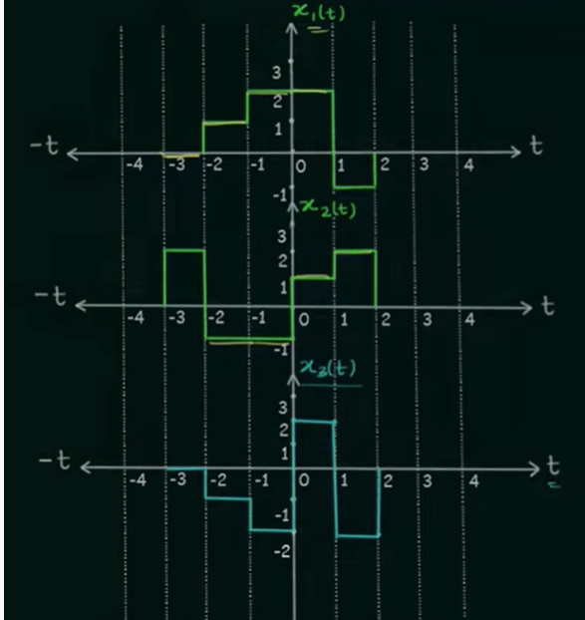
Multiplication of Continuous-Time Signals

