Slide 1
Periodic And Aperiodic Signals

Slide 2
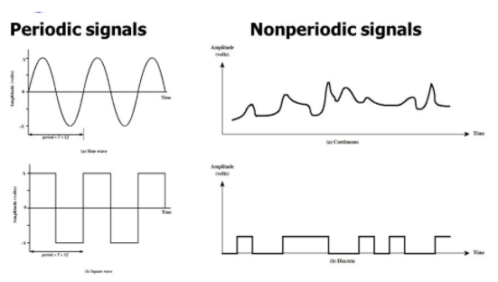
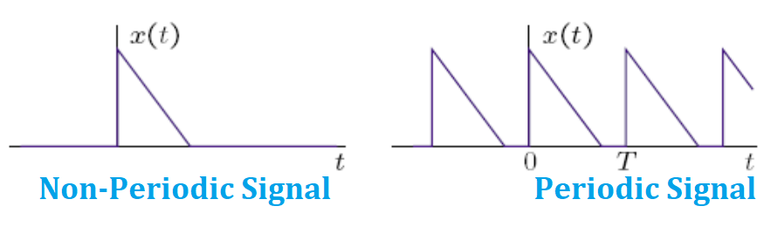
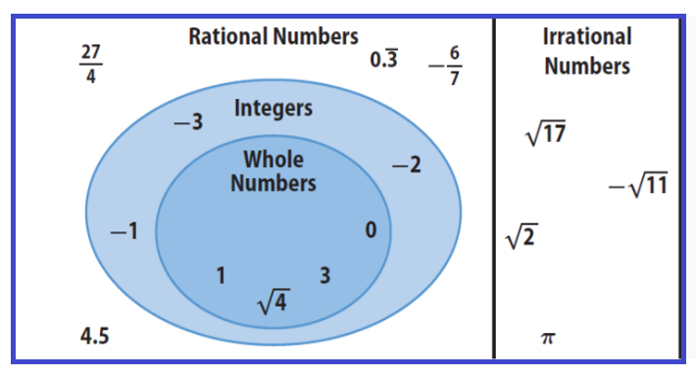
Periodic & Non-periodic Signals
Periodic signals have the property that x (t + T) = x(t) for all t.

Slide 3
Periodic And Aperiodic Of Continuous Time Signal OR Periodicity of Continuous Time Signal

Slide 4
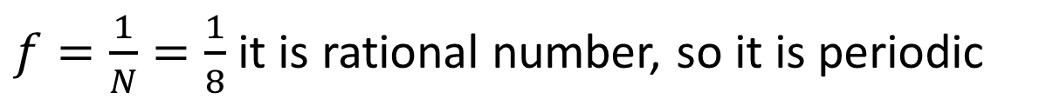

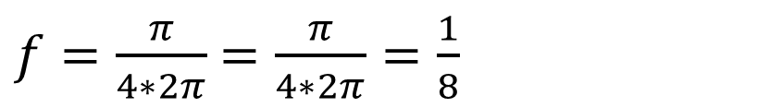
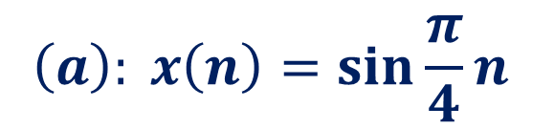
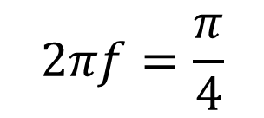
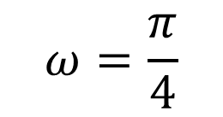

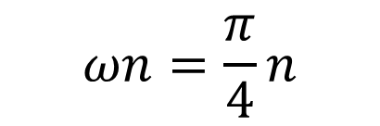
Question# Determine whether each of the following Discrete Time Signals is Periodic. If Periodic, determine its fundamental Period.
$$\left(a\right): x\left(n\right)=\sin{\frac{π}{4}n}$$
$$SOLUTION:$$
$$ωn=\frac{π}{4}n$$
$f=\frac{π}{4∗2π}$ $=\frac{π}{4∗2π}=\frac{1}{8}$
$$ω=\frac{π}{4}$$
$f=\frac{1}{N}=\frac{1}{8}$ it is rational number, so it is periodic
$$N=\frac{1}{f}=8$$
$$2πf=\frac{π}{4}$$
$$N=8, Fundamental Period is 8…. Answer$$

Slide 5
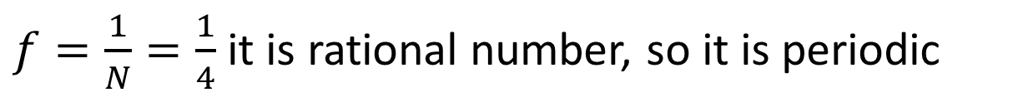

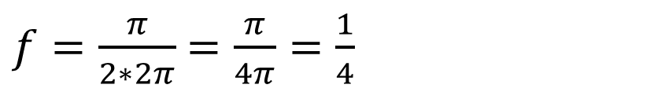

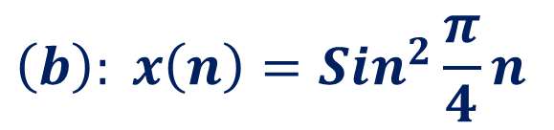
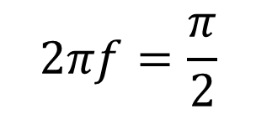
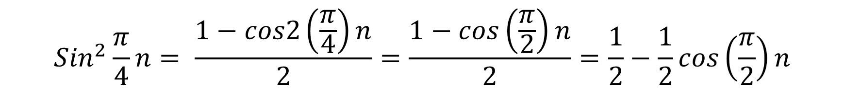
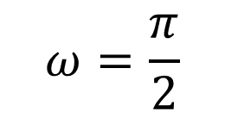

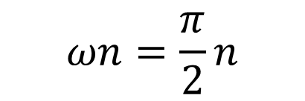
$$\left(b\right): x\left(n\right)={Sin}^{2}{\frac{π}{4}n}$$
$$SOLUTION:$$
$${Sin}^{2}{θ=\frac{1−cos2θ}{2}}$$
$${Sin}^{2}{\frac{π}{4}n}= \frac{1−cos2\left(\frac{π}{4}\right)n}{2}=\frac{1−cos\left(\frac{π}{2}\right)n}{2}=\frac{1}{2}−\frac{1}{2}cos\left(\frac{π}{2}\right)n$$
$$ωn=\frac{π}{2}n$$
$f=\frac{π}{2∗2π}$ $=\frac{π}{4π}=\frac{1}{4}$
$$ω=\frac{π}{2}$$
$f=\frac{1}{N}=\frac{1}{4}$ it is rational number, so it is periodic
$$N=\frac{1}{f}=4$$
$$2πf=\frac{π}{2}$$
$$N=4, Fundamental Period is 4…. Answer$$

Slide 6
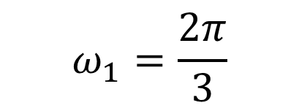
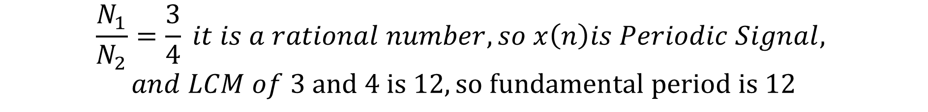
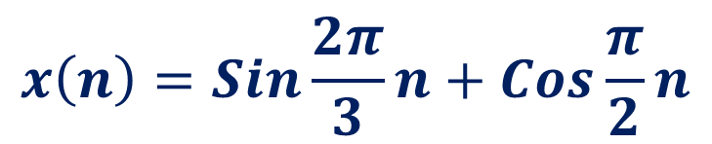
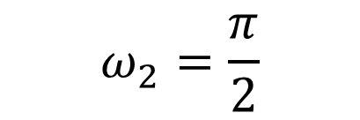
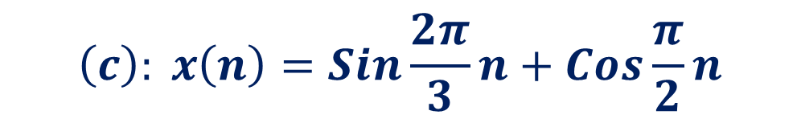
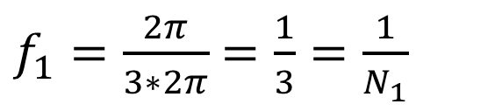
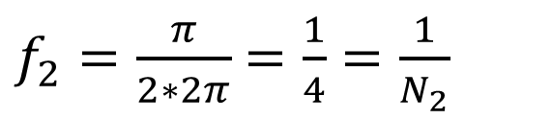
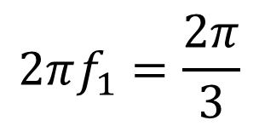
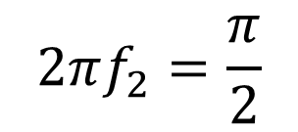
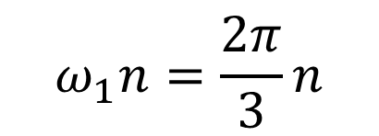
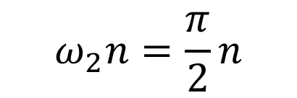
$$\left(c\right): x\left(n\right)=\operatorname{Sin}{\frac{2π}{3}n+Cos}\frac{π}{2}n$$
$$SOLUTION:$$
$$x\left(n\right)=\operatorname{Sin}{\frac{2π}{3}n+Cos}\frac{π}{2}n$$
$$ω_{1}n=\frac{2π}{3}n$$
$$ω_{2}n=\frac{π}{2}n$$
$$ω_{1}=\frac{2π}{3}$$
$$ω_{2}=\frac{π}{2}$$
$$2πf_{1}=\frac{2π}{3}$$
$$2πf_{2}=\frac{π}{2}$$
$f_{1}=\frac{2π}{3∗2π}$ $=\frac{1}{3}=\frac{1}{N_{1}}$
$f_{2}=\frac{π}{2∗2π}$ $=\frac{1}{4}=\frac{1}{N_{2}}$
$$\frac{N_{1}}{N_{2}}=\frac{3}{4} it is a rational number, so x\left(n\right)is Periodic Signal,$$
$$and LCM of 3 and 4 is 12, so fundamental period is 12$$

Slide 7




$$\left(d\right): x\left(n\right)=\operatorname{Sin}{3n}$$
$$SOLUTION:$$
$$ωn=3n$$
$$ω=3$$
$$2πf=3$$
$f=\frac{3}{2π}$ $=it is Irrational Number, So it is Non−Periodic Signal$

Slide 8
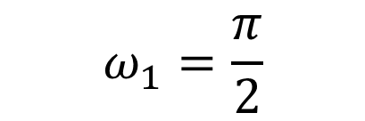
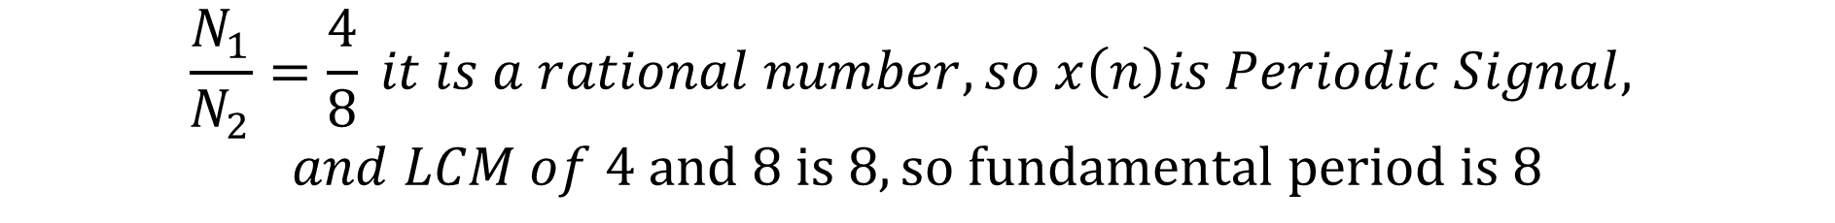
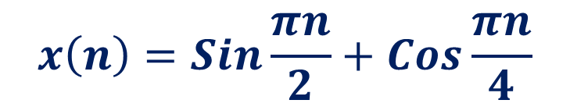
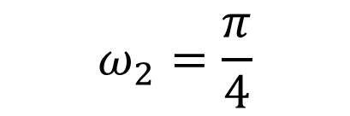

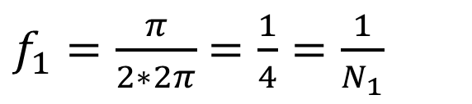
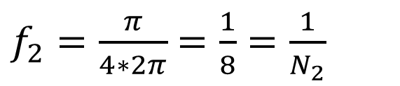
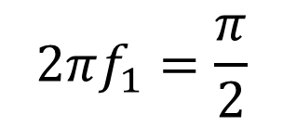
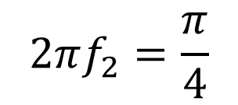
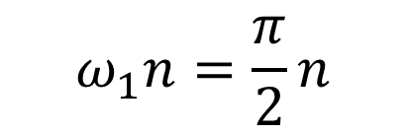
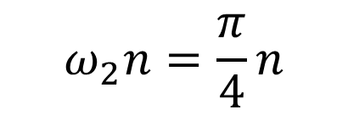
$$\left(e\right): x\left(n\right)=\operatorname{Sin}{\frac{πn}{2}+Cos}\frac{πn}{4}$$
$$SOLUTION:$$
$$x\left(n\right)=\operatorname{Sin}{\frac{πn}{2}+Cos}\frac{πn}{4}$$
$$ω_{1}n=\frac{π}{2}n$$
$$ω_{2}n=\frac{π}{4}n$$
$$ω_{1}=\frac{π}{2}$$
$$ω_{2}=\frac{π}{4}$$
$$2πf_{1}=\frac{π}{2}$$
$$2πf_{2}=\frac{π}{4}$$
$f_{1}=\frac{π}{2∗2π}$ $=\frac{1}{4}=\frac{1}{N_{1}}$
$f_{2}=\frac{π}{4∗2π}$ $=\frac{1}{8}=\frac{1}{N_{2}}$
$$\frac{N_{1}}{N_{2}}=\frac{4}{8} it is a rational number, so x\left(n\right)is Periodic Signal,$$
$$and LCM of 4 and 8 is 8, so fundamental period is 8$$

Slide 9





$$\left(f\right): x\left(n\right)=3Cos(0.2{πn)}$$
$$SOLUTION:$$
$$ωn=0.2πn$$
$ω=$ $0.2π$
$$2πf=0.2π$$
$f=\frac{0.2π}{2π}$ $=\frac{0.2}{2}$, it is rational number, so it is periodic
$N=\frac{1}{f}=\frac{2}{0.2}$ = 10, $Fundamental Period is 10…. Answer$

Slide 10




$$\left(g\right): x\left(n\right)=e^{j2n}$$
$$SOLUTION:$$
$$ωn=2n$$
$ω=$ $2$
$$2πf=2$$
$f=\frac{2}{2π}$ $=\frac{1}{π}$, it is irrational number, so it is non-periodic

Slide 11
Periodic And Aperiodic Of Continuous Time Signal OR Periodicity of Continuous Time Signal

Slide 12



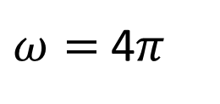

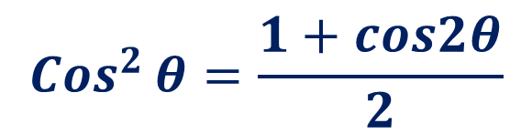
Question# Determine whether each of the following continuous-time signals is Periodic. If Periodic, determine its fundamental Period.
$$\left(a\right): x[t] ={Cos}^{2}(2{πt)}$$
$$SOLUTION:$$
$${Cos}^{2}{θ=\frac{1+cos2θ}{2}}$$
$x[t] ={Cos}^{2}(2{πt)=\frac{1+Cos2∗(2πt)}{2}=\frac{1+Cos4πt}{2}}$
$$ωt=4πt$$
$ω=$ 4$π$
$$2πf=4π$$
$f=\frac{4π}{2π}$ $=2$, it is rational number, so it is periodic
$T=\frac{1}{f}=\frac{1}{2}$ , So $Fundamental Period is\frac{1}{2}…. Answer$

Slide 13
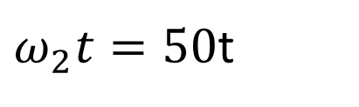

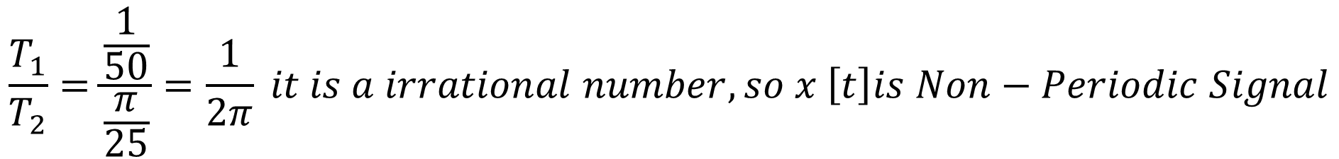
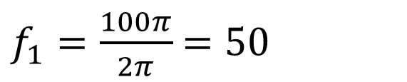


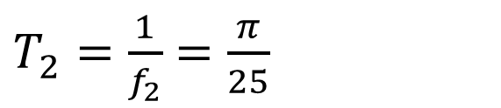
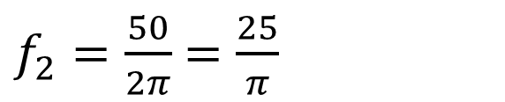


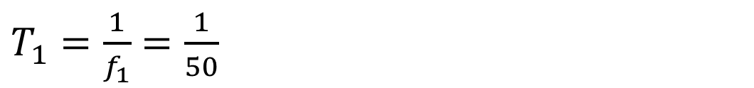
$$\left(b\right): x[t]=2Cos({100πt)+5Sin(50πt)}$$
$$SOLUTION:$$
$$x[t]=2Cos({100πt)+5Sin(50t)}$$
$$ω_{1}t=100πt$$
$ω_{2}t=50$t
$$ω_{2}=50$$
$$ω_{1}=100π$$
$$2πf_{1}=100π$$
$$2πf_{2}=50$$
$f_{1}=\frac{100π}{2π}$ $=50$
$f_{2}=\frac{50}{2π}$ $=\frac{25}{π}$
$T_{1}=\frac{1}{f_{1}}$ $=\frac{1}{50}$
$T_{2}=\frac{1}{f_{2}}$ $=\frac{π}{25}$
$$\frac{T_{1}}{T_{2}}=\frac{\frac{1}{50}}{\frac{π}{25}}=\frac{1}{2π} it is a irrational number, so x \left[t\right]is Non−Periodic Signal$$

Slide 14
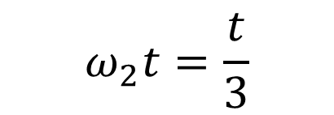
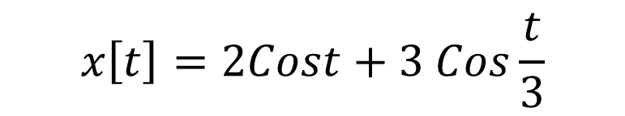

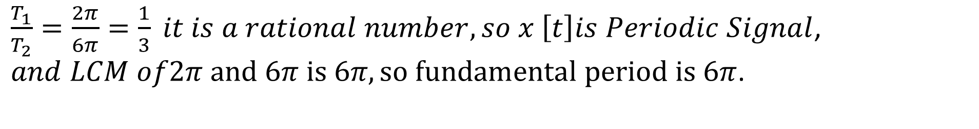
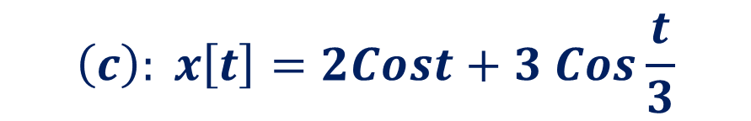
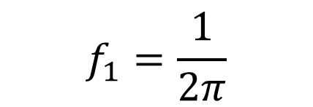







$$\left(c\right): x\left[t\right]=2Cost+3 Cos\frac{t}{3}$$
$$SOLUTION:$$
$$x\left[t\right]=2Cost+3 Cos\frac{t}{3}$$
$$ω_{2}t=\frac{t}{3}$$
$$ω_{1}t=t$$
$$ω_{2}=\frac{1}{3}$$
$$ω_{1}=1$$
$$2πf_{1}=1$$
$$2πf_{2}=\frac{1}{3}$$
$$f_{1}=\frac{1}{2π}$$
$f_{2}=\frac{1}{3∗2π}$ $=\frac{1}{6π}$
$T_{1}=\frac{1}{f_{1}}$ $=2π$
$T_{2}=\frac{1}{f_{2}}$ $=6π$
$\frac{T_{1}}{T_{2}}=\frac{2π}{6π}=\frac{1}{3} it is a rational number, so x \left[t\right]is Periodic Signal$, $and LCM of2π and 6π is 6π, so fundamental period is 6π$.

Slide 15












$$\left(d\right): x\left[t\right]=e^{−j2t}$$
$$e^{iθ}=Cosθ+j Sinθ$$
$$SOLUTION:$$
$x\left[t\right]=Cos\left(−2t\right)+j Sin\left(−2t\right)= Cos2t− j Sin2t$
$$ω_{1}t=2t$$
$$ω_{2}t=2t$$
$$ω_{1}=2$$
$$ω_{2}=2$$
$$2πf_{1}=2$$
$$2πf_{2}=2$$
$f_{1}=\frac{2}{2π}=\frac{1}{π}$
$f_{2}=\frac{2}{2π}$ $=\frac{1}{π}$
$$T_{1}=π$$
$$T_{2}=π$$
$\frac{T_{1}}{T_{2}}=\frac{π}{π}=1,it is a rational number, so x \left[t\right]is Periodic Signal$, $and LCM of π and π is π, so fundamental period is π$.

