Slide 1
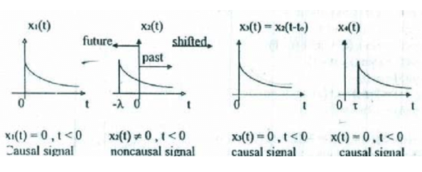
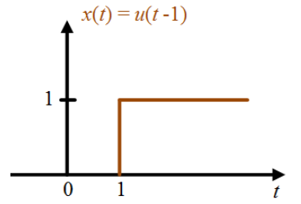
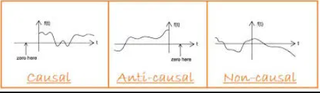
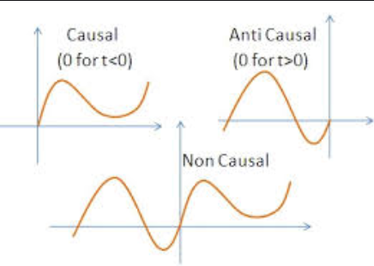
Causal Signal
Casual Signals are those signals that are zero for all negative time.

Slide 2
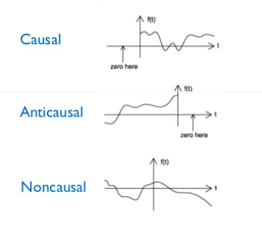
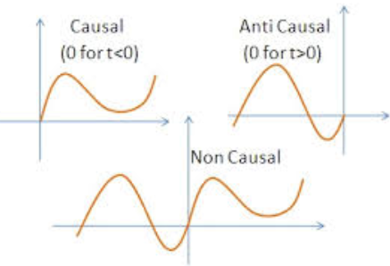
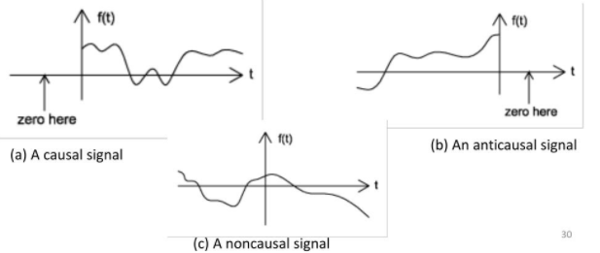
Anticausal Signal
Anticausal Signals are those signals that are zero for all positive time.

Slide 3
Noncausal Signal
Noncausal Signals are those signals that have nonzero values in both positive and negative time.

Slide 4
Causal, Anticausal and Noncausal Signals

