Slide 1
Causal and Non-Causal System

Slide 2
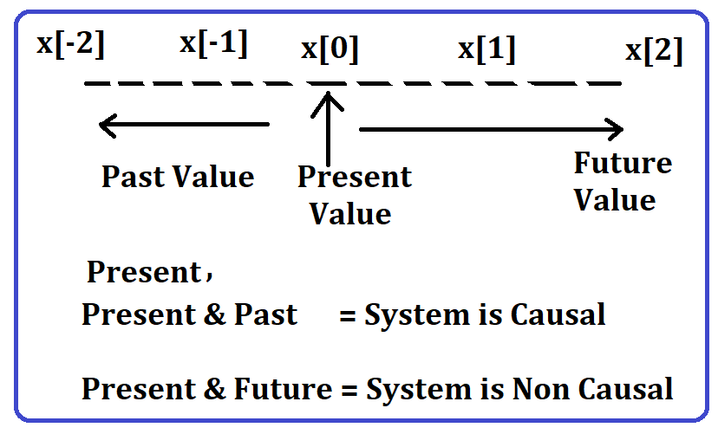
Causal and Non-Causal System
A system is said to be causal if its response is dependent upon present and past inputs and doesn’t depends upon future input.
For a non-causal system, the output depends upon present and future inputs.

Slide 3


$$Example:y\left(t\right)=x\left(t\right)−x(t−1)$$
$$Solution:put t=0$$
$$y\left(0\right)=x\left(0\right)−x\left(0−1\right)=x\left(0\right)−x\left(−1\right)=Present+Past$$
$$So, System is Causal$$

Slide 4

$$Example:y\left(t\right)=x\left(t\right)+2x(3−t)$$
$$Solution:put t=0$$
$$y\left(0\right)=x\left(0\right)+2x\left(3−0\right)=x\left(0\right)+2x\left(3\right)=Present+Future$$
$$So, System is Non Causal$$

Slide 5

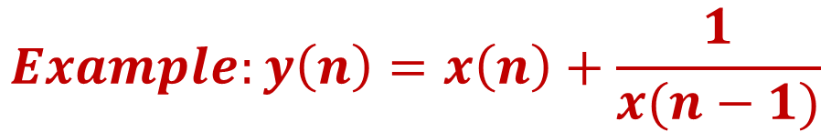
$$Example:y\left(n\right)=x\left(n\right)+\frac{1}{x(n−1)}$$
$$Solution:put n=0$$
$$y\left(0\right)=x\left(0\right)+\frac{1}{x(0−1)}=x\left(0\right)+\frac{1}{x(−1)}=Present+Past$$
$$So, System is Causal$$

Slide 6

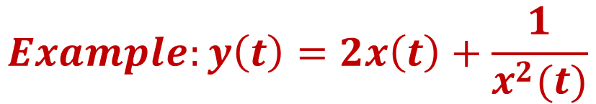
$$Example:y\left(t\right)=2x\left(t\right)+\frac{1}{x^{2}(t)}$$
$$Solution:put t=0$$
$$y\left(0\right)=2x\left(0\right)+\frac{1}{x^{2}(0)}=Present+Present$$
$$So, System is Causal$$

