Slide 1
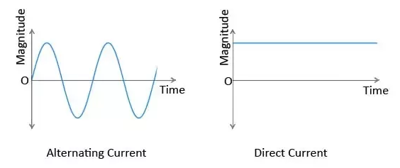
Signal
Signal is a dependent of or function of one or more independent variable.
Signal is a function of independent variable
F (x₁ , x₂ , . . . x_{n})
Signal Not a Signal
Independent variables
Signal

Slide 2
Single Variable Signal

