Slide 1
https://www.youtube.com/watch?v=ecpe7k8RQZ0
Ashraf Chaudhry Crypto Course | Leaked Course Part-2 | Skill Sekho

Slide 2


Slide 3


Slide 4
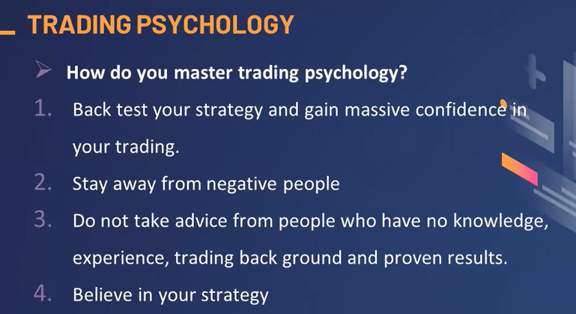

Slide 5
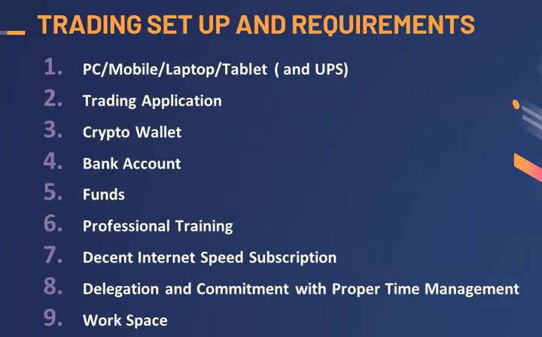

Slide 6
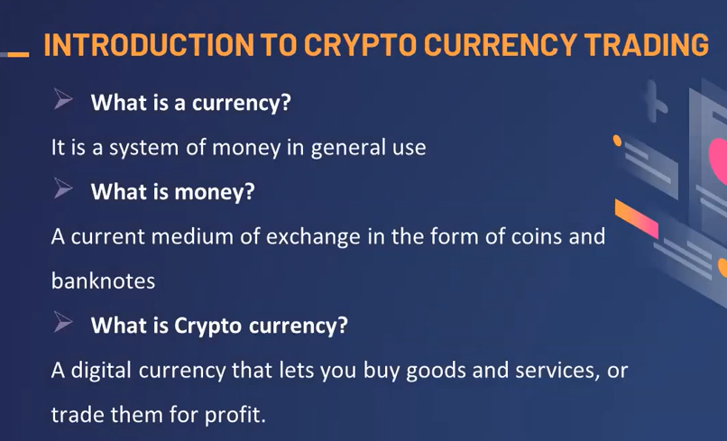

Slide 7
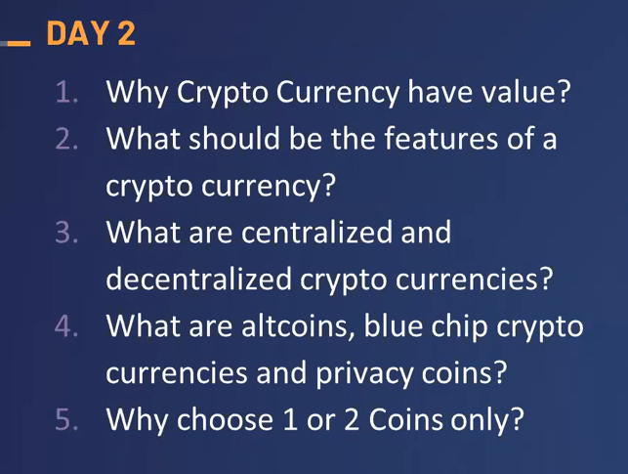

Slide 8
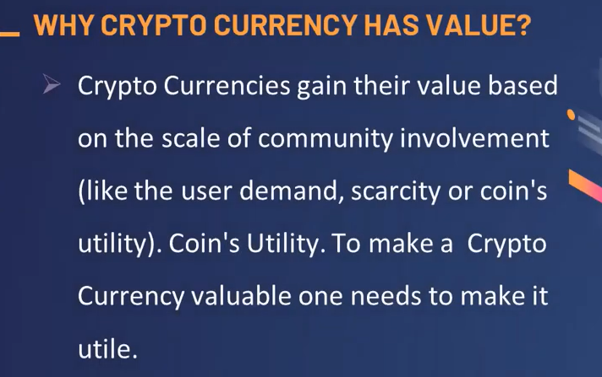

Slide 9
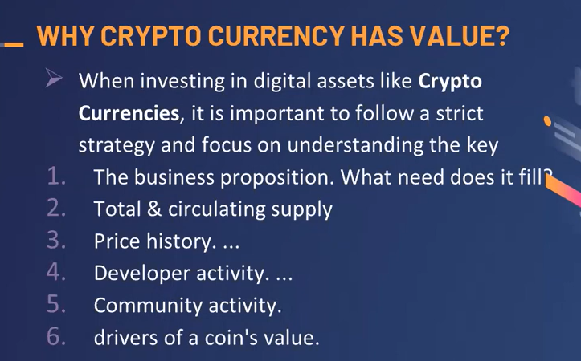

Slide 10
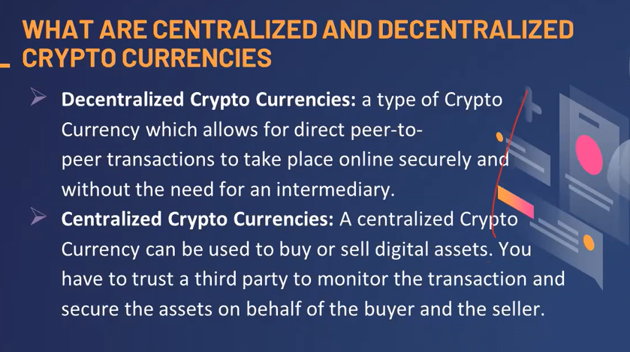

Slide 11
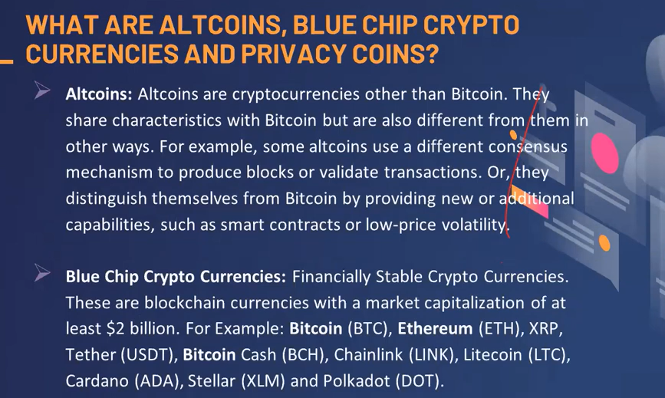

Slide 12
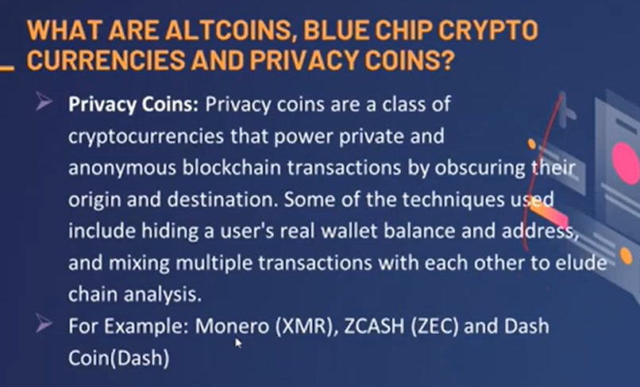

Slide 13
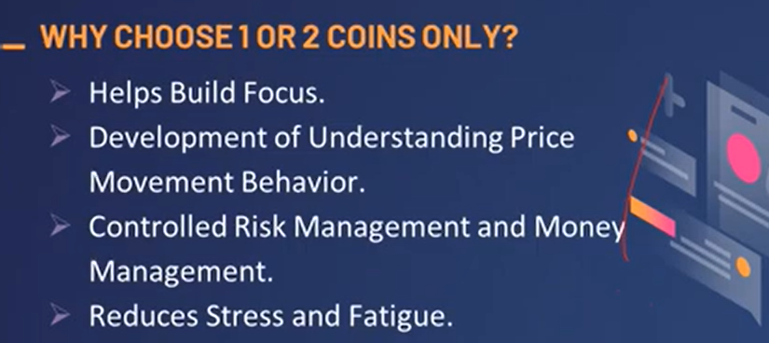

Slide 14
difference between Burning and Halving coin
Burning Just Increase the demand

Slide 15
CURRENCY DEPRECIATION is a fall in the value of a currency in terms of its exchange rate versus other currencies.

