Slide 1
https://www.youtube.com/watch?v=ecpe7k8RQZ0
Ashraf Chaudhry Crypto Course | Leaked Course Part-2 | Skill Sekho

Slide 2
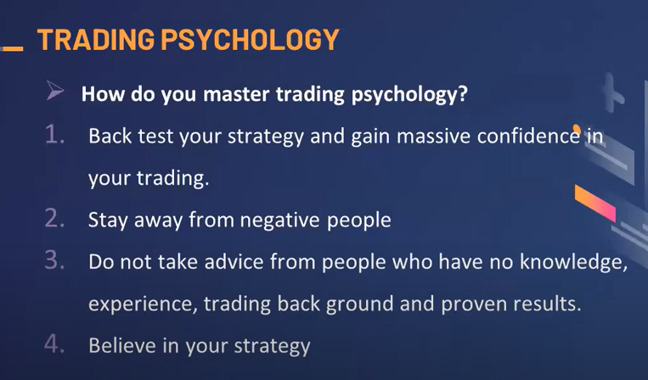

Slide 3


Slide 4
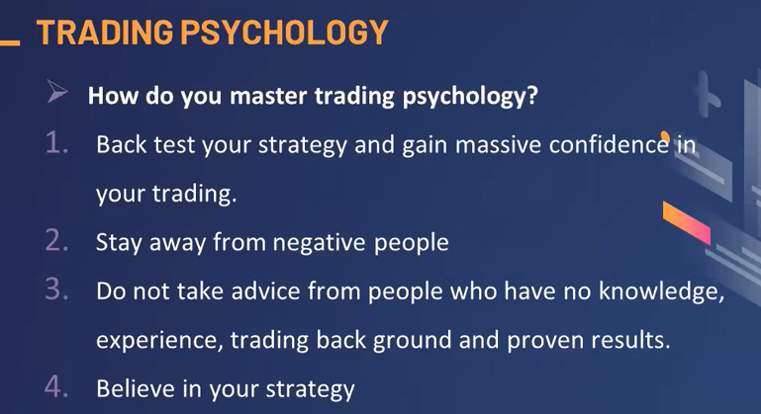

Slide 5
