Slide 1
https://www.youtube.com/watch?v=Ct66TkpNrIk
Live Trading Course Class 1 || FREE || IR TRADEx

Slide 2
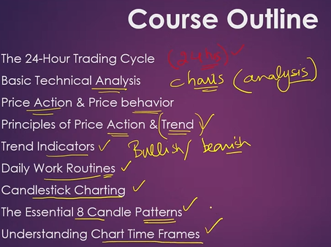

Slide 3
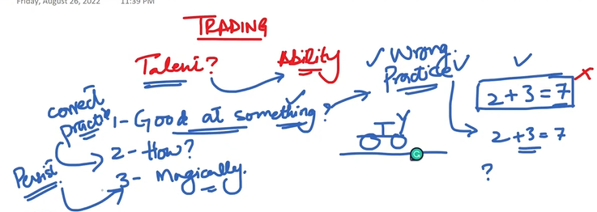
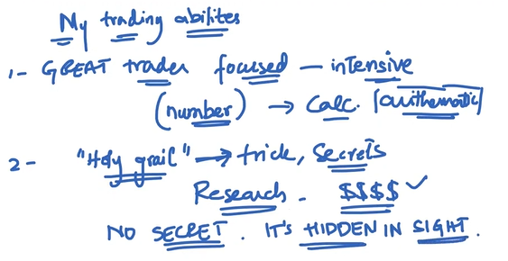
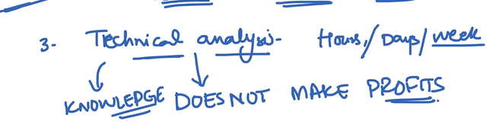

Slide 4
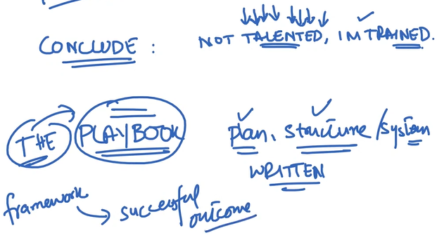
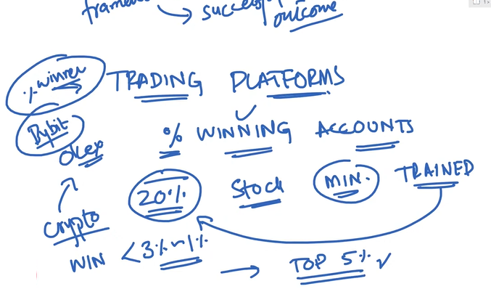

Slide 5
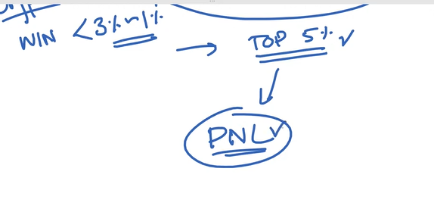
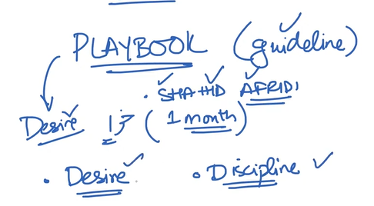
TRADING PNL

Slide 6
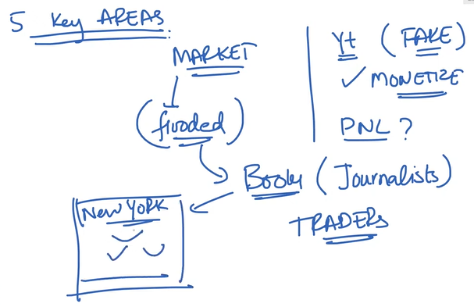

Slide 7
POST ONLY ORDER

Slide 8
STOP MARKET ORDER

Slide 9
STOP LIMIT ORDER

Slide 10
TWAP

Slide 11
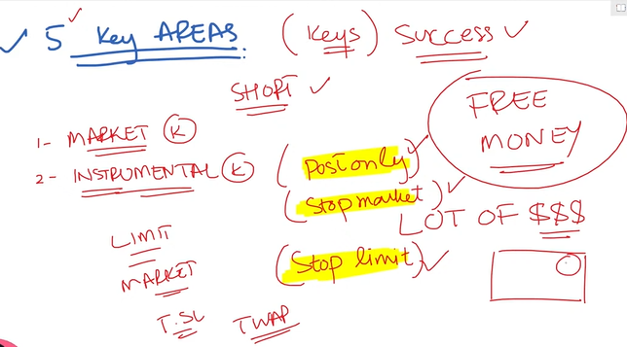

Slide 12
CME MARKEET

Slide 13
BTC1!

Slide 14
FOMC

Slide 15
FUNDING RATES

Slide 16
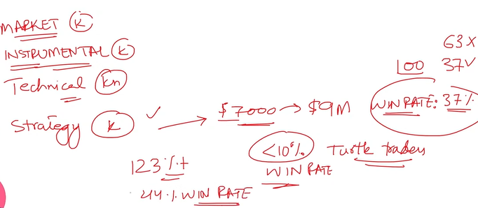
TURTLE TRADERS

Slide 17
