Slide 1
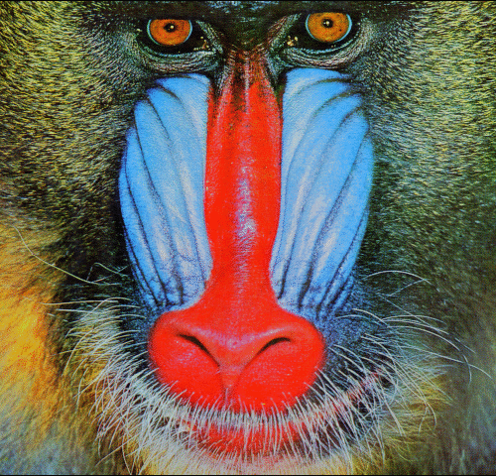

Inter-polation
(a) SRCNN
Inter-polation
(b) VDSR
Inter-polation
(c) DRCN

Slide 2
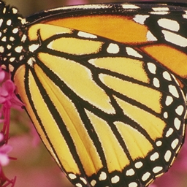
LR Input
HR Output
SEB
UBB
SFEB
SEB
SCB
CUB
Shallow feature extraction block
Split-concatenation block
Element-wise sum
Concatenate layer
3x3 CNN Layer
Squeeze-and-excitation block
Capsule unit block
Transpose
Convolution
LReLU
Upper branch block

Slide 3










$$s_{G}$$
$$x_{LR}$$
$$f(x)$$
$$x_{LR}$$
$$f(x)$$
$${r(x}_{LR})$$
$$x_{LR}$$
$$x_{0}$$
$$f(x)$$
ReLU
Conv C₁
ReLU
LReLU
Conv C₁
Conv C₂
Conv C₁
Conv C₂
$$s_{L}$$
(a)
(b)
(c)

Slide 4
Concatenate
Expand
Stage
Conv 1 × 1
Concatenate
Conv 3 × 3
Squeeze
Stage
Previous Layer

Slide 5
Concatenate
Expand
Stage
Conv 1 × 1
Concatenate
Conv 3 × 3
Squeeze
Stage
Previous Layer

Slide 6
Conv
3 × 3
BN
ReLU
Conv
3 × 3
BN
(a) SRResNet
Conv
3 × 3
ReLU
Conv
3 × 3
(b) EDSR
Conv
3 × 3
LReLU
LReLU
Conv
3 × 3
LReLU
Conv
5 × 5
LReLU
(c) Proposed SCB

Slide 7
Conv
1 × 1
LReLU
Concatenate
Conv
3 x 3

Slide 8
Conv
3 x 3
LReLU
Conv
3 x 3
LReLU
Conv
3 x 3
LReLU

Slide 9
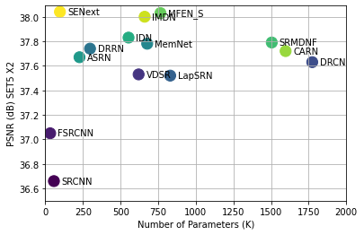

Slide 10
3 × 3 Conv
LReLU
Upper Branch Block (UBB)

Slide 11
Concate
I/P
C
M6
C
M7
C
M8
C
M9
C
M
10
Upper
C
R
M5
M5 = SFEB

Slide 12
I/P
I/P
3×3 Conv
3×3 Conv
Feature
SFEB (Ours)
SRFRN

Slide 13
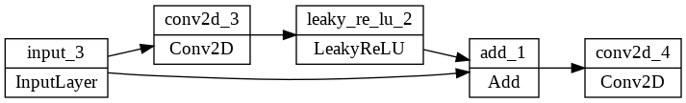
I/P
CAB (Ours)

Slide 14
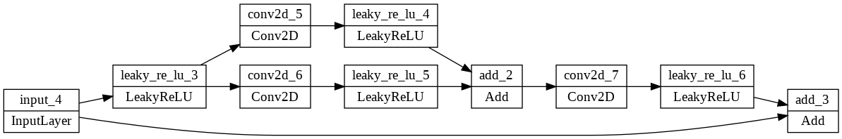
I/P
SCUB

Slide 15
LReLU
Conv 3 x 3
Conv 3 x 3
Conv 5 x5
BN
Conv 3 x 3
LReLU
LReLU
ReLU
ReLU
Conv 3 x 3
Conv 3 x 3
Conv 3 x 3
BN
LReLU
(a) SRResNet (b) EDSR (c) Proposed SCB

Slide 16
Conv 3 × 3
BN
ReLU
Conv 3 × 3
BN

Slide 17
Conv
1×1
Conv
1 × 1
LReLU
Concatenate
Conv 3 x 3
LReLU
Concat
3×3 Conv
LReLU

Slide 18
Conv2D
PReLU
Dense Block

Slide 19
