Slide 1
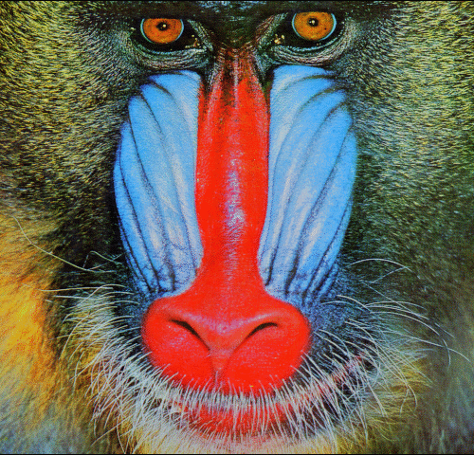

Inter-polation
(a) SRCNN
Inter-polation
(b) VDSR
Inter-polation
(c) DRCN

Slide 2
Inter-polation

Slide 3
Inter-polation

Slide 4
Inter-polation

Slide 5


$$x_{LR}$$
$$f(x)$$
ReLU
Conv C₁

Slide 6










$$s_{G}$$
$$x_{LR}$$
$$f(x)$$
$$x_{LR}$$
$$f(x)$$
$${r(x}_{LR})$$
$$x_{LR}$$
$$x_{0}$$
$$f(x)$$
ReLU
Conv C₁
ReLU
LReLU
Conv C₁
Conv C₂
Conv C₁
Conv C₂
$$s_{L}$$
(a)
(b)
(c)

Slide 7
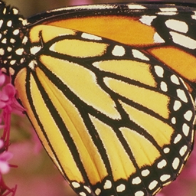
Sub-Pixel
FEB
SEB
SEB
CAB
SCUB
LR Input
SR Output
SCUB = Split-concatenation-Block
FEB = Feature Extraction Block
Bottleneck Layer
3x3 CNN Layer
SEB = Squeeze-and-Excitation Block
CAB = Capsule unit block
Sub-pixel Layer

Slide 8
LR Input
HR Output
SEB
UBB
SFEB
SEB
SCB
CUB
SFEB = Shallow Feature Extraction Block
SCB = Split-concatenation-Block
Element-wise sum
Concatenate
Layer
3x3 CNN Layer
SEB = Squeeze-and-Excitation Block
CUB = Capsule unit block
Transpose
Convolution
LReLU
UBB = Upper Branch Block

Slide 9
3 × 3 Conv
LReLU
Upper Branch Block (UBB)

Slide 10
Concate
I/P
C
M6
C
M7
C
M8
C
M9
C
M
10
Upper
C
R
M5
M5 = SFEB

Slide 11
I/P
I/P
3×3 Conv
3×3 Conv
Feature
SFEB (Ours)
SRFRN

Slide 12
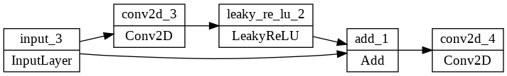
I/P
CAB (Ours)

Slide 13
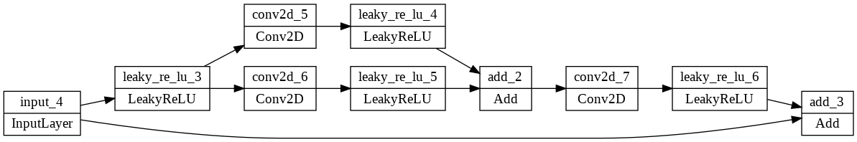
I/P
SCUB

Slide 14
Concatenate
Expand
Stage
Concatenate
Squeeze
Stage
Previous Layer

Slide 15
Concatenate
Expand
Stage
Concatenate
Squeeze
Stage
Previous Layer

Slide 16
Concatenate
Expand
Stage
Concatenate
Squeeze
Stage
Previous Layer
Proposed Fire Block (DWCF Fire Module) Depthwise separable Convolutional Fire Module)

Slide 17
LReLU
Conv 3 x 3
Conv 3 x 3
Conv 5 x5
Conv 3 x 3
LReLU
LReLU
BN
ReLU
ReLU
Conv 3 x 3
Conv 3 x 3
Conv 3 x 3
BN
LReLU
(a) SRResNet (b) EDSR (c) Our Proposed split-concatenation block (SCB)

Slide 18
3x3 Conv
1x1 Conv
LReLU
Concat

Slide 19
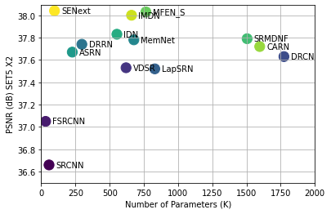

Slide 20
Conv2D
PReLU
Dense Block

Slide 21
