Slide 1


Department of ICT
A project 1 proposal defense on:
“GROCEREASE”
Project Members:
Aayush Karki 200101
Anish Bista 200105
Pragya Pokhrel 200123
Rabin Mishra 200128
Date : 19th May, 2023
Submitted to:
Department of ICT Cosmos College of
Management and Technology
Department of ICT, Cosmos College of Management and Technology
1

Slide 2
Outline:
Background Of Study
Problem Statement
Objectives
Literature Review
Significance Of Project
Methodology
Results
Working Schedule
Conclusions
References
‹#›

Slide 3
Background Of Study
Ecommerce represents a sophisticated digital ecosystem that enables businesses to conduct commercial activities online.
An ecommerce based grocery store is a go-to destination for hassle-free online grocery shopping.
An ecommerce model works on different types as : 1.Business to Business(B2B)
2.Business to Consumer(B2C) 3.Consumer to Consumer(C2C) 4.Consumer to Business(C2B) 5.Peer to Peer(P2P) 6.Subscription-Model
The transactional relationship between consumer and business can be of forms like retail ,wholesale, crowdfunded and drop shipping etc.
‹#›

Slide 4
Problem Statement
As we know that there are lot of challenges and limitations of existing E-commerce Grocery Platforms as mentioned below:
Limited Product Range
False Product Information
Difficulty in Freshness
Complex Ordering Process
Customer Service and Issue Resolution
Addressing all of these major limitations is crucial to improve overall experience of user and competition of e-commerce grocery platform. Our team is aiming to overcome all of these limitation.
‹#›

Slide 5
Objective
With Grocerease, we offer an intelligent solution that combines
the convenience of e-commerce with the necessity of grocery shopping.
The major objectives of our platform are:
To eliminate the physical queues and checkout wait times.
To provide a data driven insights for business optimization.
Provide fresh and hygienic products to customers.
Provide retail and wholesale option for customers to buy
products at different prices.
Provide easy and convenient platform for customers to purchase grocery products online.
‹#›

Slide 6
Literature Review
E-commerce which stands for Electronic commerce is the buying and selling of goods through internet using electronic method.
In 1998, after the definition of E-commerce by WTO, It has revolutionized the ecommerce industry.
Existing literature review emphasize the pros of the e-commerce grocery platforms including accessibility, time saving and wide range of product selection.
Study have proved that e-commerce grocery platform can offer fresh and high quality items at competitive price.
Analysis have highlighted things like bulk purchasing, direct import from the local farmers are key factors that helps to set the lowest price for the grocery items.
Department of ICT, Cosmos College of Management and Technology
7

Slide 7
Literature Review
UI and UX is important factor the user convenience that helps the customer for easy navigation and faster accessing of the required items.
Efficient and reliable logistic service is the important parts and studies have highlighted that integration with the local delivery partner plays key role in it.
After all of these, there remains several challenges like maintain the quality of items long lasting, ensuring food safety and hygiene
Future research and study needs to be done making things advanced like real time tracking system, innovative packing system for long sustaining of items.
Overall e-commerce grocery platform plays significant role , providing consumer an easy and convenient way of purchasing items from the comfort of their space while posing traditional grocery store to remain competitive in this digital era.
Department of ICT, Cosmos College of Management and Technology
8

Slide 8
Significance Of Project
★ Eliminates physical queues and checkout wait times.
★ Provides data-driven insights for business optimization.
★ Helps to save time and cost for customers by providing personalized shopping experience.
★ Provides opportunity for reliable delivery with efficient order tracking and delivery updates.
★ Ensures the convenience of customers by providing 24/7 availability of the products

Slide 9
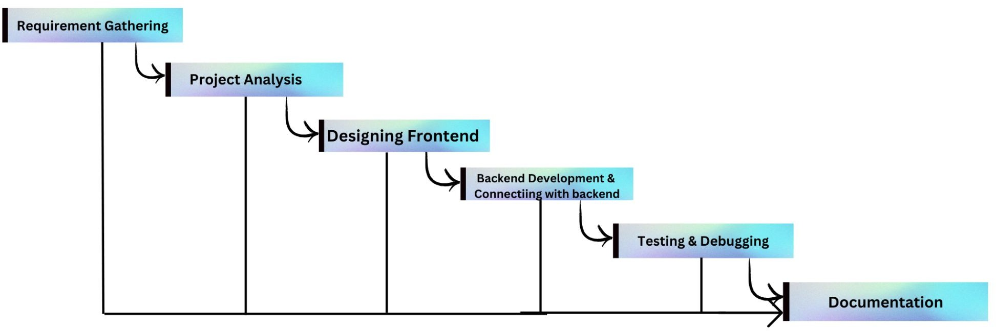
Methodology:
Software Process Model:

Slide 10
Technology and software used
HTML, CSS & JavaScript for the development of the frontend system.
PHP for the backend scripting.
MySql database for the database work.
Git and Github as a version control system and maintain the code.
Visual Studio Code, Webstorm, Sublime text editor as the development software for the Coding and development work.
Xammp as the local server to test the project in the local host.
Google docs to prepare the documentation of the project.
Department of ICT, Cosmos College of Management and Technology

Slide 11
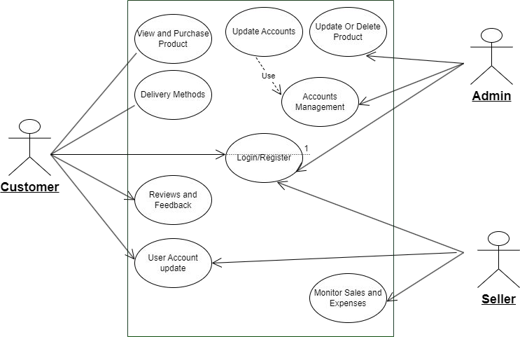
Methodology Contd….
Use Case Diagram:

Slide 12
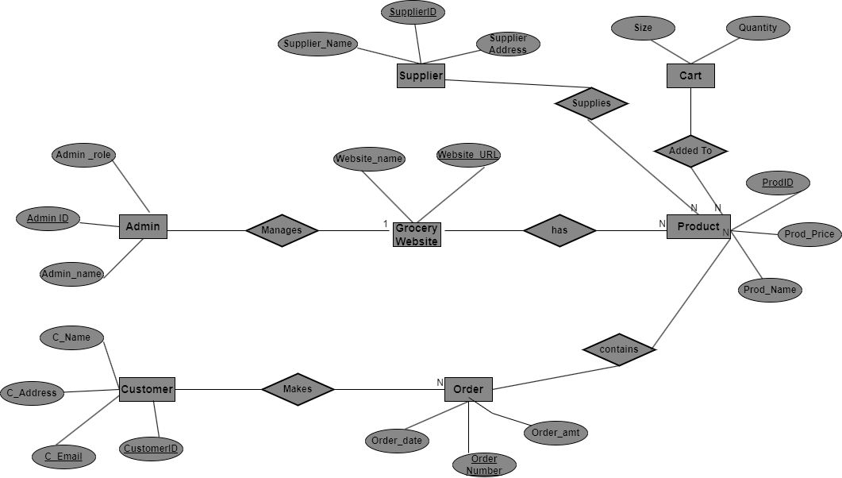
Methodology Contd….
ER Diagram

Slide 13
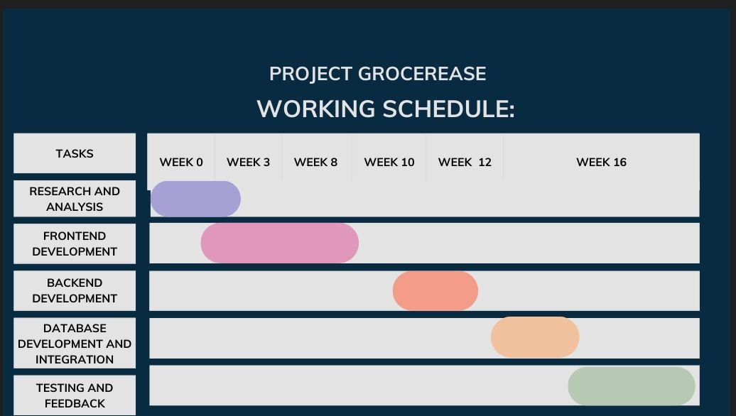
Time Schedule

Slide 14
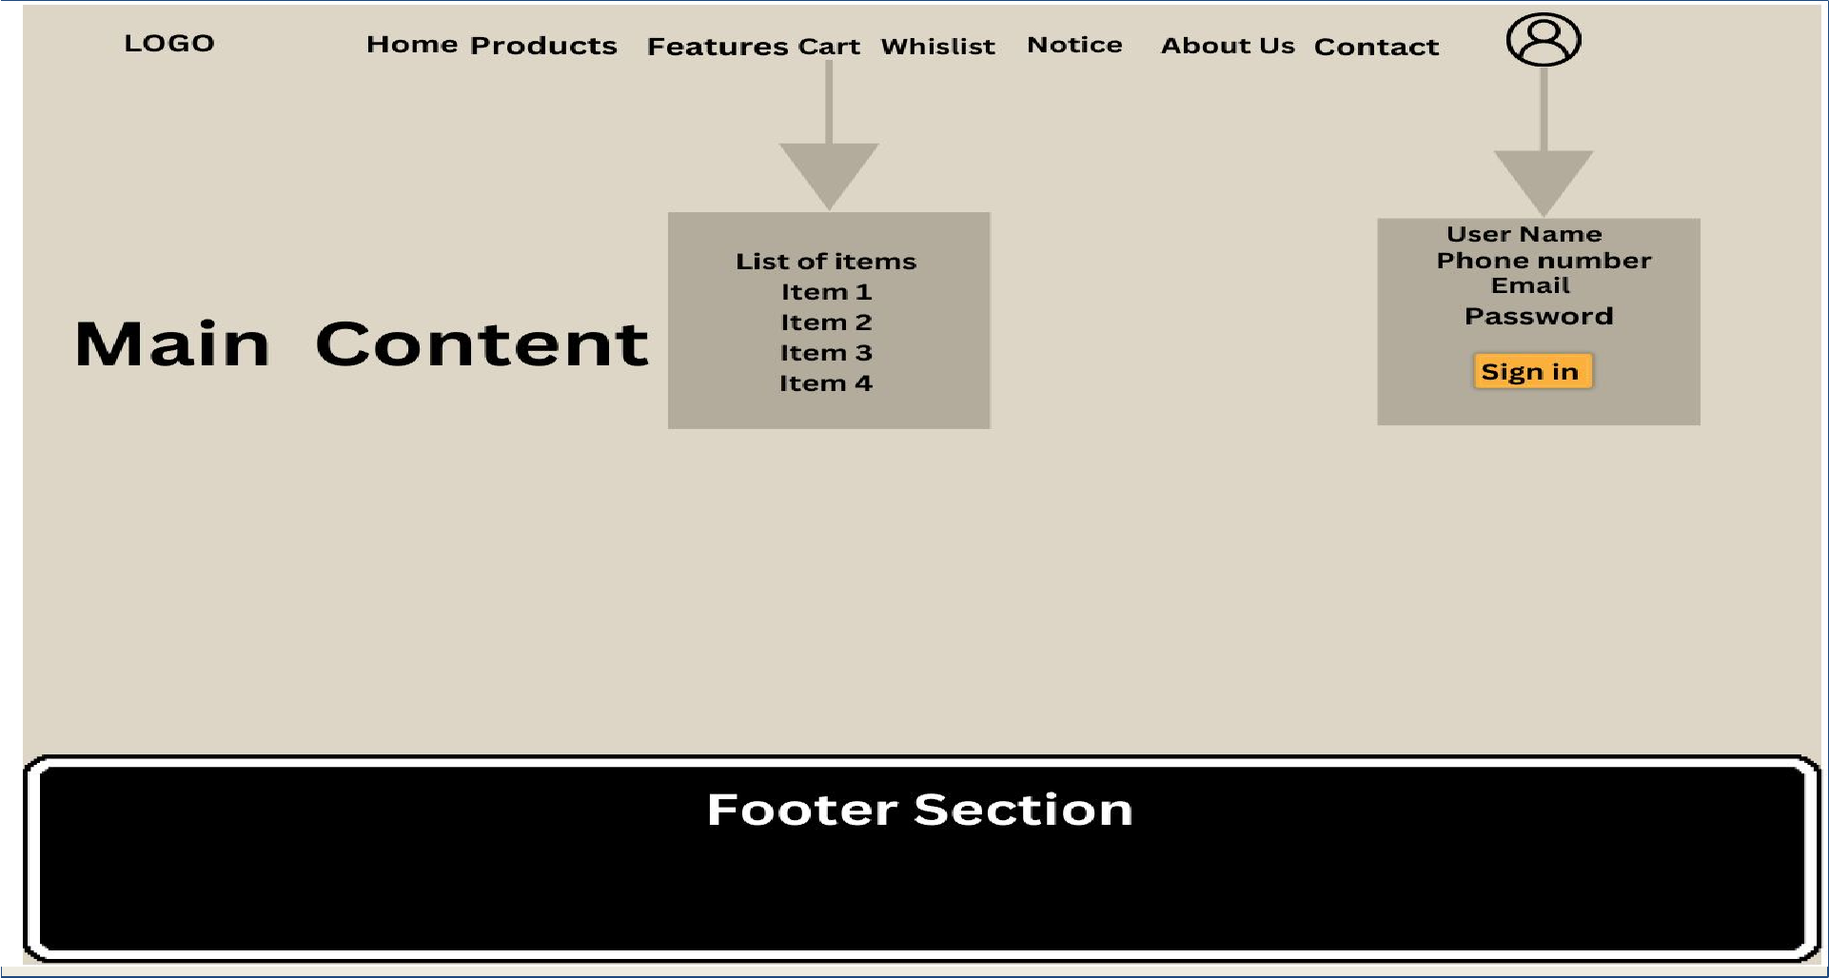
Expected Output

Slide 15
Conclusions
Thus in conclusion an ecommerce based grocery store will ensure the following points on completion of project:
Removes the traditional concept of grocery shopping and provides more of a seamless and hassle free quality shopping experience from home.
Eradicates the concept of physical queues and checkout wait times.
Offer customers to choose from the vendor whose products are the qualitative,quantitative and financially approachable.
Provides both the wholesale and retail options under the same proprietary technology with the flexibility in the method of delivery.
Increases the amount of sale and provides customers an opportunity to grasp items at its best quality.

Slide 16
References
Moses, Sharon J., and LD Dhinesh Babu. "Buyagain grocery recommender algorithm for online shopping of grocery and gourmet foods." International Journal of Web Services Research (IJWSR) 15.3 (2018): 1-17.
Walker, Brian K. "Trends 2010: eCommerce Platform And Technology." (2010).
Martín, Juan Carlos, Francesca Pagliara, and Concepción Román. "The research topics on e-grocery: Trends and existing gaps." Sustainability 11.2 (2019): 321.
Department of ICT, Cosmos College of Management and Technology
16

Slide 17
Thank You!
Department of ICT, Cosmos College of Management and Technology
17

