Slide 1
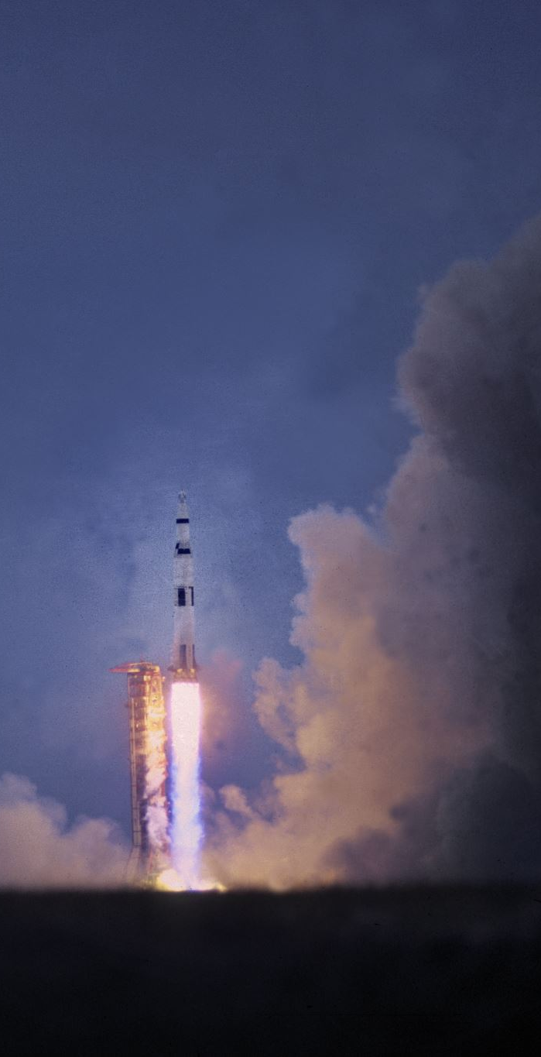
🚀 Project Presentation
Project Name: Cinematic Rocket Journey in Manim
For: Imran’s Lab
Tools: Python, Manim, Virtual Environment

Slide 2
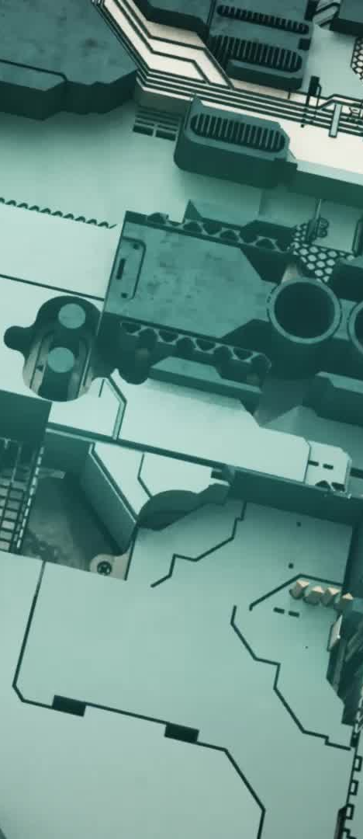
Project Overview
Purpose: Create a cinematic rocket journey animation
Technology: Manim (Mathematical Animation Engine)
Structure: Intro scene, main rocket journey, outro scene
Output: Single MP4 video

Slide 3
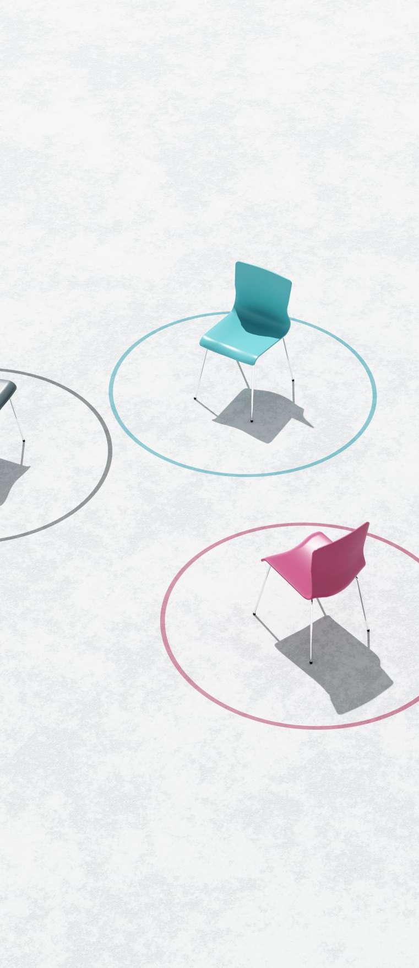
Folder Structure
main.py → Master controller (calls all scenes)
scenes/: intro.py, main_scenes.py, outro.py
assets/ → Logo & images
venv/ → Virtual environment with Manim installed

Slide 4

Intro Scene
Background with gradient + starfield
Animated logo with glow effect
Title: Imran’s Lab Presents
Tagline: Cinematic Rocket in Manim
Professional entry animation

Slide 5
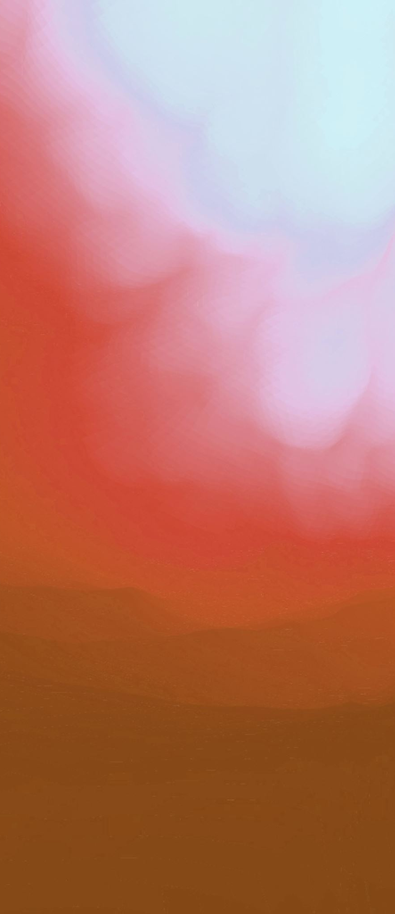
Rocket Journey
Scene 1: Launch → Rocket flame + vibration, smooth upward liftoff
Scene 2: Orbit → Rocket stabilizes into space orbit, stars & parallax background
Scene 3: Transfer to Mars → Rocket scales & moves, Mars background with hills and details

Slide 6

Outro Scene
Animated starfield & particles
Company Logo with glowing circle
Text: Thanks for Watching
Branding: Visit imranslab.org
Smooth fade out

Slide 7
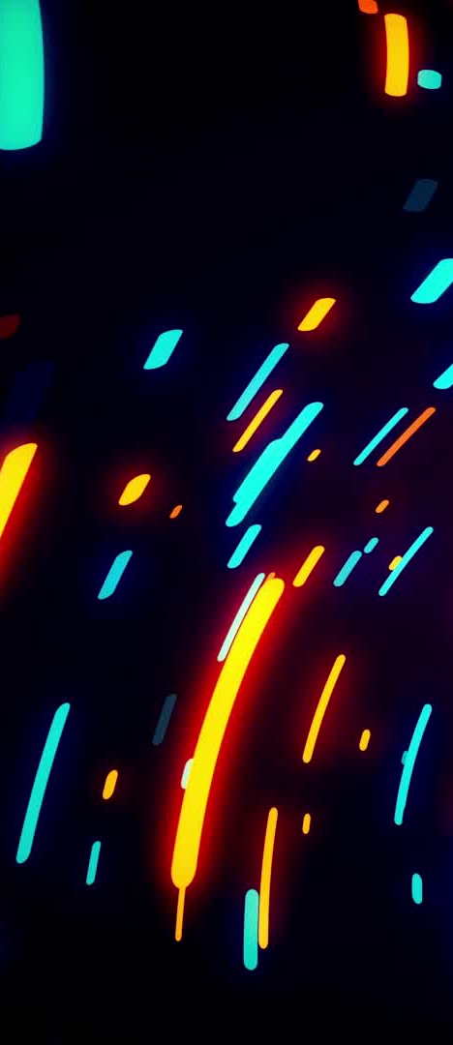
Key Features
Cinematic animations (launch, orbit, transfer)
Dynamic backgrounds (parallax, particles, glow effects)
Professional branding (intro & outro sequences)
Reusable modular scenes (intro, main, outro separated)

Slide 8
Technical Setup
Python Virtual Environment (venv)
Manim library for 2D/3D animation
Assets: logo.png
Output: Combined MP4 video

Slide 9

Challenges & Solutions
Realistic rocket design → Custom rocket shape
Flame & vibration effects → Updaters in Manim
Smooth scene transitions → Timed animations
Professional polish → Glow, gradient, parallax

Slide 10
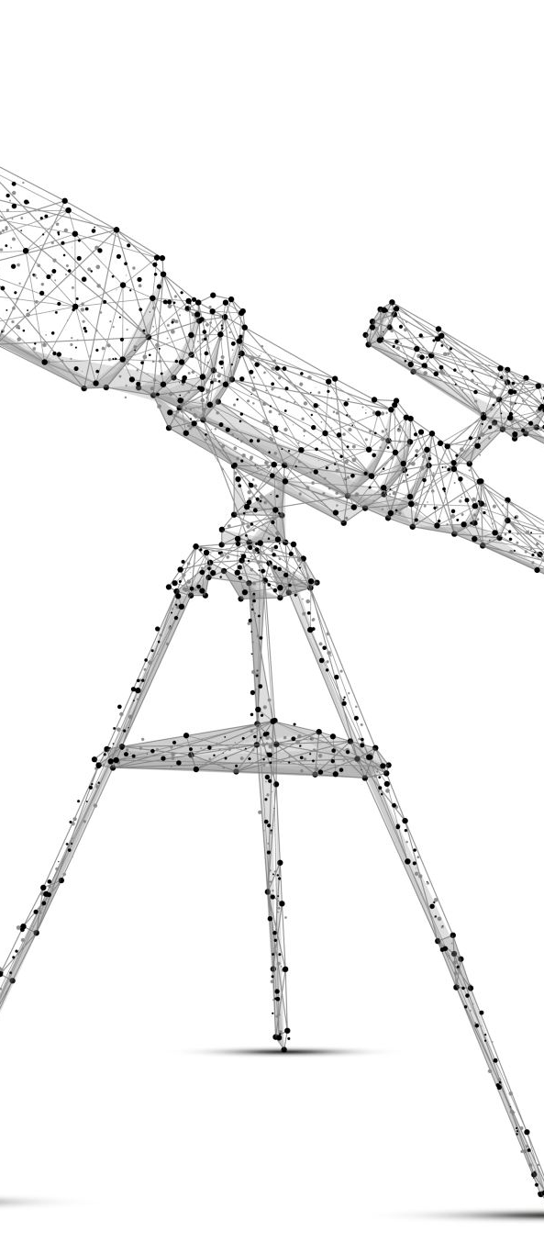
Future Improvements
Camera tracking rocket dynamically
More realistic space objects (planets, stars, asteroids)
Sound effects & background music
Longer cinematic storytelling

Slide 11
Conclusion
Achieved: A full cinematic rocket journey animation
Tech Used: Python, Manim
Professional, branded video output
Flexible structure for future projects

