Slide 1
Medical Image Analysis Lab 2020
Final Presentation
Image normalization has an important influence on the segmentation performance
Thomas Buchegger, Carolina Duran, Stefan Weber
14. December 2020

Slide 2
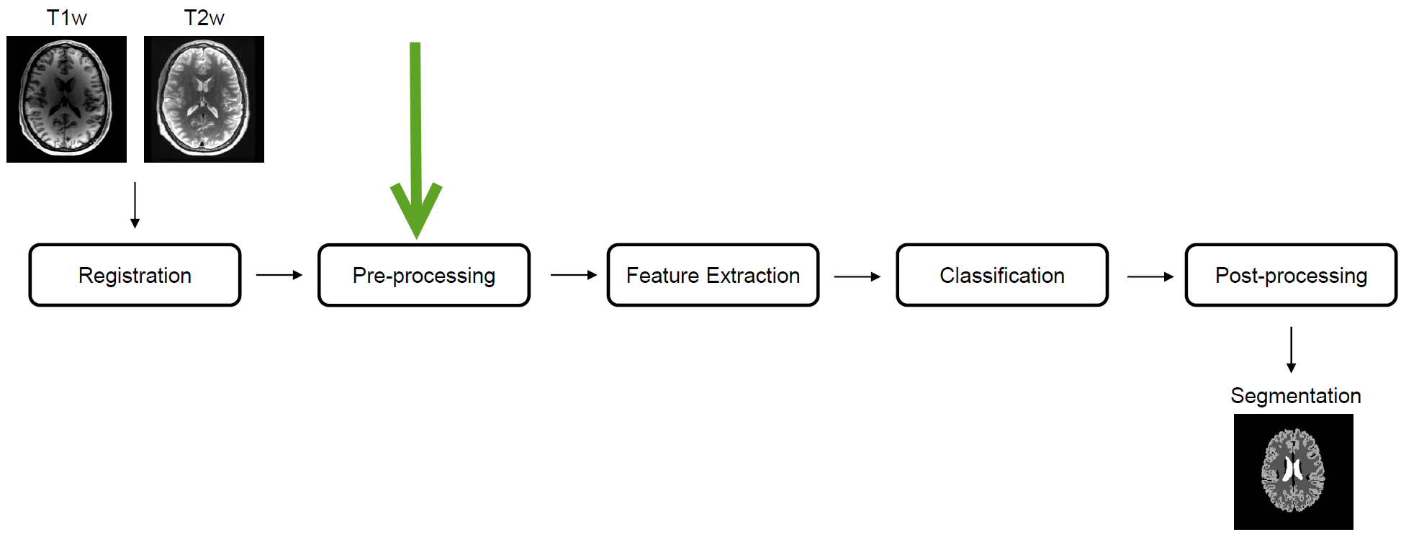
Introduction
MIA Pipeline

Slide 3
Normalizations
Min Max Normalization
Simple Formula
Output Range [0, 1]
Z-Score Normalization
Simple Formula

Slide 4
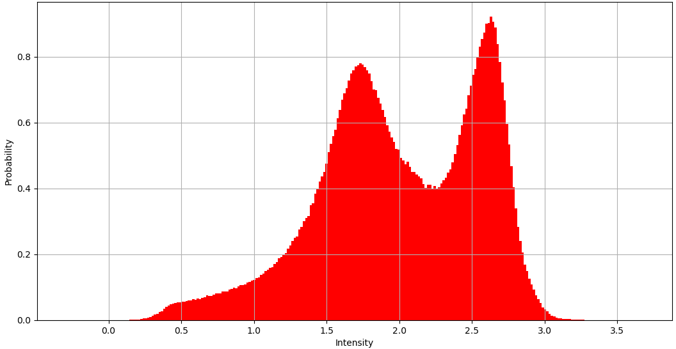

Normalizations
Histogram Z-Score
No Normalization
Z-Score
Z-Score
Min Max g
White Stripe
Gaussian Mixture Model
Fuzzy C-Means

Slide 5
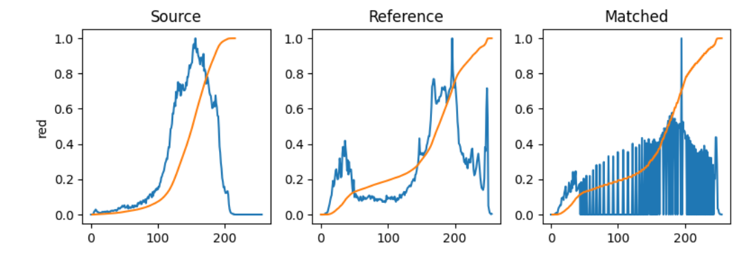
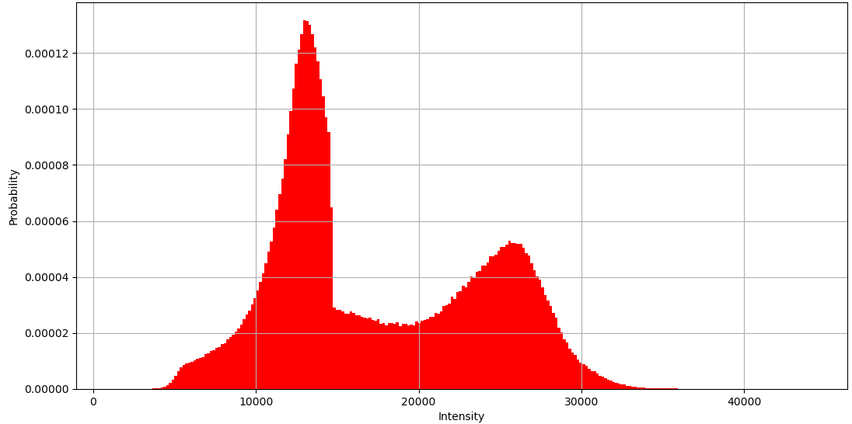
Normalizations
Histogram Matching

Slide 6
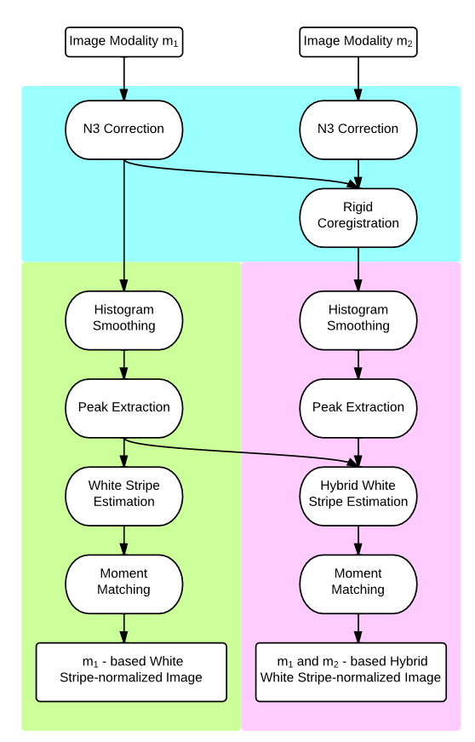

Normalizations
White Stripe
Notes:
WhiteStripe intensity normalization [3] attempts to do a Z-score normalization based on the intensity values of normal appearing white matter (NAWM). The NAWM is found by smoothing the histogram of the image and selecting the largest peak (for T1-w images). Let μ be the intensity associated with this peak. The “white stripe” is then defined as the 10% segment of intensity values around μ. That is, let F(x) be the cdf of the specific MR image I(x) inside its brain mask B, and define τ=5%. Then, the white stripe Ωτ is defined as the set

Slide 7
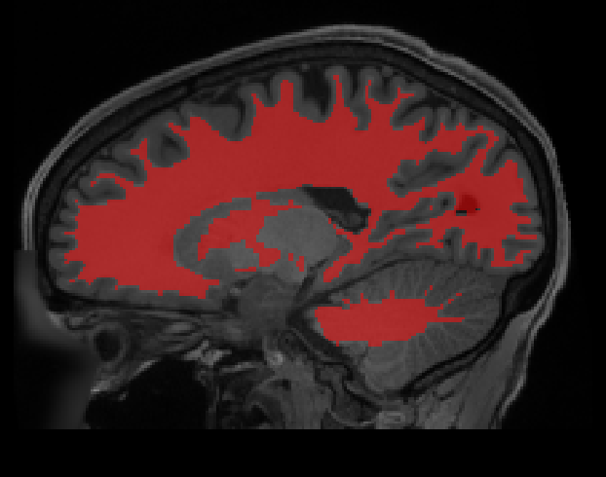
Normalizations
Fuzzy C-Means
Find tissue mask of white matter with fuzzy C-means
Find mean of the found mask
Scale the input
Move found mean to target value
Notes:
Create a tissue mask from that T1w image’s FCM tissue mask. Then we can use that tissue mask as input to the func again, where the tissue mask is used to find an approximate mean of the tissue intensity in another target contrast, and move it to some standard value.

Slide 8
Normalizations
Gaussian Mixture Model
Fits gaussians to the histogram of skull-stripped image and normalize the Withe Matter mean to some standard value

Slide 9
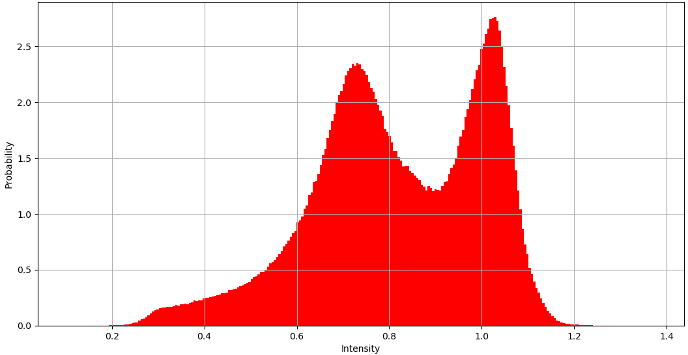


Normalizations
Gaussian Mixture Model
Fuzzy C-Means
No Normalization
Min Max
Z-Score
Histogram Matching
White Stripe
White Stripe
Gaussian Mixture Model
Fuzzy C-Means

Slide 10
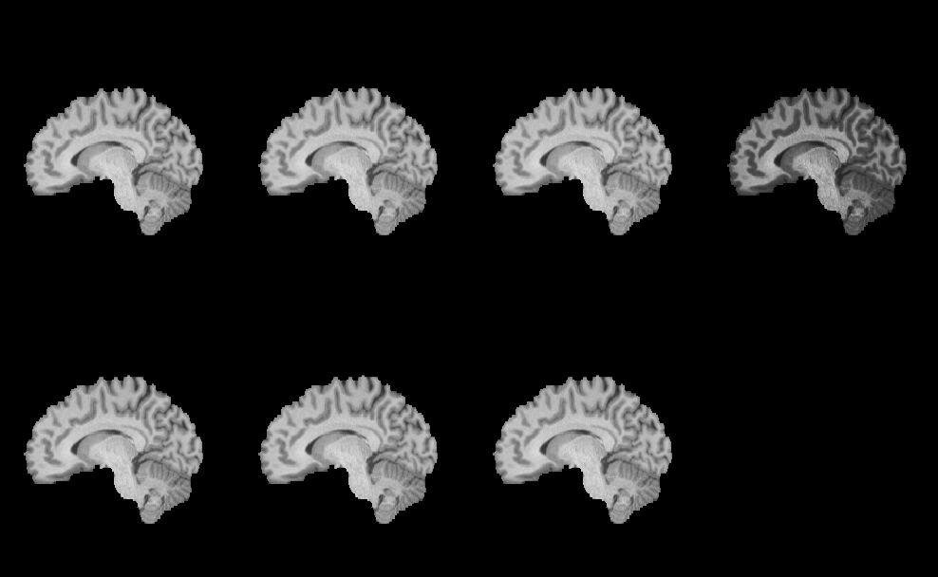
Normalizations
Normalization
No Normalization
Min Max
Z-Score
Histogram Matching
White Stripe
Gaussian Mixture Model
Fuzzy C-Means

Slide 11
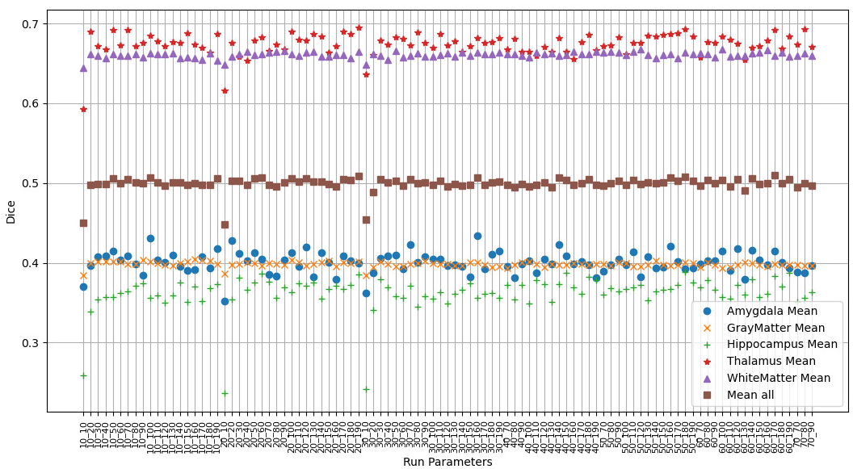
Results
Grid Search

Slide 12
Results
Grid Search

Slide 13
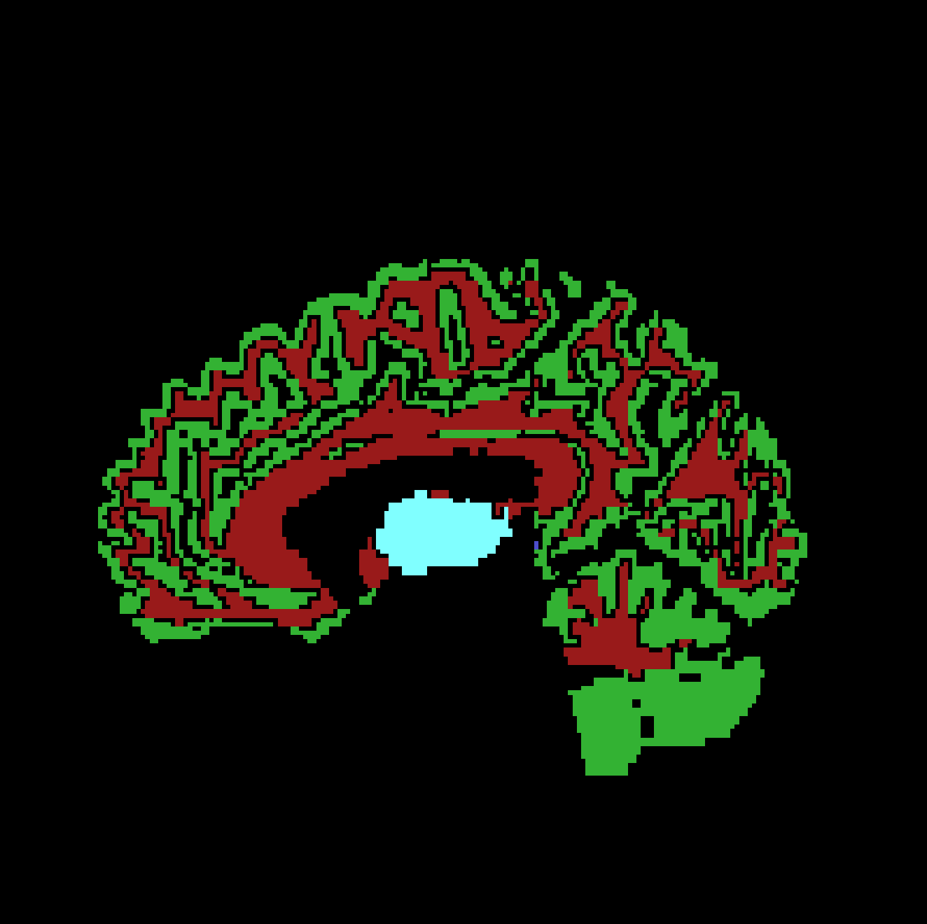
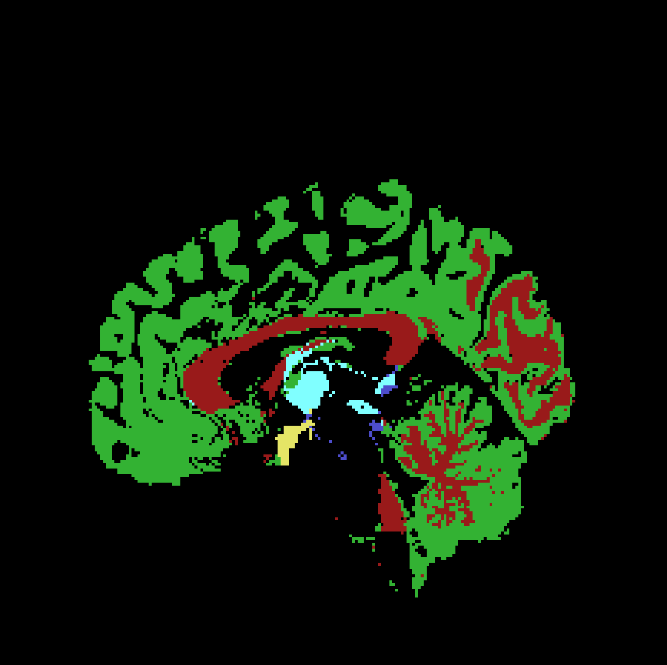
Results
Ground truth vs. no normalization

Slide 14
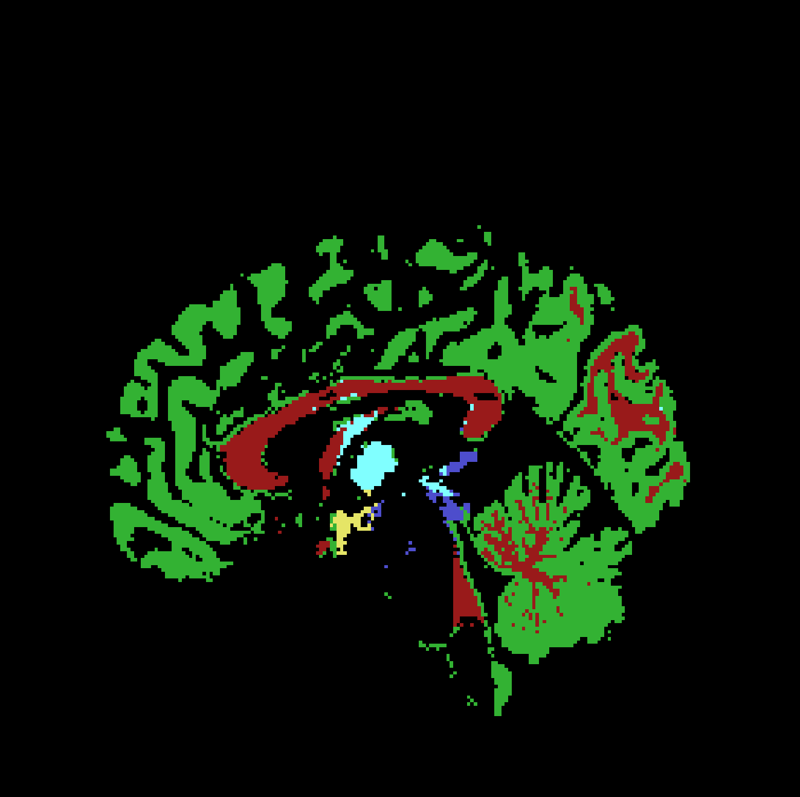
Results
Ground truth vs. FCM

Slide 15

Results
Ground truth vs. GMM

Slide 16
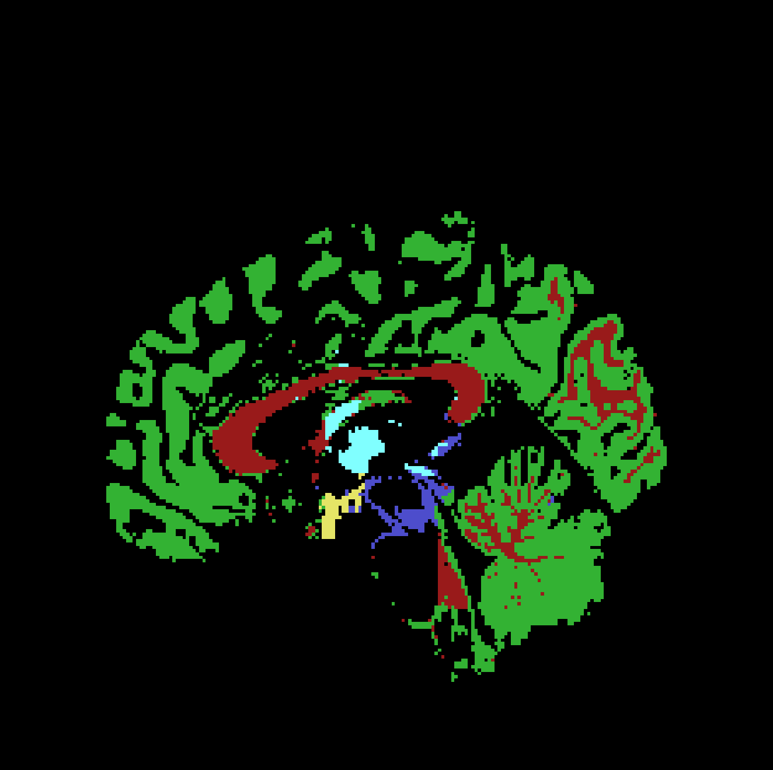
Results
Ground truth vs. Histogram Matching

Slide 17
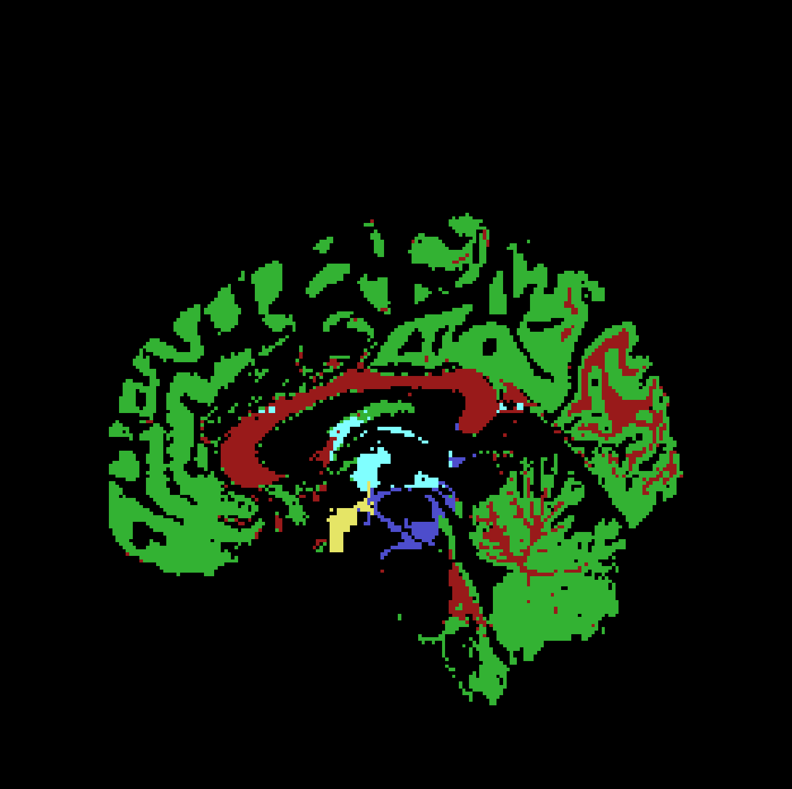
Results
Ground truth vs. MinMax

Slide 18
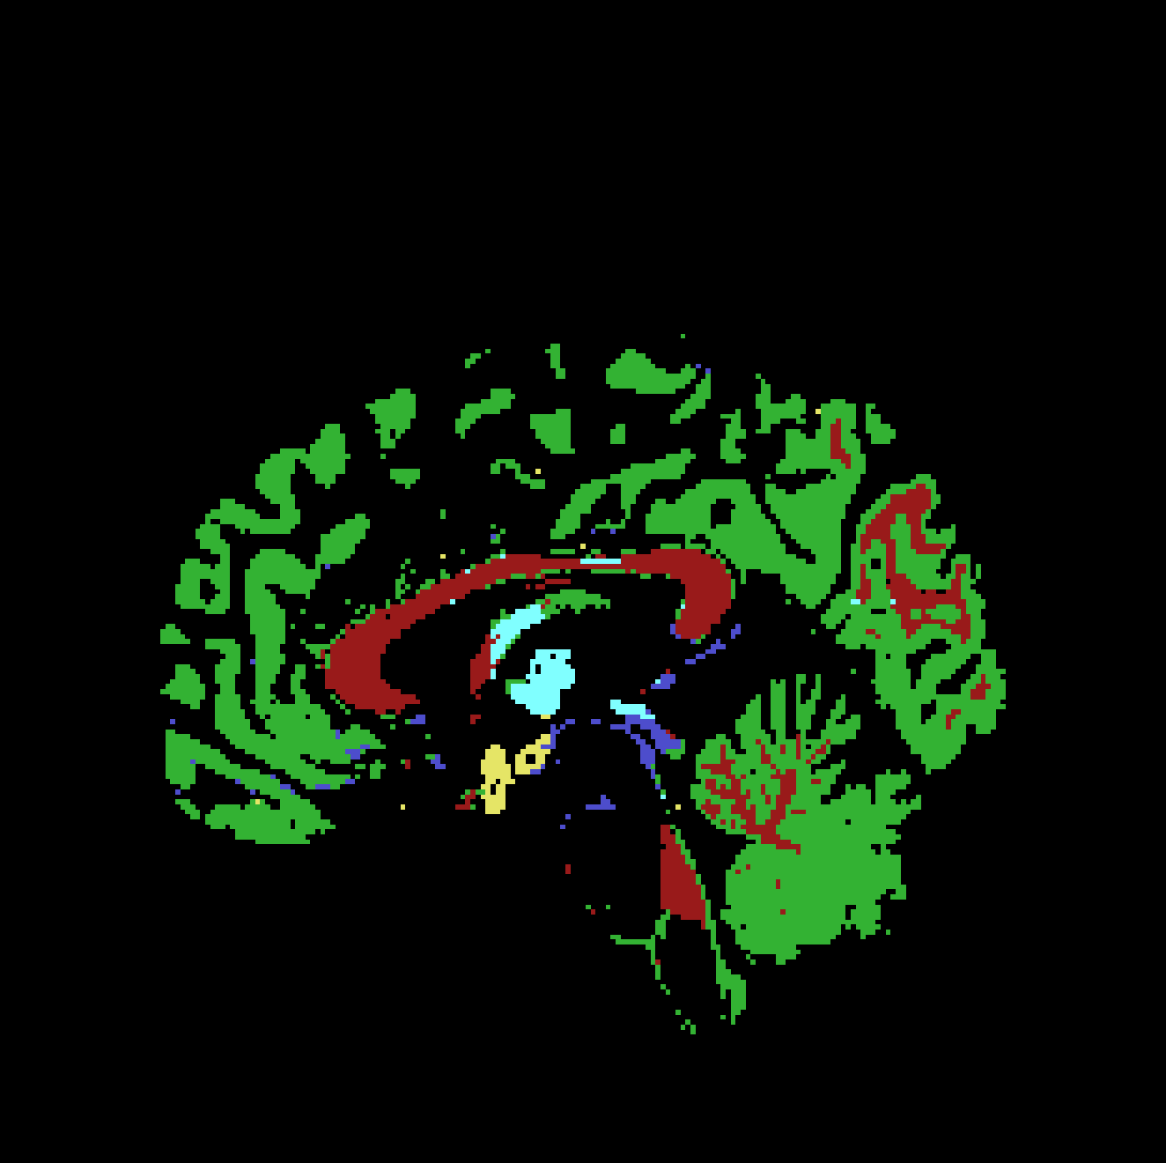
Results
Ground truth vs. Whitestripe

Slide 19
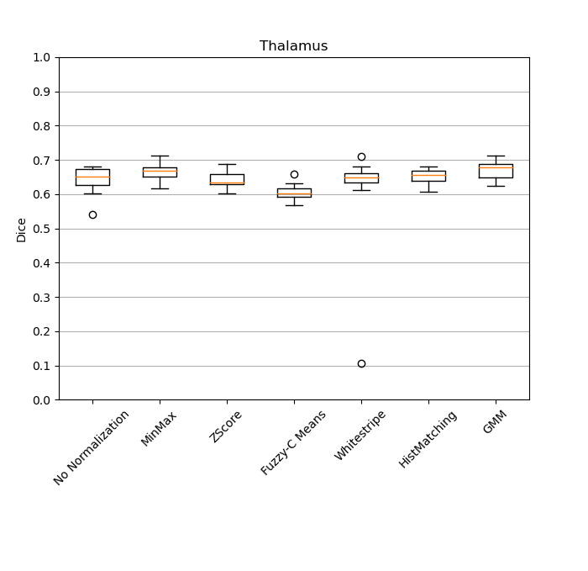
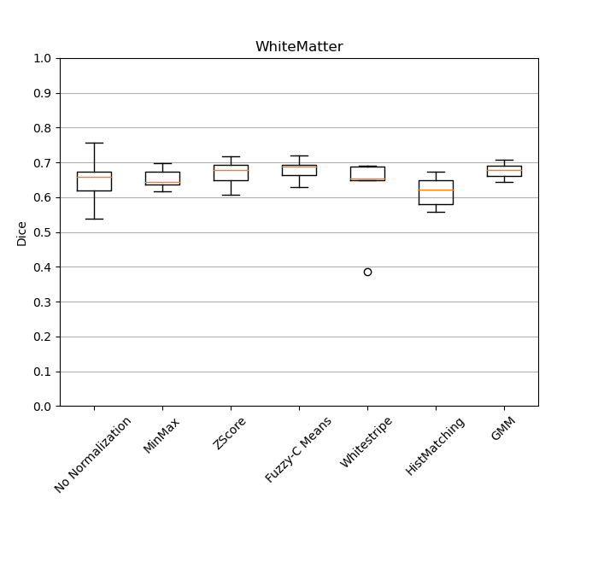
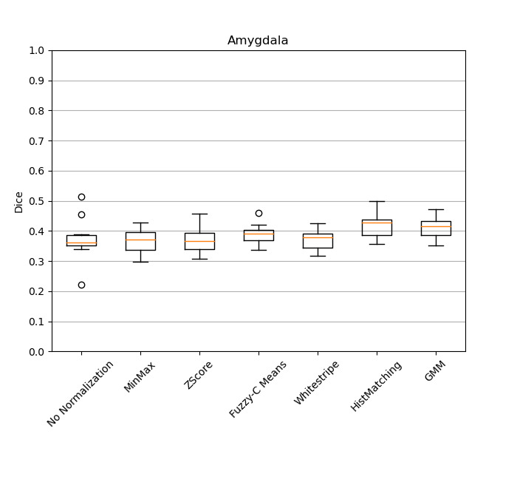
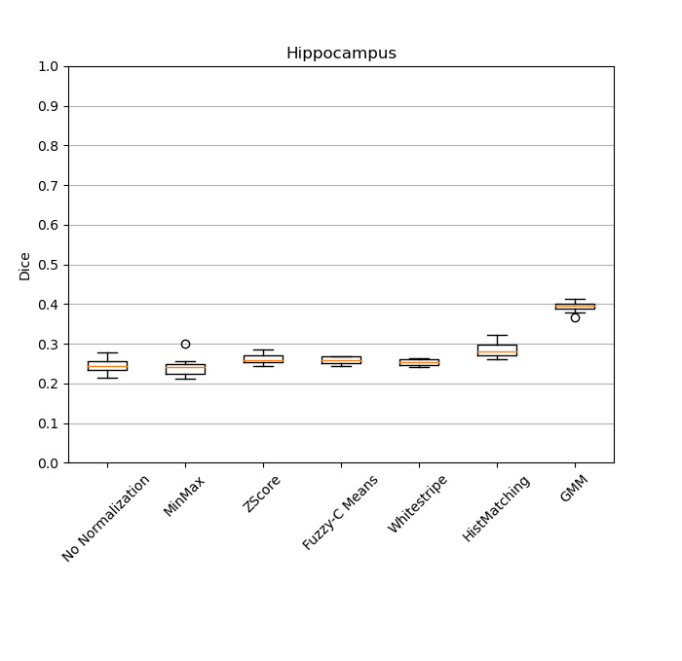
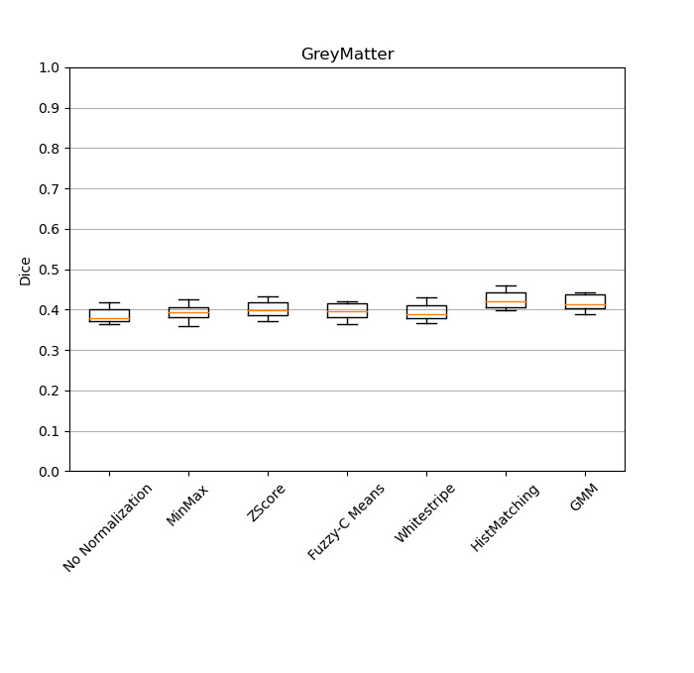
Results

Slide 20
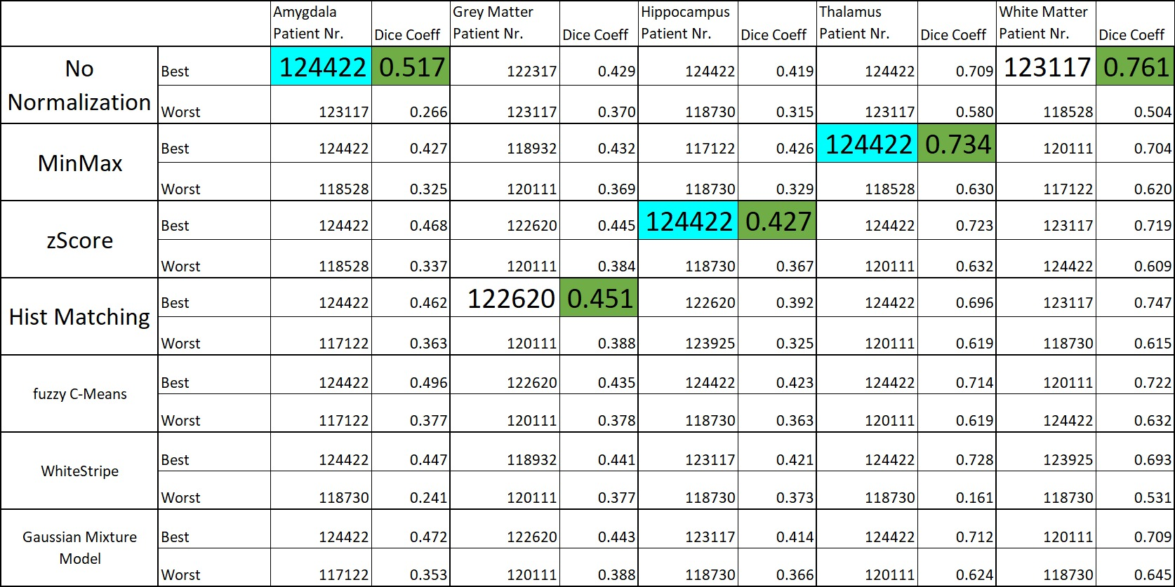
Results

Slide 21
Discussion
«Image normalization has an important influence on the segmentation performance»
Assumption images are already «normalized»
Get better results by combining different preprocessing methods
Change Algorithm

Slide 22

Thank you
for your attention
Thomas Buchegger, Carolina Duran, Stefan Weber
14. Dezember 2020

