Slide 1
Medical Image Analysis Lab 2020
Final Presentation
Image normalization has an important influence on the segmentation performance
Thomas Buchegger, Carolina Duran, Stefan Weber
14. December 2020

Slide 2
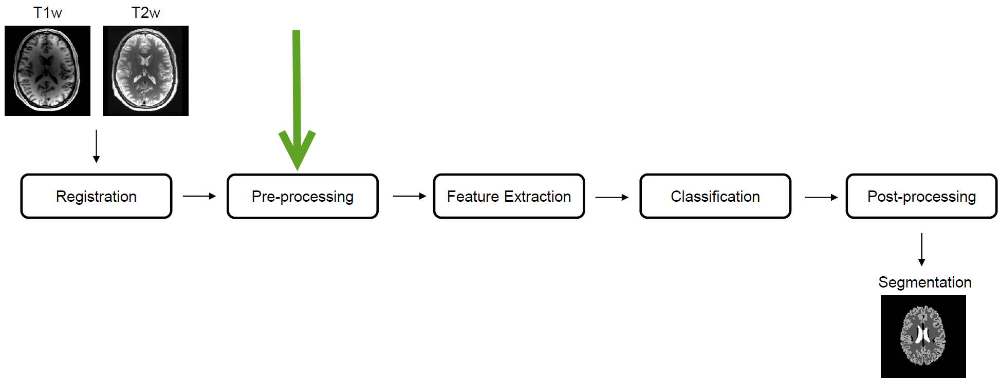
Introduction
MIA Pipeline

Slide 3
Introduction
What is the purpose of normalization?
To improve the image quality for comparison
Normalize image information
Simple and effective
Be careful with bias or confound

Slide 4
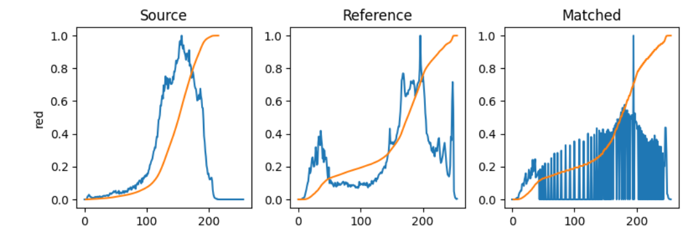
Our Project
Used Normalizations
MinMax
Zscore
Histogram Matching

Slide 5
Our Project
Used Normalizations
Fuzzy C-Means
Use fuzzy c-means to find a mask for a specified tissue type given a T1w image and it’s brain mask. Create a tissue mask from that T1w image’s FCM tissue mask. Then we can use that tissue mask as input to the func again, where the tissue mask is used to find an approximate mean of the tissue intensity in another target contrast, and move it to some standard value
White Stripe
Image Modality m₁
Histogram Smoothing
Peak Extraction
Moment Matching
Normalized Image

Slide 6
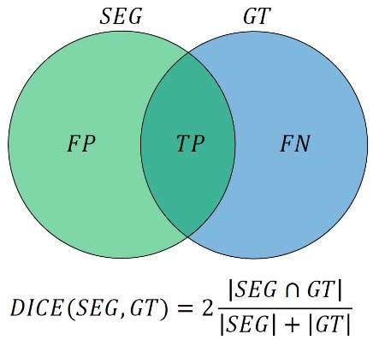
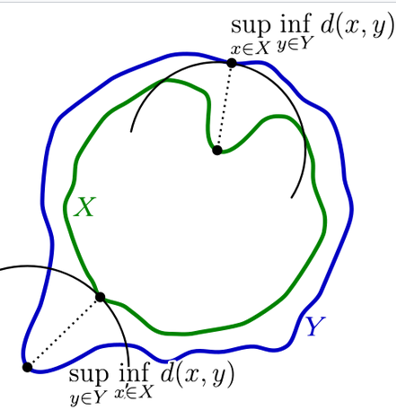
Our Project
Used Metrics
Dice
Hausdorff-Distance

Slide 7
Results
Dice Coefficient

Slide 8
Results
Dice Coefficient Improvement

Slide 9
Results
Hausdorff Distance

Slide 10
Results
Hausdorff Distance Improvement

Slide 11
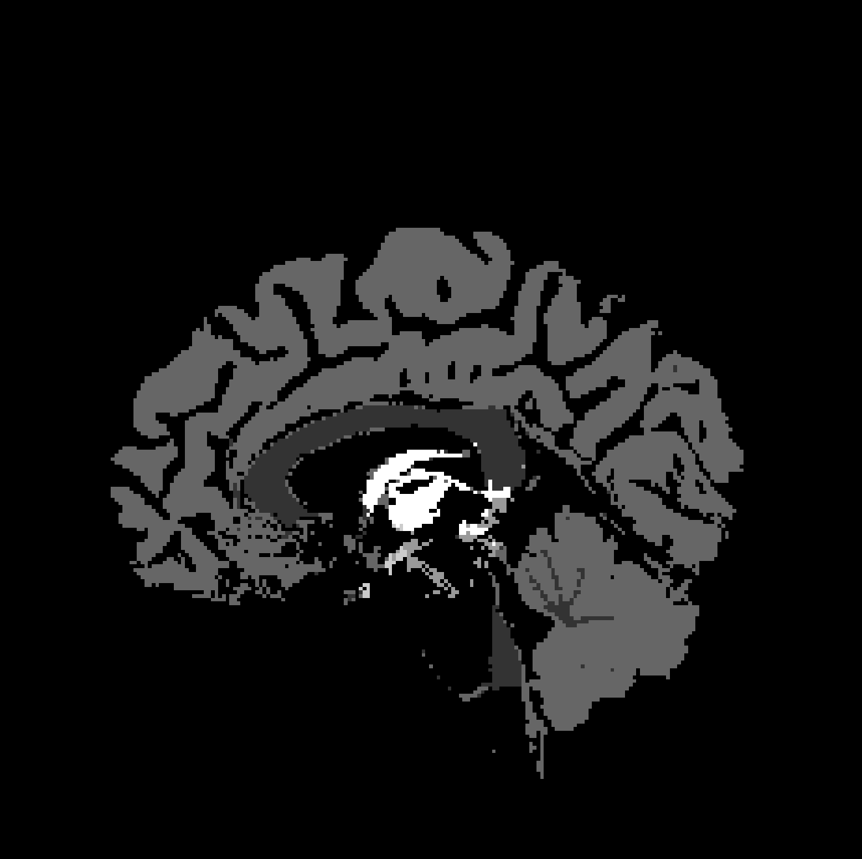
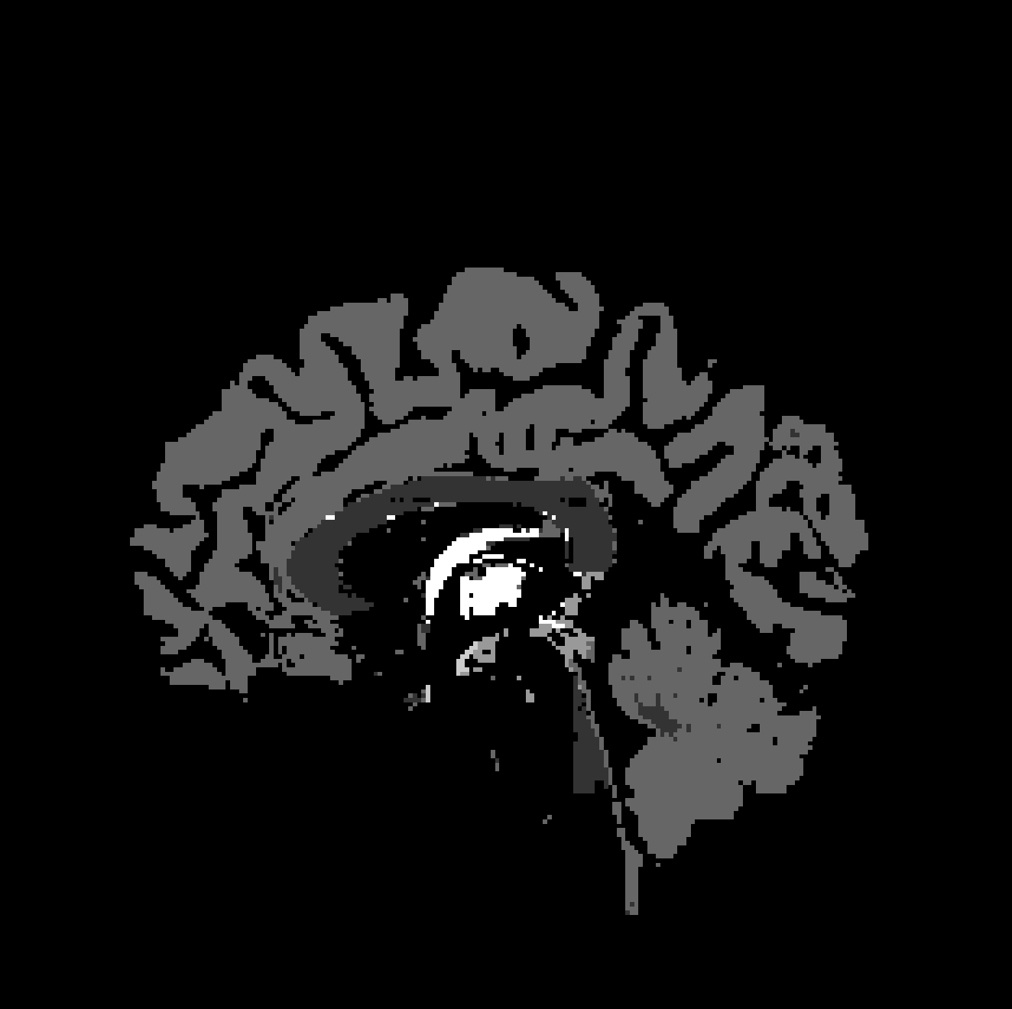
Results
No Normalization vs. FCM

Slide 12
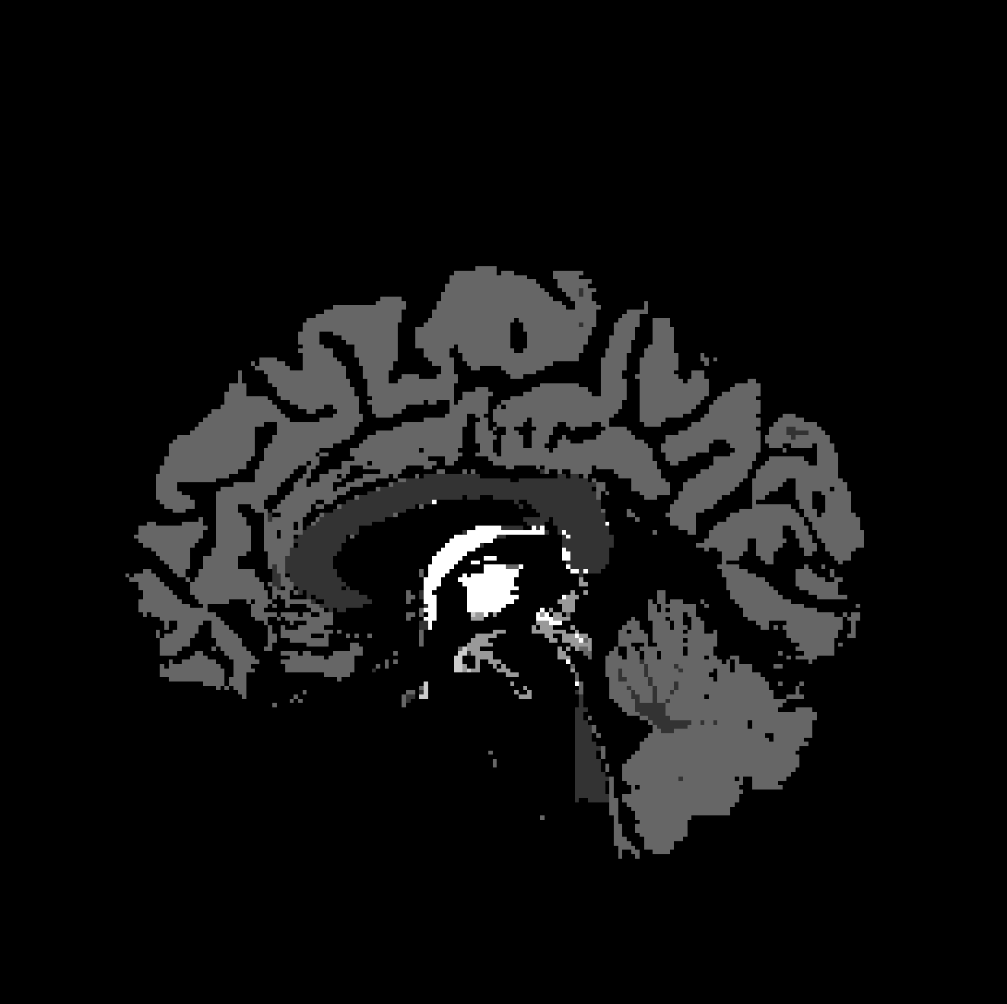
Results
No Normalization vs. GMM

Slide 13
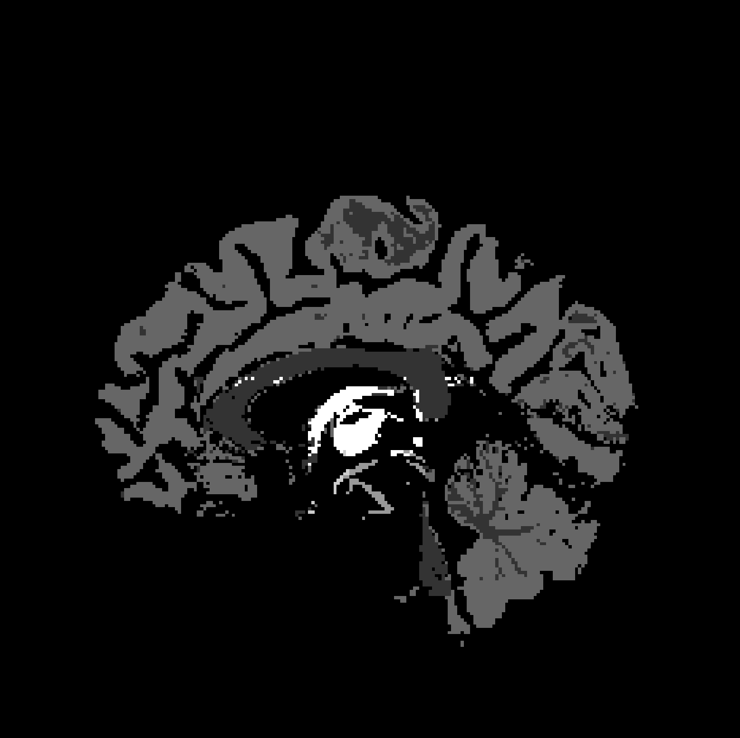
Results
No Normalization vs. MinMax

Slide 14

Results
No Normalization vs. Histogram Matching

Slide 15

Results
No Normalization vs. Whitestripe

Slide 16

Results
No Normalization vs. zScore

Slide 17
Recap
What have we learned?
Teamwork with GitHub
Bla
Bla
Bla

Slide 18
Outlook
What else could be done?
Try other preprocessing methods
Xxx
xxx

Slide 19

Thank you
for your attention
Thomas Buchegger, Carolina Duran, Stefan Weber
16. November 2020

