Slide 1
BLablablablabla
Thomas Buchegger, Carolina Duran, Stefan Weber
16. November 2020

Slide 2
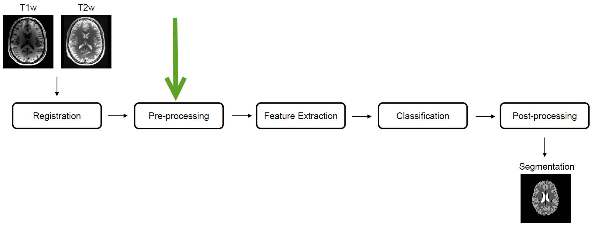
Introduction
MIA Pipeline

Slide 3
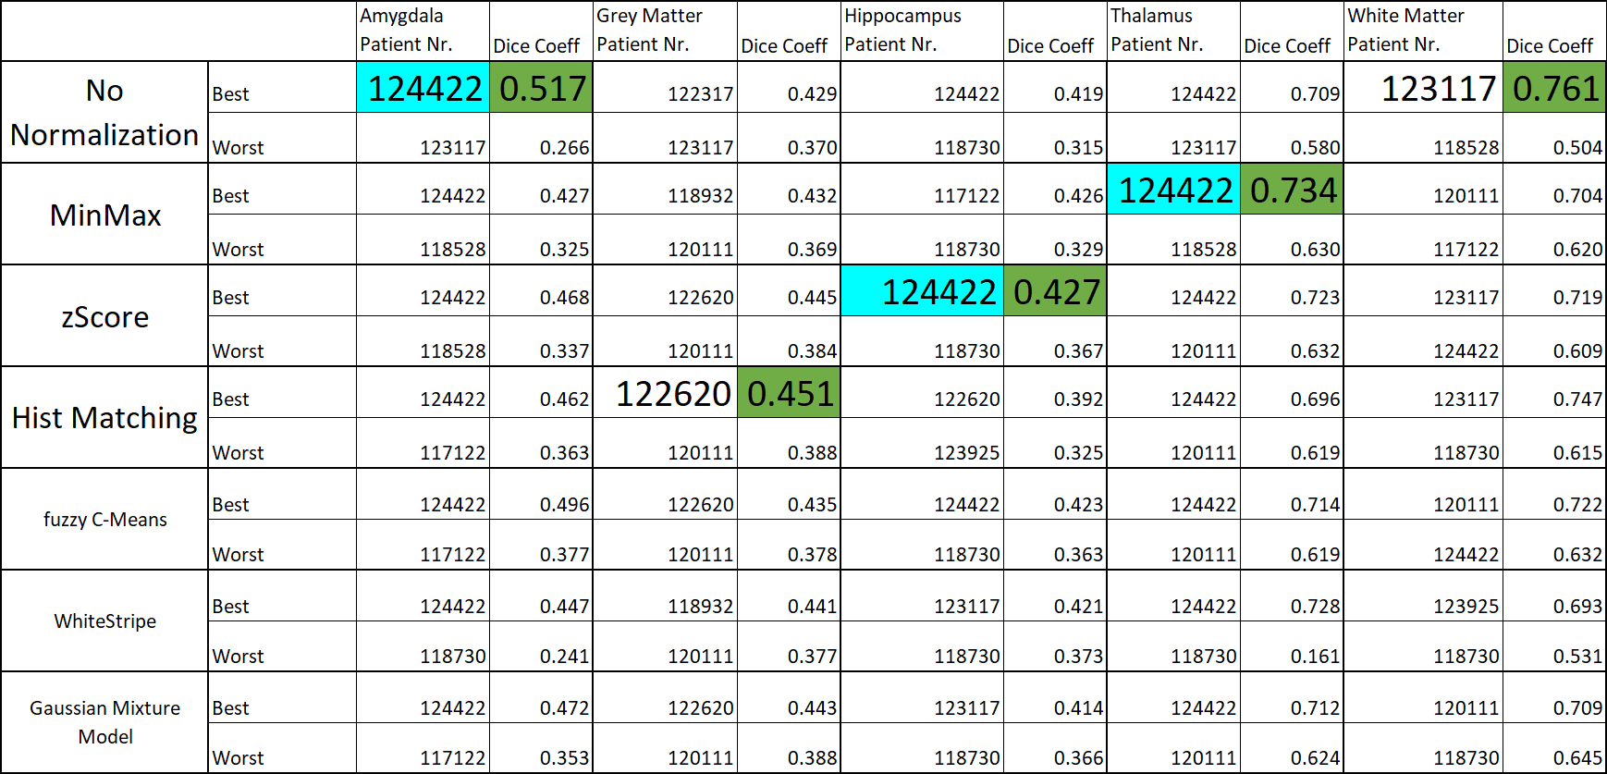

Slide 4

Thank you
for your attention
Thomas Buchegger, Carolina Duran, Stefan Weber
16. November 2020

