Slide 1

Teaching a Robot to See You
Real-Time Face Tracking & Proximity-Guided Pivot
A working prototype built with Python, OpenCV & OhBot servos
Group-1
Sazzad Abdullah
Mahbub Ul Islam Khan
Notes:
Welcome. This presentation covers two integrated systems: the existing face-tracking camera module and the future work — ultrasonic proximity sensing to guide OhBot before a face enters the camera frame.

Slide 2




Current System Overview
Camera
Capture
Haar Cascade
Face Detector
Coordinate
Mapping
OhBot
Servos
640×480 px
30fps live feed
OpenCV
grayscale scan
Normalize 0→1
Scale to 0→10
HEADTURN
Notes:
The system has three layers. The camera layer handles real-time face detection. The Pico layer handles peripheral sensing. The state controller decides which layer drives the robot at any given moment.

Slide 3

Live Demonstration
🔴 LIVE DEMO
Run: python ohbot_camera_tracker_V1.py
Notes:
Invite a volunteer. Point out the three observable behaviours. The demo is the strongest part of the presentation.

Slide 4
Future Work
Peripheral proximity sensing with ultrasonic sensors
Proposed extension
Two HC-SR04 sensors flanking the robot detect approach at up to 5 m
Pico 2 W broadcasts left/right proximity as JSON over USB at 20 Hz
OhBot pivots toward the closest sensor reading until the camera acquires a face lock
Hardware
Raspberry Pi Pico 2 W · 2× HC-SR04 sensors (voltage-divided to 3.3V for ECHO pins) · MicroPython firmware · JSON output: {"left": cm, "right": cm}
Notes:
The Pico firmware is already written and tested. The remaining work is reading the serial stream on the laptop and integrating it into the OhBot state controller.

Slide 5
Next System Architecture
Hardware sensing → coordination layer → servo output
Hardware layer
HC-SR04 left
Pico 2 W
HC-SR04 right
GP14 / GP15
MicroPython · 20 Hz
GP16 / GP17
Coordination layer
Serial reader
Proximity decision
Webcam · OpenCV
Parse JSON
min(left, right) → dir
Haar Cascade · face lock
State controller — SENSOR_PIVOT ↔ CV_TRACKING
Output layer
HEADTURN
HEADNOD
EYETURN
EYETILT
Notes:
Three layers. Hardware layer captures raw distance data. Coordination layer decides whether to pivot (sensor mode) or track (CV mode). Output layer sends servo commands.

Slide 6
Live Demonstration
🔴 LIVE DEMO
Notes:
Invite a volunteer. Point out the three observable behaviours. The demo is the strongest part of the presentation.

Slide 7
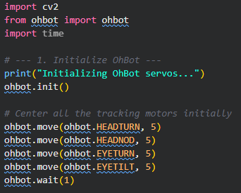
Imports & Robot Initialisation
1.
Code
import cv2 — OpenCV for webcam & face detection from ohbot import ohbot — robot motor control
2.
ohbot.init() — starts USB connection to the robot 4 motors moved to position 5 (center of 0-10 scale)
3.
ohbot.wait(1) — pause to let servos physically reach centre

Slide 8
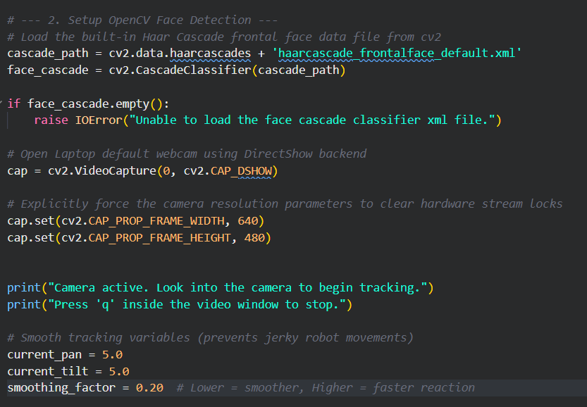
Camera Setup & Face Detection
Opening the webcam and detecting faces each frame
1.
Face Detection Setup
Code
cascade_path and face_cascade are the variables for OpenCV's built-in face detection data file and to load the XML data into a CascadeClassifier object respectively.
2.
2
Open webcam at 640x480
cap variable opens the webcam and cap.set() function forces are camera resolution to be 640x 480 as per OpenCV model.
3.
3
Smoothing Variables
current_pan = 5.0 and current_tilt = 5.0 are to set the current servo posiotion to center and smoothing_factor is to movement speed.

Slide 9
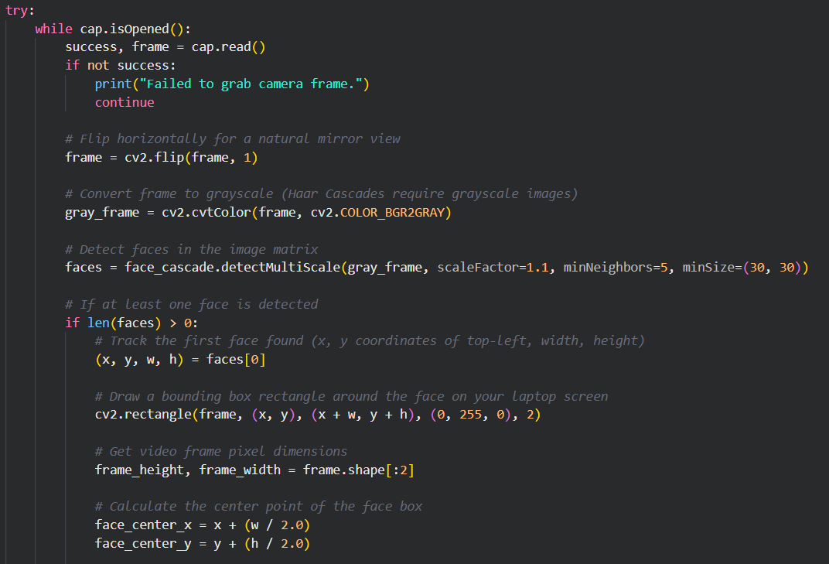
Face Detection & Coordinate Mapping
Mapping the face
1.
If the camera can grab a frame successfully , it then flips the frame and converts it to a grayscale for the model to detect the face and stores in faces.
Code
2.
Faces gives the X,Y coordinates of the detected face in the frame and also the width and height of the face.
3.
cv2.rectangle() creates a rectangle box around the face.
4.
face_center_x /_y finds the center coordinates of the face.
Notes:
The Haar Cascade is a pre-trained Viola-Jones classifier. scaleFactor steps through scale space; minNeighbors=5 suppresses false positives by requiring multiple overlapping detections at each position.

Slide 10
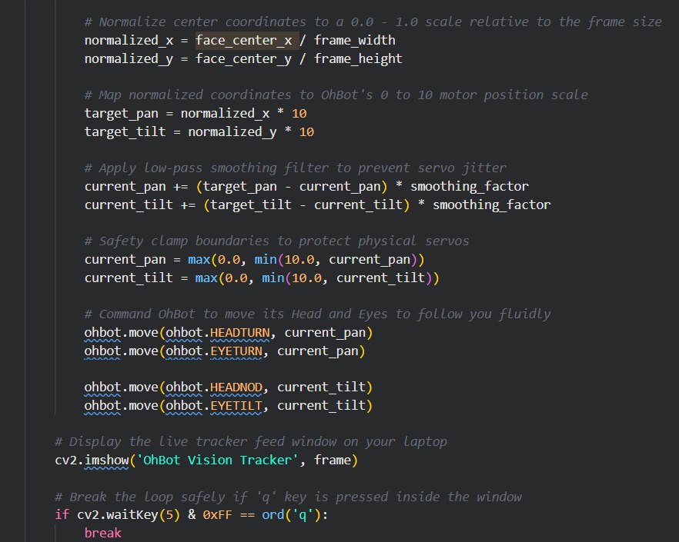
Moving the Ohbot
From pixel position to servo command
1.
Code
normalized_x /_y finds the relative positions of the face to the x and y coordinate of the frame.
2.
target_pan and target_tilt gives the position of the pan and tilt servo. as pan servo ranges from 0 to 10 from left and tilt servo is also same from bottom.
3.
current_pan and current_tilt , prevents servo jitter an overshoot. Feels the Ohbot movement more humen.
4.
Before moving the servos, a maximum servo movement is set inorder prevent over-drive and hardware damage.. Finally, ohbot.move () is the function that moves the servos.
Notes:
The Haar Cascade is a pre-trained Viola-Jones classifier. scaleFactor steps through scale space; minNeighbors=5 suppresses false positives by requiring multiple overlapping detections at each position.

Slide 11
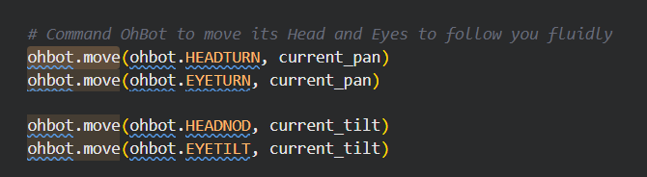
OhBot Servo Reference
Four servos · 0–10 scale ·
Servo constant | Axis | 0 (min) | 5 (centre) | 10 (max)
ohbot.HEADTURN | Horizontal yaw | Full left | Straight ahead | Full right
ohbot.HEADNOD | Vertical pitch | Down | Level | Up
ohbot.EYETURN | Eye horizontal | Look left | Centre | Look right
ohbot.EYETILT | Eye vertical | Look down | Centre | Look up
Code
Notes:
HEADTURN and EYETURN always receive the same pan value so head and eyes move in sync. The 0-10 scale maps to the physical servo range — 5 is always the neutral forward position.

Slide 12
Thank You
Questions & Discussion
Notes:
Close by inviting questions. Key messages: (1) the whole system is ~120 lines of Python, (2) future work with the Pico sensors is already prototyped, (3) this is a platform — the vision and awareness layer can power many different robot behaviours.

