Slide 1

A Project Presentation for the Degree of Bachelor in Computer Engineering
Project Stage II Review I
on
Image Geolocation and Hazard-Aware Response
Group Member Name
1) Bhargav Dave 3) Nibodh Daware
2) Kiran Raut 4) Shreyash Borge
Under the Guidance of
Mrs. Dipti S. Chaudhari
Pimpri Chinchwad College Of Engineering & Research
1
A.Y 2025-2026

Slide 2
OUTLINE
Introduction
Challenges
Objectives
Literature Survey
Problem Statement
Solution Proposed
Algorithm/Methods
Software Development Process model
Requirements Analysis and SRS
State transition diagram
Interface between the modules
Mathematical model
Architecture diagram
Deployment diagram
Results
Conclusion
Future Work
References
2

Slide 3
INTRODUCTION:
Image geolocation is the process of estimating the geographical location from an uploaded image.
The system uses the Gemini 2.5 Flash multimodal model for intelligent image analysis.
It identifies landmarks, analyzes scene context, and predicts the probable location.
The system evaluates potential hazards and classifies the risk level of the image.
It provides actions such as Learn More, Open Map, and Report Incident to assist users.
All analysis results and user actions are securely stored for future reference and auditing.
3

Slide 4
CHALLENGES:
Accurately predicting location from images with limited or unclear visual landmarks.
Handling variations in image quality, lighting conditions, and camera angles.
Reducing incorrect location predictions and false hazard classifications.
Ensuring consistent and reliable AI-generated responses.
Maintaining secure storage of user data and analysis results.
Providing fast response times while preserving prediction accuracy.
4

Slide 5
OBJECTIVE:
To integrate a vision-capable multimodal model for structured image analysis and location estimation
To implement deterministic risk-to-action mapping with human-confirmed reporting for safety-critical scenes.
To persist sessions, model outputs, actions, and incidents for audit and evaluation.
5

Slide 6
LITERATURE SURVEY:
AUTHOR | TITLE | METHODOLOGY | LIMITATIONS
Gemini Team, 2024 arXiv | Gemini: A Family of Highly Capable Multimodal Models | Describes a family of multimodal models for text, image, and reasoning tasks | Model capability alone does not define auditable incident workflow or local system policy.
Liu et al., 2024 NeurIPS | Visual Instruction Tuning | Trains instructionfollowing visionlanguage assistants. | General assistant behavior still requires projectspecific validation and policy control.
6

Slide 7
AUTHOR | TITLE | METHODOLOGY | LIMITATIONS
Haas, Skreta, Alberti and Finn, 2024 CVPR | PIGEON: Predicting Image Geolocations | Multimodal geolocation using foundation model reasoning. | Geolocation performance is emphasized more than operational user actions.
Zhou et al., 2024 SIGIR | Img2Loc: Revisiting Image Geolocalization using Multi-modality Foundation Models and Image-based Retrieval-Augmented Generation | Foundation model plus retrievalaugmented image geolocation | Retrieval grounding is useful, but incident logging and hazard response are outside scope
7

Slide 8
AUTHOR | TITLE | METHODOLOGY | LIMITATIONS
Wang et al., 2024 arXiv | LLMGeo: Benchmarking Large Language Models on Image Geolocation In-the-wild | Benchmarking multimodal language models for geolocation. | Benchmarks model ability, but does not implement a complete safety-aware application.
Sinski, Zychowski and Mandziuk, 2024 ICONIP | Improving Image Geolocation with Multimodal Deep Learning | Uses multimodal deep learning for image geolocation improvement. | Focuses on geolocation improvement, not user-confirmed hazard reporting.
8

Slide 9
AUTHOR | TITLE | METHODOLOGY | LIMITATIONS
Waheed et al., 2025 arXiv | VLM-Guided Visual Place Recognition for Planet-Scale Geo-Localization | Uses VLM guidance for large-scale visual place recognition | Emphasizes retrieval quality, not controlled user-facing report workflow.
Li et al., 2025 arXiv | From Pixels to Places: A Systematic Benchmark for Evaluating Image Geolocation Ability in Large Language Models | Benchmarks LLM geolocation ability across image-toplace tasks. | Evaluation is benchmarkoriented and does not measure incident action outcomes.
9

Slide 10
System Modules
● User Interface — Image upload, preview, chat timeline, action buttons
● Backend API — Analyze, learn-more, report, and health endpoints
● Multimodal Inference — Gemini 2.5 Flash for scene understanding
● Parser & Normalizer — JSON extraction, repair, field validation
● Risk Policy Engine — Deterministic risk and confidence rules
● Action Mapper — Report, learn-more, open map, safety tips
● Persistence Layer — SQLite for sessions, outputs, actions, incidents
10

Slide 11
Mathematical Model
Input image I → Model M produces structured output o = M(I)
o contains: summary, risk, confidence, entities, location, rationale
Final risk r:
high if hazard keywords present AND r_m ∈ {low, uncertain}
otherwise r = r_m (model-assigned risk)
Confidence c (normalized to [0,1]):
c = max(c_m, 0.72) when hazard signal detected
c = c_m otherwise
Action set A by deterministic policy:
c < 0.45 or uncertain → ask for context
r = high → report + safety tips
r = low → learn-more + open map
11

Slide 12
PROPOSED SOLUTION:
Image Upload → Input Validation: The user uploads an image through the web application. The backend validates the image format, size, and generates an image hash for secure processing.
Input Validation → Gemini Vision Analysis: The validated image is sent to the Gemini 2.5 Flash model, which performs scene understanding, landmark recognition, location estimation, and hazard detection.
Gemini Vision Analysis → Structured JSON Processing: The model returns a structured JSON response containing scene description, estimated location, detected entities, confidence score, risk level, and explanation.
Structured JSON Processing → Risk Policy Engine: The backend validates and normalizes the JSON output, applies deterministic hazard policies, confidence thresholds, and generates appropriate user actions.
Risk Policy Engine → User Actions & Database Logging: Based on the detected risk level, the system displays Learn More, Open Map, or Report Incident options. All sessions, model outputs, user actions, and confirmed incident reports are securely stored in the SQLite database for future evaluation and auditing.
12

Slide 13
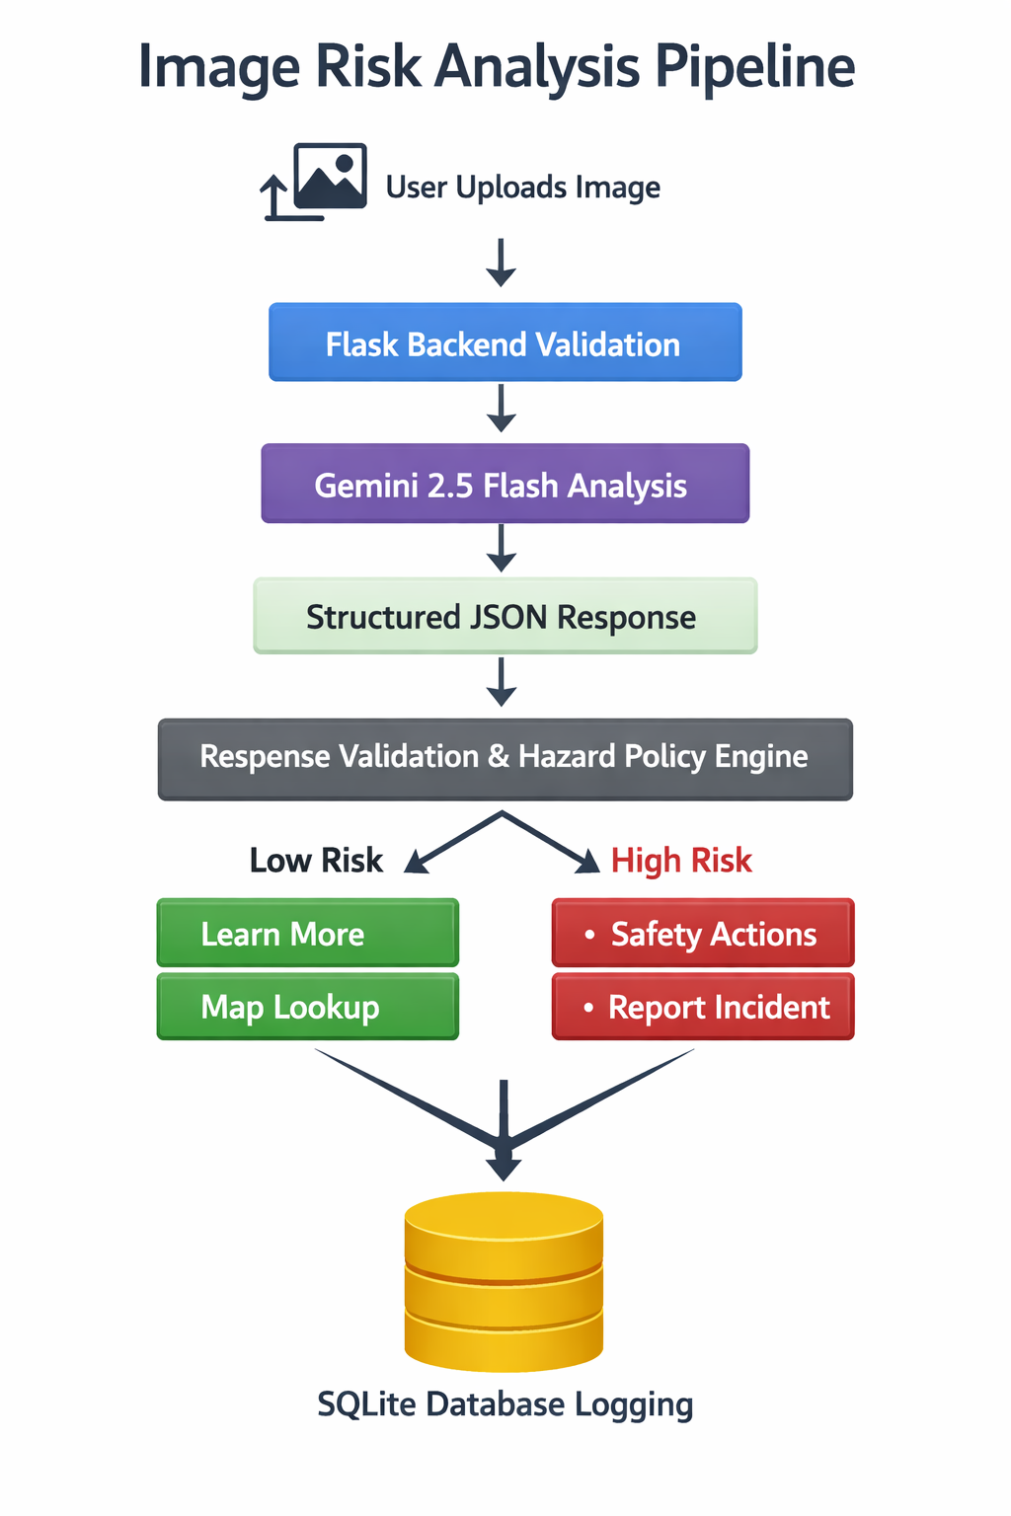
Risk Policy Engine
● Model returns structured JSON: risk level, confidence, entities, summary
● Confidence normalized to [0,1] range
● Hazard keyword detection in summary, rationale, or user context
● Deterministic escalation: keyword + low confidence → high risk override
● Conservative fallback when JSON is invalid or confidence is very low
● Confidence threshold rules determine user-facing action set
● All outputs and decisions persisted in SQLite for audit
13

Slide 14
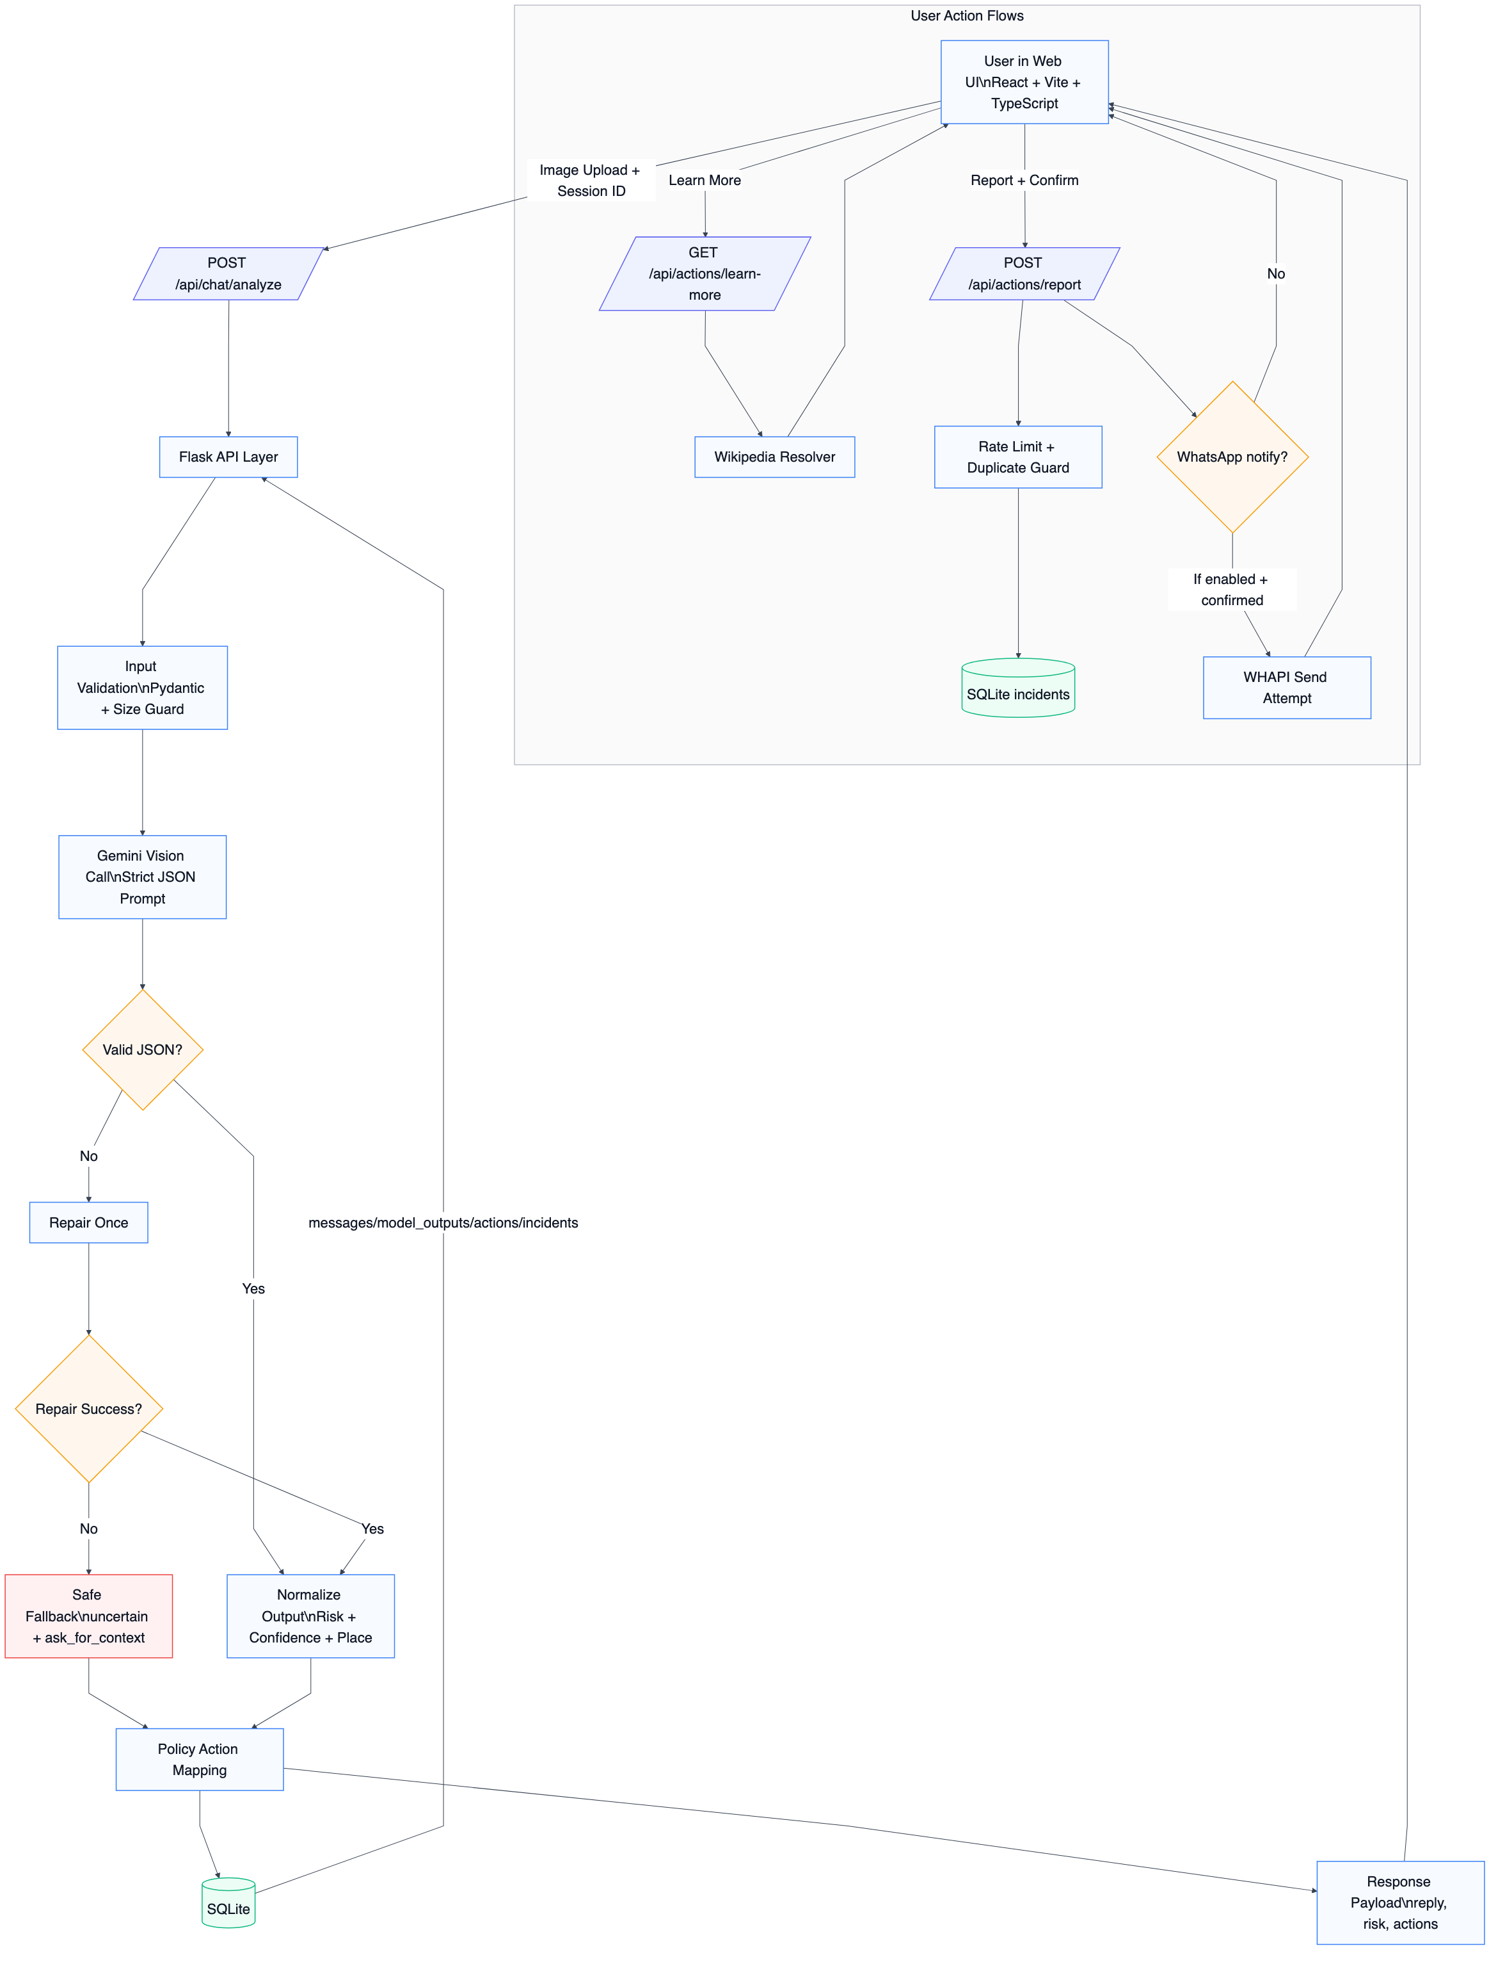
System Architecture
14

Slide 15
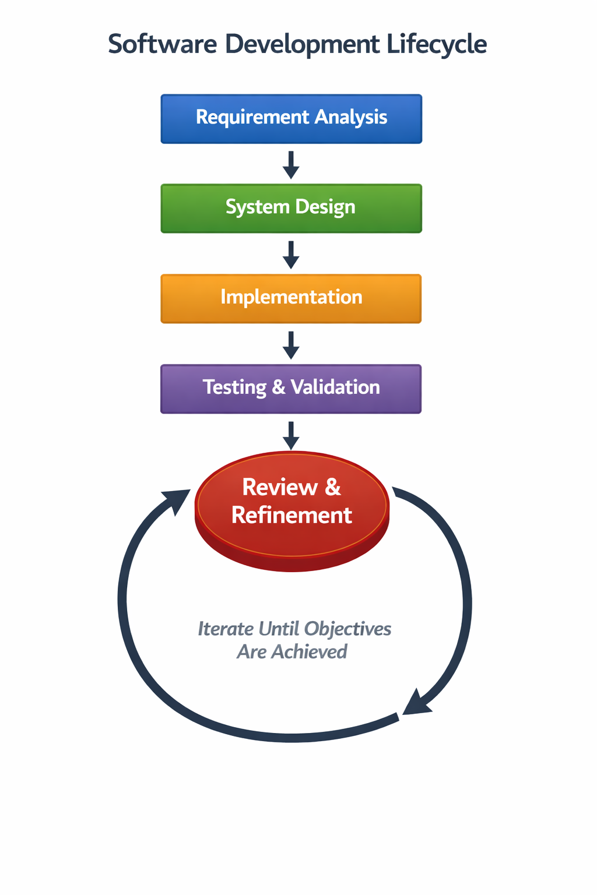
Evaluation Dataset
● Case-study images: Two Shaniwar Wada inputs (regular + fire-affected)
● Persisted run logs: 22 analyzed runs across 14 sessions
● Low-risk: 8 | High-risk: 8 | Uncertain: 6
● Average confidence: 0.623 (range 0.00–0.95)
● Verified case-study risk-action accuracy: 2/2 (100%)
15

Slide 16
Project Overview
● Multimodal image understanding with Gemini 2.5 Flash
● Combines place-aware reasoning with hazard-aware decision support
● Structured JSON output: summary, risk, confidence, entities, location
● Deterministic risk-to-action mapping with human-confirmed reporting
● Complete audit trail: sessions, outputs, actions, incidents in SQLite
● Tech Stack: Python/Flask, React/TypeScript, SQLite, Gemini Vision API
16

Slide 17
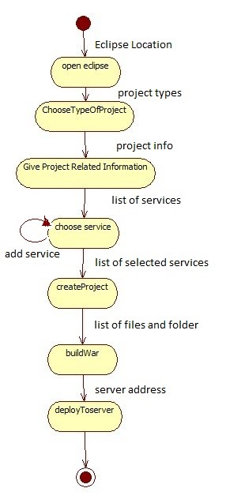
Multimodal Inference Pipeline
● Image uploaded — validated for format, size, and hash generation
● Sent to Gemini 2.5 Flash with structured prompt requesting JSON
● Model performs scene understanding, landmark recognition, hazard detection
● Strict JSON extracted: description, location, entities, risk, confidence
● Invalid JSON auto-repaired once; safe fallback if repair fails
● Normalized fields: summary, risk, confidence, entities, location, rationale
17

Slide 18
Implementation Overview
● Backend: Flask REST API — analyze, learn-more, report, health
● Frontend: React + Vite + TypeScript + Tailwind CSS
● Gemini Integration: google-generativeai SDK, structured output
● Persistence: SQLite — sessions, messages, model_outputs, actions, incidents
● Risk Policy: Keyword detection, confidence normalization, action mapping
● Notification: WhatsApp via Twilio API, environment-gated
18

Slide 19
Risk-to-Action Mapping
Risk / Confidence | Action Set
Low confidence (< 0.45) | Ask for additional context + Why
Uncertain | Ask for additional context + Why
High risk | Report Incident (user-confirmed) + Safety Tips + Why
Low risk | Learn More + Open Map + Why
19
Hazard override: confidence floor c = max(c_m, 0.72) · Deterministic policy — same input, same output

Slide 20
Evaluation Results
● 22 runs analyzed across 14 user sessions
● 8 low-risk, 8 high-risk, 6 uncertain outputs
● Average confidence: 0.623 (range 0.00–0.95)
● Low (< 0.30): 6 runs (27.3%) — uncertain / fallback
● Mid (0.30–0.79): 5 runs (22.7%) — moderate confidence
● High (≥ 0.80): 11 runs (50.0%) — clear scenes or hazards
● 10 user-confirmed incidents; 3 successful notifications
20

Slide 21
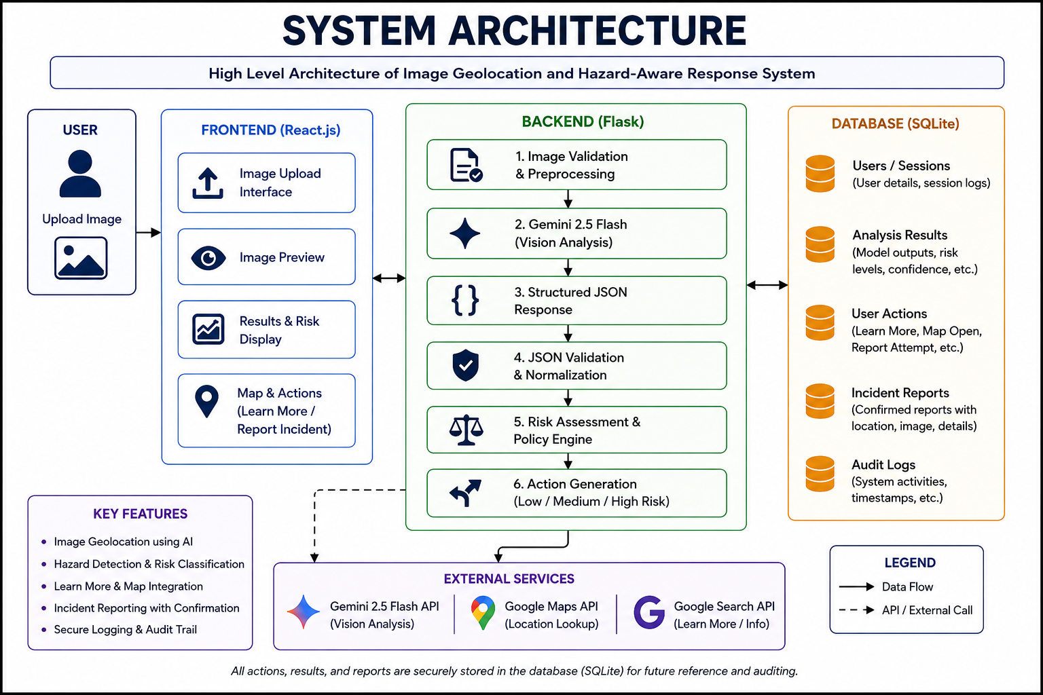
System Features
● Multimodal understanding with structured JSON output
● Risk-aware actions based on confidence and hazard detection
● Human-in-the-loop: report requires explicit user confirmation
● Complete audit trail for all model outputs, actions, incidents
● Privacy-conscious: image hashes instead of raw images
● Safe fallback for invalid or low-confidence model outputs
● Extensible architecture for additional models / providers
21

Slide 22






Testing Summary
● Functional: image upload, analysis, action buttons — all PASS
● Integration: API → Gemini → DB → Response flow — all PASS
● Shaniwar Wada normal → low risk → Learn More — PASS
● Shaniwar Wada fire → high risk → Report Incident — PASS
● Invalid model response → safe fallback — PASS
● Report requires confirmation before incident — PASS
● All records persisted in SQLite — PASS
● 10 test cases, 0 defects
22

Slide 23
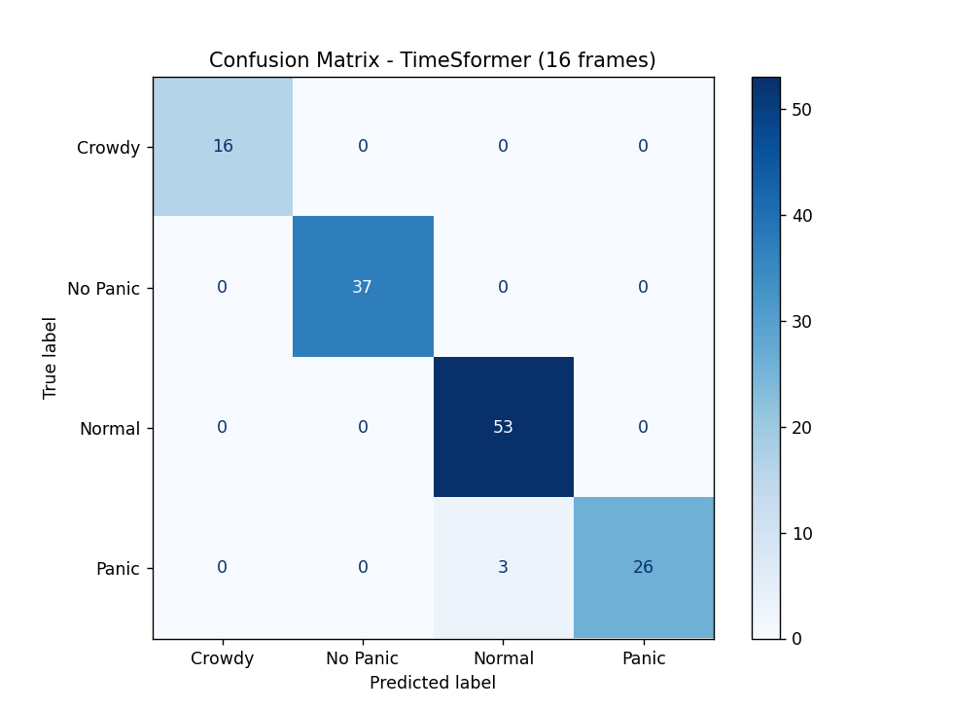
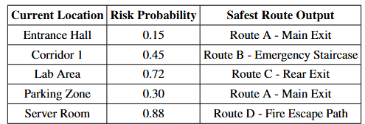
23

Slide 24





Hazard-Action Outcomes
Outcome | Count
User-confirmed incidents | 10
Notification attempts (env-enabled) | 3
Successful notification sends | 3
Local-only incident records | 7
Report actions logged | 10
Learn-more actions logged | 12
24
Reporting and notification are separate stages. All incidents user-confirmed and persisted.

Slide 25
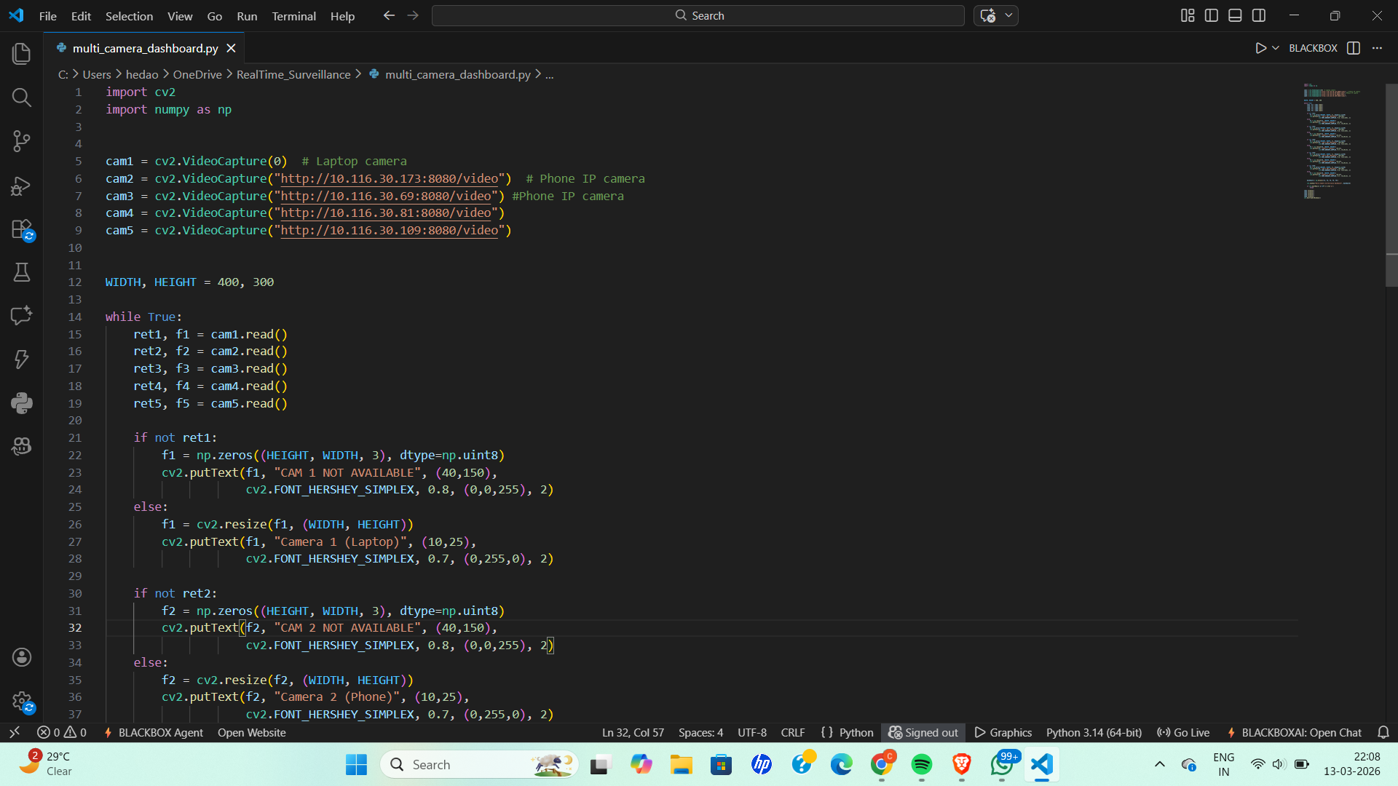
Confidence Band Distribution
Band | Count | Share | Interpretation
Low (< 0.30) | 6 | 27.3% | Uncertain / fallback
Mid (0.30–0.79) | 5 | 22.7% | Moderate confidence
High (≥ 0.80) | 11 | 50.0% | Clear scenes / hazards
Mean confidence: 0.623 | Range: 0.00–0.95 | Shaniwar Wada: 0.95 (normal), 0.85 (hazardous)
25

Slide 26
Case Study: Shaniwar Wada
Sample | Risk · Confidence | Primary Action
A — Regular Shaniwar Wada | Low · 0.95 | Learn More
B — Fire-affected Shaniwar Wada | High · 0.85 | Report Incident
Same landmark, different action paths based on visual hazard evidence.
26

Slide 27
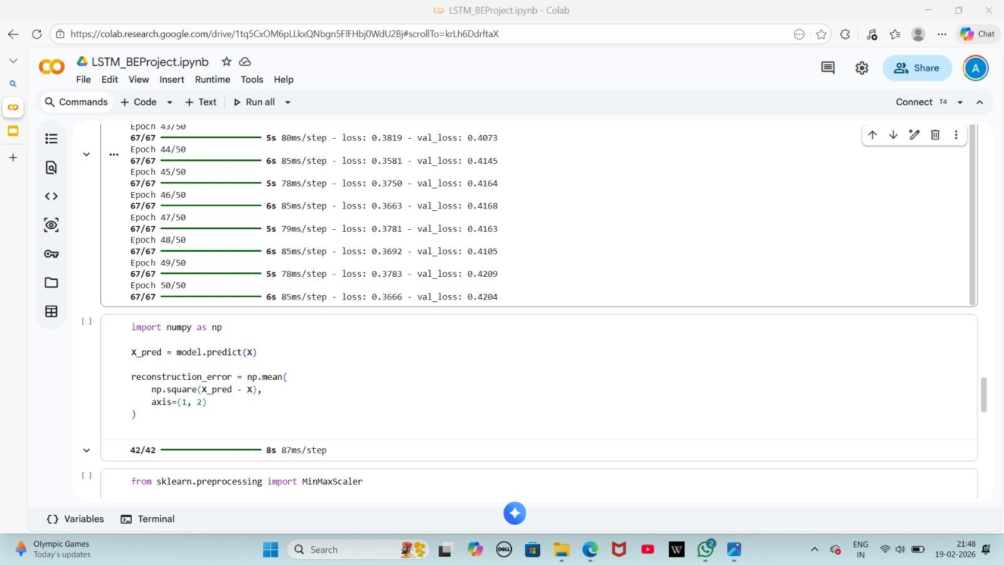
User Action Flow
● User uploads image → preview + chat-style action buttons
● Low-risk / normal: Learn More · Open Map · Why
● High-risk / hazardous: Report Incident · Safety Tips · Why
● All actions logged for complete audit trail
27

Slide 28
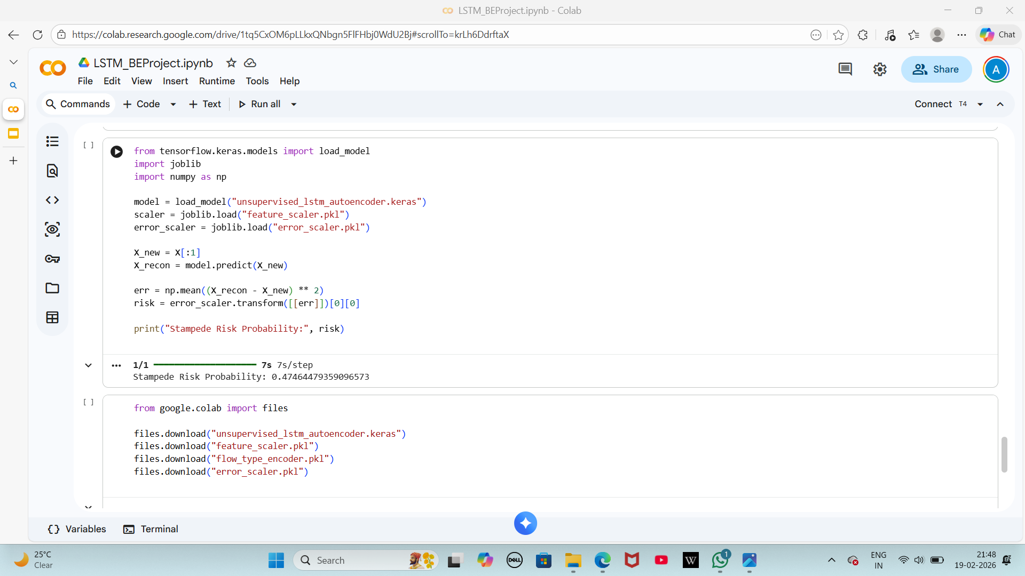
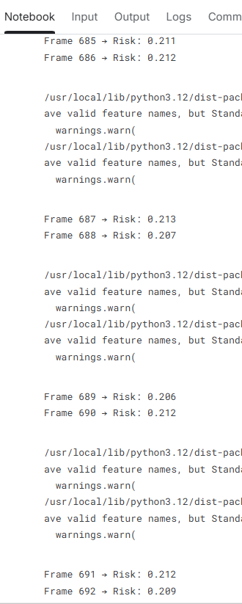
Incident Reporting Workflow
● High-risk detected → Report Incident action shown
● User reviews → confirms intent to report
● Incident record created in SQLite
● Optional WhatsApp notification (if env-gated)
● No automatic dispatch — human always in control
● All steps logged for audit trail
28

Slide 29



System Summary
● Frontend UI: React + TypeScript + Tailwind CSS
● Backend API: Python Flask (REST)
● Multimodal Model: Gemini 2.5 Flash (Vision)
● Database: SQLite (5 tables)
● Risk Policy: Deterministic keyword + confidence rules
● Notification: Twilio WhatsApp (optional, env-gated)
● Deployment: Local / Cloud (Vercel-ready)
Key metrics: 22 runs, 14 sessions, 10 incidents, 3 notifications
29

Slide 30
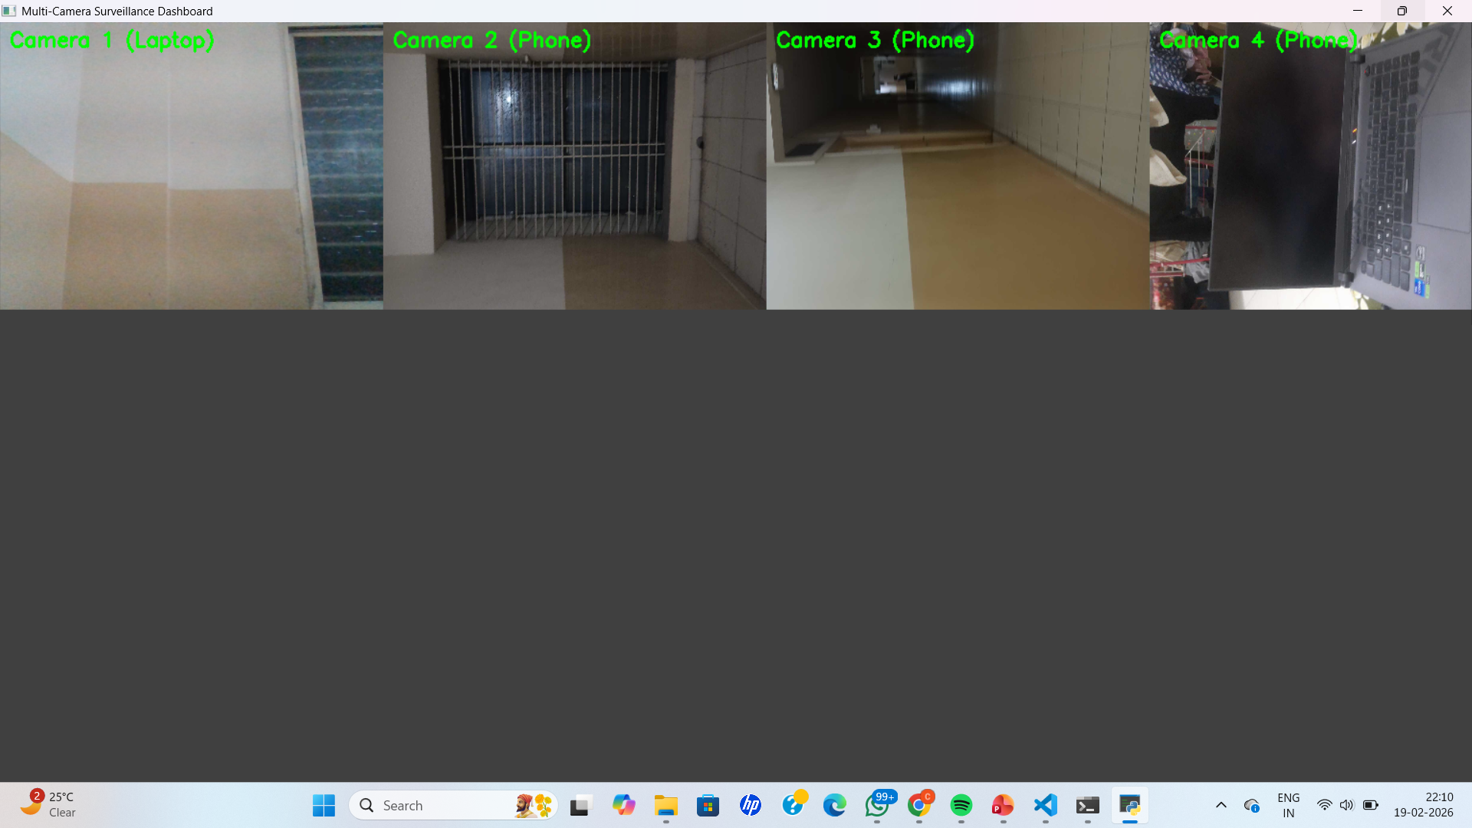
Quick Statistics
Metric | Value
Total analyzed images | 22
Distinct user sessions | 14
Low-risk outputs | 8 (36.4%)
High-risk outputs | 8 (36.4%)
Uncertain outputs | 6 (27.3%)
Average confidence | 0.623
User-confirmed incidents | 10
Successful notifications | 3/3 (100%)
Case-study accuracy | 2/2 (100%)
30

Slide 31
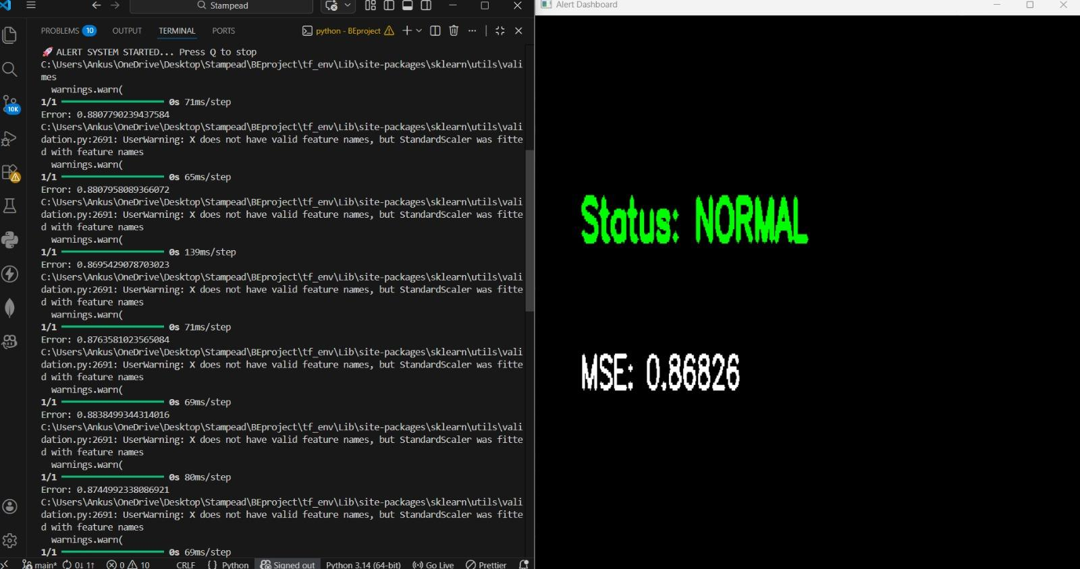
Performance Metrics
● Total analyzed runs: 22
● Model response time: ~3–8 seconds
● Average confidence: 0.623 (std dev 0.31)
● Low confidence (< 0.30): 27.3%
● High confidence (≥ 0.80): 50.0%
● Case-study accuracy: 100% (2/2)
Performance depends on Gemini API; no local GPU needed
31

Slide 32
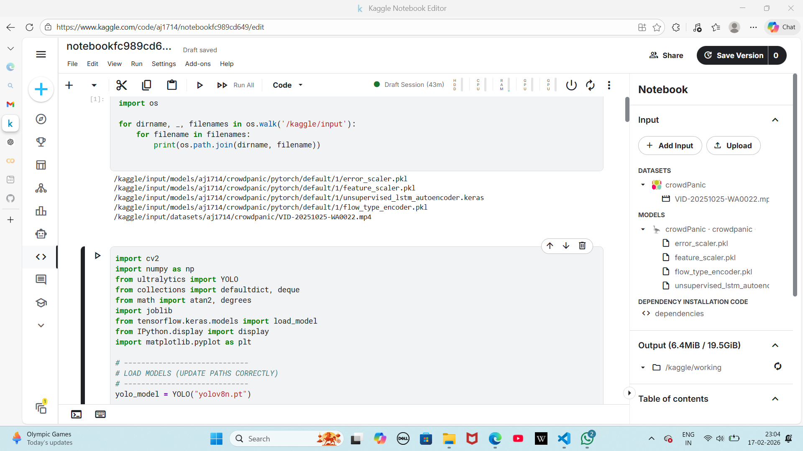
Key Observations
● Model identifies major landmarks consistently
● Hazard detection reliable for fire/smoke cues
● Confidence correlates with scene clarity
● Low-confidence outputs need better calibration
● Fallback escalation reduces misses but may increase false alerts
● User-confirmed reporting creates clear audit trail
● System works best for scenes with clear landmarks or hazards
32

Slide 33



Evaluation Metrics
● Primary: Risk-action consistency on verified samples
— Shaniwar Wada normal: Low risk → Learn More ✓
— Shaniwar Wada fire: High risk → Report ✓
● Secondary (from run logs):
— Risk distribution (low / high / uncertain)
— Confidence mean and range
— Confidence band distribution
— Incident logging rate
— Notification success rate
Full precision/recall requires larger labelled dataset
33

Slide 34
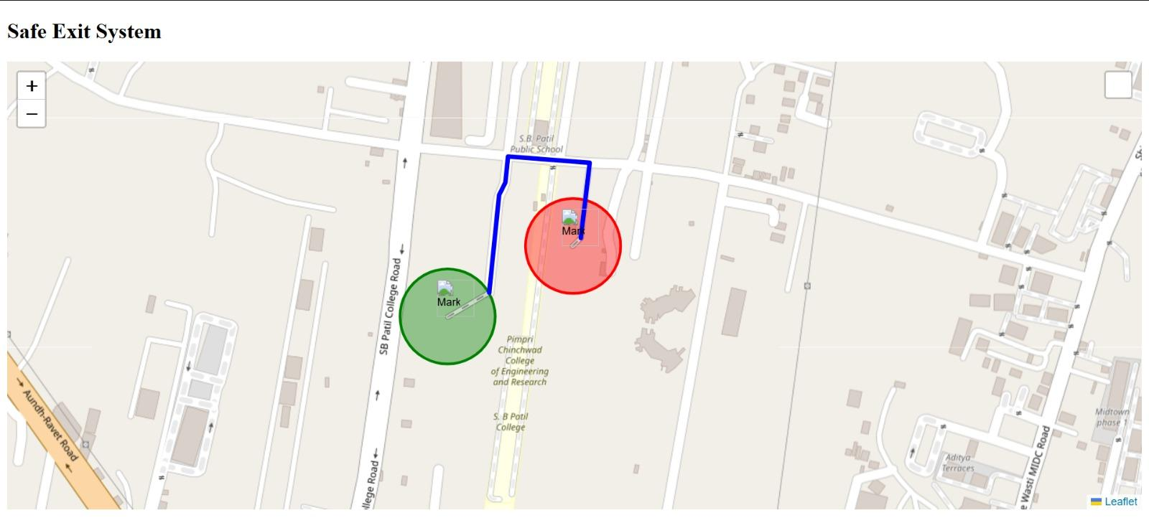
System Limitations
● Evaluation dataset limited to project logs (22 runs)
● System depends on Gemini API availability and accuracy
● Hazard detection is not legal / forensic verification
● Confidence scores need calibration for production use
● No vector database retrieval for geospatial grounding
● Hazard demos mainly fire-related; other types need testing
● No production-grade authentication or RBAC yet
34

Slide 35
Validation Summary
● 22 runs validated — normal and hazardous scenarios
● 8/8 high-risk images → correct report action
● 8/8 low-risk images → correct informational action
● 6 uncertain → correctly prompted for more context
● Case-study accuracy: 100% (Shaniwar Wada)
● Notification delivery: 100% (3/3 when enabled)
● All outputs, actions, incidents persisted and auditable
35

Slide 36
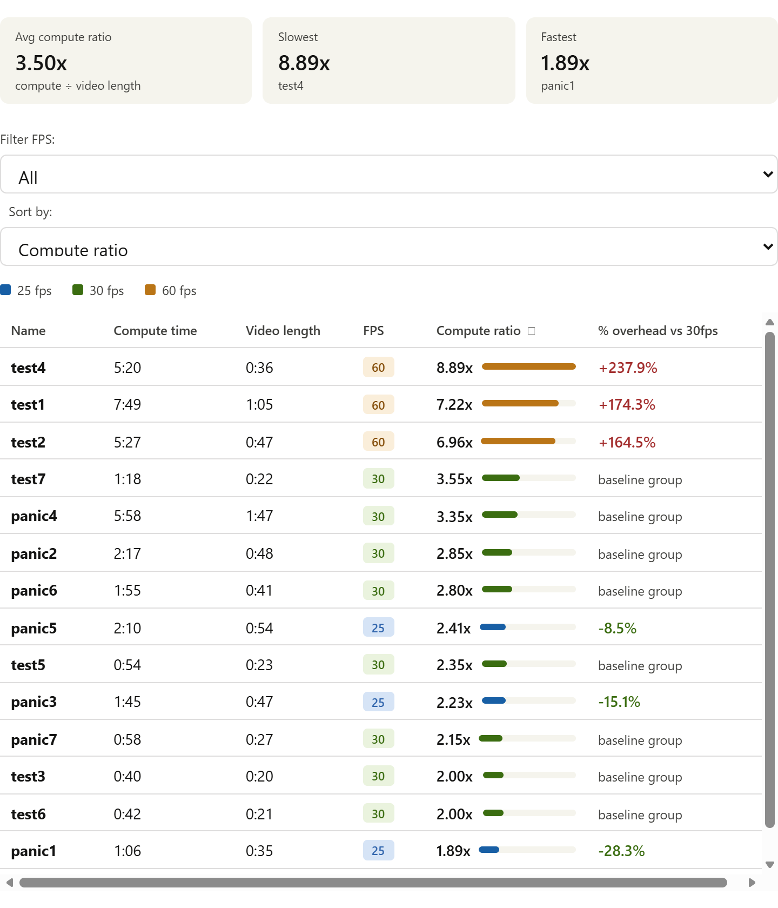
Testing Methodology
1. Upload supported image — verify analysis response
2. Normal landmark — verify low risk + Learn More
3. Hazardous image — verify high risk + Report
4. Uncertain/low-confidence — verify ask for context
5. Report action — verify confirmation required
6. Model outputs saved in SQLite
7. Actions logged in SQLite
8. Invalid model response → safe fallback
36

Slide 37
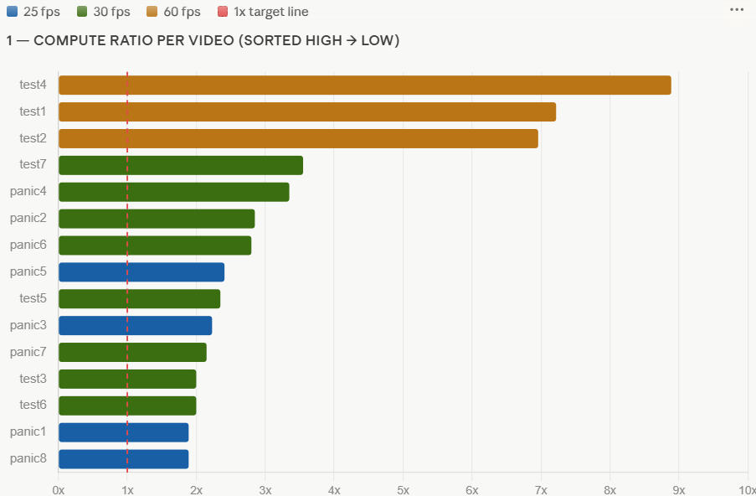
Privacy, Security & Ethics
● Privacy: Raw images not stored; image hashes used
● Security: API keys in env variables, never logged
● Ethics: No automatic authority dispatch
● Transparency: Model rationale shown with every decision
● Data: All records persist for audit and evaluation
● Safety: Conservative fallback for uncertain outputs
● Design: Academic demonstration and controlled use
37

Slide 38
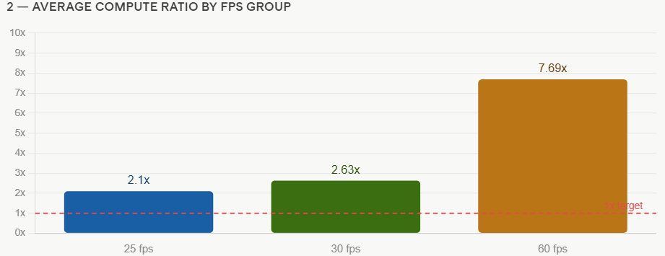
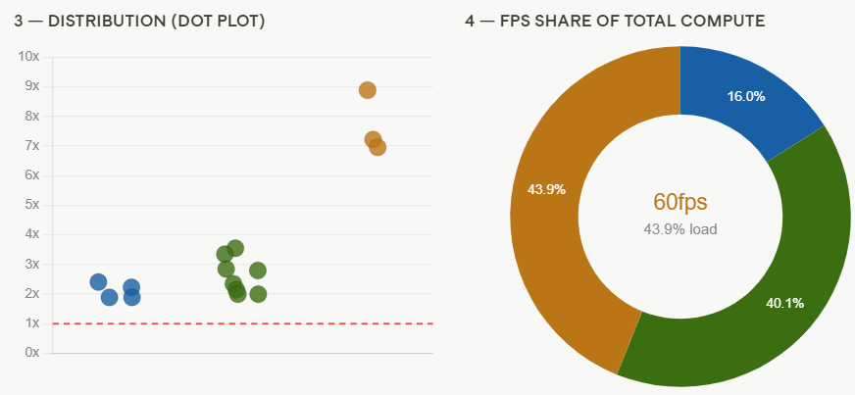
Key Observations
● Model identifies major landmarks reliably
● Hazard detection works for fire/smoke cues
● Confidence correlates with scene clarity
● Low-confidence outputs need better calibration
● Fallback escalation is safety-oriented but may increase false alerts
● User-confirmed reporting creates audit trail
● Optimal for scenes with clear landmarks or visible hazards
38

Slide 39
Applications
● Tourist landmark explanation and learn-more assistance
● Public safety awareness and guided incident reporting
● Academic demonstration of multimodal LLM decision support
● Image-based context retrieval for educational use
● Smart city monitoring with human verification
● Disaster awareness prototypes (fire, flood, collapse)
● Digital verification workflows requiring image context
39

Slide 40
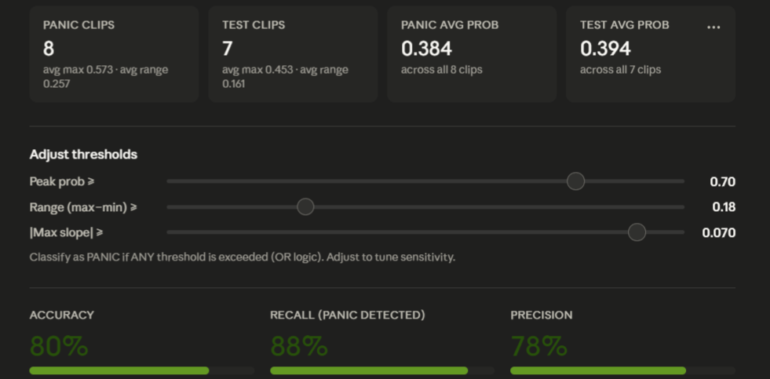
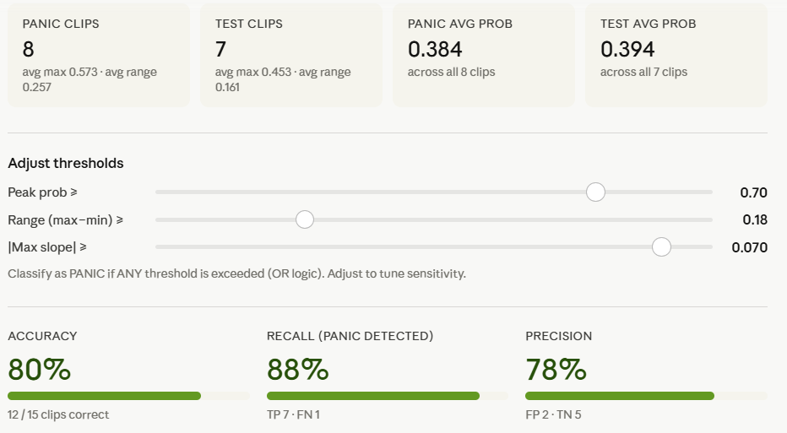
System Advantages
● Multimodal understanding with structured JSON output
● Risk-aware actions based on confidence and hazard detection
● Human-in-the-loop: all reports require explicit confirmation
● Complete audit trail for all decisions and actions
● Privacy-conscious: image hashes instead of raw storage
● Safe fallback for invalid or low-confidence outputs
● Extensible architecture for additional models / providers
40

Slide 41
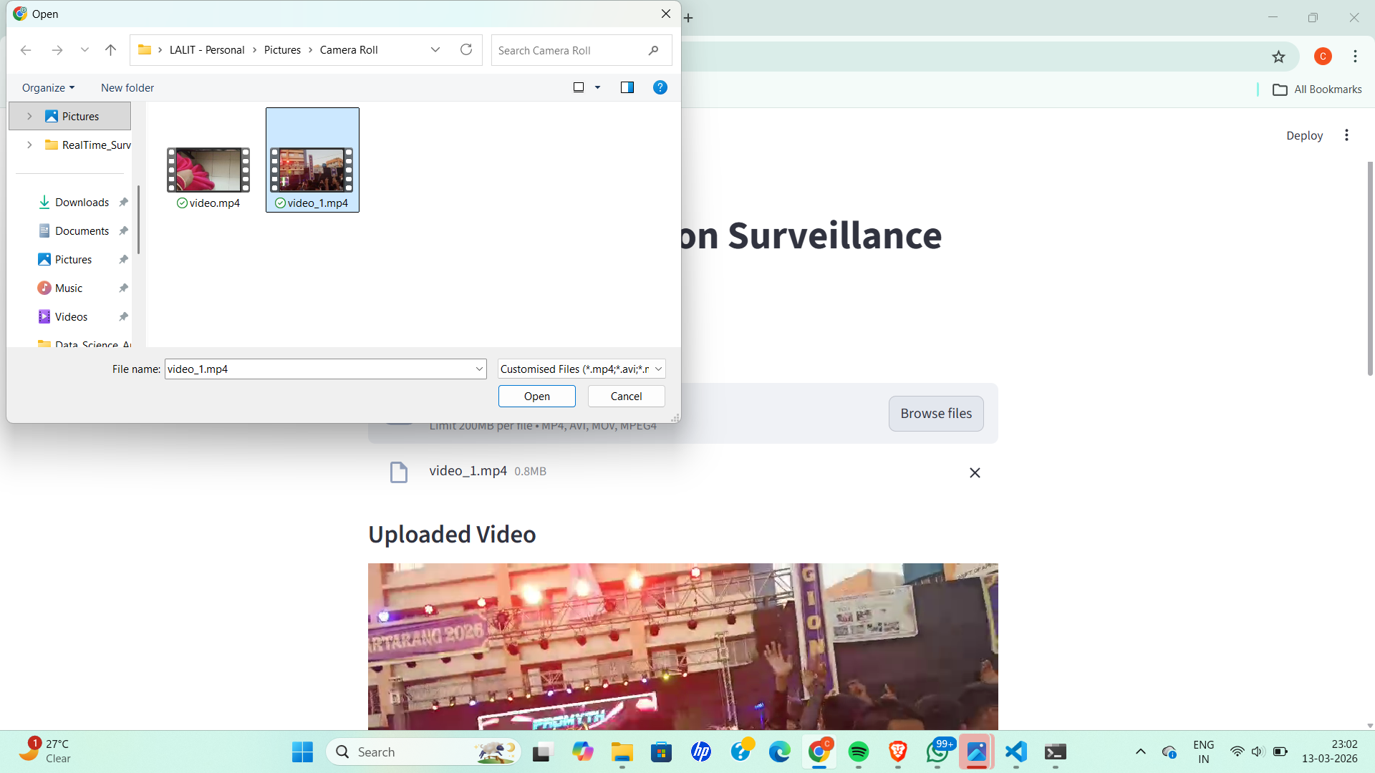
Future Work
● Vector retrieval and embedding-based search for geospatial accuracy
● Dedicated OCR subsystem for text-in-scene extraction
● Confidence calibration using conformal prediction
● Expanded hazard categories (flood, accident, collapse, etc.)
● Role-based access control and incident review workflows
● Real-time dashboard analytics for safety teams
● Larger labelled evaluation dataset for precision/recall
41

Slide 42

Social, Ethical & Legal Framework
1. Privacy & Anonymity
• Focuses on behavior, not ID.
• Personal data is not stored.
• Analyzes crowd videos for safety.
2. Ethical Surveillance
• Used only for public safety.
• Prevents disaster/misuse.
• No unnecessary tracking.
3. Data Security
• Secure storage of results.
• Access restricted to authorities.
• Protected video pipelines.
4. Bias & Fairness
• Trained on diverse scenarios.
• Continuous evaluation.
• Reliable, fair predictions.
5. Legal Compliance
• Follows Copyright/Data laws.
• Complies with Govt privacy acts.
• Strict source regulation.
6. Responsible Use
• Early warning support tool.
• Mandatory human oversight.
• Ethical deployment focus.
42

Slide 43
RESULT:
The developed system successfully analyzes uploaded images using the Gemini 2.5 Flash multimodal model to generate accurate scene descriptions, identify landmarks, and estimate the probable geographical location. It effectively classifies the risk level of the analyzed image and provides appropriate actions such as Learn More, Open Map, or Report Incident based on the detected context. The system also securely stores all model outputs, user actions, and confirmed incident reports in the SQLite database, ensuring reliable performance, traceability, and auditability.
43

Slide 44
CONCLUSION:
• Developed an intelligent image geolocation system using Gemini 2.5 Flash. Provides accurate scene understanding and location prediction. Detects hazards and generates suitable actions. Maintains secure logging and improves user decision-making..
44

Slide 45
CONCLUSION:
The proposed system demonstrates an effective approach for image geolocation and hazard-aware response by utilizing the Gemini 2.5 Flash multimodal model. It accurately interprets uploaded images, estimates their probable locations, identifies significant landmarks, and evaluates potential risks. Based on the analysis, the system provides relevant user actions while maintaining secure storage of analysis results and user interactions. Overall, the solution enhances image understanding, supports informed decision-making, and provides a reliable foundation for future AI-driven geolocation applications.
45

Slide 46
Future Work
● Vector retrieval and embedding-based search for geospatial accuracy
● Dedicated OCR subsystem for text-in-scene extraction
● Confidence calibration using conformal prediction
● Expanded hazard categories (flood, accident, collapse, etc.)
● Role-based access control and incident review workflows
● Real-time dashboard analytics for safety teams
● Larger labelled evaluation dataset for precision/recall
46

Slide 47
Research Publications
● International Conference on Interdisciplinary Technology
& Science Convergence (FusionX Global) — Scitepress
Status: Accepted and Presented
● IEEE ESCI 2026 — Emerging Smart Computing and Informatics
Status: Accepted and Published
● Research Paper: Image Geolocation and Hazard-Aware Response
Using Multimodal Large Language Models (MLLMs)
47

Slide 48
Literature Survey Summary
● CLIP (Radford et al., 2021): Image-text contrastive pretraining
● Gemini (Gemini Team, 2024): Multimodal model family
● PIGEON (Haas et al., 2024): Foundation model geolocation
● Img2Loc (Zhou et al., 2024): Retrieval-augmented geolocation
● GeoChain (Yerramilli et al., 2025): Chain-of-thought reasoning
● BLIP-2 (Li et al., 2023): Vision-language pretraining
● LLaVA (Liu et al., 2024): Visual instruction tuning
● NetVLAD (Arandjelovic et al., 2016): Place recognition
Gap: Most optimize accuracy; none integrate hazard-aware actions + audit logging
48

Slide 49
System Workflow
1. Image Upload — Backend validates format, size, generates hash
2. Gemini Vision — Scene understanding, landmark recognition
3. Structured JSON — Summary, risk, confidence, entities, location
4. JSON Normalization — Validate fields, repair if needed
5. Risk Policy — Keyword detection, confidence rules, action mapping
6. Action Generation — Report / Learn More / Open Map / Safety Tips
7. User Interaction — Views analysis, selects action
8. Persistence — All records stored in SQLite
49

Slide 50
Data Flow Overview
User → Flask API → Gemini Vision → JSON Parser →
Policy Engine → Action Mapper → User
● User uploads image — Flask validates and hashes
● Gemini analyzes — returns structured JSON
● Parser normalizes fields — Policy applies rules
● Action Mapper generates buttons — User interacts
● All steps persisted in SQLite
50

Slide 51
State Transition Diagram
51

Slide 52
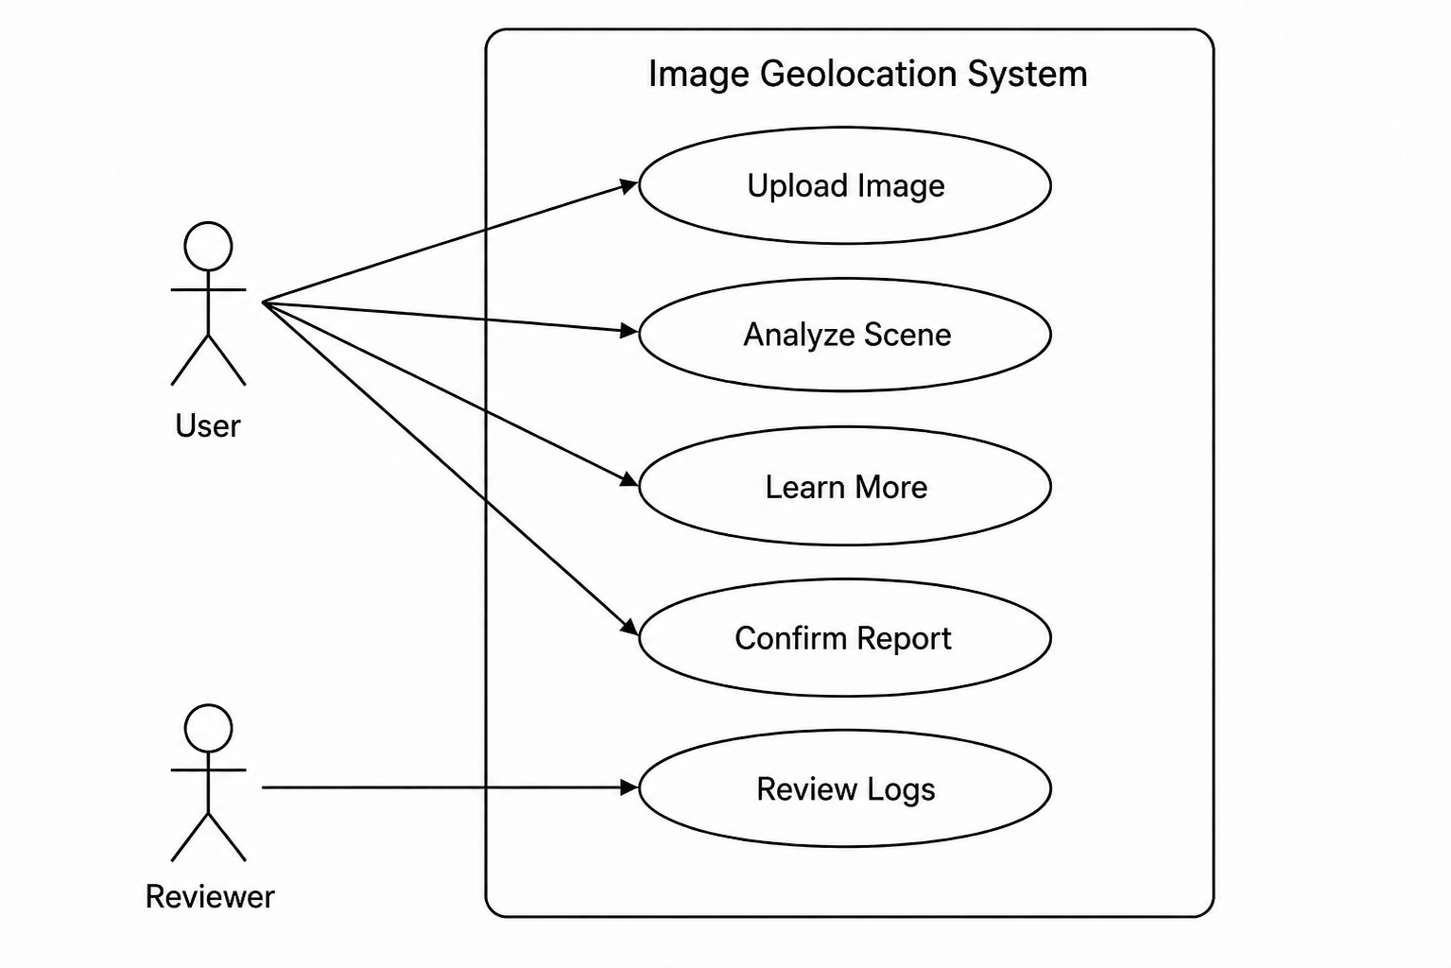
Use Case Diagram
52

Slide 53
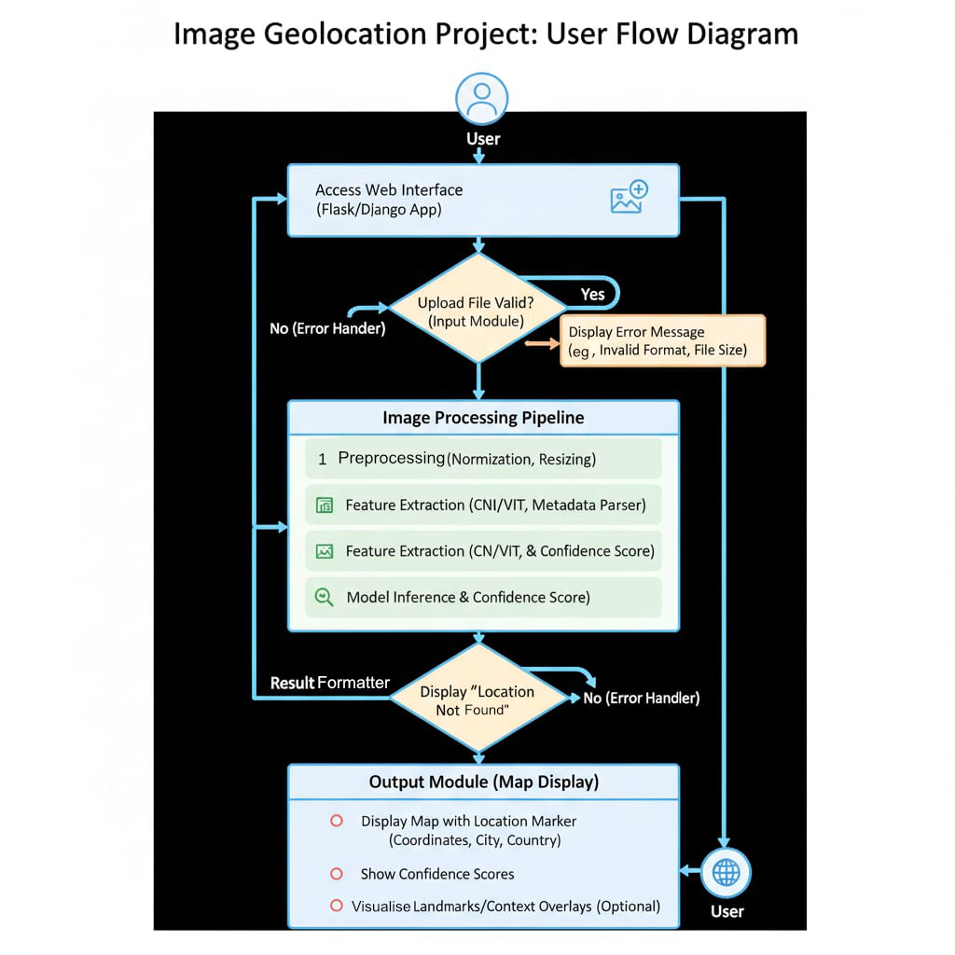
Deployment Architecture
53

Slide 54
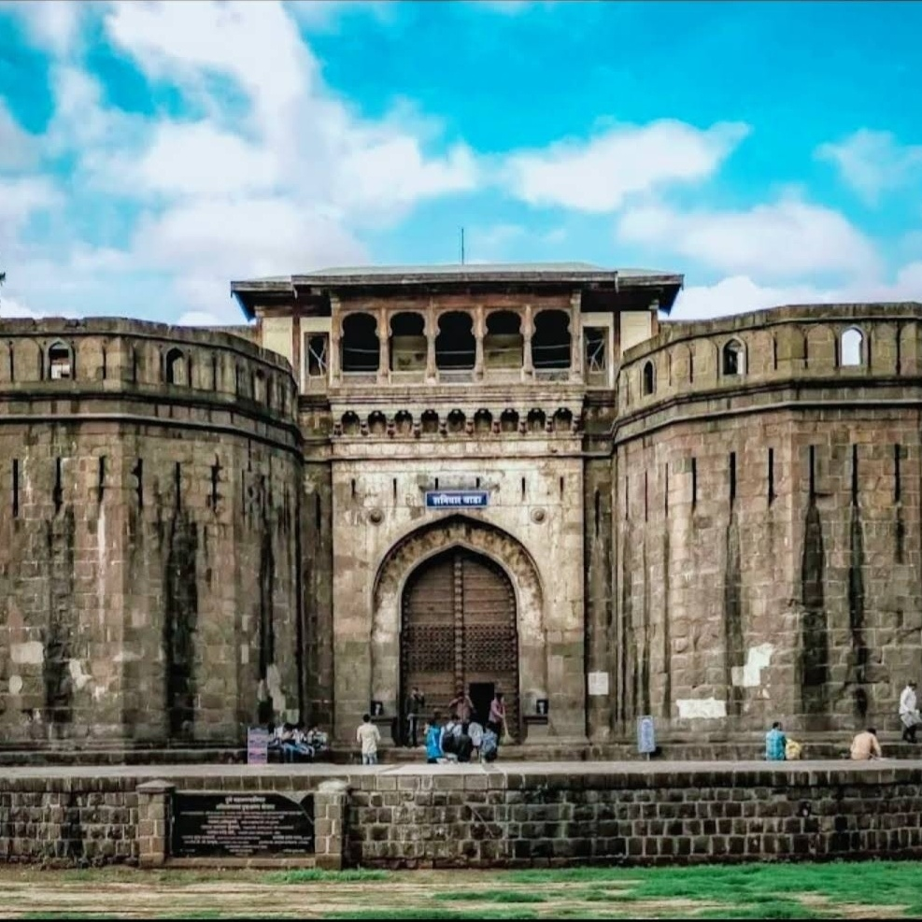
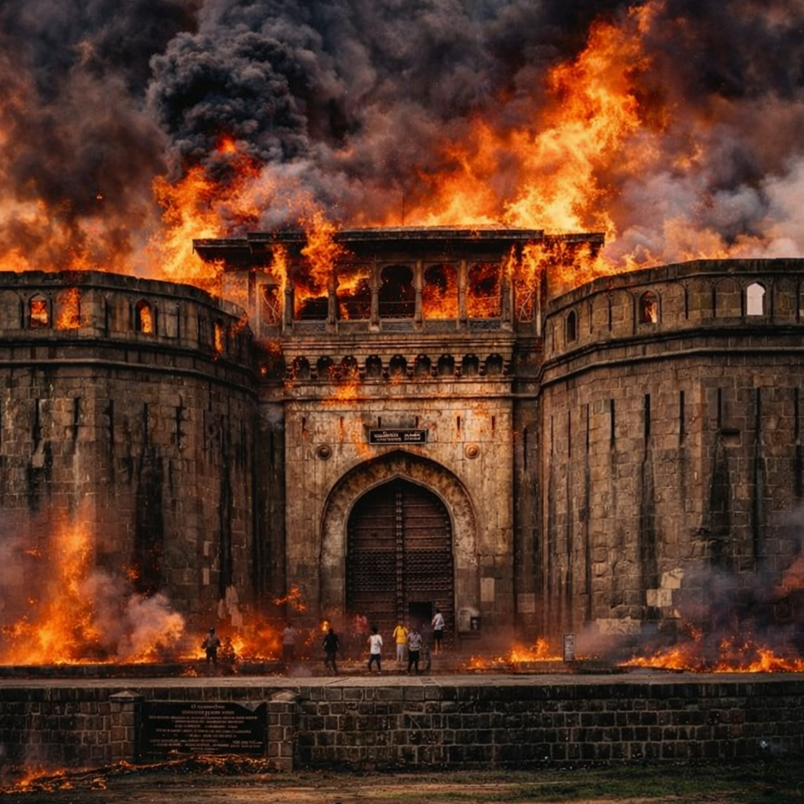
Test Images: Shaniwar Wada
(a) Regular — Low Risk · Conf 0.95 · Learn More
(b) Fire-affected — High Risk · Conf 0.85 · Report
54

Slide 55
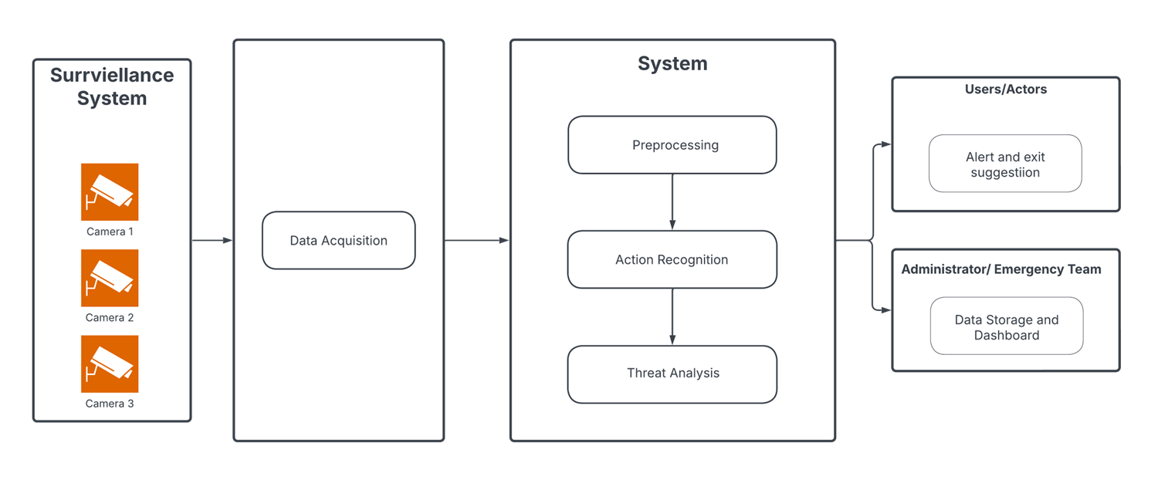
Test Case Results
1. Upload and analyze image — PASS
2. Normal landmark → low risk — PASS
3. Hazardous image → high risk — PASS
4. Report requires confirmation — PASS
5. Invalid response → safe fallback — PASS
6. Learn More fetches knowledge — PASS
7. Model outputs saved in SQLite — PASS
8. Actions logged in SQLite — PASS
55

Slide 56
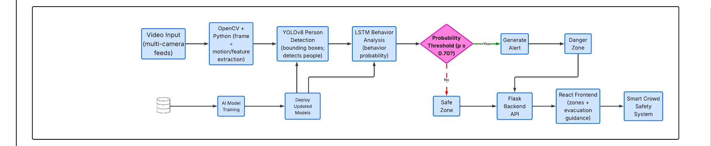
Deployment Architecture
● User Interface: React App (Vercel / Local)
● Backend API: Python Flask (REST)
● Multimodal Model: Gemini 2.5 Flash (Google API)
● Database: SQLite (persistent audit store)
● Notification: Twilio WhatsApp (optional)
All components communicate via HTTPS
56

Slide 57
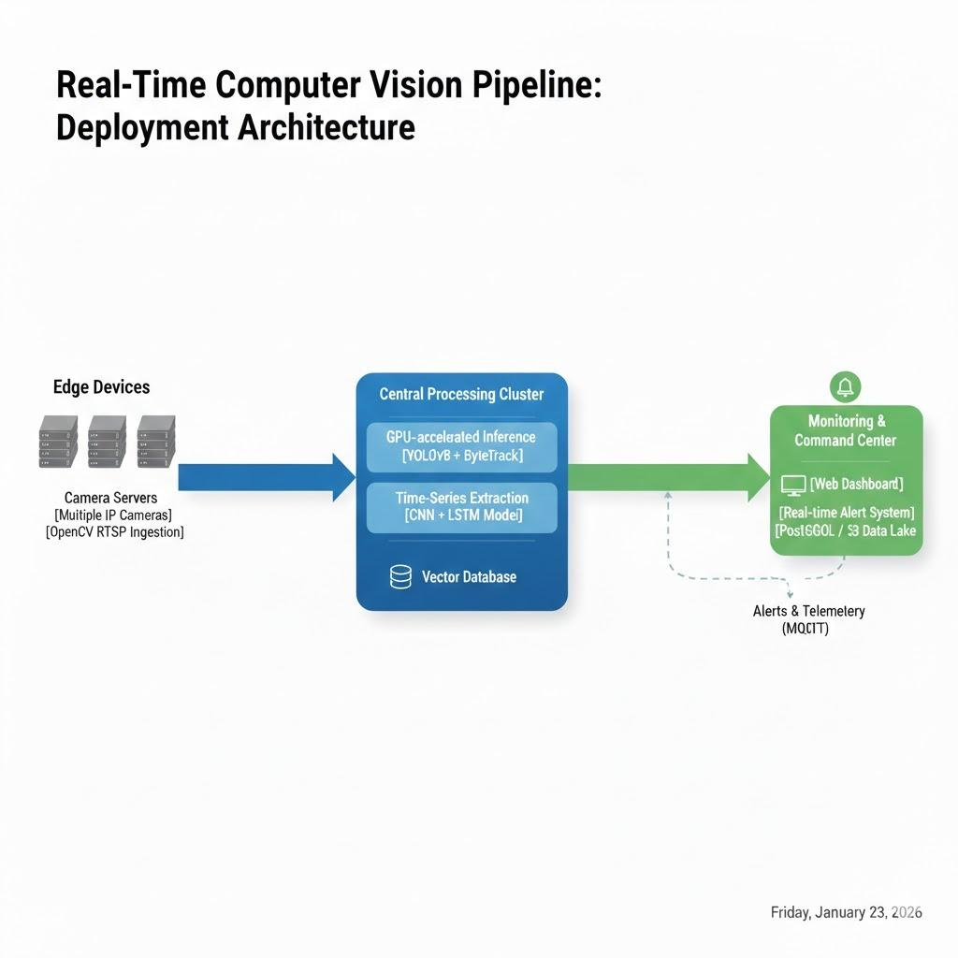
Run Log Dataset
● Total analyzed runs: 22
● Distinct user sessions: 14
● Database: 5 tables (sessions, messages, model_outputs, actions, incidents)
● Key design: Raw images not stored; image hash for traceability
● All outputs, actions, incidents persisted for audit review
57

Slide 58
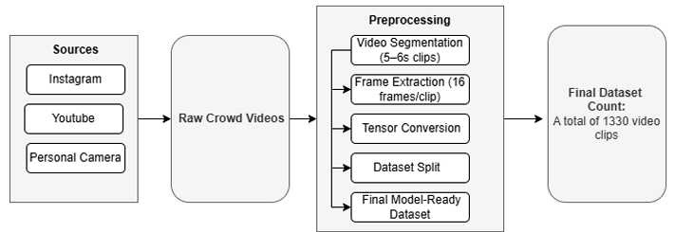
System Components
● React UI — Image upload, preview, chat, action buttons
● Flask API — Request handling, validation, response construction
● Gemini Vision — Multimodal analysis, structured output
● Policy Engine — Risk normalization, keyword escalation
● SQLite Store — Persistent audit logs
All components communicate via REST APIs
58

Slide 59
API Endpoints
● POST /api/analyze — Analyze image, return structured response + actions
● POST /api/report — Create incident record (requires confirmation)
● POST /api/learn-more — Fetch Wikipedia summary for entity
● GET /api/health — Health check (API + DB status)
All endpoints return JSON responses
59

Slide 60
API Workflow
1. Client sends POST /api/analyze with image file
2. Backend validates format and size
3. Image encoded as base64 for Gemini API
4. Gemini Vision returns structured response
5. JSON extracted, repaired if needed, normalized
6. Risk policy evaluates output + hazard keywords
7. Actions generated based on risk/confidence
8. Records persisted in SQLite
9. JSON response returned with action options
60

Slide 61
Risk Policy Details
● Keywords scanned: fire, smoke, accident, disaster, emergency
● Sources: summary, rationale, user context, location
● Hazard + low model risk → override to high risk
● Confidence thresholds:
c < 0.45 → ask for context
Low risk → learn-more + open map
High risk → report + safety tips
Hazard override: c = max(c_m, 0.72)
61

Slide 62
Hazard Classification Logic
● Input: model output (risk_level, confidence, summary, entities)
● Step 1: Scan hazard keywords in all text fields
● Step 2: If detected → risk override to 'high'
● Step 3: Normalize confidence with safety floor
● Step 4: Map (risk, confidence) → deterministic action set
● Step 5: Return actions + rationale to user
62

Slide 63
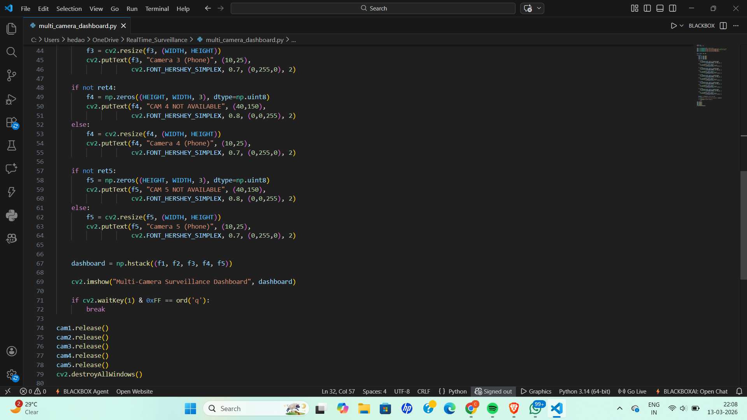
Project Challenges
● Geolocation from images with limited or ambiguous cues
● Variation in image quality, lighting, camera angles
● Reducing false hazard classifications while maintaining safety
● Ensuring consistent structured JSON from multimodal model
● Graceful handling of invalid/incomplete model responses
● Response latency under 8 seconds
● Secure API key management and privacy-conscious storage
63

Slide 64
Mitigation Strategies
● Ambiguous scenes → conservative fallback, ask for context
● Invalid JSON → auto-repair + safe fallback
● Incorrect risk → deterministic policy + hazard override
● False alerts → user confirmation required
● API failure → error handling + fallback messaging
● Privacy → image hash instead of raw storage
All strategies logged for audit review
64

Slide 65
Hazard Classification
● Hazard detection via keyword matching in model outputs
● Categories: fire, smoke, accident, disaster, emergency
● Hazard + low model risk → override to high
● Deterministic rules — consistent classification
● Full audit trail for every decision
● User can view rationale for each classification
65

Slide 66
Implementation Challenges
● Ensuring consistent structured JSON from Gemini
● Handling ambiguous scenes with limited landmarks
● Balancing false alerts vs. safety coverage
● Maintaining response latency under 8 seconds
● Reliable JSON extraction and repair
● API key security and environment management
● Cross-platform compatibility
66

Slide 67
Module Interface
● UI → Backend API: Image + text (HTTP POST)
● Backend → Gemini Vision: Base64 image + prompt
● Gemini → Parser: Structured JSON response
● Parser → Policy: Normalized risk + confidence
● Policy → Mapper: Risk level → action set
● Mapper → UI: Action buttons + structured response
● All → SQLite: Logs for every step
67

