Slide 1
WEB DESIGN PROPOSAL

Slide 2
PROPOSAL OUTLINE:-
1) Client
2) Competitors
3) Audience
4) Need
5) Sitemap
6) Wireframes
7) SEO keywords

Slide 3
CLIENT
Client Name:- Ravi Judge
Business:- Liquor Express Store
Location:- 3080 Comox Rd, Courtenay, BC V9N 3P8
Website:- He does not have one

Slide 4


COMPETITORS
1)Alcool NB Liquor:- 2)Joe’s Liquor:-
https://www.anbl.com/ https://joesliquor.com/

Slide 5
AUDIENCE
The most important part of the target audience is adult citizens(Above 18) and people who can earn $15,000+ annually.

Slide 6
NEED
My client said he wants to expand his business in different cities in Canada. So, I decided to develop a website for him that could be the easiest approach to business. He does not have any website for his company.
My proposed website will help him to generate annual revenue more than average.
I have included lots of features on this website such as day delivery, Discount points, Credit card bill payments, and many more.

Slide 7
SITEMAP
Homepage
About
Services
Acount
Products
The Company
FAQs
Login or
Register
Beer
Team
Security
Sellers acount
Wine
History
Delivery
Cart
Vodka
Reviews
Return Policy
My Orders
Rum

Slide 8
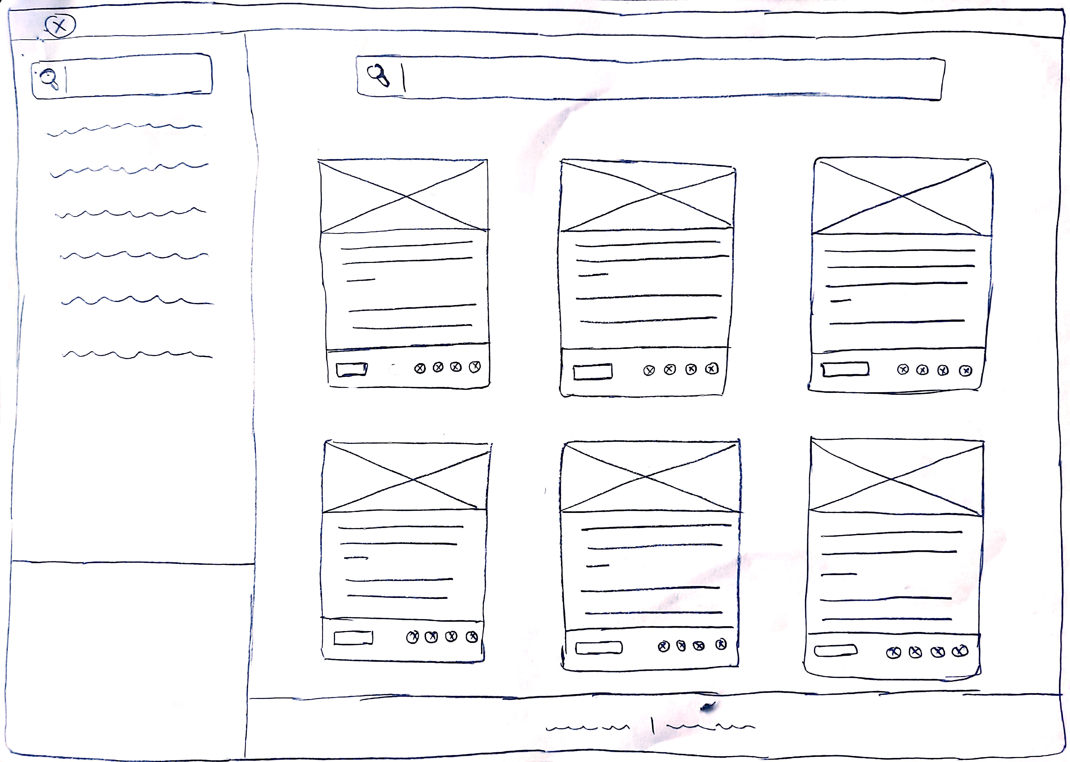
WIREFRAMES
1) HOMEPAGE

Slide 9
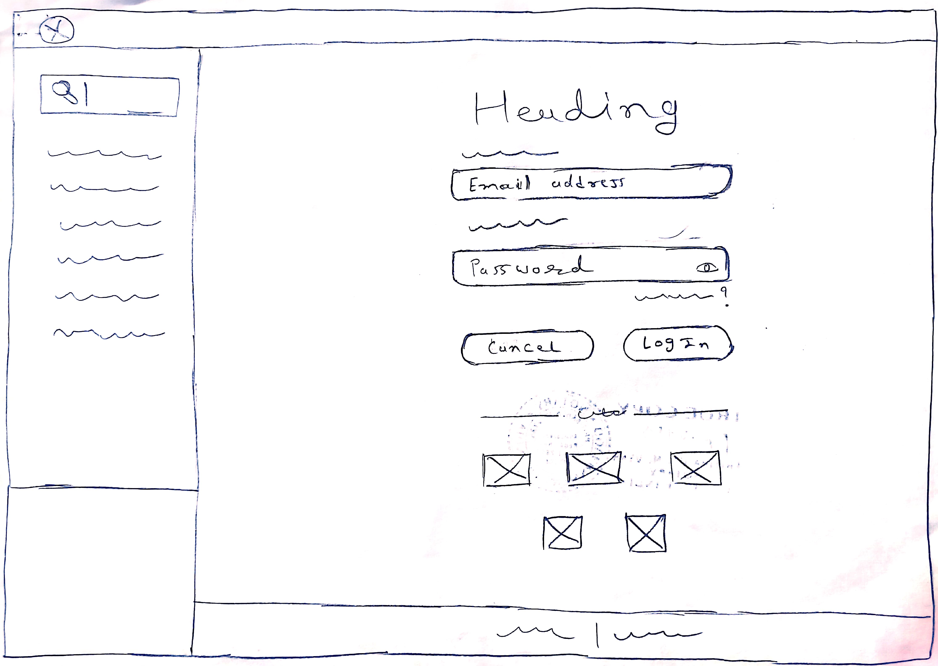
2)LOGIN PAGE

Slide 10
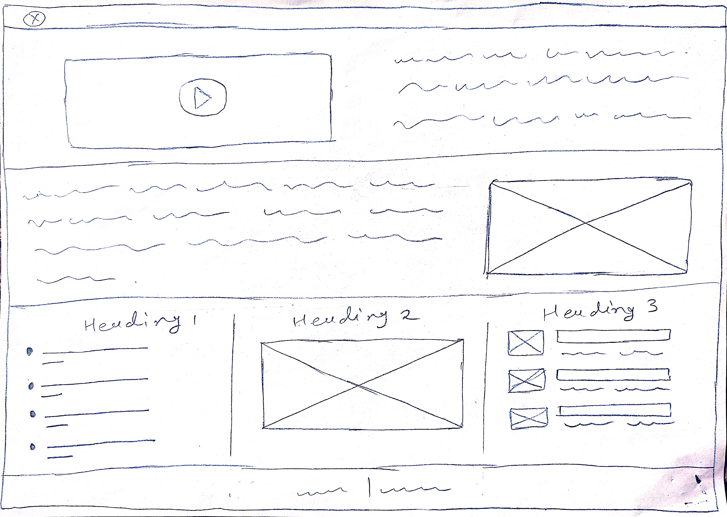
3)ABOUT US

Slide 11
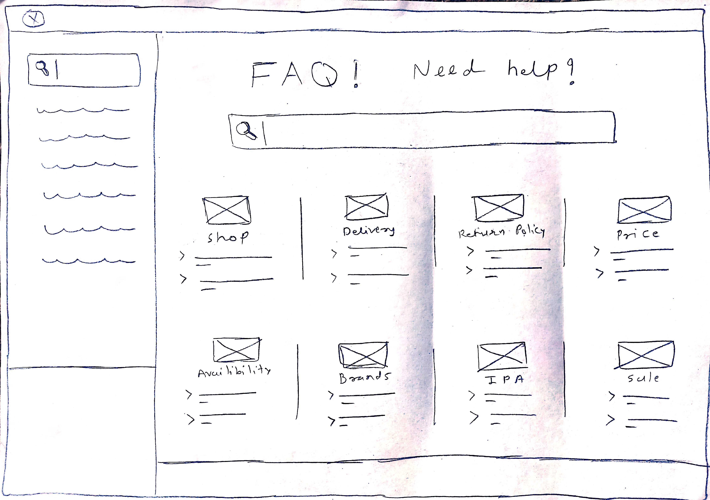
4)SERVICE PAGE

Slide 12
7)SEARCH ENGINE OPTIMIZATION
Liquor store near me
Liquor store courtenay, comox, vancouver island
Best wine shop in courtenay
Wine store vancouver
Liquor types, Liquor brands
Liquor online
Wine delivery
Liquor Express store
Drive through liquor store
Liquor store open near me

Slide 13
8)THE LOOK AND FEEL
i) MOOD:-
Luxurious
ii) COLORS:-
Dark maroon
White
iii) TYPEFACE:-
Aqua Grotesque
Roboto
iv)Images :-
https://unsplash.com/
https://www.pexels.com/
https://www.shutterstock.com/
https://free-images.com/

Slide 14
9)FORMS
REGISTRATION FORM:-
Login form
Registration form
Table booking form
Address form
Comments
Feedback
These forms will collect users’ Email id, Contact numbers, Addresses, Passwords, Gender, Age, and so on.

Slide 15
10)MULTIMEDIA
Still Images
Visual Graphics
Text
Animation
Motion Video
Stroyline
I would like to add these multimedia components to different pages of the website.
For example, Motion videos will help users to understand about company’s goals and fundamentals.
Images and Animation can show the history of business.
Storyline can be built up reliability towards users.

