Slide 1
Directed Research Fall 2017
With Professor Deshmukh
Student: Nicole Fronda

Slide 2
Part 1: Clustering car logs

Slide 3
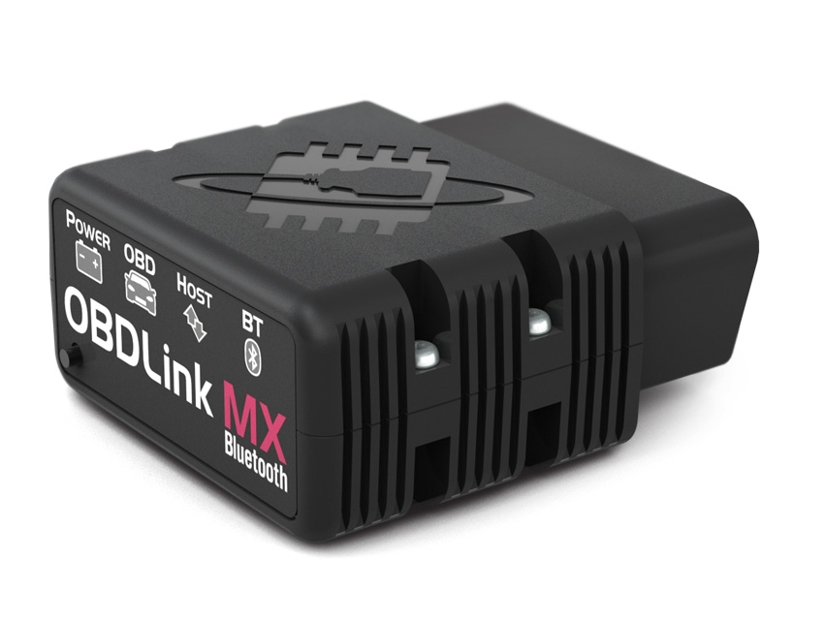
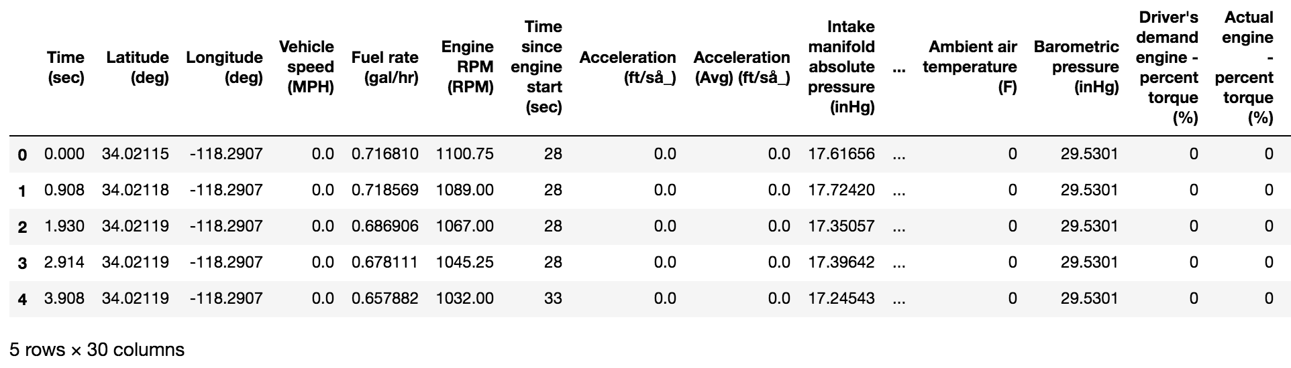
Part 1: Clustering car logs The Data
Collected from Professor Deshmukh’s Toyota Sienna with an OBDLink MX Bluetooth Connector
Sample Data:

Slide 4
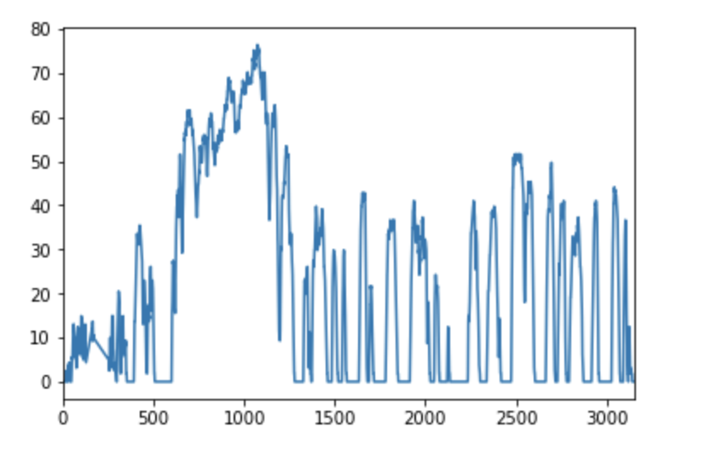
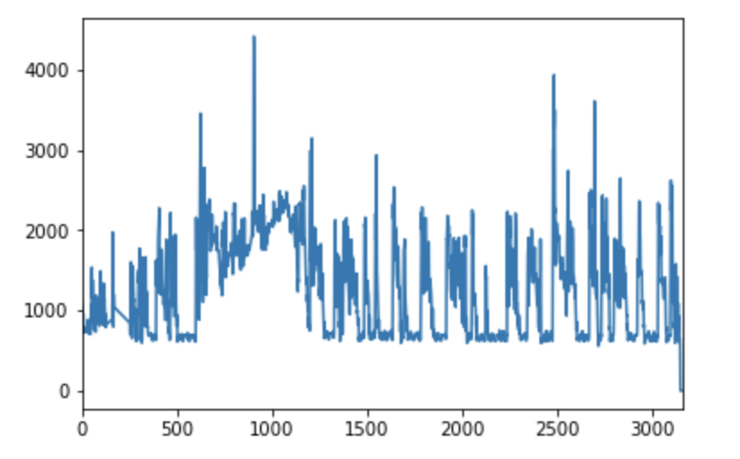
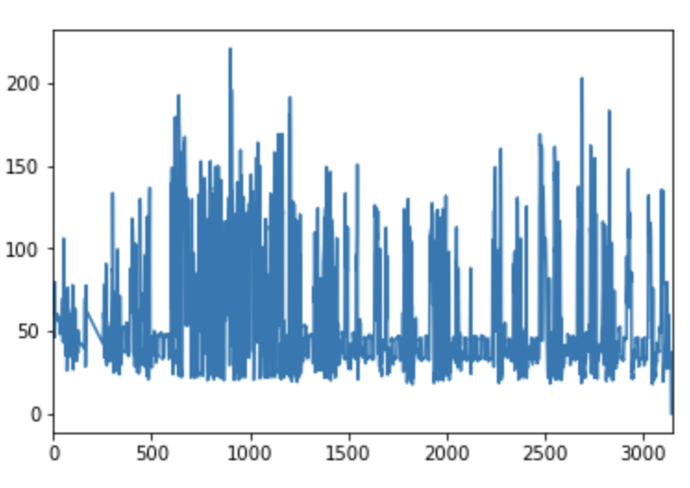
Part 1: Clustering car logs The Data (time series examples from a single time log) Note: x axis is time in seconds
Speed (MPH)
RPM
Torque (lb*ft)

Slide 5
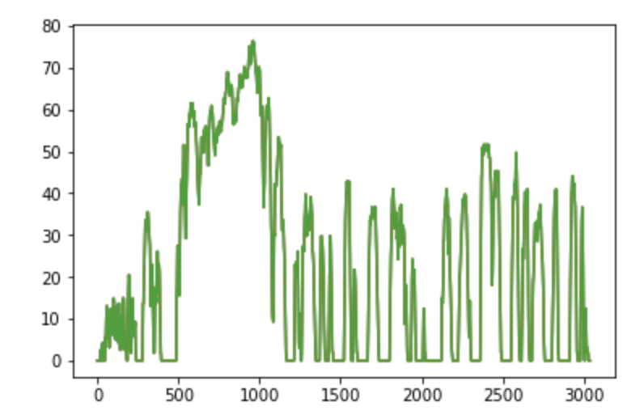
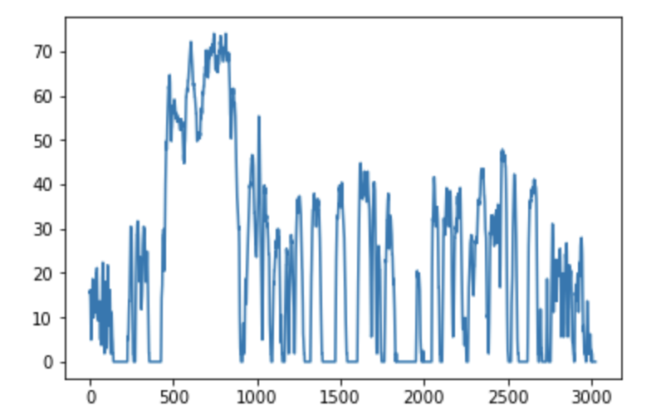
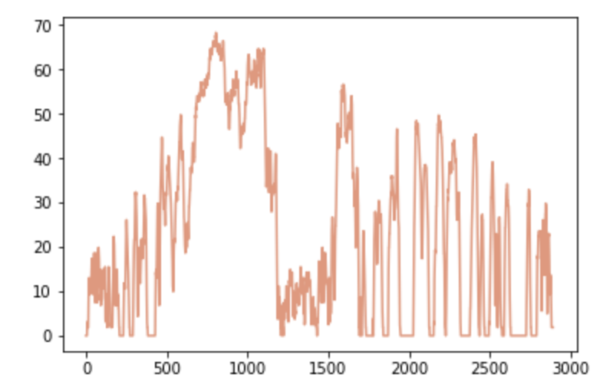
Part 1: Clustering car logs Experiment: Cluster the ’Speed’ (MPH) time series across different logs of the same trip to identify distinct segments of a trip (eg. Which segments are on the highway, which segments are on surface streets, how long are each segment)
Log 1 – MPH
Log 2 - MPH
Log 3 - MPH

Slide 6
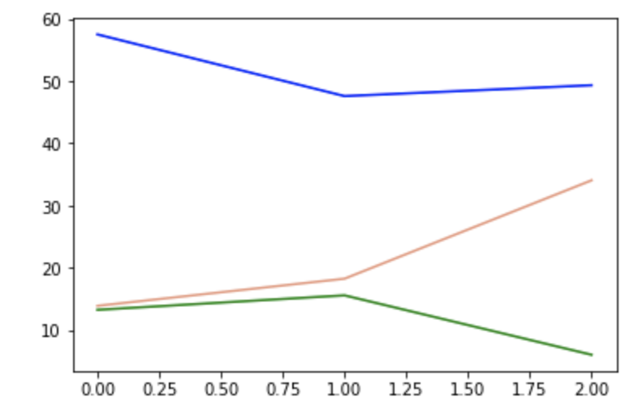
Part 1: Clustering car logs Experiment and Results: Hypothesized that there could be 3 clusters of data
Log 1 – MPH
Log 2 - MPH
Log 3 - MPH
Possibly 3 Clusters
(based on MPH)
driving before freeway
Low-Medium MPH
0 < t < 500
driving on freeway
High MPH
500 < t < 1000
driving after freeway
Low-Medium MPH
1000 < t < 3000
Centroids of Clusters 1 and 3 would be close because of similar MPH
Trained a simple K-Means cluster model using LB-Keogh and Dynamic Time Warping (DTW) to see if these clusters could be identified --→
K-Means (3 centroids) Cluster Results

Slide 7
Part II: Learning with Kitti Data

Slide 8
Part II: Learning with KITTI Data
Objective: Train a model that may inform a self-driving car when to 'Brake' given certain data inputs
Data:
Source: KITTI Vision Benchmark Suite http://www.cvlibs.net/datasets/kitti/index.ph
Drive Data (ie. Lat/long coordinates, velocity, acceleration, etc.)
Camera Images
Labeled Tracklets – XML data describing objects detected during drive like cars, bikes,
Source: KITTI MoSeg http://webdocs.cs.ualberta.ca/~vis/kittimoseg/
Labeled Bounding Boxes of objects found in the Camera Images

Slide 9
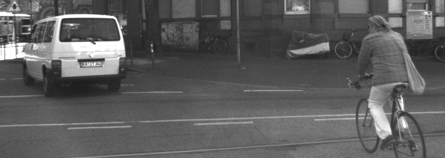
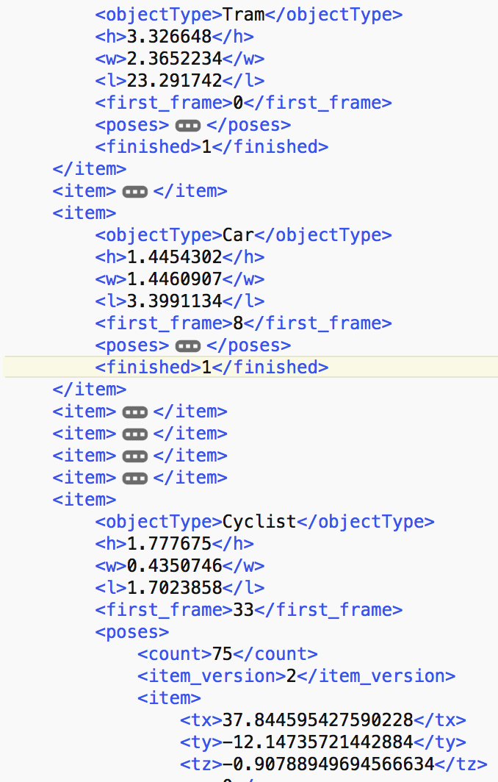
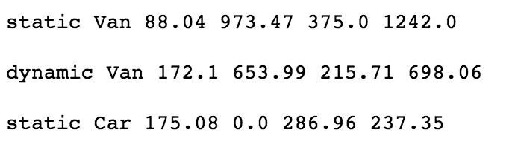
Part II: Learning with KITTI Data Data
Example Camera Image from KITTI
Example Labeled Bounding Boxes from KITTI MoSeg
Example Tracklet Object

Slide 10
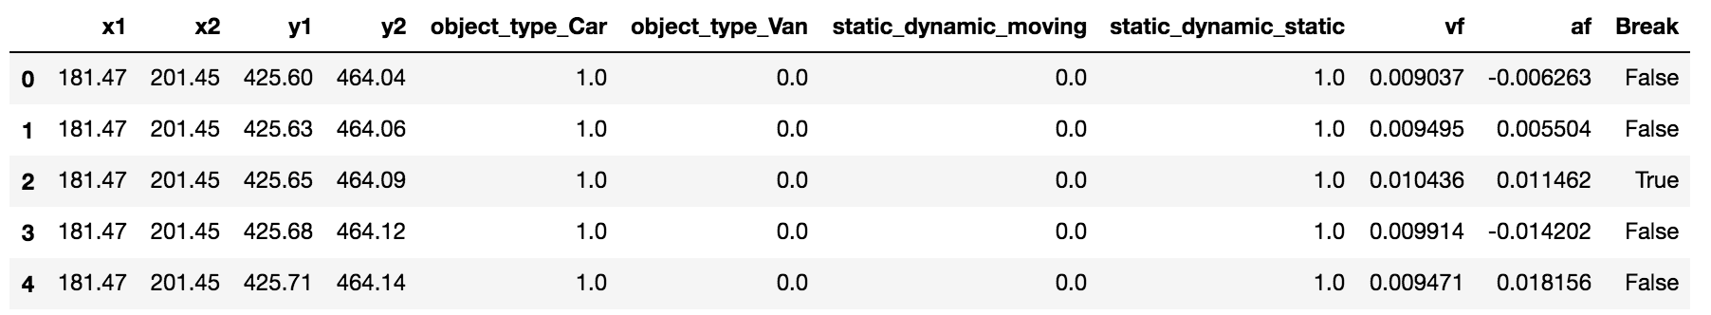
Part II: Learning with KITTI Data Processed Data
Combined the Drive Data from KITTI and labeled Bounding Box Data from KITTI MoSeg project
- Sample data, not all rows/columns shown

Slide 11
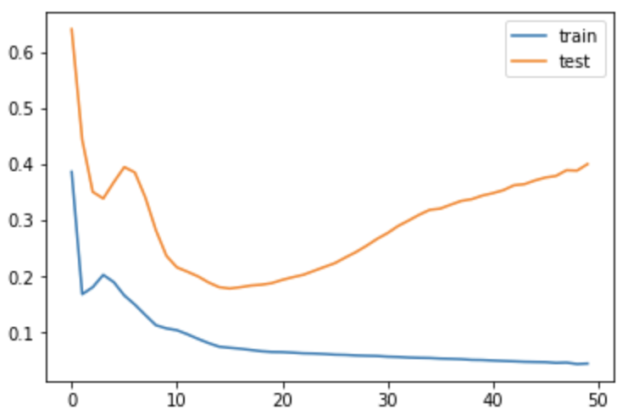
Part II: Learning with KITTI Data Model Development – Predict the ‘Break’ Response Variable over the time for a single drive
Using General ML Classifier Models
Support Vector Machine: Mean Cross Validation Score of 0.628694581281
Gaussian Naive Bayes: Mean Cross Validation Score of 0.566009852217
Decision Tree: Mean Cross Validation Score of 0.749536679537
Using an LSTM model:
Mean Value Loss: 0.29673187792301176
RMSE of LSTM model

Slide 12
Possible next steps

Slide 13
Possible Next Steps & Extension of Research
Continue refining model to predict when to brake
Collect and incorporate different data to train in
Sensor Data
Other data from the tracklets besides the bounding boxes
Refine the model itself
Experiment with HMMs
Refine LSTM
Explore other models
Data distortion
Modify aspects of the KITTI tracklet data and/or images to create new observations
Feed new observations into model as test data
Evaluate if model can interpret the new contrived situation and act accordingly

