Slide 1
Effects and Trends of Social Media on Mental Health
Group 1: Michele Aguilar, Monica Dorsey, Mayra Martinez, Nicholas Armada

Slide 2
Project Overview
Goal: To explore the effects and trends of social media on mental health by analyzing survey data.
Questions Addressed:
Are there correlations between passive scrolling engagement (e.g., passive scrolling vs. active posting) and mental health metrics?
What is the correlation between the frequency or duration of social media use and mental health outcomes like anxiety, depression, or loneliness?
Is there evidence that social media increases feelings of loneliness or isolation, especially in younger users?
Are there notable differences in how social media impacts mental health across age groups (e.g., teens vs. young adults vs. older adults)?
How do different platforms (e.g., Instagram, TikTok, Facebook) impact mental health differently?

Slide 3
Our Approach
Data Sources:
Kaggle: Social Media and Mental Health
Kaggle: 📱💻 Mental Health & Technology Usage Dataset 🌱

Slide 4
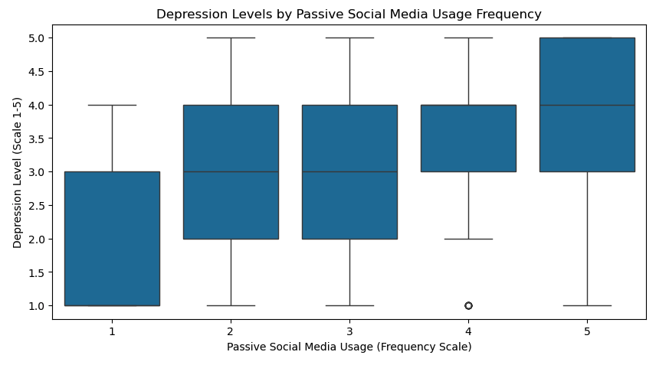
Question 1: Are there correlations between types of engagement (e.g., passive scrolling vs. active posting) and mental health metrics?
Box Plot
Individuals with greater passive social media usage show higher median depression scores
Suggests a positive correlation between passive scrolling and increased depression levels
Only one outlier in highest usage group, with a notably low depression score

Slide 5
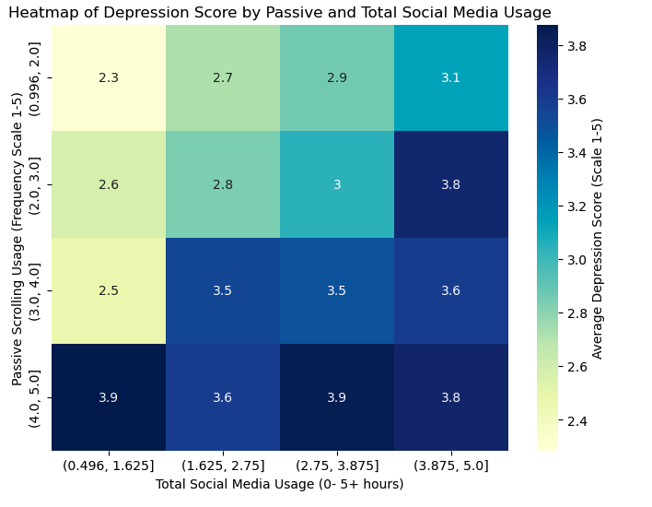
Question 1: Are there correlations between types of engagement (e.g., passive scrolling vs. active posting) and mental health metrics?
Heatmap Findings
Darker Cells: higher depression scores
Elevated depression levels linked to both high passive scrolling and total social media time
Suggests that combined high usage may amplify negative mental health impacts

Slide 6
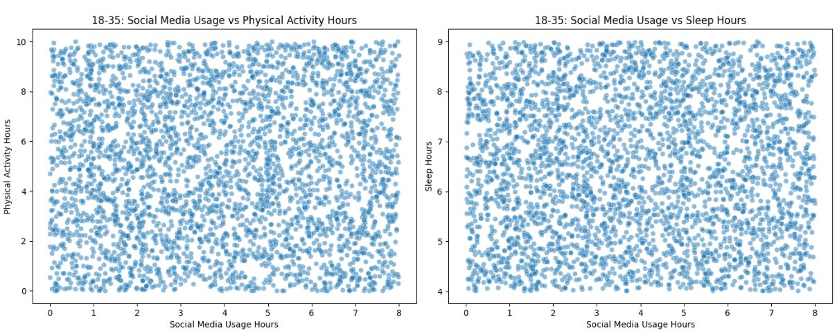
Question 2: Are there notable differences in how social media impacts mental health across age groups?

Slide 7
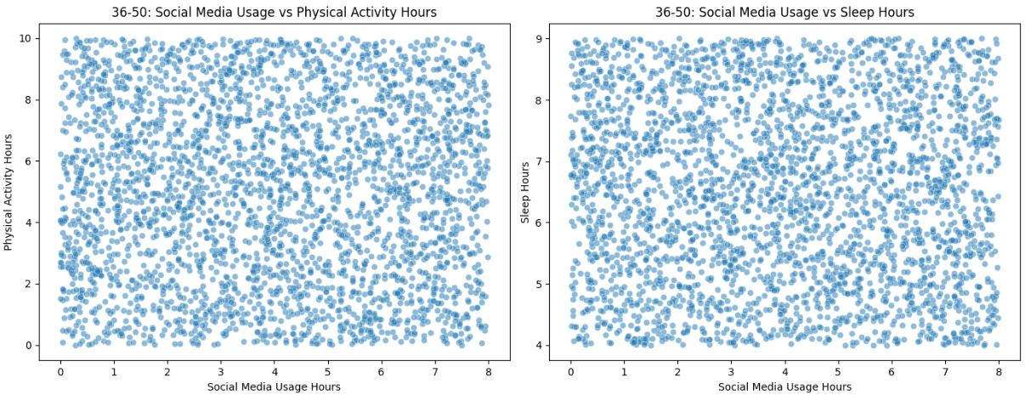
Question 2: Are there notable differences in how social media impacts mental health across age groups?

Slide 8
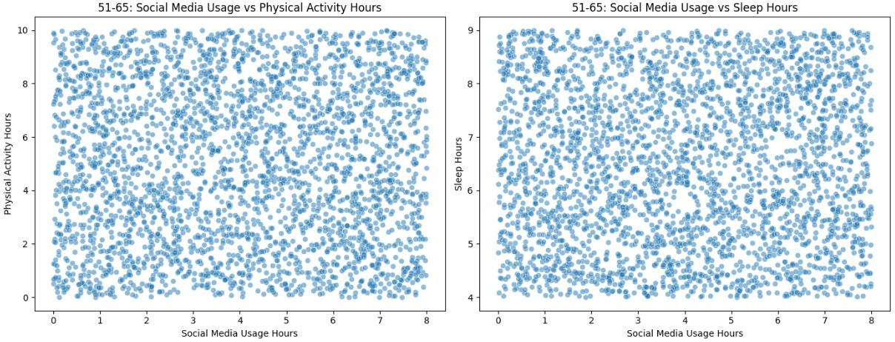
Question 2: Are there notable differences in how social media impacts mental health across age groups?

Slide 9
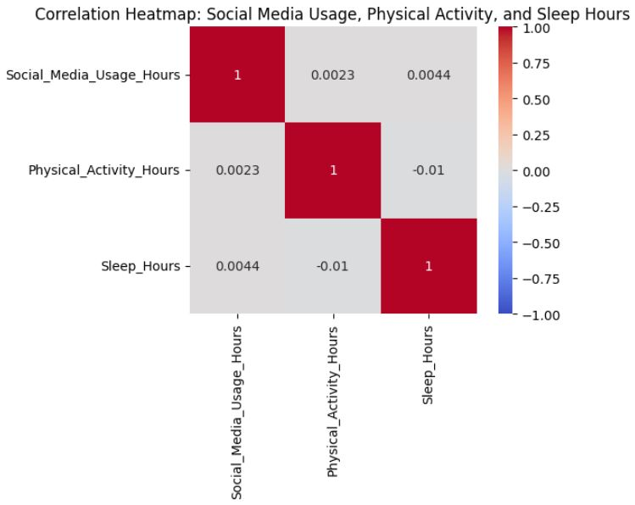
Question 2: Are there notable differences in how social media impacts mental health across age groups?

Slide 10
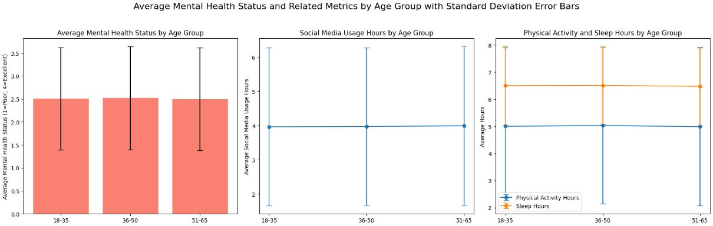
Question 2: Are there notable differences in how social media impacts mental health across age groups?

Slide 11
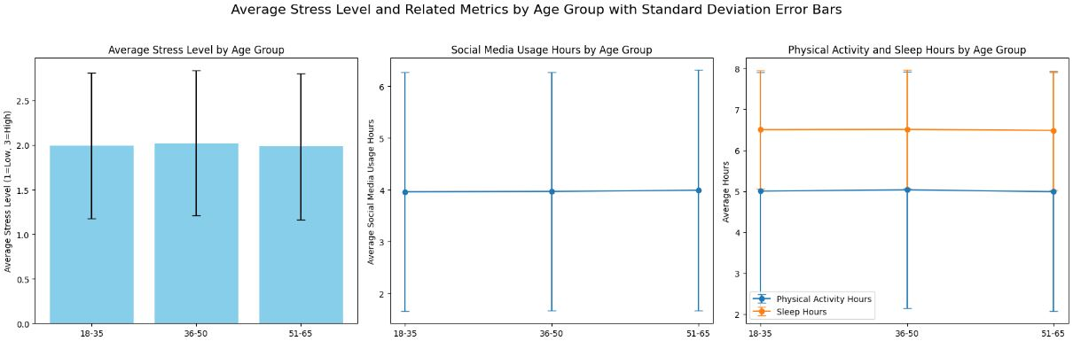
Question 2: Are there notable differences in how social media impacts mental health across age groups?

Slide 12
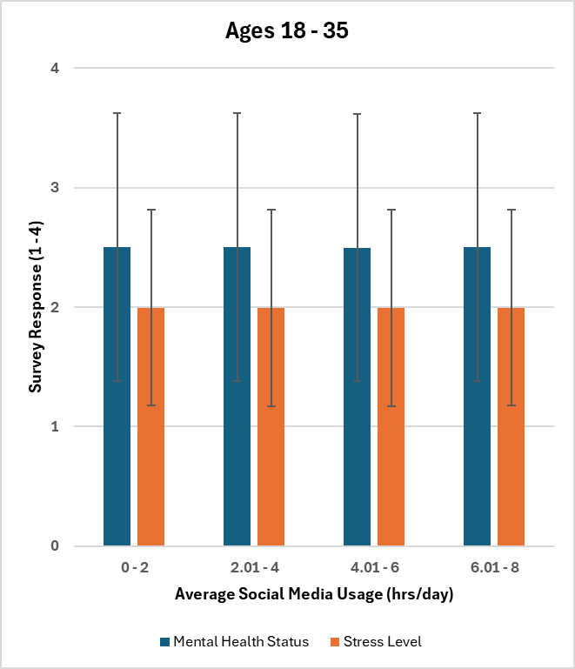
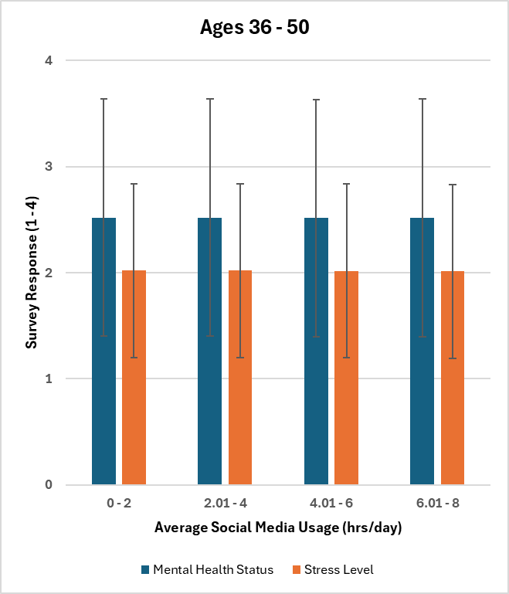

Question 2: Are there notable differences in how social media impacts mental health across age groups?

Slide 13
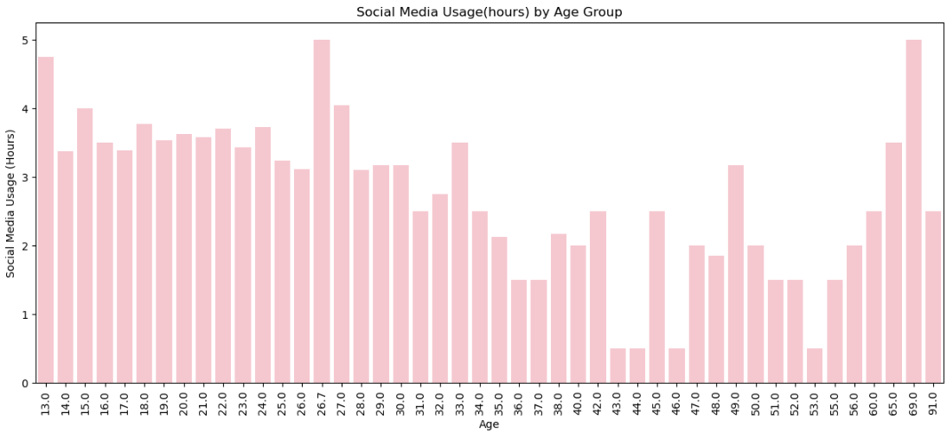
Question 3: What is the correlation between the frequency or duration of social media use and mental health outcomes like anxiety, depression, or loneliness? Especially in younger age groups
Bar graph
Younger ages tend to spend more time on social media.
30-55 ages show a major decrease.
56-69 show a progressive spike.
Graph shows general idea of what people think age and media usage look like.

Slide 14
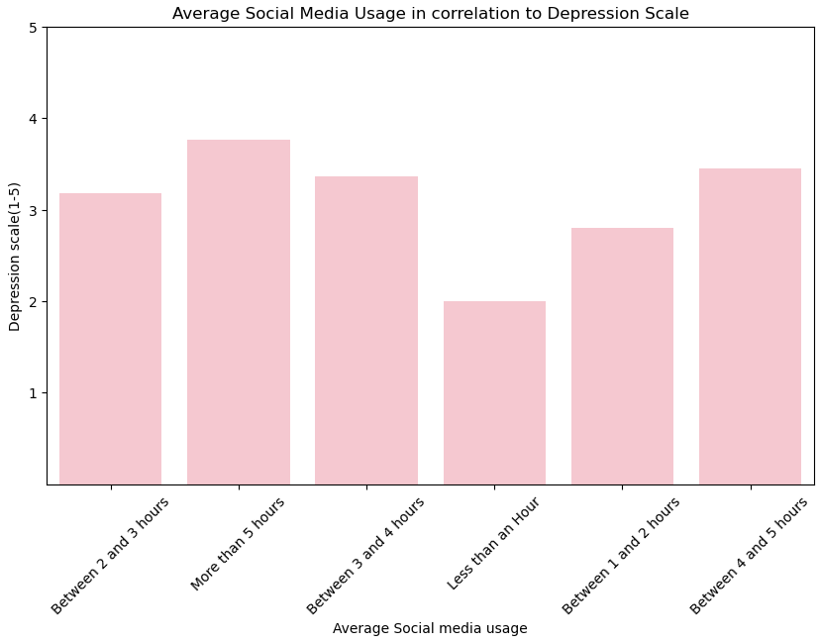
Question 3: What is the correlation between the frequency or duration of social media use and mental health outcomes like anxiety, depression, or loneliness? Especially in younger age groups
Bar plot
People who spend less time on social media are lower on the depression scale
People who spend more amount of time on media are more depressed
Although less time on social media is more likely to lower depression, that does not mean it'll be at zero if you quit social media all together.

Slide 15
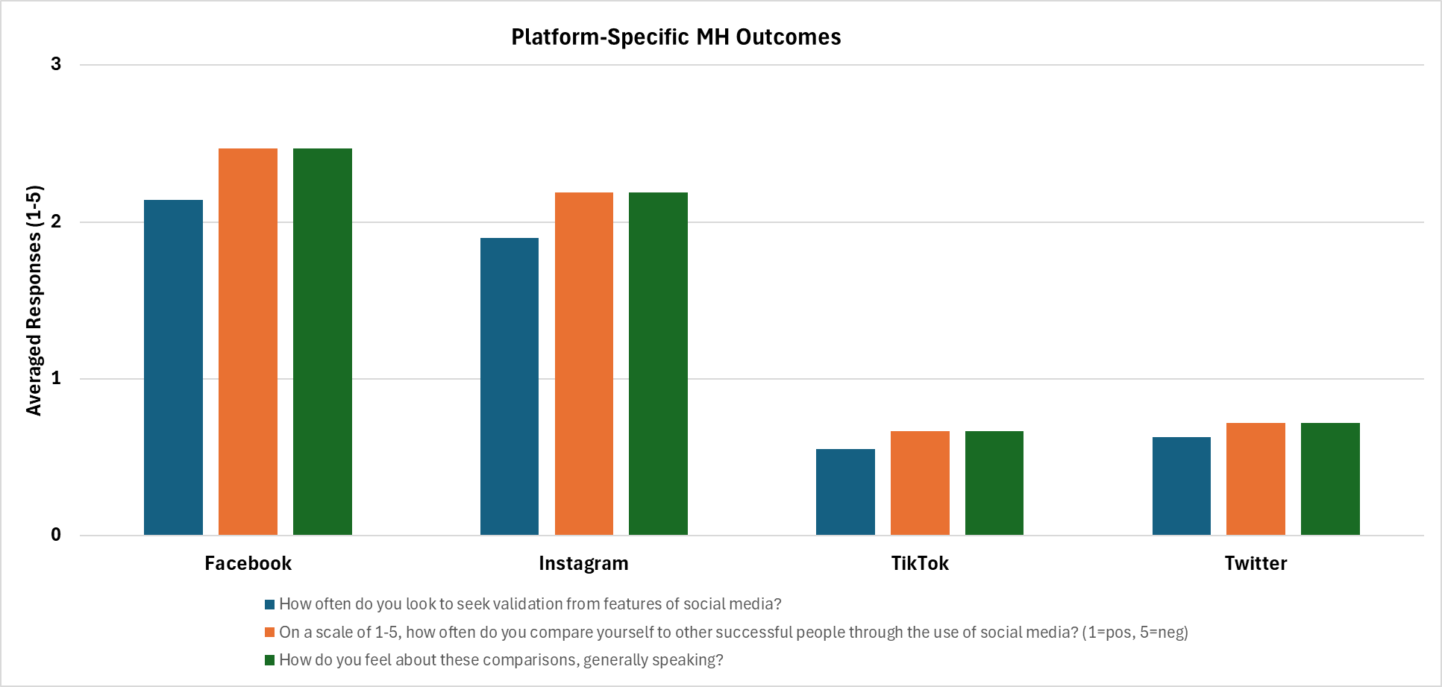
Question 4: How do different platforms (e.g Instagram, Tiktok, Facebook, Twitter) impact mental health differently?
g
People seek more validation from Facebook and Instagram more than Tiktok and Twitter

Slide 16
Summary of Findings
Key Takeaways
Individuals with greater passive social media usage show higher median depression scores.
There seems to be an age-related correlation between average daily social media usage duration and self-reported stress levels and mental health statuses.
Elevated depression levels linked to both high passive scrolling and total social media time. Suggests that combined high usage may amplify negative mental health impacts.
People tend to seek more validation from Facebook and Instagram. The data suggests that people will tend to share more information on Facebook and Instagram to get positive validation.

