Slide 1
Offline Stage
Disturbances
Trajectory
library
Desired
trajectory
Actual
trajectory
Gaussian Process
Offline Training
Goal state
Trajectory
Planner
Trajectory
Executer
Initial state
Max deviation
Desired
trajectory
Reachable
sets
State
observation
Goal state
Fast
Reachability
Recovery and
Replanning
Initial state
Trajectory
Planner
Self/event-triggered
Monitoring
Obstacles
Online Stage
Replanning action

Slide 2
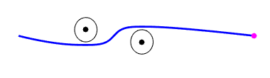
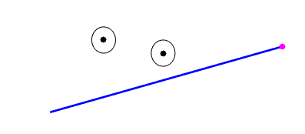
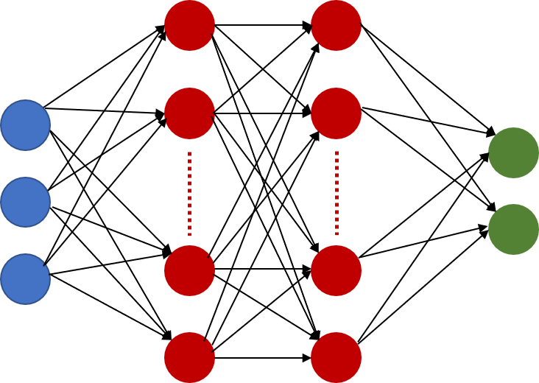
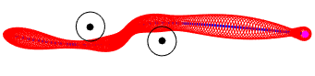
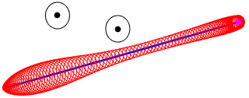
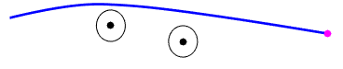
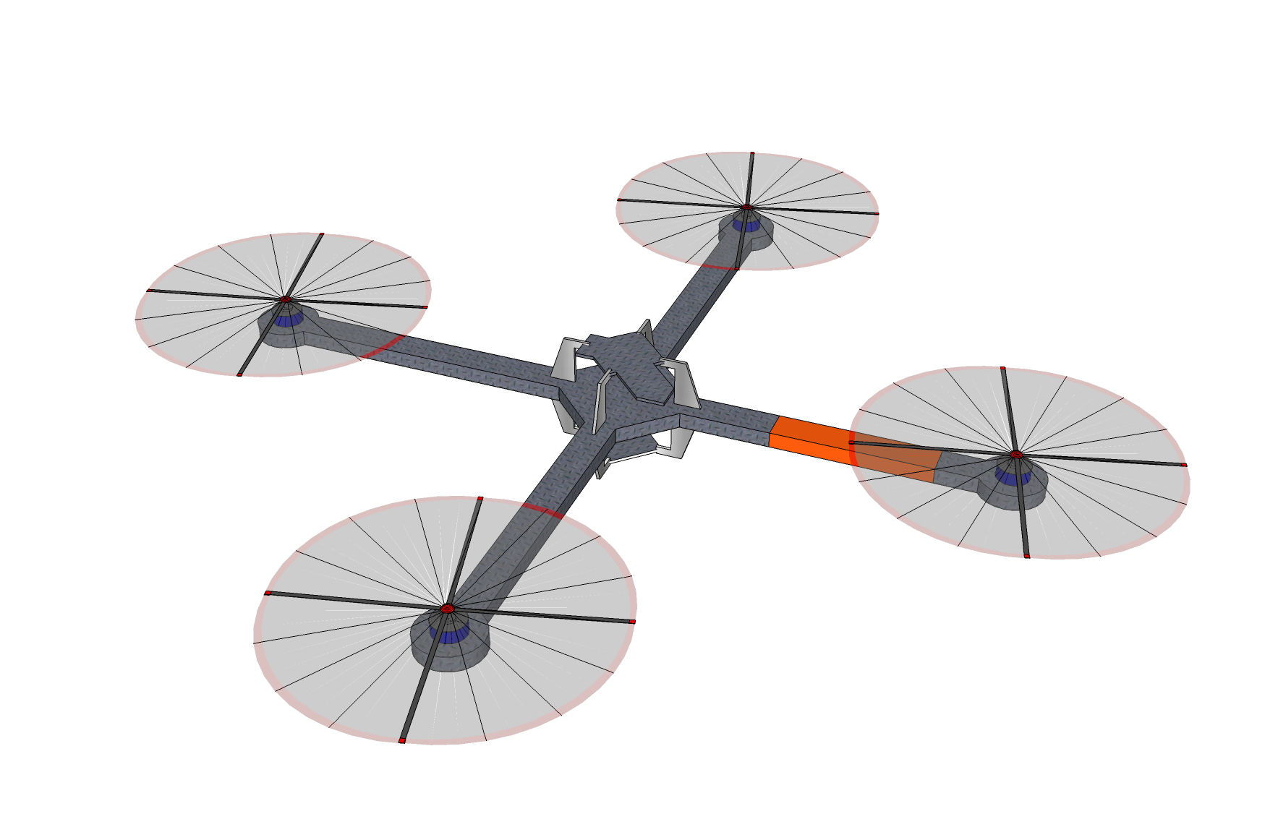
OFFLINE STAGE
Trajectory Planner
Library of labeled
Initial positions
DNN Training
Trained
Network
Verisig
Reachability Analysis
UNSAFE
SAFE
Trajectory Planner
SAFE
Executer
Decision: SAFE or UNSAFE?
UNSAFE
ONLINE STAGE

