Slide 1
RESEARCH PROJECT
Interactive RL
Feature Selection
Does a Decision-Tree-coached RL learner outperform classical feature selection?
Yigal Meshulam · Yuval Wilf
IRFS · One honest benchmark pipeline
Notes:
Welcome. This deck walks through the IRFS project - Interactive Reinforcement Learning Feature Selection. The core question: can a Decision Tree put 'in the loop' of a RL feature selector beat classical methods?

Slide 2
Overview
Section | Guiding Question
Dataset Selection | Which datasets put the method to the test?
Baselines | What are we comparing against?
IRFS Method | How does Full IRFS improve on simple RL?
Ablation Design | Which IRFS components actually matter?
Results & Takeaways | Does IRFS outperform the alternatives?

Slide 3
Two External Datasets Test Different Failure Modes
WDBC
Baseline
Parkinson's Disease Classification
Stress-test
Wisconsin Diagnostic Breast Cancer
KEY DETAILS
KEY DETAILS
569 samples · 30 real-valued features · binary target (malignant vs. benign). Features describe cell shape and texture from biopsy images: radius, area, smoothness, etc. No missing values.
756 voice recordings from 252 subjects: 188 Parkinson's patients and 64 healthy controls, with 3 sustained vowel recordings per subject. In our pipeline: 753 candidate features after dropping subject id and target class. No missing values.
WHY IT MATTERS
WHY IT MATTERS
A compact, well-known biomedical benchmark. Good for checking whether the pipeline works under a clean, low-dimensional setting.
A high-dimensional biomedical dataset where feature selection really matters. Because each subject has repeated recordings, the split must be subject-aware to avoid leakage.
Notes:
WDBC is the sanity check - if the pipeline can't work here, nothing else matters. Parkinson's is where it gets genuinely hard: 753 features on 480 training rows (p > n), 3:1 class imbalance, and a subject-aware split to prevent leakage.

Slide 4
Baselines - Classical + MARLFS
Four classical single-shot methods and one iterative RL baseline - all scored by the same probe on the same splits.
Filter
Relevance Top-k
Wrapper
DT Recursive Elimination
Filter
mRMR
Ranks features by their correlation with the label and keeps the top half. Fast, but blind to redundancy between features.
Build a Decision Tree, drop the least-used feature, rebuild, repeat until half remain. Re-evaluates survivors each round.
Minimum Redundancy Maximum Relevance. Picks features that are relevant to the target and non-redundant with each other.
Single pass · fixed size
Iterative · fixed size
Diverse coverage · fixed size
Embedded
L1 / LASSO
RL
MARLFS (Simple RL)
Fit a model with an L1 penalty; features whose influence collapses to zero are dropped. Decides its own subset size.
RL baseline: one agent per feature learns whether to keep or drop it.
Variable size
Iterative · learned
Notes:
The four classical methods are all single-shot - they decide once and return a subset. Simple RL learns iteratively but without coaching or a rich feature state. These five are the bar that full IRFS must clear.

Slide 5
Simple RL - How the Loop Works
1
Start with a Subset
Seed the search with a random half-subset - not empty, not all features. Gives the loop a valid world to improve from.
S₀ = sample(F, max(1, n ÷ 2))
4
Learn, Carry Forward, Repeat
2
Observe and Vote
Store agent's transition, apply a Q-learning update to its value network, and carry the subset into the next step.
A voting
loop with
memory
Each feature sees its own [relevance, redundancy] state and votes SELECT or DESELECT ε-greedily.
target(a_{i}) = reward + γ · max Q_{i}(s′_{i}), γ = 0.9 repeat n steps → return best-ever subset
s_{i} = [|corr(x_{i}, y)|, mean|corr(x_{i}, x_{j})|] a_{i} = ε-greedy(Q_{i}(s_{i})), ε = 0.1 Q_{i} - Linear(2,128) | ReLU | Linear(128,128) | ReLU | Linear(128,2)
3
Score and Reward the Subset
Collect SELECT votes into a subset, score validation accuracy, and penalize redundancy.
reward(S) = acc(S) − β · penalty(S) penalty(S) = mean_{i<j∈S}|corr(x_{i}, x_{j})|
Notes:
Key insight: the loop keeps the best-ever subset, not the final step. Agents improve over 250 rounds but there is no coaching or feature-specific reward - that is what Full IRFS adds.

Slide 6
Full IRFS - Three Additions to Simple RL
Full IRFS adds three targeted improvements to Simple RL:
Handle Hesitates with Trainers
1
Prevent useful features from being dropped too early.
Richer State
2
Let each agent judge a feature in context, not alone.
Personal Reward
3
Give clearer credit to the features that actually helped.
Notes:
Three improvements over Simple RL: coaching hesitant agents, richer per-feature state, personalized reward signal.

Slide 7

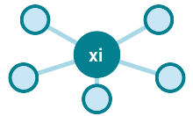
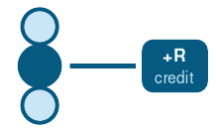
Full IRFS Adds Coaching, Context, and Credit
COACHING
CONTEXT
CREDIT
Trainers
Richer State
Personal Reward
Relevance and Decision Tree trainers help hesitant agents avoid dropping useful features too early.
Agents judge features with more context: value statistics, feature correlations, and tree importance of selected features.
Tree importance becomes a reward multiplier, giving stronger credit to features that actually helped.
Notes:
Three targeted improvements over Simple RL: trainer coaching prevents premature deselection; richer state gives each agent more context; personalized reward sharpens credit assignment.

Slide 8
Reinforced Coaching Variants
All four variants keep the same state and reward. Only the coaching source changes.
1
No-trainer RL
Trainer: None
No coaching baseline
2
Relevance-only
Trainer: Relevance trainer
Advice from feature-label relevance
3
DT-importance-only
Trainer: Decision Tree importance trainer
Advice from DT feature importance
4
Full IRFS
Trainer: Relevance → DT-importance → withdrawn
Headline method - Hybrid Teaching schedule
This isolates the coaching effect: same state, same reward, different advice source.
Notes:
The ablation study is designed to answer not just 'does it work' but 'which part earns its keep'. This is what makes the result scientifically credible.

Slide 9
WDBC Final Results: Test Accuracy, Validation Accuracy, and Feature Count
Group | Method | Test Accuracy | Val Accuracy | Features | Win. Best | Win. Avg
Classic | relevance_topk | 91.75% ± 2.49 | 91.87% ± 3.16 | 15.0 ± 0.0 | - | -
Classic | dt_rfe | 91.49% ± 3.07 | 92.09% ± 3.06 | 15.0 ± 0.0 | - | -
Classic | mrmr | 91.40% ± 3.03 | 92.20% ± 3.13 | 15.0 ± 0.0 | - | -
Classic | l1 | 93.42% ± 1.81 | 91.54% ± 3.07 | 13.1 ± 2.3 | - | -
MARLFS | marlfs | 91.14% ± 3.05 | 97.58% ± 1.78 | 16.0 ± 2.6 | 97.58% | 92.59%
Ablation | no_trainer | 92.54% ± 1.81 | 96.92% ± 2.31 | 18.8 ± 3.1 | 96.92% | 92.46%
Ablation | relevance | 92.19% ± 3.37 | 95.71% ± 2.81 | 21.9 ± 4.0 | 95.71% | 92.55%
Ablation | dt_importance | 92.02% ± 2.36 | 95.27% ± 2.84 | 18.6 ± 2.3 | 95.27% | 92.50%
Full IRFS | full_irfs | 91.49% ± 3.18 | 96.48% ± 2.73 | 18.1 ± 2.8 | 96.48% | 92.56%
L1 wins test accuracy and compactness. MARLFS leads validation.
Protocol: mean ± std over 10 seeds.

Slide 10
Parkinsons Final Results: Test Accuracy, Validation Accuracy, and Feature Count
Group | Method | Test Accuracy | Val Accuracy | Features | Win. Best | Win. Avg
Classic | relevance_topk | 74.25% ± 2.87 | 75.77% ± 5.90 | 376.0 ± 0.0 | - | -
Classic | dt_rfe | 71.24% ± 5.49 | 73.50% ± 6.26 | 376.0 ± 0.0 | - | -
Classic | mrmr | 72.81% ± 3.48 | 74.63% ± 4.68 | 376.0 ± 0.0 | - | -
Classic | l1 | 70.59% ± 4.69 | 76.10% ± 3.53 | 122.2 ± 9.7 | - | -
MARLFS | marlfs | 69.02% ± 6.71 | 85.37% ± 3.45 | 368.6 ± 15.0 | 85.37% | 75.23%
Ablation | no_trainer | 70.46% ± 3.71 | 84.23% ± 3.38 | 398.8 ± 15.0 | 84.23% | 73.79%
Ablation | relevance | 72.29% ± 4.10 | 81.14% ± 4.04 | 527.0 ± 29.9 | 81.14% | 73.43%
Ablation | dt_importance | 72.55% ± 4.13 | 79.35% ± 4.17 | 404.8 ± 18.9 | 79.35% | 72.77%
Full | full_irfs | 75.16% ± 2.61 | 83.09% ± 2.95 | 431.6 ± 49.5 | 83.09% | 73.69%
Full IRFS wins test accuracy. MARLFS wins validation. L1 is most compact (122 vs. 368-432 features).
Protocol: mean ± std over 10 seeds; Parkinsons split is subject-aware to prevent repeated-recording leakage.

Slide 11
Final Verdict
IRFS earns its complexity only on hard, high-dimensional tasks.
Win
IRFS wins on the harder Parkinsons task.
75.16%
vs. 74.25% classical
Loss
On the low-dim WDBC benchmark, L1 is both more accurate and more compact.
L1: 93.42%
vs. 91.49% IRFS
Cost
On Parkinsons, IRFS buys accuracy by keeping many more features.
431.6 feat.
vs. L1: 122.2
Takeaway · Use IRFS when high-dimensional interactions matter and accuracy is worth a larger feature set; prefer simpler methods when compactness matters.
Notes:
IRFS can help on hard high-dimensional datasets but trades compactness for accuracy. It is not automatically better than classical methods.

Slide 12
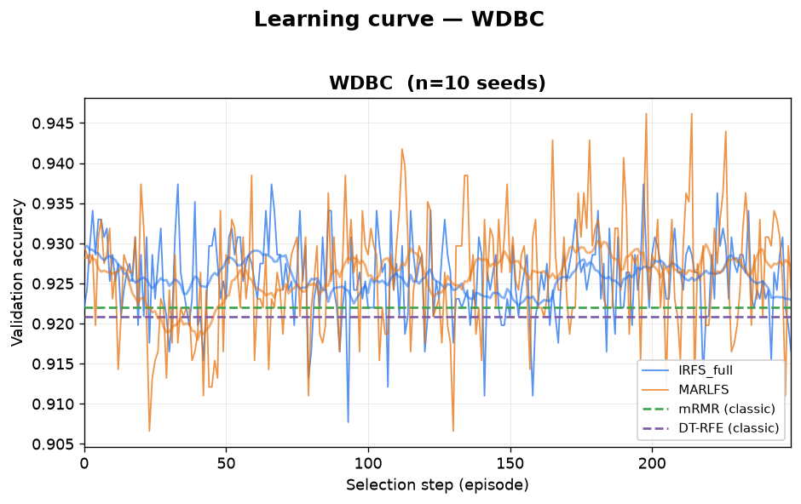
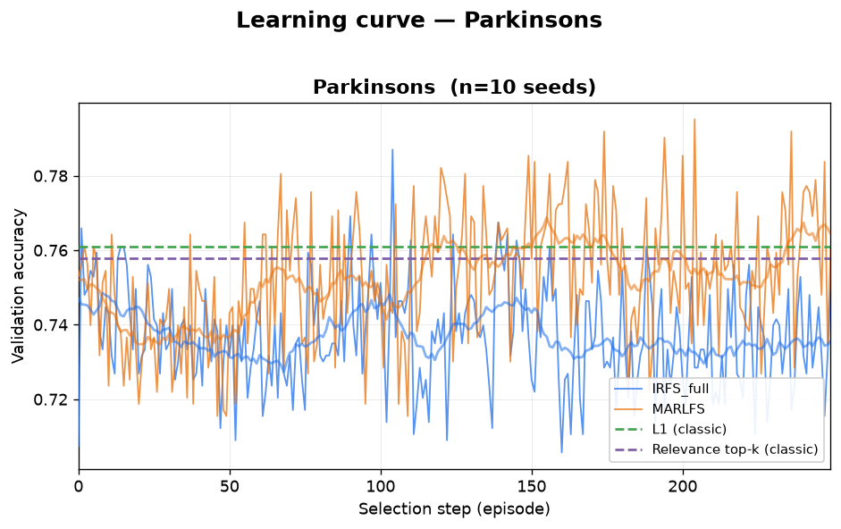
Appendix 1: Learning Curves
WDBC
Parkinsons
Notes:
Learning curves showing validation accuracy over training steps for WDBC and Parkinsons datasets.

Slide 13
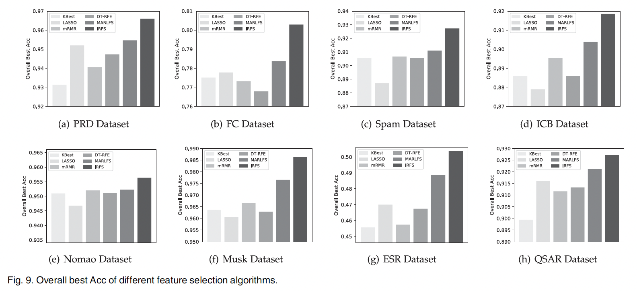
Appendix 2: Original Paper Results (Fig. 9)
▸ No standard deviation or random seed reported.
▸ Random 80/20 split - not subject-leakage-free.
▸ Most questionable for PRD, Musk, and ESR: these datasets have grouped structure that a stronger evaluation should respect.
Notes:
Original paper Fig. 9. No std or seed reported; random 80/20 split is not subject-leakage-free. PRD, Musk, and ESR have grouped structure that makes random splitting questionable.

