Slide 1
Classification Models
for
Data Exfiltration Detection
Done by : Group 3

Slide 2
Table of contents
01
02
03
Dataset Used
ML Algorithms
Data
Preprocessing
04
05
06
Result Analysis
Conclusion
Demonstration

Slide 3
Dataset Used
01

Slide 4


MITRE ATT&CK Techniques
T1041
T1048
Exfiltration over
C2 Channels
Exfiltration over
Alternative protocols

Slide 5
T1041 - Exfiltration over C2
05
12
20
21
22
DNS
HTTP
DNS
FTP
SSH

Slide 6
T1048 - Exfiltration over AP
08
10
11
17
18
DNS
SSH
HTTP
DNS
SSH
Notes:
DNS SSH HTTP DNS SSH
8 10 11 17 18

Slide 7
Data Preprocessing & Cleaning
02

Slide 8

Encoders Used
Label
One Hot
Used on column consisting of binary values
Used on column consisting of categorical values

Slide 9

Data Preprocessing & Cleaning
Host Name
Categorical Data
Type
Categorical Data
Features
Network Transport
Categorical Data
Source IP - 1
Categorical Data

Slide 10
Data Preprocessing & Cleaning
Source IP - 2
Categorical Data
Source IP - 3
Categorical Data
Features
Source IP - 4
Categorical Data
Source MAC
Categorical Data

Slide 11
Data Preprocessing & Cleaning
Destination Port
Categorical Data
Bytes_in
Continuous Data
Features
File Name
Categorical Data
File Extension
Categorical Data

Slide 12

Data Preprocessing & Cleaning
0
Data Exfil
Dependent
Feature
1

Slide 13
03
ML Algorithms

Slide 14

Machine Learning Algorithms
Logistic Regression
Naive
Bayes
K-Nearest Neighbors
Random Forest

Slide 15
04
Result Analysis

Slide 16
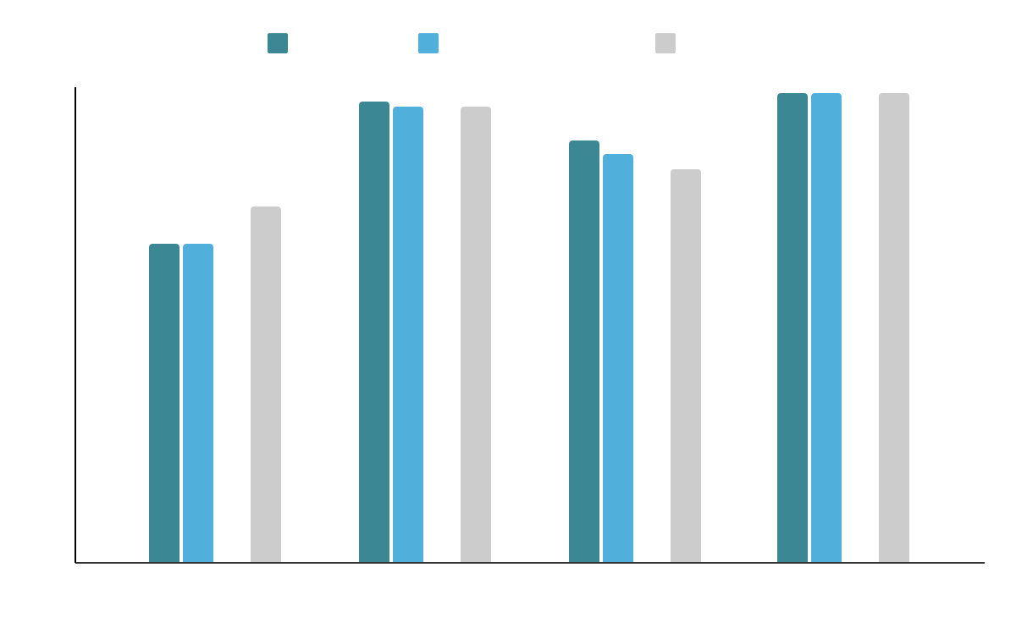
Results Analysis
Selected Algorithm
Random Forest

Slide 17
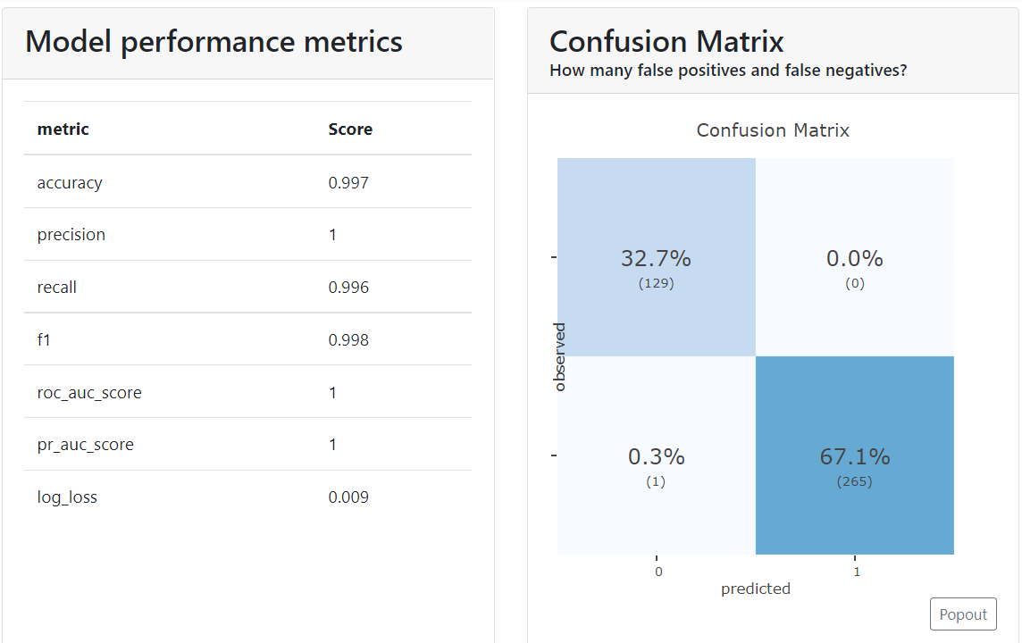

Notes:
Dashboard for KNN algorithm

Slide 18
05
Conclusion

Slide 19

Conclusion
Random
Forest
Future
Works
Final selected ML algorithm
Informative Datasets
Deep Learning Technique

Slide 20

06
Demonstration

Slide 21
Thank You
Done by - Group 3

