Slide 1
Komponentenprogrammierung &
Middleware
Ping
2014-07-17
Nicco Kunzmann, Angelo Haller

Slide 2
Agenda
Technologies & Motivation
Architecture
Demo
Challenges
Discussion

Slide 3
Technologies & Motivation

Slide 4
Motivation
Familiar with Python
  Try out Python Remote Objects
Interoperability of different languages
  Combining statically typed and dynamically typed lanuages
No CORBA

Slide 5



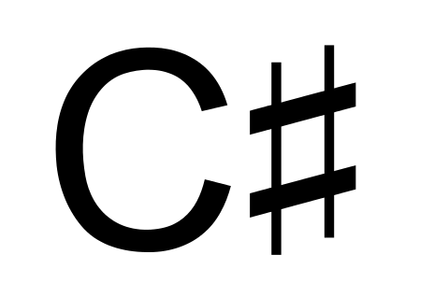

Technologies
Languages:
Frameworks:
Python Remote Objects

Slide 6
Python IronPython C#
Python Jython Java
Python C#
Python Java
Pyro
Pyro
Pyrolite
Pyrolite

Slide 7
Pyro
Pyrolite
Python, IronPython, Jython
Calls on proxies
Can host objects
Futures
Register in nameserver
C#, Java
Calls on proxies

Slide 8
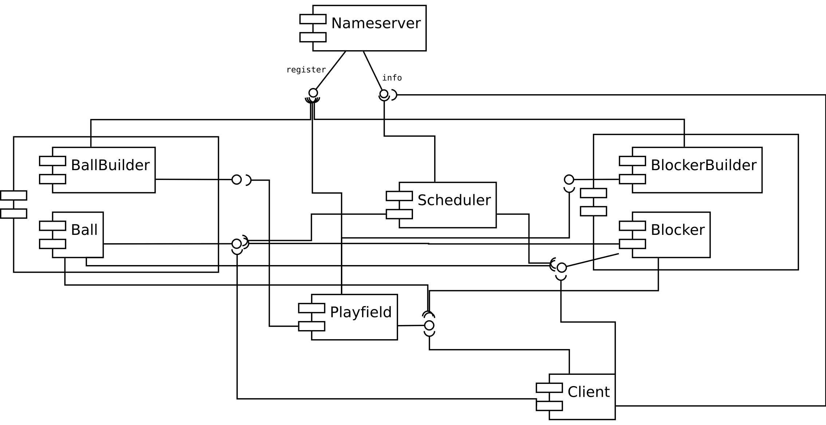
Architecture

Slide 9
Demo
https://github.com/niccokunzmann/ping

Slide 10
Challenges

Slide 11
Synchronous/Asynchronous
private void update_balls()
{
List<Object> proxies = (List<Object>)playfield.call("get_balls");
foreach (PyroProxy ball in proxies)
{
//synchronous: copy data
balls.Add(Ball.FromPyroProxy(ball));
}
}

Slide 12
Casts (Python)
def get_x(self):
return int(self.x)

Slide 13
“Ugly Calls” (C#)
C# way:
What it actually looks like:
playfield.getWidth();
(int)playfield.call(“get_width”);

Slide 14
“Ugly Calls” (C#)
Solution DynamicObject:
public class PyroProxy : DynamicObject
{
public override bool TryInvokeMember(InvokeMemberBinder
binder, object[] args, out object result)
{
result = call(binder.Name, args);
return true;
}
}
dynamic playfield = new PyroProxy();
playfield.get_width(); //still not playfield.getWidth();

Slide 15
“Ugly Calls” (C#)
Solution ExtensionMethods:
public static class ExtensionMethods
{
public static int getWidth(this PyroProxy proxy,
params object[] arguments)
{
return (int)proxy.call("get_width", arguments);
}
}
dynamic playfield = new PyroProxy();
playfield.getWidth();

Slide 16
URI Resolution
Wrong IP address
pyro:obj_98d3b51...ea1cac@192.168.0.101:4853
pyro:obj_98d3b51...ea1cac@127.0.0.1:4853
Solution: explicit binding to one host

Slide 17
Port Numbers Are Limited!
“Only” 65535 ports
1 connection / Pyro proxy
Many short lived proxies created constantly
Framework assumes proxy reuse

Slide 18
Port Numbers Are Limited!
Exception in thread "main" java.net.NoRouteToHostException: Cannot assign requested address
at java.net.PlainSocketImpl.socketConnect(Native Method)
[...]
at ping.Scheduler.main(Scheduler.java:27)
[Errno 10055] An operation on a socket could not be performed because the system lacked
sufficient buffer space or because a queue was full

Slide 19
Discussion

Slide 20
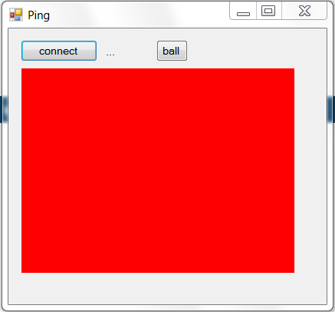
Real World Context
student.call_oneway(“discuss”);

Slide 21
Sources
https://pythonhosted.org/Pyro4/_images/pyro-large.png
http://en.wikipedia.org/wiki/.NET_Framework#mediaviewer/File:Microsoft_.NET_Framework_v4.5_logo.png
http://en.wikipedia.org/wiki/Java_(programming_language)#mediaviewer/File:Java_logo_and_wordmark.svg
http://en.wikipedia.org/wiki/C_Sharp_(programming_language)#mediaviewer/File:C_Sharp_wordmark.svg
http://en.wikipedia.org/wiki/Python_(programming_language)#mediaviewer/File:Python_logo_and_wordmark.svg
http://stackoverflow.com/questions/24365101/c-sharp-generate-method-if-not-existent?noredirect=1#24365101

