Slide 1
Sales Analytics
Walmart 2010-2012
Marla Blanco, Nic Duffee, Alia Tirado-Smith, Sara Bagherikashkooli

Slide 2
Overview
The aim of this project is to examine Walmart store sales data from 45 stores across the years 2010-2012, utilizing knowledge of machine learning to develop a model that can predict future sales numbers for these stores.
We are determining whether or not the weather, unemployment rates, gas prices, or holidays have a marked effect on sales at these locations. Also we wanted to know whether or not these elements’ effects have changed over the 3 years of data that we’re using, and what trends might affect future sales.

Slide 3
Project objective:
Develop a ML Model to Predict future sales at 45 Walmart stores

Slide 4
Methodology and Roadblocks
Skills Used
Group Assignments
Roadblocks
Python
Pandas
Amazon Web Services
Google Colab
SparkSQL
Tableau
Linear Regression
Random Forest Regression
Github
Alia: Cleaning and Processing
Nic: Data Exploration, AWS Bucket Creation & Hosting
Marla: ML and Data Modeling, Further Cleaning
Sara: Tableau Visualizations and Story.
Creative struggles while cleaning the data.
There were several unsatisfactory ML models that did not reach the levels of accuracy desired.
Trouble with visualizing the data in Tableau
Configuring permissions on S3 Bucket

Slide 5
Data Questions:
How do the different stores' weekly sales compare?
How do the holiday periods affect sales?
What effect does the local fuel prices have on sales numbers?
What effect does the local temperature have on sales numbers?
Does the local Unemployment percentage have a positive or negative effects on sales?
Does the Consumer Price Index (CPI) have an affect on sales numbers?

Slide 6
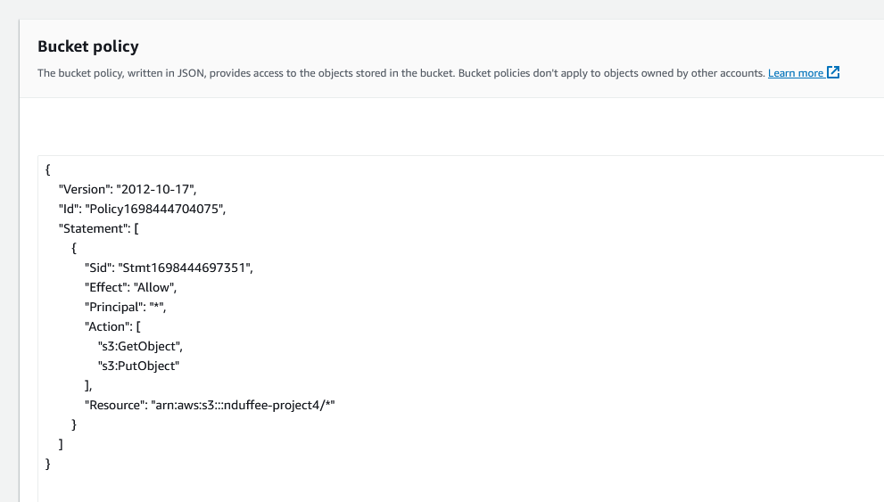
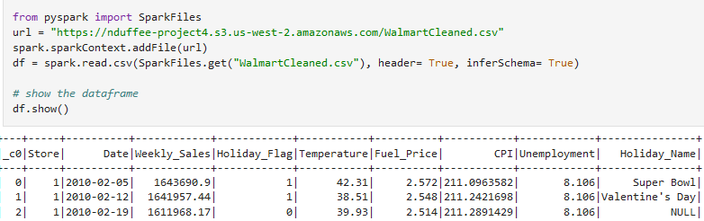
Data Exploration
Initially started generating a PostGreSQL database and Queries but decided to switch to SparkSQL
Understanding S3 bucket permissions took some time
SparkSQL query for each question
Converted to pandas df to plot using matplotlib for some questions to guide tableau

Slide 7
Tableau Story

Slide 8
Summary of Findings
Trend 1
Sales at each store only minorly fluctuate with changes in:
Local employment rates
Cold or Hot weather
Gasoline prices
Consumer Price Index
Trend 2
There are significant spikes in weekly sales around the major end of year holidays:
Marketing
Celebration
Culture of ‘holiday sales’
Notes:
Spikes in sales could be due to, ble bla

Slide 9
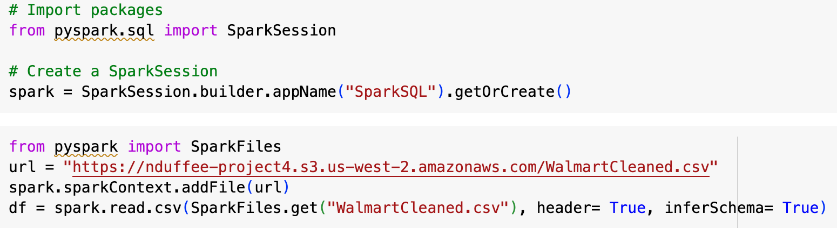
Supervised Machine Learning
Linear Regression vs. Random Forest Regression
Process:
-Create Spark session to call S3 data
-Further clean data
-Remove outliers
-Determine target variable and features
-Train, test, split
-Evaluate metrics to determine if successful

Slide 10
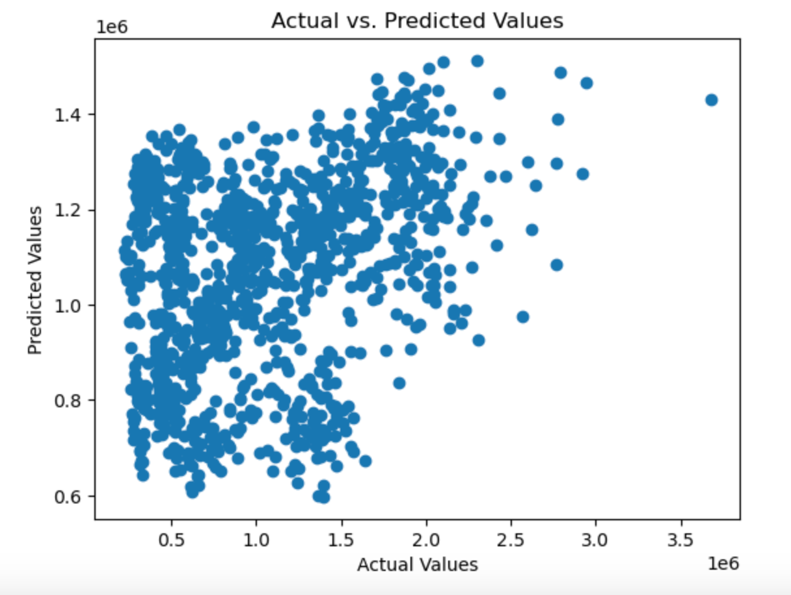
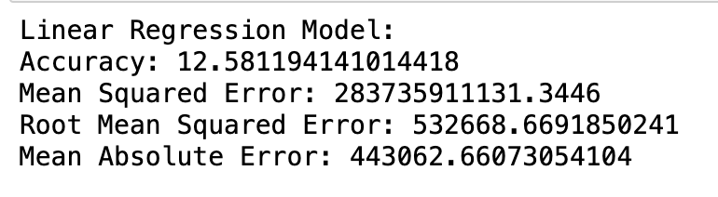
Linear Regression Model
Less than 13% accuracy

Slide 11
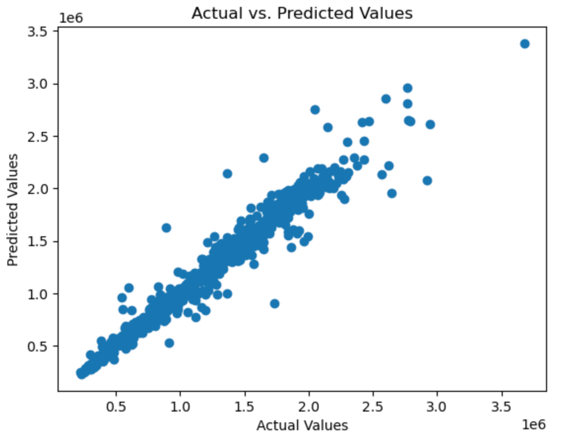
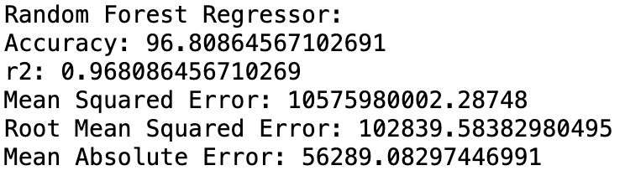
Random Forest Regression Model
Almost 97% accuracy!

Slide 12
ML Roadblocks
A lot of trial and error
-Outliers
-Splitting Date into day, month, and year
-To scale or not to scale data
-When linear regression model was unsuccessful, deciding which model to attempt next

Slide 13
Future Sales Analysis
As always there is more to learn and know with data, and there are some questions we could explore in the future:
Are some stores showing increasing or decreasing overall sales across a larger time period?
Can we predict a change in popularity of certain holidays over the years?
Provided with department data, what is the breakdown of sales by department?

Slide 14
Questions?

