Slide 1


Slide 2
Aim of the Project
San Diego is known as a military town
Explore Veterans Affairs budget and veteran population data
How does San Diego compare?
Evaluate any relationship between program cost and number of users

Slide 3

The Data
Data sourced from Data.gov
Department of Veterans Affairs are required to publish all information as open data
2010 - 2015 Veteran Population & Budget Expenditure data
Census API for Veteran Population
Compensation & Pension program data

Slide 4
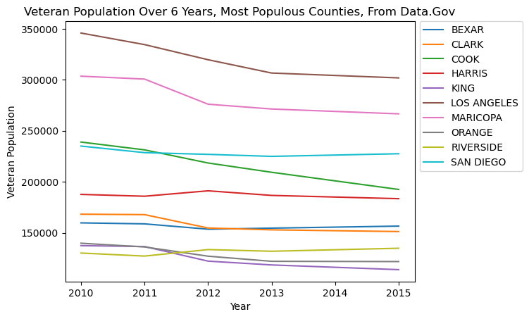
Where do Veterans Reside?
San Diego is #3 in veteran population. However, we noticed something strange about this.

Slide 5
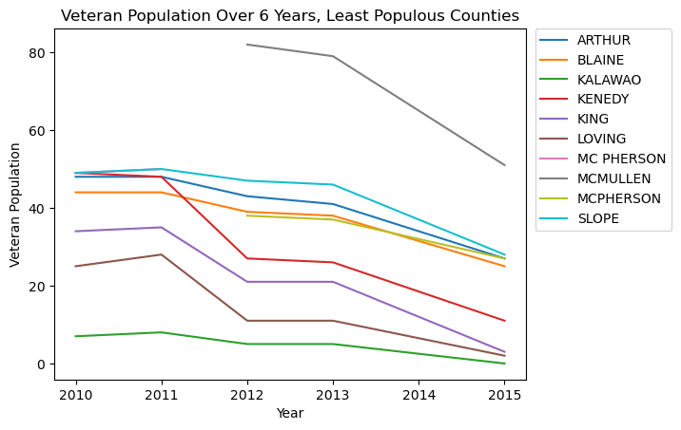
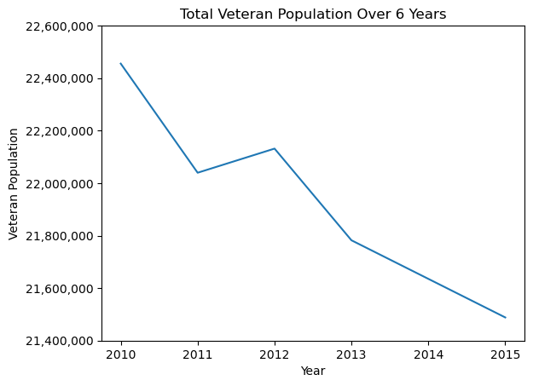
Wait… Decreasing?
The top 10 are not alone: veteran population is dropping across the board. There are a few places where it increases slightly, but, overall, it’s fairly rapidly decreasing. In the wake of the wars in the Middle East, one would think that we’d get even more veterans. However, this doesn’t seem to be the case. Why is that? Unfortunately, our data did not hold the answers.

Slide 6
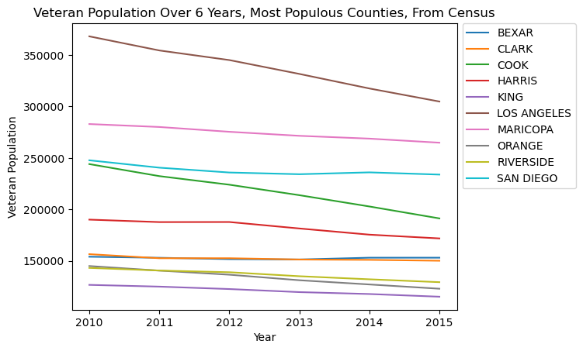
How accurate is the Census?
This graph looks very similar to the one for the top 10 cities from earlier, with some minor differences: the curves are more gradual, and San Diego is slightly higher, but overall it looks very similar. However, that’s just the graphed lines. Do the numbers compare?

Slide 7
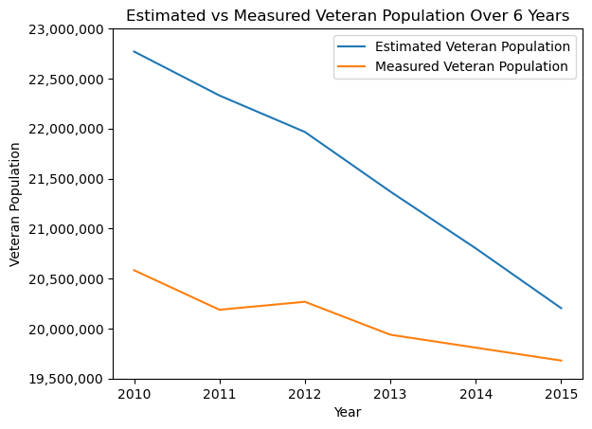
Overall Census Accuracy
For the most part, they do. However, the estimates are high, and the margins of error given by the census (which, unfortunately, were not obtainable for the data set) do not account for the difference between the estimates and measured numbers. So budget allocations are based on inflated data. The good news is that, over time, the estimates do get better.

Slide 8
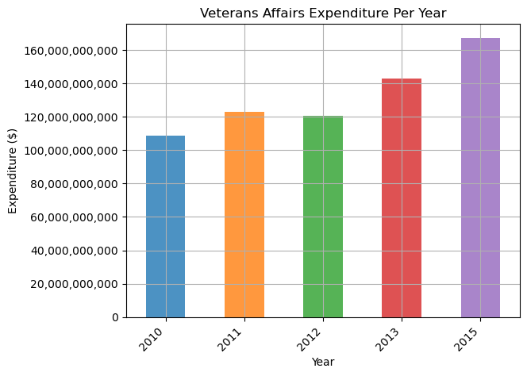
How Much Money Is The VA Spending?
Afghanistan Surge began 2010 & ended 2014
~ 60 Billion increase 2010 - 2015
2012 saw slight decrease in spending
Decrease reflected in San Diego’s 2012 spend

Slide 9
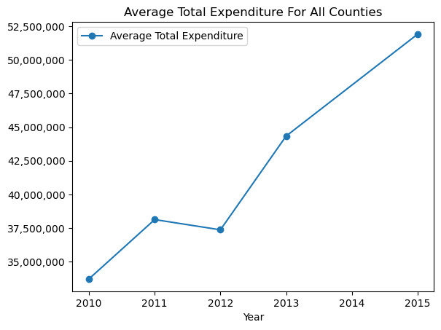
Average County Expenditure
Reflects the 2012 decrease in Expenditure
Overall trend is a nearly steady increase
Similar trend reflected in San Diego’s expenditure

Slide 10
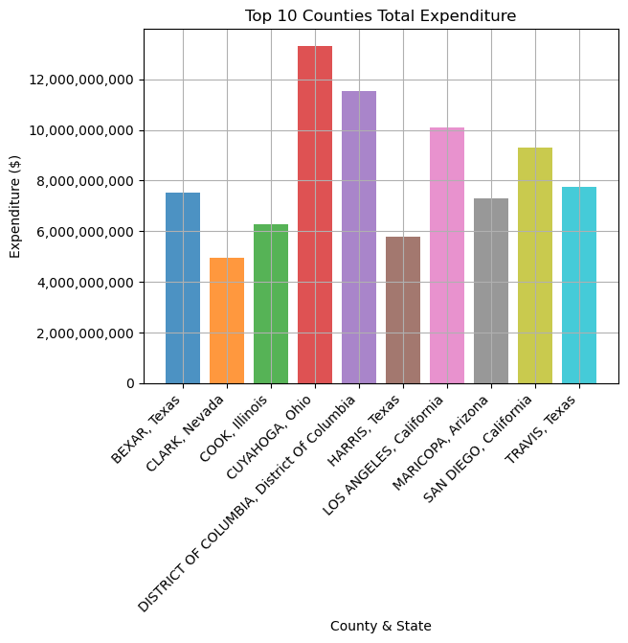
Top 10 Counties by Expenditure
Sum of Expenditure from 2010 - 2015
Seven out of Top 10 also in Top 10 for Veteran Population
Indicates a good correlation between veteran population and expenditure. Not only factor affecting expenditure
San Diego 4th in Expenditure
~ 9.3 Billion
Cuyahoga highest in expenses not in Top ten population-wise

Slide 11
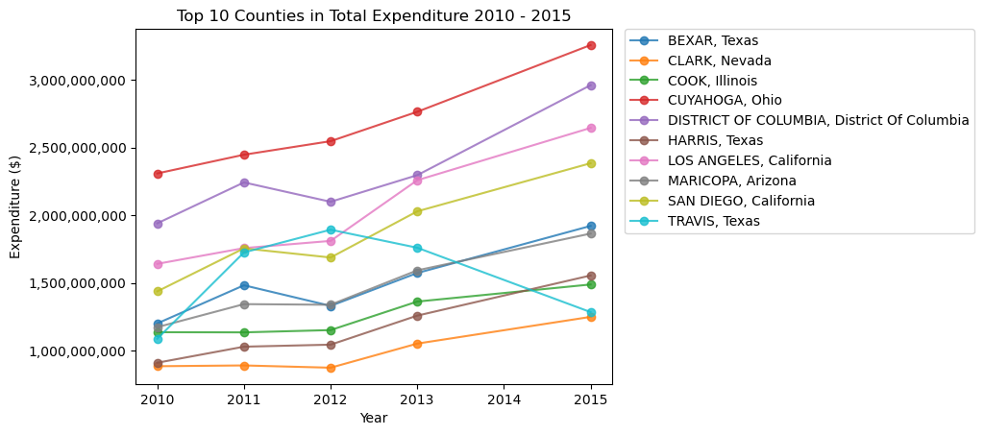
Top 10 Counties by Expenditure
2012 decrease visible in majority of top ten
Hardly see any change in order
Notable exception being Travis County, Texas

Slide 12
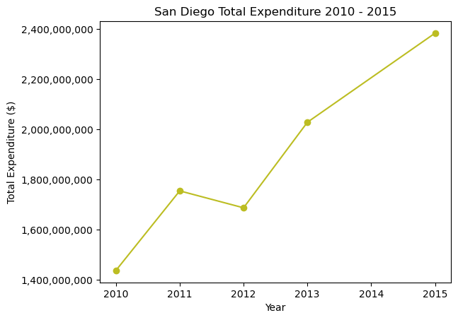
San Diego Spending
3rd on Population
4th on Expenditure
~ 1 Billion Dollar increase in spending between 2010 - 2015
Very similar trend to the average county expenditure

Slide 13
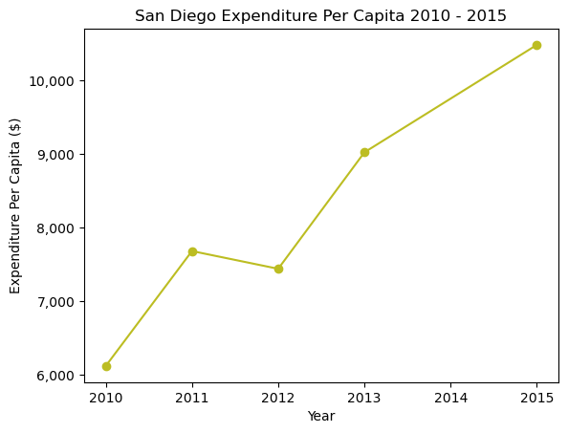
San Diego Per Capita
This expenditure per capita from San Diego is mostly repeated across the nation.
In an ideal world, this graph would have a very gentle upwards slope, as the average amount paid out to a veteran would only be increasing based upon inflation.
Instead, it almost doubles over just a 6-year period. Why? Is the VA not getting enough money to give everyone what they need? Are industries taking advantage of the extra money and hiking rates for the same rendered services? Our data sets, unfortunately, don’t contain the answers.

Slide 14
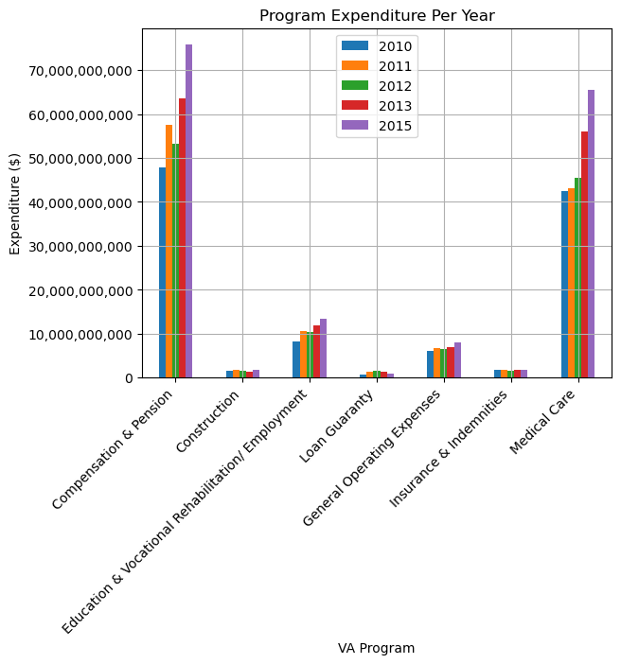
Which VA Program Is Most Expensive?
Compensation & Pension payments most expensive program
Compensation = Monthly Disability checks for veterans
Ongoing medical costs of disability possibly why Medical Care close second
2012 decrease seen across programs except Medical

Slide 15
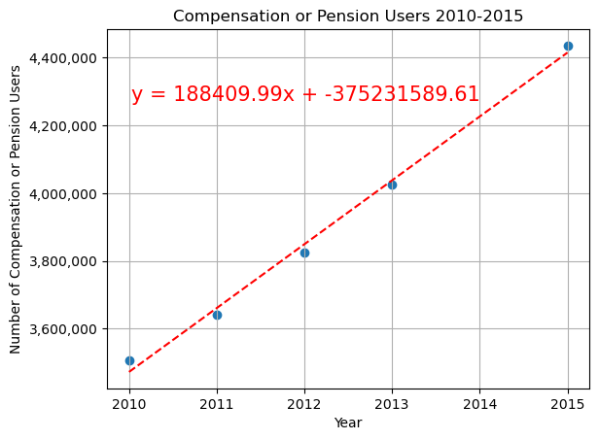
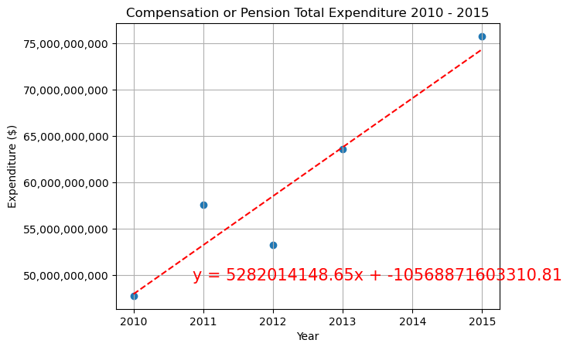
Number of Users Helps Drive Compensation Expenditure
Though it is not the only factor driving Expenditure. While the slopes are both steadily increasing, Expenditure is increasing at a faster rate as reference by the equations.

Slide 16
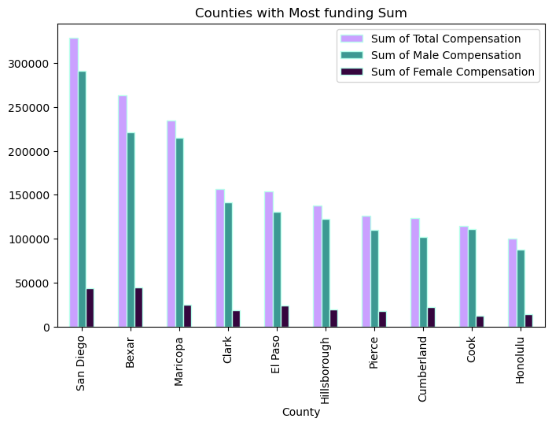
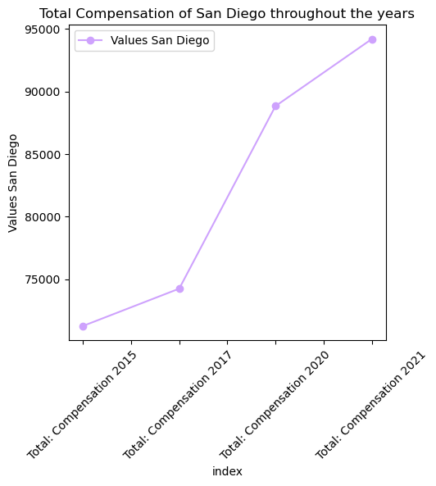
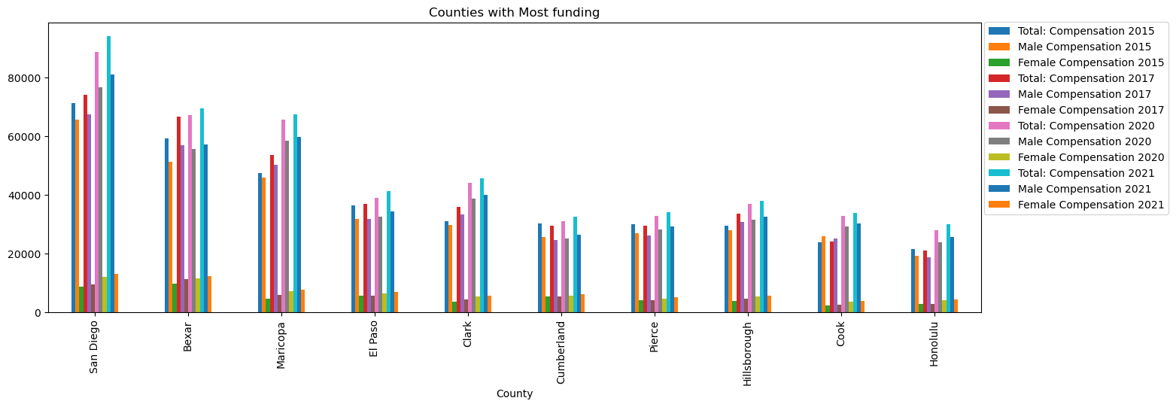
Who Is Spending The Most on Compensation?
San Diego had the most compensation overall in Male Compensation and
Total Compensation. Bexar county took the lead in Female compensation.
The female compensation is significantly less.
The compensation for San Diego significantly increased throughout the years.

Slide 17
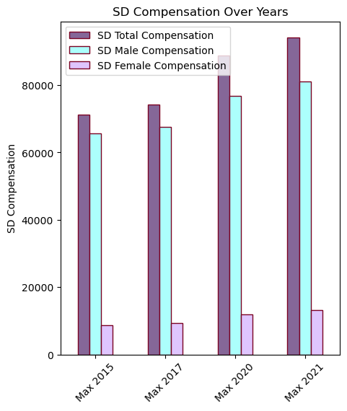
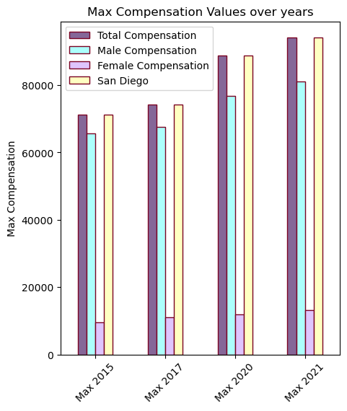
How Does San Diego’s Compensation Compare?
Many of the same values for San Diego Matched the max values for Female, Male, and Total Compensation over all states and counties. The values increased over the years.

Slide 18
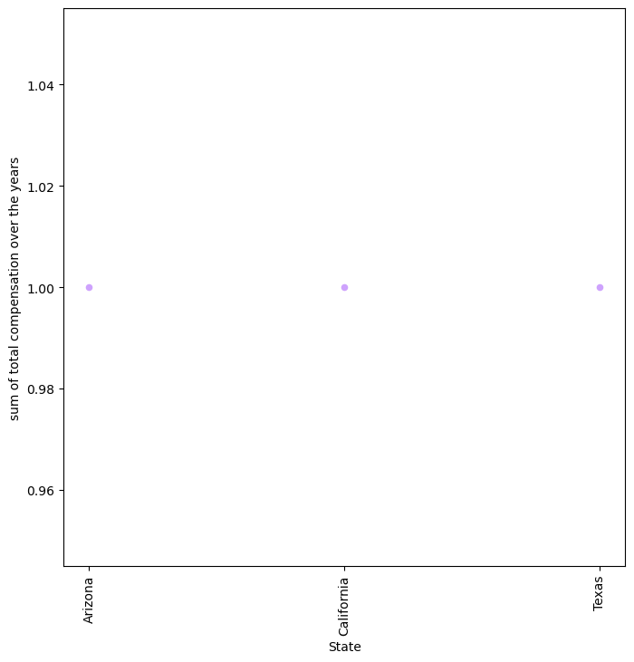
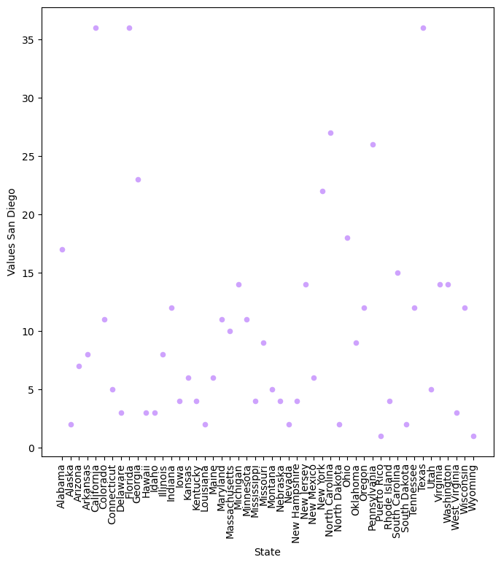
How many states go beyond the mean ?
At least one county from each state was greater than the mean in 2015 with California, Florida, and Texas having 36.
When adding the total compensation of the years together then taking the mean, only three counties were greater than the mean in Arizona, California, and texas.

Slide 19
Questions?

