Slide 1


IVR Technical Workshop
Technical TOI

Slide 2

Objectives
Explain different IVR architecture
IVR Driver implementations
IVR Server logging
IVR Driver logging
Troubleshooting Tips
Helpful Documents
Q&A

Slide 3
IVR Architecture
Customers choose either in-front, behind, or network mode (7.x IVR Server replaces NTS XML version for network customers)
IVR In-Front must be used if there is no CTI link to the switch or if the PBX does not support monitoring IVR ports.
IVR Behind is used when the IVR is using some sort of line side protocol. This can be T1/E1, or analog lines as long as they provide CTI events via a premise T-Server
Many customers are implementing their own IVR Drivers written in either XML or using the IVR SDK (which uses the ILIBRARY function calls), but the customer must choose the from the three different modes above.

Slide 4
IVR In Front
When a vendor-provided IVR is connected directly to the PSTN (Public Switched Telephone Network) without a premise switch, the configuration is called IVR-In-Front.
In the IVR-In-Front configuration, a “virtual T-Server” function resides within the IVR Server (providing TServer events to the IVR Server internally). IVR Server operating in IVR-In-Front mode is designed to support IVRs that are connected directly to a PSTN by performing functions similar to a regular T-Server.
Transfers originating from the IVR (operating in the in-front mode) must use ISCC to transfer the call with data to a premise switch. The IVR application can invoke URS through Routing APIs (usual method) or it can invoke External Routing directly through CDT* IVR application APIs.

Slide 5
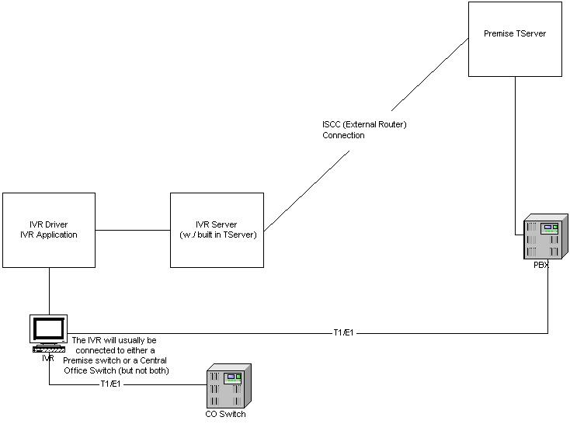
IVR In Front

Slide 6
IVR Behind
In the IVR-Behind-Switch configuration, an incoming call arrives at the premise switch before going to the vendor-provided IVR (see Figure 1).
This IVR Server setup includes the premise switch and T-Server at the same site.
In this configuration, a physical T-Server is connected to a premise switch, and the IVR is connected directly to both the switch (through phone lines) and the IVR Server (through data lines). The IVR Server communicates with the T-Server and the Statistics Server.

Slide 7
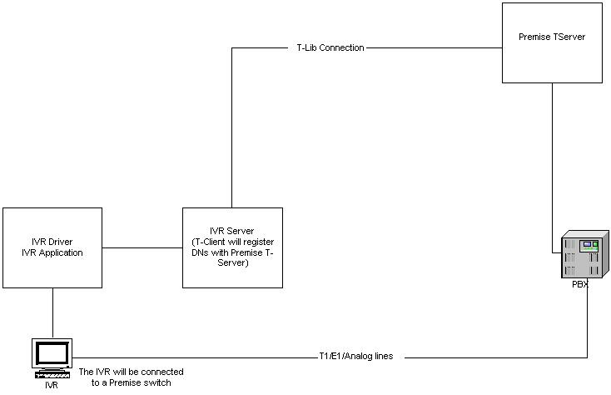
IVR Behind

Slide 8
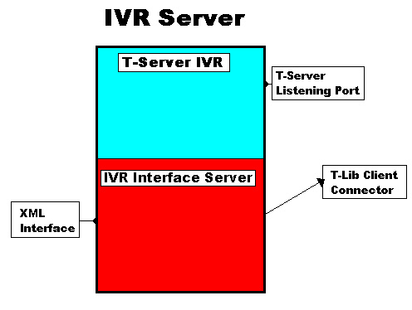
IVR Server Components

Slide 9
IVR Server Components (two separate applications)
T-Server_IVR
- Uses T-Server ‘Common Part’ to provide ISCC and other common functions
IVR Interface Server
-Provides the XML interface for IVR drivers
-Provides the ability to connect to one or more T-Servers (depending on mode)

Slide 10
Connections
Connections are listed in the 7.0 IVR Server System Administrator’s Guide
  Under the section titled “Entries on Connections Tab” there are different configurations tables depending upon how you are configuring your IVR Server
    IVR-In-Front Connections
    IVR-Behind-Switch Connections
    IVR Network T-Server Connections
Note that 6.5.315.04 and above (including all 7.0 IVR Servers) support ADDP
  This means that you should be running one of these versions if you are running in IVR-Behind-Switch mode

Slide 11
IVR Driver Components
The Genesys 6.5 IVR Drivers use up to 4 libraries to implement interfacing between the IVR Server and the IVR Application, and these libraries make up the “C” IVR SDK.
The 6.5 “C” IVR SDK is single threaded (there is a single thread of execution).
This can cause performance problems when there are large number of IVR ports all being serviced by one instance of the IVR SDK, and this performance issue has been addressed in the 7.0 “C” IVR SDK by creating a request thread (which handles requests from the IVR application to send to the IVR Server) and a response thread (which receives and processes events and responses from the IVR Server).
Each Genesys IVR Driver is implemented slightly differently due to the differences in the different IVR APIs which the IVR vendors provide to a third party vendor. I could talk for an hour on each specific implementation since they are all unique in many ways.

Slide 12
IVR Driver 7.0 changes
7.0 IVR Drivers start up by passing Config Server information + IVR Driver Application name instead of IVR Server information (as in 6.5 IVR products)
The information concerning IVR Servers to connect to (all of them) are in the IVR Driver Application object (which is new for 7.0 IVR Suite)
The IVR Driver Applications can be used for all of the customer IVR if:
  All IVRs have the same log file names
  The customer does not want to change logging levels independently
  I suggest one IVR Driver Application per IVR Driver instance

Slide 13
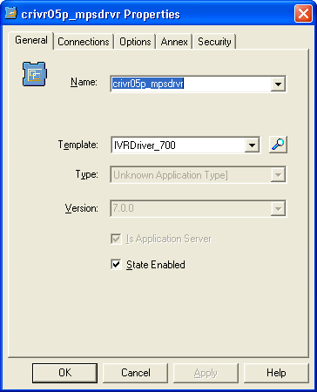
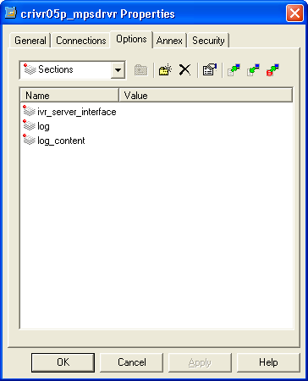
IVR 7.0 Config Changes

Slide 14
IVR Wizard Manager
Use the Genesys Wizard Manager to create new objects in Configuration Manager for IVR Server 7 and IVR Driver 7. Using this wizard, you can create new objects for use with IVR Interface Option 7, including:
  • I-Server application
  • TServer_IVR application
  • IVRDriver application
  • IVR object (including a range of ports with assigned DNs and agent logins)
  • Switch object
  • Switching Office object
The 6.1 and 6.5 versions of the IVR Suite did not have a wizard to help with installation and configuration.

Slide 15
7.0 IVR Driver application
IVR Driver application
  With IVR Server 7, the IVR Annex tab is used only with the IVR Drivers for Aspect, Conversant, and for the IVR SDK C. For all other IVR Drivers, use the options on the IVR Driver application object. The reason for this difference is the Genesys configuration libraries for the Unixware platform do not exist.
  The section ivr_server_interface]/load_sharing_iservers in the IVR Driver application must contain all of the 7.0 IVR Servers configured. This is different than in 6.5 (which listed only the load sharing (non-primary I-Servers), and this change is required since the IVR Server now supports warm standby in 7.0 where all IVR Servers are considered the same.

Slide 16
IVR Objects and CME
IVR Object
  Represents one instance of an IVR driver. Can also contain information needed by that driver, such as the ‘DataTransport’ options (only used in the “6.5 mode”).
  Is linked to an IVR Interface Server object via its properties
  Contains a list of IVR port objects
IVR Port Object
  Represents the mapping between a physical IVR channel residing on the actual IVR, and a TServer DN, be it virtual (In-Front) or real (Behind).
  Resides within an IVR Object, and the annex tab can contain login and password information used by the IVR Server to log in the port and set it to a ready state automatically if so configured.

Slide 17
IVR Objects and CME (cont)
IVR Interface Server
  Represents one instance of an IVR interface server
  Is linked to T-Server object(s) via its ‘Connections’ tab.
  Contains only a few options specific to the IVR Interface functions of the IVR Server, such as ‘LoadBalancing’, ‘LogoutOnShutdown’, ‘Statistics’, ‘VirtualRoutePoints’, and InFront for using IVR Server as a target for external routing.
IVR T-Server
  Represents ‘Virtual T-Server’ aspect of the IVR Server
  Contains all the common options used by both, including logging and licensing (IVR Server 7.0 only)
  Also contains all the ‘GLI’ options, which determine which TCP/IP port the IVR Interface Server subsystem will listen on, as well as heartbeating options.
  Has a connection only to other T-Servers, and only when used in ‘In-Front’ mode.

Slide 18
IVR Server logging
IVR Server uses the TSCP (T-Server Common Part)
This means that the IVR Server will log with the “log” section in the TServer_IVR application object
The above logging has nothing to do with real debug information concerning the IVR Drivers connected to it
The above setting logs:
  Xml strings to/from the IVR Driver
  Call status events being sent to the IVR Driver (EventRinging, etc)
  Keep-alive requests/events (used to maintain the TCPIP socket connection between the IVR Server and the IVR Driver)
  6.5.315.04 and higher (including 7.0) IVR Server added all required logging under the standard “verbose=all”

Slide 19
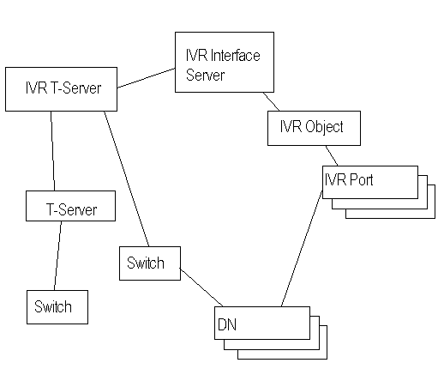
IVR Objects in CME- In-Front

Slide 20
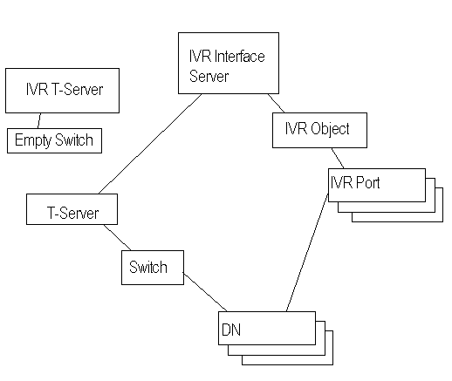
IVR Objects in CME- Behind

Slide 21
IVR Server logging continued
IVR T-Server Configuration
  Option list
    TServer list
    options list <+>
    port = 9876 <+>
    compatibility-port = 0
    management-port = 12600 <+>
    <etc>
  DN List (if used as a ‘Virtual T-Server’)
    DN array
    [93782] dn = '1000' type = N/A xtype = DN reg-mode = 0x1 = +force
    2000_ivr_switch [125405] dn = '2000' type = N/A xtype = Queue reg-mode = 0x1 = +force

Slide 22
IVR Server logging continued
IVR Interface Server Configuration
  PortMap
    Lists the IVR ports this IVR interface server is configured to use and shows which driver ports match up with each switch DN.
  Example:
    01/16/04 17:01:53.995 Trace maximus ts_ivr_behind GCTI-01-28001 PortMap: Port To DN configuration
    <IVR PortNum <-> Switch DN>
    Daves_IVR_behind 1000 <-> Definity 5316

Slide 23
IVR Server logging continued
IVR Interface Server Configuration
  TServerMap
    Lists all the TServers that this IVR Interface Server connects to.
  Example:
    01/16/04 17:01:54.011 Trace maximus ts_ivr_behind GCTI-01-28001 TServerMap: Configured T-Server connections
    <TServerName -> Host Port RedundancyType BackupHost BackupPort Switch>
    ts_definity_61 -> maximus 5000 1 {} {} 10 Definity

Slide 24
IVR Server logging continued
IVR Interface Server Configuration
  LocationMap
    Lists the names of the switches for each of the TServers listed in the ‘TServerMap’
  Example:
    01/16/04 17:01:54.011 Trace maximus ts_ivr_behind GCTI-01-28001 LocationMap: Relevant switches
    <Switch -> Tenant Password TServer SwitchType>
    Definity -> Resources {} ts_definity_61 5

Slide 25
IVR Server logging continued
IVR Interface Server Configuration
  DNRegistrationMap
    Lists all the DNs that this IVR Interface Server will register and what location they reside in.
  Example:
  16:08:41.3990 [tcl:DEBUG]: DNRegistrationMap: DNs requiring registration
  <Switch -> DN1 DN2 ...>
  Definity -> 5316.

Slide 26
IVR Server logging continued
IVR Interface Server Configuration
  LoginMap
    Lists the login information for any ports configured to be AutoLogin and/or AutoReady.
  Example:
  16:08:41.3990 [tcl:DEBUG]: LoginMap: Configured agent login information
  <Switch DN -> AgentId Queue SetReady Password SetLoggedIn>
  Definity 5316 -> 5611 5502 1 {} 1.

Slide 27
IVR Server logging continued
IVR Interface Server Configuration
  StatServerMap
    Lists the Statserver applications that this IVR Interface Server is configured to connect to, along with the configured host and port of each.
  Example:
  16:08:41.3990 [tcl:DEBUG]: StatServerMap: Configured StatServer connections
  <StatServerName -> Host Port RedundancyType BackupHost BackupPort>
  ss_definity_60 -> maximus 3200 1 {} {} 10.

Slide 28
IVR Server logging continued
IVR Interface Server Configuration
  DataMap
    Lists configuration for each of the IVR Drivers listed in CME for this IVR Interface Server. Only lists items in the ‘DataTransport’ section.
  Example:
  16:08:41.3990 [tcl:DEBUG]: DataMap: IVR specific data
  <IVR -> Key1 Value1 Key2 Value2 ...>
  Daves_IVR_behind -> #load_sharing_Iservers maximus:14100 log_dbg yes log_file_name dave_driver_behind.log log_file_size 1000000 log_print_date yes log_print_hb yes log_print_name yes log_print_recv yes log_print_send yes log_print_time yes log_print_time_ms yes log_print_timeouts yes log_print_udata yes print_options yes time_hb_is 0.

Slide 29
IVR Server logging continued
XML Messaging
  NotifyCallStart received from the driver
    Xml string received = [ <?xml version="1.0" encoding="iso-8859-1"?><!DOCTYPE GctiMsg SYSTEM "IServer.dtd"><GctiMsg><CallId>IVR_Proÿ1ÿ2</CallId> <NewCall CallControlMode="Network"><CalledNum>1</CalledNum> </NewCall></GctiMsg> ].
  Xml Call status events being sent to the IVR Driver (EventRinging, etc)
    Xml string to transmit = [ <?xml version='1.0' encoding='iso-8859-1'?><!DOCTYPE GctiMsg SYSTEM 'IServer.dtd'><GctiMsg><CallId>IVR_Proÿ1ÿ2</CallId> <CallStatus Event='Ringing'/></GctiMsg> ].
  Keep-alive requests/events
    11:33:20.9690 [gli:DEBUG3]: Wrote: 0: 00 00 00 02 02 00

Slide 30
IVR Server logging continued
TServer Messaging
@16:46:24.4600 [0] TServerClientSap received: message EventRinging
AttributeCallType 2
AttributeCallID 152
AttributeConnID 012e01101eb64004
AttributeDNIS '5316'
AttributeANI '5346'
AttributeCustomerID 'Resources'
AttributeExtensions [39] 00 02 01 00..
'TimeInQueue' 0
'UCID' bin: 51 18 08 40.. (len=8)
AttributeThisDN '5316'
AttributeThisDNRole 2
AttributeOtherDN '5346'
AttributeOtherDNRole 1
AttributeCallState 0
AttributeTimeinSecs 1074285984 (16:46:24)
AttributeTimeinuSecs 460000

Slide 31
IVR Drivers
The IVR Server is a T-client to either itself (in in-front mode) or a Premise TServer via the T-library.
The IVR Server supports ONLY an XML interface to it from its clients.
The IVR SDK is a C interface for applications, and it uses the I-Library to send/receive XML requests/events to and from the IVR Server.
Customers can also build a custom ‘driver’ that sends and receives XML to and from I-Server.

Slide 32
IVR Driver implementations: IVR SDK vs XML
IVR SDK – Some customers use the “C” IVR SDK to implement an IVR Driver. Genesys developed IVR Drivers all use the “C” IVR SDK to interface to the IVR Server
IVR SDK and IVR Driver use libraries (I-Library and Co-Library) to keep state information on the IVR port, maintain the connection to the IVR Server, and load share to the available IVR Servers.
XML implementation examples are GVP and Intervoice 3.0.
An XML driver sends requests to the IVR Server and receives responses back, and the XML driver must maintain the connections and state information themselves per the documented XML SDK interface.

Slide 33
IVR Drivers
The 6.5 IVR Driver needs to know only 3 items of information:
  Host of the IVR Interface Server
  TCP/IP port of the IVR Interface Server
  IVR object name as configured in CME
The 7.0 IVR Driver needs to know
  Host of the Config Server
  Port of the Config Server
  Application name of the IVR Driver Application object
    From this application the IVR gets the IVR Servers that it must connect to
    In 7.0 the IVR Driver treats all of the IVR Servers the same – which helps in Warm Standby

Slide 34
Enabling IVR Driver logs
For IVR Drivers built using the Genesys I-Lib in 6.5 mode, logs are enabled in the [DataTransport] section of the IVR Object in CME.
For IVR Drivers built using the Genesys I-Lib in 7.0 mode, logs are enabled in the IVR Driver application object under the log_content section. This is dynamic in the 7.0 mode of operation (the driver does not have to be restarted for the log settings to be changed as in 6.5)
I-Lib 7.0 also uses the file “ivrlibrary.ini” to be able to log in case it cannot connect to the config server
Customer written XML IVR Drivers have their own logs.

Slide 35
6.5 IVR Driver log messages
11:46:11> === IS "IVR_Pro" has been opened {1992} [kevinh::3333]
11:46:11> IS<00000001|IVR_Pro: Service "IVR_Pro"
11:46:12> IS>00000001|IVR_Pro:0 OK "|#load_sharing_Iservers|palomar:5112,palomar:5122|#log_file_backup_amount|3|#time_hb_is|60000|#time_recon_is|10000|log_dbg|yes|log_file_backup_name_short|yes|log_file_name|con|log_file_size|1000|log_print_date|yes|log_print_hb|yes|log_print_name|yes|log_print_recv|yes|log_print_time_ms|yes|log_print_timeouts|no|log_print_udata|yes"
IVR simulator connected to Host = kevinh Port = 3333
DBG:> <--- {ilib version}
DBG:> <--- {=#2::OK:I-Lib 6.5.100.25}
09/04+11:46:12.028@IVR_Pro> IS<00000003|IVR_Pro:1 NoteCallStart "CallID=,DNIS=,ANI=,TagCDT="
DBG:> <--- {<?xml version="1.0" encoding="iso-8859-1"?><!DOCTYPE GctiMsg SYSTEM
"IServer.dtd"><GctiMsg><CallId>IVR_Pro 1 2</CallId><NewCall CallControlMode="Net
work"><CalledNum>1</CalledNum></NewCall></GctiMsg>}
DBG:> <--- {=OK:OK}
09/04+11:46:12.028@IVR_Pro> IS|00000003|IVR_Pro:1 NotifyCallStart: "OK"
DBG:> IS>--- {<?xml version='1.0' encoding='iso-8859-1'?><!DOCTYPE GctiMsg SYSTE
M 'IServer.dtd'><GctiMsg><CallId>IVR_Pro 1 2</CallId><CallStatus Event='Ringing'
/></GctiMsg>}
09/04+11:46:12.044@IVR_Pro> AP<00000003|IVR_Pro:1 GetReply "OK"

Slide 36
7.0 Log messages
62 40:07/20/04 10:10:40:019 AP>00000006|:201:DT6000ÿ201ÿ4:kevinh.us.int.genesyslab.com:12012: NoteCallStart Call ID = "", DNIS = "", ANI = "", CDT Tag = ""
63 40:07/20/04 10:10:40:020 XM|00000006|:201:DT6000ÿ201ÿ4:kevinh.us.int.genesyslab.com:12012: <?xml version="1.0" encoding="iso-8859-1"?><!DOCTYPE GctiMsg SYSTEM "IServer.dtd"><GctiMsg><CallId>DT6000ÿ201ÿ4</CallId><NewCall CallControlMode="Network" Version="3.0"><CalledNum>201</CalledNum></NewCall></GctiMsg>
63 189:07/20/04 10:10:40:020 XM|00000006|:201:DT6000ÿ201ÿ4:kevinh.us.int.genesyslab.com:12012: <?xml version="1.0" encoding="iso-8859-1"?><!DOCTYPE GctiMsg SYSTEM "IServer.dtd"><GctiMsg><CallId>DT6000ÿ201ÿ4</CallId><NewCall CallControlMode="Network" Version="3.0"><CalledNum>201</CalledNum></NewCall></GctiMsg>
64 40:07/20/04 10:10:40:021 IS<00000006|:201:DT6000ÿ201ÿ4:kevinh.us.int.genesyslab.com:12012: NewCall Call ID = "", DNIS = "", ANI = "", CDT Tag = ""
65 40:07/20/04 10:10:40:021 AP<00000006|:201:DT6000ÿ201ÿ4:kevinh.us.int.genesyslab.com:12012: NoteCallStart rc=0
66 40:07/20/04 10:10:40:022 AP>00000006|:201:DT6000ÿ201ÿ4:kevinh.us.int.genesyslab.com:12012: GetReply request id = 00000006
67 40:07/20/04 10:10:40:023 AP<00000006|:201:DT6000ÿ201ÿ4:kevinh.us.int.genesyslab.com:12012: GetReply "OK"
68 40:07/20/04 10:10:40:090 XM|ffffffff|:201:DT6000ÿ201ÿ4:kevinh.us.int.genesyslab.com:12012: Received on socket <DT6000:12012:kevinh.us.int.genesyslab.com> XML message <<?xml version='1.0' encoding='iso-8859-1'?><!DOCTYPE GctiMsg SYSTEM 'IServer.dtd'><GctiMsg><CallId>DT6000ÿ201ÿ4</CallId><CallStatus Event='Ringing'/></GctiMsg>>
68 265:07/20/04 10:10:40:090 XM|ffffffff|:201:DT6000ÿ201ÿ4:kevinh.us.int.genesyslab.com:12012: Received on socket <DT6000:12012:kevinh.us.int.genesyslab.com> XML message <<?xml version='1.0' encoding='iso-8859-1'?><!DOCTYPE GctiMsg SYSTEM 'IServer.dtd'><GctiMsg><CallId>DT6000ÿ201ÿ4</CallId><CallStatus Event='Ringing'/></GctiMsg>>
69 40:07/20/04 10:10:40:091 IS>ffffffff|:201:DT6000ÿ201ÿ4:kevinh.us.int.genesyslab.com:12012: CallStatus "Ringing"
70 40:07/20/04 10:10:40:220 XM|ffffffff|:201:DT6000ÿ201ÿ4:kevinh.us.int.genesyslab.com:12012: Received on socket <DT6000:12012:kevinh.us.int.genesyslab.com> XML message <<?xml version='1.0' encoding='iso-8859-1'?><!DOCTYPE GctiMsg SYSTEM 'IServer.dtd'><GctiMsg><CallId>DT6000ÿ201ÿ4</CallId><CallStatus Event='Established'/></GctiMsg>>
70 265:07/20/04 10:10:40:220 XM|ffffffff|:201:DT6000ÿ201ÿ4:kevinh.us.int.genesyslab.com:12012: Received on socket <DT6000:12012:kevinh.us.int.genesyslab.com> XML message <<?xml version='1.0' encoding='iso-8859-1'?><!DOCTYPE GctiMsg SYSTEM 'IServer.dtd'><GctiMsg><CallId>DT6000ÿ201ÿ4</CallId><CallStatus Event='Established'/></GctiMsg>>
71 40:07/20/04 10:10:40:221 IS>ffffffff|:201:DT6000ÿ201ÿ4:kevinh.us.int.genesyslab.com:12012: CallStatus "Established"

Slide 37
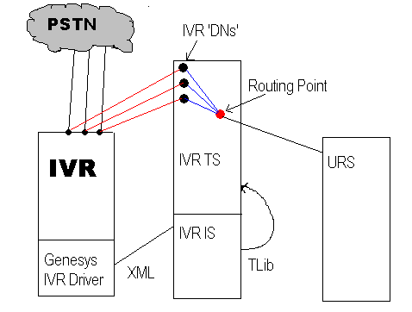
IVR Server and URS – In Front

Slide 38
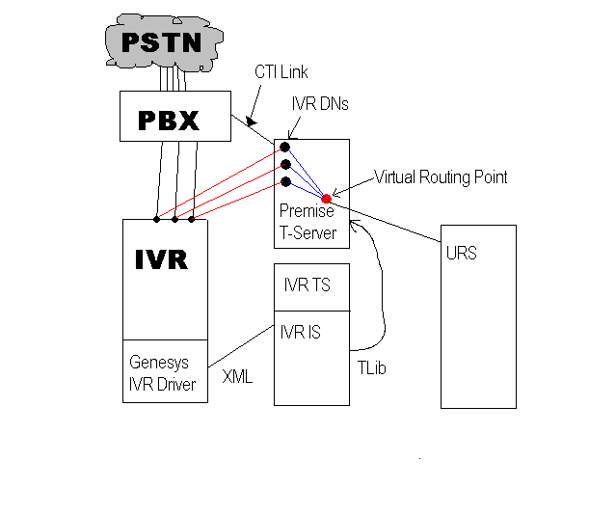
IVR Server and URS – Behind

Slide 39
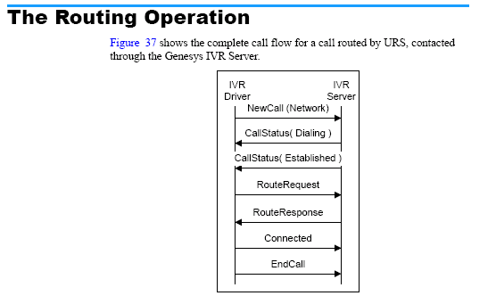
IVR Server and URS – Example of Events
From the XML developers guide

Slide 40
IVR Server and Statserver
IVR Server can also connect to one or more Stat Server applications and all the IVR application to request statistics on certain object types.
  SObjectRoutePoint
  SObjectQueue
  SObjectSwitch
  SObjectRegDN
  SObjectGroupQueues * (7.0 IVR Server 7.0.207.02 + only)
The API request for the statistic is done using the ‘PeekStat’ command.
The data returned to the IVR application is not modified in any way – it is a string that represents the data from Stat Server.
If the data is not updated frequently enough, the IVR Server configuration of the statistic can be modified to increase the frequency or have another time profile assigned to it.

Slide 41
Troubleshooting Tips
IVR Driver and IVR Server are usually not on the same physical machines. This means that there are time differences (but you should make the time equal on both machines to facilitate troubleshooting)
The XML messages should be enabled in the IVR Driver by setting the log_dbg=yes option in the IVR Object/[DataTransport] section in 6.5. In IVR Driver 7.0 mode the section was moved to the log_content section in the IVR Driver application object and should be set to “debug”
Port numbers must match exactly between the IVR driver and CME:
  EG ‘1’ and ’01’ are not the same because they are treated as strings in the IVR Server
Mapping XML messages to ConnIDs is performed by IVR Server.
6.5.315.04 and higher (including 7.0) IVR Server added all required logging under the standard “verbose=all”

Slide 42
More troubleshooting tips
Most problems have to do with not syncing up between the IVR application the Genesys components
Problems where the application cannot get the response of the GetCallInfo API where the last event is not NULL (or the string “Not Available”)
The IVR application must ensure it is calling NotifyCallEnd when the caller hangs up (abandons).
If there are problems matching IVR Driver/IVR Server/and TServer (premise – Behind configuration) are required.
The xml messages are very important since they have the xml call id which can be found in the IVR Server logs.
A common problem is that that IVR port is assigned to the incorrect starting DN in a T1/E1 span. A simple test call will show that the EventRinging is on DN 4001, and the xml sent down at the same time will show “NewCall” where the port is 2. This can be corrected in CME.

Slide 43
Connectivity issues
6.5 and 7.0 IVR Server support “keep-alive” requests from IVR Server to client
  Controlled by TServer_IVR_Appl - > Properties - > Options - > gli
  gli-keep-alive-interval (seconds between requests)
  gli-keep-alive-tries (max number of missed requests where the IVR client does not respond to requests before the socket is shutdown)
6.5 IVR Object
  IVRName - > Annex - > DataTransport
    time_hb_is (Driver expects heartbeat request witin N msec )
    time_recon_is (Driver attempts to reconnect after N msec. after closing socket )

Slide 44
Wrapup
The IVR Suite consisting of the IVR Server, the IVR Drivers, and the IVR SDK have been discussed along with their interoperability.
The configuration of these components (both in 6.5 mode and 7.0 mode) has also been presented.
The basic troubleshooting of these components has been discussed from a high level.
Please use the ticket search resource since many of the problems one customer may have has more than likely been discovered previously by someone else.
Any issues that you have concerning the IVR suite of products (after checking ticket search) should be brought to our attention via a TS ticket.
One concern that we have run into is customers who have older IVR hardware/software which runs fine but has been dropped from support from the IVR vendor. Please check the supported media interfaces document to see if the IVR Driver you are about to install will work on your IVR version.

Slide 45
Helpful Documents
www.genesyslab.com/support has a link to the current IVR documents
The IVR XML SDK document explain the XML requests and events in the IVR Server logs
The admin guides for the IVR Drivers show the supported APIs per driver
The admin guide for the IVR Server shows the general setting for all IVR Objects / ie. [DataTransport] for 6.5 or log_content for 7.0 modes

Slide 46
Other resources

Slide 47
Other resources
Courses through Genesys University
Troubleshooting Workshops
  T-Server, Stat Server, and URS Troubleshooting Workshop
  Outbound Troubleshooting Workshop
For more details on these and other classes offered by Genesys University, go to:
  http://www.genesyslab.com/about/training/

Slide 48
Other resources
Tech Support Knowledgebase
Tech Support Knowledgebase
  FAQs
  Product Advisories
  Release Notes and Information
  Product Manuals
  White Papers
Tech Support Public Ticket Archive
  Over 24,000 resolved tickets for you to reference
Weekly Notifications about new or updated Product Advisories and Release Notes
  Request on the subscriptions tab of your TS Website Profile

Slide 49
Other resources
Future Tech Tutorial Webinars
Each session is offered at two times to accommodate all time zones.
Tech Tutorial #11: ADDP | 26-Aug-2004 27-Aug-2004 (APAC)
Tech Tutorial #12: Gplus Adapter 6.5 for Siebel and SAP | 22-Sep-2004 23-Sep-2004 (APAC)
Register for these and other sessions on the Tech Tutorials page of the Genesys Tech Support Website.
http://genesyslab.com/support/tutorials/

Slide 50
Thank you
Question time

