Slide 1
SMARTCOURSE
AI-POWERED COURSE
RECOMMENDATION SYSTEM
AI
A simple way to discover, compare, and save courses.
WORDS
MEANING
exact terms
related ideas
Final Year Project
Group ID F25PROJECTEC4D8 | Roll No BC240419615
Supervisor Muhammad Bilal
find → compare → save
SMARTCOURSE / PROJECT
01
Notes:
SmartCourse is an AI-assisted course finder. A learner describes what they want to learn, then the app helps them find, compare, and save suitable courses.
[Sources]
- README.md
- app.py
- project-documents/FinalDeliverables_F25PROJECTEC4D8/2-FinalReport_SmartCourse_F25PROJECTEC4D8.docx

Slide 2
01 / THE CHALLENGE
Finding the right course can be difficult.
Course catalogs are large, and people may not know the exact title to search for.
A learner often knows what they want to learn—even without knowing the course name.
WHY THIS IS HARD
01
Different words
SmartCourse accepts everyday language and returns a clear list of useful options.
A learner and a course may describe the same topic in different ways.
02
Too many options
Large catalogs take time to browse and compare by hand.
LEARNER INPUT
03
Hard to choose
“I want to learn Python
for data science.”
People need useful details to understand which course fits best.
SMARTCOURSE / PROJECT
02
Notes:
The main problem is choice. Large catalogs use many different terms, so learners can struggle to find the right course even when they know their goal.
[Sources]
- project-documents/Fall 2025_CS619_11727_1.docx
- templates/home.html
- templates/recommend.html

Slide 3
02 / HOW IT HELPS
SmartCourse turns a learning goal into useful course choices.
Each result includes the course name, a match score, and helpful details.
WHAT THE LEARNER WANTS
HOW SMARTCOURSE MATCHES
BEST MATCHES
learn Python
for data science
Words
Meaning
matches exact terms
matches related ideas
Recommended
The learner can compare results, save a course, and return to it later.
91% match
title · level · rating
The system supports a decision instead of giving one unexplained answer.
SMARTCOURSE / PROJECT
03
Notes:
SmartCourse turns an everyday learning goal into a ranked list. It also shows course details and a score so the learner can make an informed choice.
[Sources]
- smartcourse/api.py
- smartcourse/services/recommendation.py
- static/js/main.js
- templates/recommend.html

Slide 4
03 / HOW THE AI MATCHES
SmartCourse checks both the words and the meaning.
The two methods look at the same learning request in different ways.
METHOD 1
METHOD 2
WORD MATCH
IDEA MATCH
Best for named skills and tools
Best for everyday language
• Finds shared words and short phrases
• Works well for names like Python or SQL
• Quick and easy to explain
• Uses TF-IDF behind the scenes
• Finds courses with a similar idea
• Can match different wording
• Helps when the exact title is unknown
• Uses a neural model behind the scenes
Example: “Python”, “SQL”, “cloud”
Example: “predictive modeling” ≈ “machine learning”
The Both option shows the two result lists side by side.
SMARTCOURSE / PROJECT
04
Notes:
The app checks exact words and overall meaning. These two views complement each other and are shown side by side when the learner chooses Both.
[Sources]
- smartcourse/models/tfidf_model.py
- smartcourse/models/neural_model.py
- smartcourse/services/recommendation.py
- smartcourse/data/preprocess.py

Slide 5
04 / HOW IT GETS READY
Most preparation is done before the learner searches.
The course list is organized once so recommendations can appear quickly.
BEFORE A SEARCH
01
02
03
04
Collect
Organize
Learn
Save
course catalog
8,500+ courses
remove duplicates
standardize text
find word and
meaning patterns
prepared models
ready to use
WHEN SEARCHING
Read request → find matches → show best courses → remember the search
This preparation keeps the experience fast and consistent.
SMARTCOURSE / PROJECT
05
Notes:
The course catalog is collected, cleaned, analyzed, and prepared in advance. This lets each learner search return useful results quickly.
[Sources]
- smartcourse/data/pipeline.py
- scripts/prepare_data.py
- scripts/build_models.py
- smartcourse/models/neural_model.py

Slide 6
05 / HOW THE PARTS CONNECT
Three simple parts work together.
The screens, app logic, and stored information each have a clear job.
WHAT USERS SEE
Pages for finding and saving courses
Home
Recommendations
Dashboard
About
WHAT THE APP DOES
Handles the learner's actions
Receive request
Find matches
Save history
Show results
WHAT IT REMEMBERS
Courses, searches, and trained models
Saved searches
Course catalog
Word matcher
Meaning matcher
Together, these parts keep the experience organized and reliable.
SMARTCOURSE / PROJECT
06
Notes:
The project has three easy-to-understand parts: the screens people use, the app logic that handles actions, and the stored information that supports results and history.
[Sources]
- smartcourse/__init__.py
- smartcourse/config.py
- smartcourse/api.py
- smartcourse/services/recommendation.py
- smartcourse/services/history.py

Slide 7
06 / AFTER YOU CLICK SEARCH
A course request moves through five clear steps.
The app checks the request, finds matches, saves the search, and displays the results.
1
Check the request
make sure a goal was entered
YOUR REQUEST
“I want to learn Python for data science.”
Choose: Both methods
2
Find matching courses
use both matching methods
3
Sort the results
place the best matches first
4
Save this search
keep it in the dashboard
Click “Find Courses”
5
Show useful details
display scores and course facts
The learner sees clear results while the app handles the work in the background.
SMARTCOURSE / PROJECT
07
Notes:
After the learner clicks Find Courses, the app checks the request, finds and sorts matches, remembers the search, and displays useful course information.
[Sources]
- smartcourse/api.py
- smartcourse/services/recommendation.py
- smartcourse/services/history.py

Slide 8
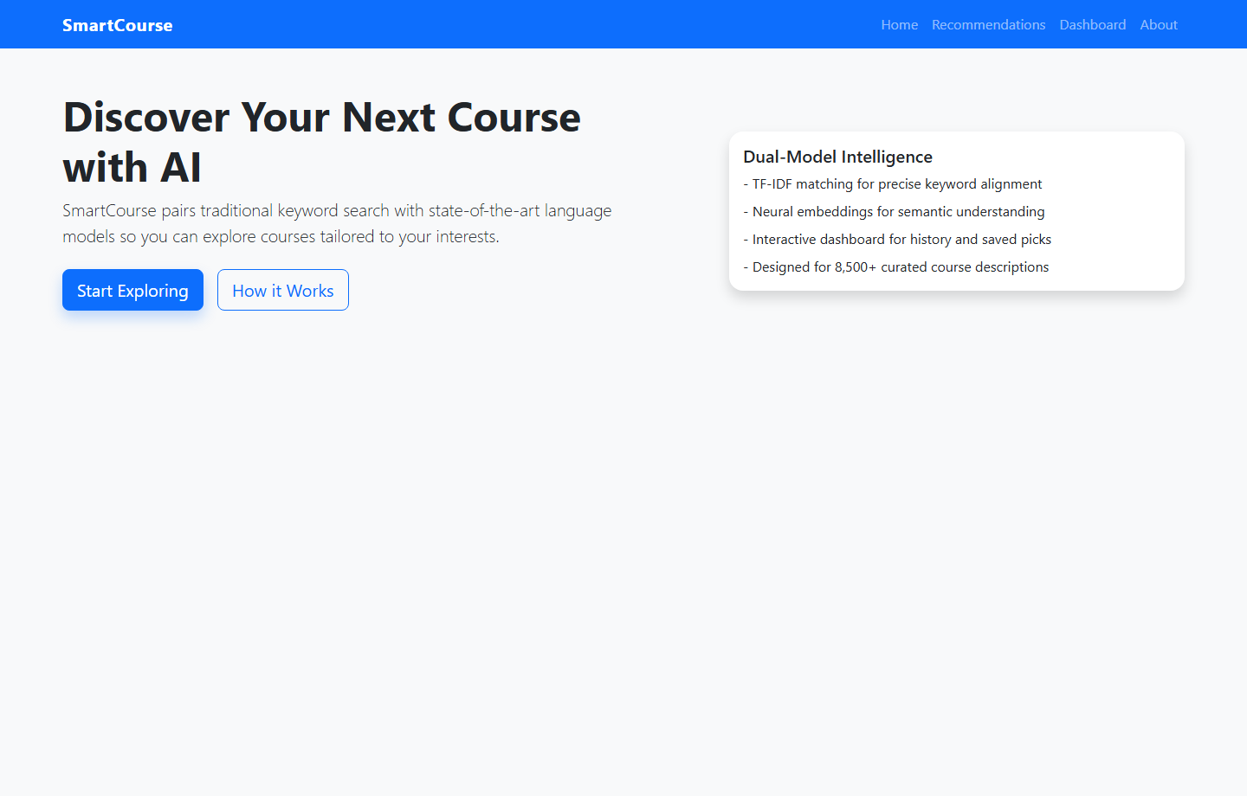
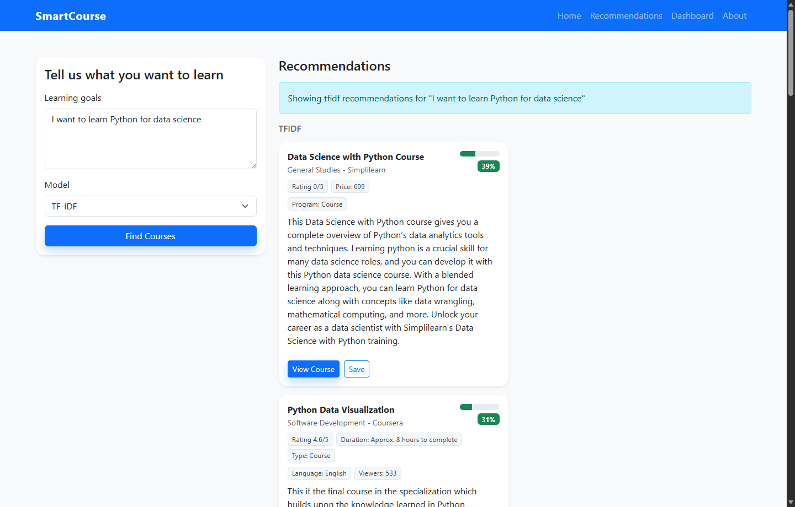
07 / SEE IT WORK
The learner enters a goal and receives course recommendations.
The real app lets the learner write what they want to learn and choose a matching method.
HOME / start with a learning goal
RECOMMENDATIONS / review the best matches
SMARTCOURSE / PROJECT
08
Notes:
These are real screenshots of the running application. The first screen introduces the product, while the second lets the learner enter a goal and review recommendations.
[Sources]
- Captured from the local Flask app at http://127.0.0.1:5000/
- templates/home.html
- templates/recommend.html
- static/js/main.js

Slide 9
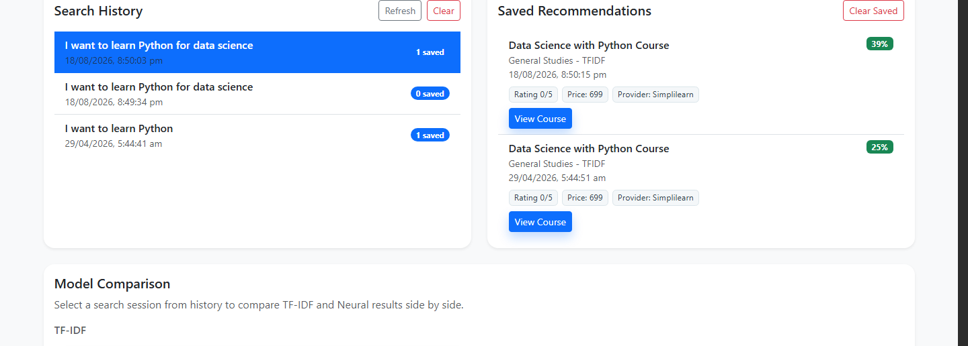
08 / YOUR DASHBOARD
The dashboard keeps useful courses and past searches together.
Learners can return to earlier searches, review saved courses, and compare results.
DASHBOARD / history, saved courses, and comparison
SMARTCOURSE / PROJECT
09
Notes:
The dashboard keeps the experience continuous. Learners can reopen past searches, review saved courses, and compare the two matching methods.
[Sources]
- Captured from the local Flask app at http://127.0.0.1:5000/dashboard
- templates/dashboard.html
- smartcourse/models/db_models.py
- static/js/main.js

Slide 10
09 / YOUR LEARNING JOURNEY
A search becomes a useful learning record.
SmartCourse keeps the journey simple: search, compare, save, and return.
1
2
3
4
Search
Compare
Save
Revisit
Describe what you want to learn.
Review results from both matching methods.
Keep a promising course for later.
Open the dashboard and continue.
WHAT IS SAVED
search history ↔ saved courses
Course details stay available for review.
SMARTCOURSE / PROJECT
10
Notes:
SmartCourse supports a simple four-step journey: search, compare, save, and revisit. This turns a one-time search into a useful learning record.
[Sources]
- smartcourse/models/db_models.py
- smartcourse/services/history.py
- templates/dashboard.html
- static/js/main.js

Slide 11
10 / HOW WE CHECK QUALITY
We check whether the recommended courses are useful.
The system is tested with example learning goals and known useful courses.
Useful suggestions
Good coverage
One strong match
How many top results actually match the learner's goal?
How many known useful courses appear in the results?
Does the list include at least one helpful course?
How the check works
1
Choose
2
Run
3
Check
4
Review
example learning goals
both matching methods
results against expected courses
overall recommendation quality
The current test set is small, so results guide improvement rather than prove perfect accuracy.
SMARTCOURSE / PROJECT
11
Notes:
Recommendation quality is checked using example goals and expected useful courses. The current test set is small, so these checks guide future improvement.
[Sources]
- scripts/evaluate_models.py
- data/evaluation_queries.json
- project-documents/FinalDeliverables_F25PROJECTEC4D8/2-FinalReport_SmartCourse_F25PROJECTEC4D8.docx

Slide 12
11 / WHY THESE CHOICES
Each choice keeps the prototype clear and practical.
The project combines fast matching, smarter matching, and a simple web experience.
Why use word matching?
Why use meaning matching?
It is fast and easy to understand when exact terms matter.
It finds related topics even when the words are different.
How are courses compared?
Why a lightweight web app?
Each course receives a match score so results can be ordered.
It is simple to run and stores searches without a complex setup.
What does “Both” mean?
What can improve next?
The two result lists appear side by side for easy comparison.
More test data, personal accounts, filters, and stronger security.
NEXT STEPS
Learn from feedback · combine scores · add filters · improve personalization
SMARTCOURSE / PROJECT
12
Notes:
The chosen technologies keep the prototype practical: one method is fast and clear, another understands related meaning, and the web app is lightweight to run.
[Sources]
- README.md
- smartcourse/models/tfidf_model.py
- smartcourse/models/neural_model.py
- smartcourse/services/recommendation.py
- smartcourse/config.py

Slide 13
12 / SIMPLE DEMO
The complete journey is search → compare → save → revisit.
Four short actions show how SmartCourse helps a learner choose.
01
02
03
04
Search
Compare
Save
Revisit
Open Recommendations
Enter a learning goal
Choose Both
Review two result lists
Choose a course
Click Save
Open Dashboard
Review saved courses
Start with your own words
See words and meaning
Keep it for later
Continue anytime
Every step stays connected from the first search to the saved course.
SMARTCOURSE / PROJECT
13
Notes:
The demonstration follows four actions: enter a goal, compare both result lists, save a promising course, and open the dashboard to revisit it.
[Sources]
- templates/recommend.html
- templates/dashboard.html
- static/js/main.js
- smartcourse/api.py

Slide 14
THE TAKEAWAY
SmartCourse makes finding
courses simpler and clearer.
QUESTIONS
It understands a learner's goal, offers ranked choices, explains the match, and keeps useful courses available for later.
Project discussion
Problem
Solution
Outcome
too many choices
two matching methods
confident decisions
F25PROJECTEC4D8
14
Notes:
SmartCourse makes a large course catalog easier to use by understanding the learner's goal, ranking suitable options, and keeping useful choices available later.
[Sources]
- README.md
- project-documents/FinalDeliverables_F25PROJECTEC4D8/2-FinalReport_SmartCourse_F25PROJECTEC4D8.docx
- project-documents/FinalDeliverables_F25PROJECTEC4D8/3-FinalPresentation_SmartCourse_F25PROJECTEC4D8.pptx

