Slide 1
SMARTCOURSE
AI-POWERED COURSE
RECOMMENDATION SYSTEM
NLP
A viva-ready look at the problem, the models, and the product flow.
TF-IDF
NEURAL
keyword lens
meaning lens
Final Year Project Viva
20 August 2026 · 3:45 PM
Peshawar Institute VU Campus · Board Bazar
rank → compare → save
Group ID F25PROJECTEC4D8 | Roll No BC240419615
Supervisor Muhammad Bilal
SMARTCOURSE / FYP VIVA
01
Notes:
Open with the single-sentence project summary. Establish that the presentation explains both the engineering flow and the recommendation logic.
[Sources]
- README.md
- app.py
- project-documents/FinalDeliverables_F25PROJECTEC4D8/2-FinalReport_SmartCourse_F25PROJECTEC4D8.docx

Slide 2
01 / THE PROBLEM
The challenge is not a lack of courses — it is finding the right ones.
Manual browsing is slow, while exact keyword search can miss the learner's intent.
A learner may know the outcome they want, but not the exact course title or vocabulary used by the catalog.
WHY SEARCH BREAKS
01
Vocabulary mismatch
SmartCourse starts with the learner's own words and turns them into a ranked, inspectable set of options.
The course may say “predictive modeling” while the learner says “data science.”
02
Catalog scale
Thousands of records make manual comparison expensive.
LEARNER INPUT
03
Trust and choice
“I want to learn Python
for data science.”
The learner needs relevance signals and a way to compare rankings.
SMARTCOURSE / FYP VIVA
02
Notes:
Frame the problem before describing features. Use the example query to connect the user experience to the need for both keyword and semantic retrieval.
[Sources]
- project-documents/Fall 2025_CS619_11727_1.docx
- templates/home.html
- templates/recommend.html

Slide 3
02 / THE SOLUTION
SmartCourse turns one sentence into a learning path.
The product keeps ranking explainable: every result includes a course, a score, and enough context to judge the match.
NATURAL-LANGUAGE GOAL
RANKING ENGINES
RANKED OUTPUT
learn Python
for data science
TF-IDF
Neural
precise keyword alignment
semantic similarity
Course match
The learner can inspect, compare, save, and revisit — not just receive a black-box answer.
score 0.91
title · level · rating
That combination of relevance + traceability is the product's core value.
SMARTCOURSE / FYP VIVA
03
Notes:
Explain that the recommendation is not only a model output. It becomes a user-facing learning decision with metadata, saving, and history.
[Sources]
- smartcourse/api.py
- smartcourse/services/recommendation.py
- static/js/main.js
- templates/recommend.html

Slide 4
03 / THE AI
Two models answer two different questions.
TF-IDF asks “which courses use similar words?” Neural search asks “which courses express a similar meaning?”
KEYWORD LENS
MEANING LENS
TF-IDF
NEURAL
Best when exact terms matter
Best when intent is implicit
• spaCy cleans and lemmatizes the text
• Unigrams + bigrams build the vector space
• Cosine similarity ranks the catalog
• Fast, transparent, easy to explain
• MiniLM converts text into embeddings
• Course embeddings are precomputed
• Query embedding is compared at runtime
• Related wording can still match
“Python”, “SQL”, “cloud”
“predictive modeling” ≈ “machine learning”
Hybrid mode in this prototype = both ranked lists shown side by side.
SMARTCOURSE / FYP VIVA
04
Notes:
Spend the most time on this slide. Explain the difference between lexical similarity and semantic similarity, then state the exact Hybrid behavior honestly.
[Sources]
- smartcourse/models/tfidf_model.py
- smartcourse/models/neural_model.py
- smartcourse/services/recommendation.py
- smartcourse/data/preprocess.py

Slide 5
04 / THE PIPELINE
The expensive work happens offline; the user query stays lightweight.
Cleaning and embedding the catalog creates reusable artifacts that the Flask app loads when needed.
OFFLINE PREPARATION
01
02
03
04
Catalog
Clean
Train
Artifacts
raw CSV
8,500+ courses
dedupe · fill
normalize text
TF-IDF matrix
Neural embeddings
joblib files
ready to load
ONLINE QUERY
Load model → encode query → calculate similarity → return Top-N → persist session
Saved artifacts: models/tfidf_recommender.joblib and models/neural_recommender.joblib
SMARTCOURSE / FYP VIVA
05
Notes:
Connect the data-science work to the application. The key performance idea is precomputation: catalog-side work is done during model building, while each request only processes the query and performs similarity search.
[Sources]
- smartcourse/data/pipeline.py
- scripts/prepare_data.py
- scripts/build_models.py
- smartcourse/models/neural_model.py

Slide 6
05 / THE ARCHITECTURE
Three tiers keep the system understandable.
The Flask application factory wires the UI, services, persistence, and model artifacts together.
PRESENTATION TIER
Bootstrap + Jinja pages
Home
Recommendations
Dashboard
About
APPLICATION TIER
Flask controllers + services
API blueprint
Recommend service
HistoryService
Logging
DATA / MODEL TIER
Persistent data + trained artifacts
SQLite
CSV catalog
TF-IDF artifact
Neural artifact
Cross-cutting concerns: configuration · validation · CORS · error handling · rotating logs
SMARTCOURSE / FYP VIVA
06
Notes:
Walk top to bottom. The important separation is that the API does not implement ranking itself; it validates and delegates to services, while the model and database layers remain replaceable.
[Sources]
- smartcourse/__init__.py
- smartcourse/config.py
- smartcourse/api.py
- smartcourse/services/recommendation.py
- smartcourse/services/history.py

Slide 7
06 / THE API
JSON endpoints keep browser and ranking logic loosely coupled.
This keeps the frontend replaceable and makes the recommendation workflow testable outside the UI.
POST
/api/recommend
validate → rank → persist
POST /api/recommend
{
"preference": "Python for data science",
"model": "hybrid",
"top_n": 10
}
GET
/api/history
history + saved results
POST
/api/save
bookmark a course
DELETE
/api/history
clear sessions
→ response: results + session_id
DELETE
/api/saved
clear bookmarks
Validation lives at the boundary; ranking and persistence live in services.
SMARTCOURSE / FYP VIVA
07
Notes:
Show the request contract. Explain that the API validates model names and empty preferences, then delegates. Mention the 400, 404, 503, and 500 error paths if asked.
[Sources]
- smartcourse/api.py
- smartcourse/services/recommendation.py
- smartcourse/services/history.py

Slide 8
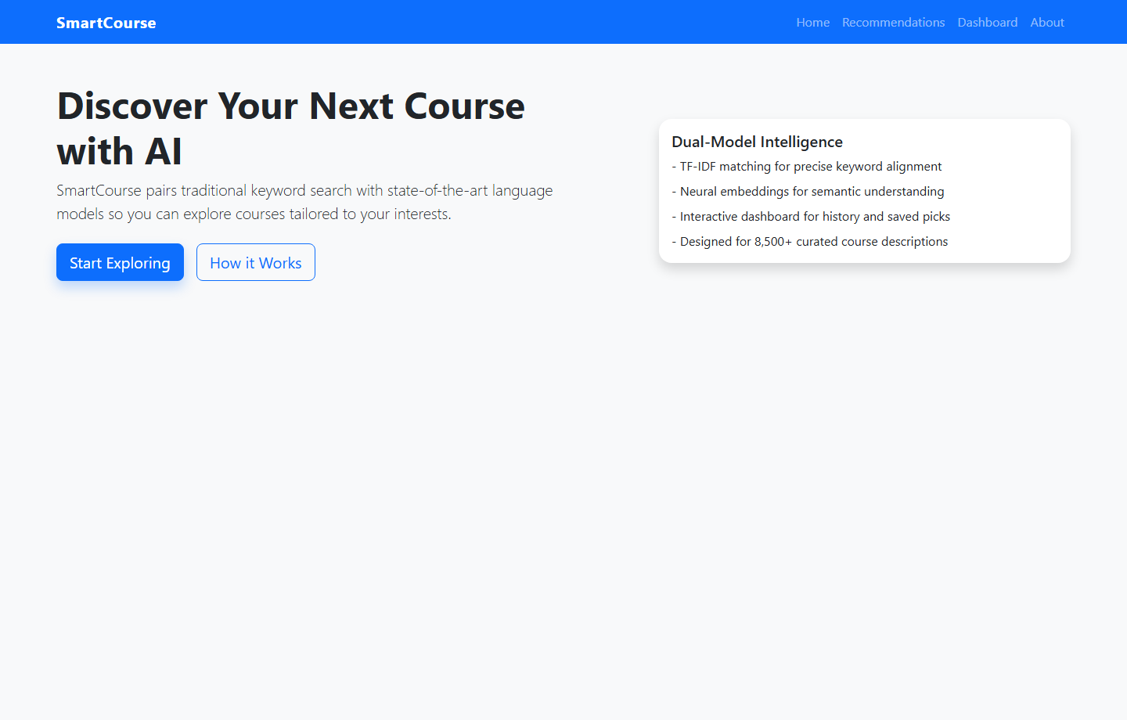
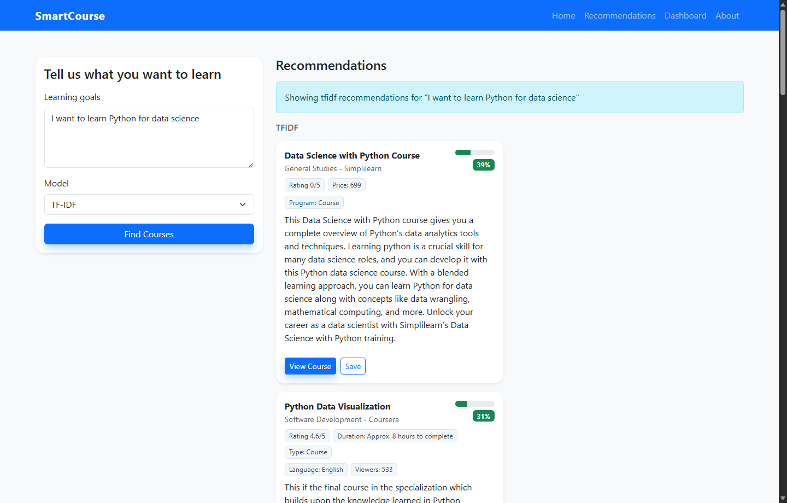
07 / LIVE OPERATION
The running app makes the recommendation workflow visible.
These screenshots were captured from the local Flask application using the project’s real Home and Recommendations pages.
HOME / value proposition
RECOMMENDATIONS / live TF-IDF result
SMARTCOURSE / FYP VIVA
08
Notes:
Use the screenshots to anchor the explanation in the actual product. Point out the natural-language input, model selector, score bar, course metadata, and Save button.
[Sources]
- Captured from the local Flask app at http://127.0.0.1:5000/
- templates/home.html
- templates/recommend.html
- static/js/main.js

Slide 9
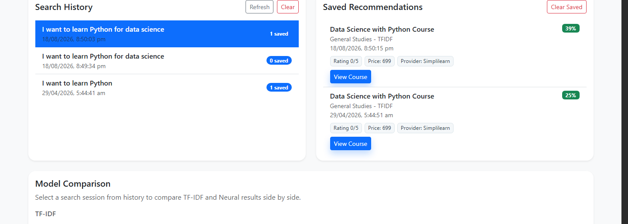
08 / LIVE OPERATION
The dashboard preserves the learner trail after a search.
The captured state shows search history, saved recommendations, and the model-comparison area working together.
DASHBOARD / persistence + comparison
SMARTCOURSE / FYP VIVA
09
Notes:
Point to the selected search session on the left, the saved recommendation on the right, and the side-by-side comparison below. This is where SQLite persistence becomes visible to the learner.
[Sources]
- Captured from the local Flask app at http://127.0.0.1:5000/dashboard
- templates/dashboard.html
- smartcourse/models/db_models.py
- static/js/main.js

Slide 10
09 / THE LEARNER LOOP
A one-time search becomes a reusable learning trail.
Every search becomes a session; promising courses can be saved and the two ranking perspectives can be compared later.
1
2
3
4
Search
Compare
Save
Revisit
The query and both result lists are stored.
TF-IDF and Neural results stay visible side by side.
A selected course is linked to its search session.
The dashboard makes prior decisions easy to inspect.
SQLite tables
search_sessions ↔ saved_recommendations
JSON keeps rich course metadata portable.
SMARTCOURSE / FYP VIVA
10
Notes:
Emphasize that persistence is part of the product, not an afterthought. One SearchSession can have many SavedRecommendation records.
[Sources]
- smartcourse/models/db_models.py
- smartcourse/services/history.py
- templates/dashboard.html
- static/js/main.js

Slide 11
10 / EVALUATION
The project measures ranking quality — not just screen polish.
Evaluation tooling compares how useful the top of each ranking is for predefined queries and relevance labels.
Precision@K
Recall@K
Hit Rate
Of the top K courses, how many are relevant?
Of all known relevant courses, how many appear in the top K?
Did the top K contain at least one relevant course?
How the evaluation is run
1
Load
2
Rank
3
Compare
4
Report
evaluation_queries.json
TF-IDF and Neural @ K
titles against labels
average metrics
Honest scope note: the checked evaluation set is small, so metrics are a starting point—not a claim of universal quality.
SMARTCOURSE / FYP VIVA
11
Notes:
Do not invent metric values during the viva. Explain the definitions and the evaluation procedure. If asked for results, show the output after running the script in the correct environment.
[Sources]
- scripts/evaluate_models.py
- data/evaluation_queries.json
- project-documents/SmartCourse_FYP_Viva_Guide.pdf

Slide 12
11 / LIKELY VIVA QUESTIONS
Answer with the current prototype, then name the next improvement.
Short, structured answers keep the discussion grounded in what the code actually does.
Why TF-IDF?
Why sentence transformers?
It is fast, transparent, and strong when exact technical terms matter.
They capture semantic meaning, so related phrases can match without identical words.
What is cosine similarity?
Why Flask and SQLite?
It compares vector direction; a higher value means a closer match in that representation.
Flask is lightweight for pages plus APIs; SQLite is file-based and enough for prototype persistence.
What is Hybrid?
What are the limits?
Both models run and the ranked lists are shown side by side; scores are not fused.
Small evaluation data, no accounts or personalization yet, and prototype-level deployment.
FUTURE WORK
Feedback-based re-ranking · weighted score fusion · larger labels · filters · production security
SMARTCOURSE / FYP VIVA
12
Notes:
Use these as concise answers. Always describe the current prototype honestly, then connect the limitation to a concrete future improvement.
[Sources]
- README.md
- smartcourse/models/tfidf_model.py
- smartcourse/models/neural_model.py
- smartcourse/services/recommendation.py
- smartcourse/config.py

Slide 13
12 / THE DEMO
The live story is simple: search → compare → save → revisit.
A short, repeatable demo keeps the viva focused on the system's value and the engineering behind it.
01
02
03
04
Search
Compare
Save
Revisit
Open Recommendations
Enter: Python for data science
Select Hybrid
Explain both ranking lenses
Choose a course
Point out score and metadata
Open Dashboard
Show history + saved item
UI → API
models → cards
POST /api/save
GET /api/history
If the examiner asks “what happens underneath?”, return to the request flow: validate → rank → normalize → persist → render.
SMARTCOURSE / FYP VIVA
13
Notes:
Use this slide as the presenter checklist. Keep the demo under control: one query, one saved course, one dashboard view. If a model is slow to load, explain lazy loading and precomputed artifacts.
[Sources]
- templates/recommend.html
- templates/dashboard.html
- static/js/main.js
- smartcourse/api.py

Slide 14
THE TAKEAWAY
SmartCourse makes course
discovery more explainable.
QUESTIONS
It combines two complementary ranking methods with a usable web experience, persistent learner history, and a clear path toward personalization.
Thank you
Problem
Solution
Outcome
large catalog
two ranking lenses
better decisions
F25PROJECTEC4D8
14
Notes:
Close by restating the system in one sentence, then invite questions. If the first question is technical, return to the separation between data preparation, model ranking, API orchestration, and persistence.
[Sources]
- README.md
- project-documents/FinalDeliverables_F25PROJECTEC4D8/2-FinalReport_SmartCourse_F25PROJECTEC4D8.docx
- project-documents/FinalDeliverables_F25PROJECTEC4D8/3-FinalPresentation_SmartCourse_F25PROJECTEC4D8.pptx

