Slide 1
Healthy Alternatives

Slide 2
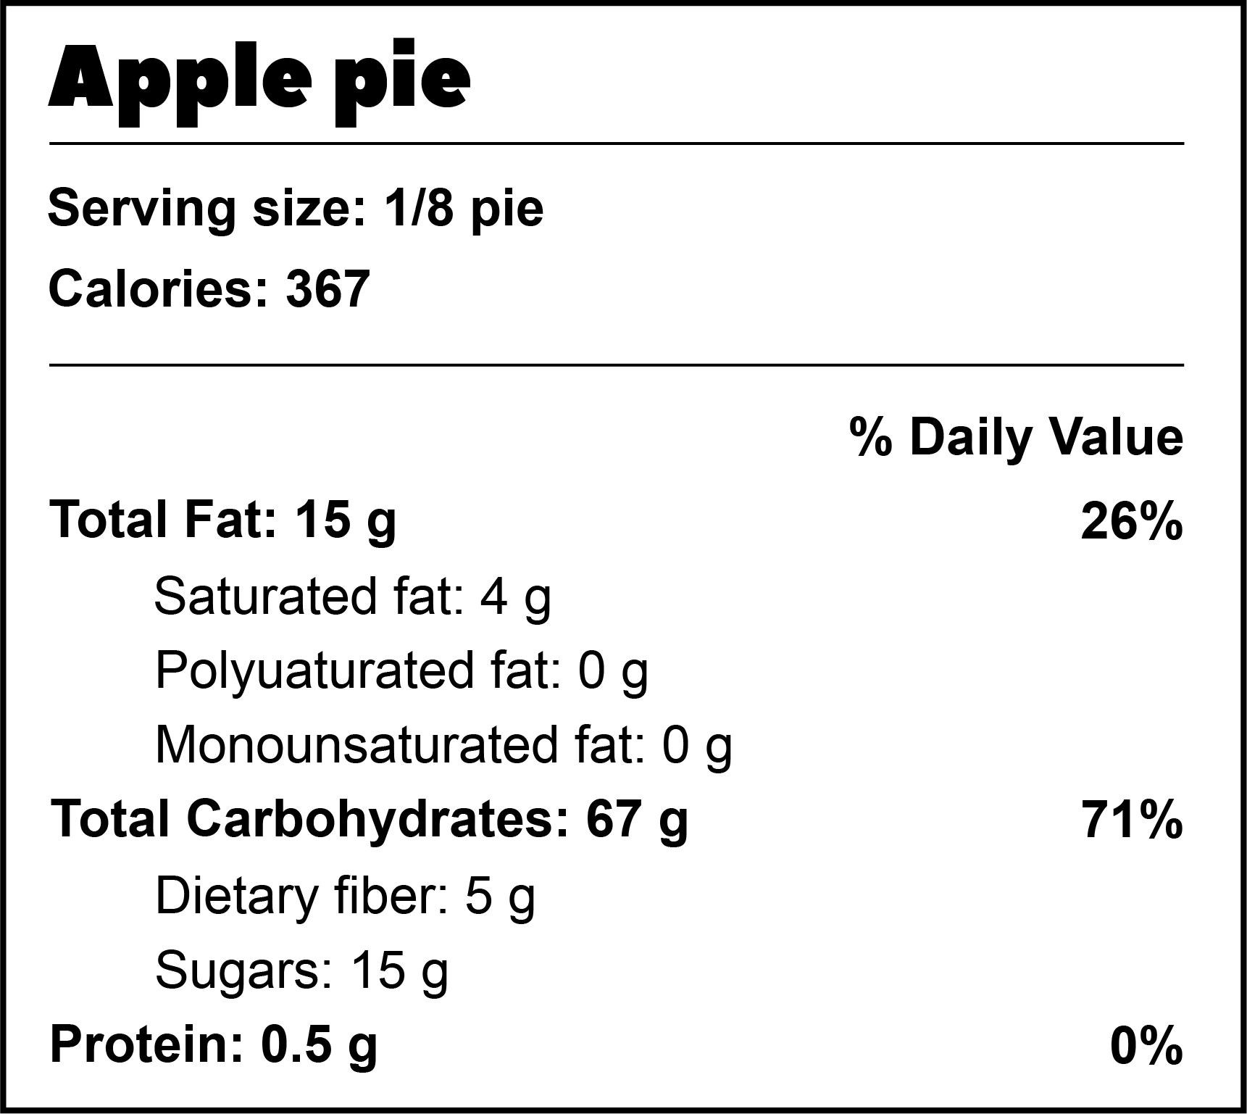
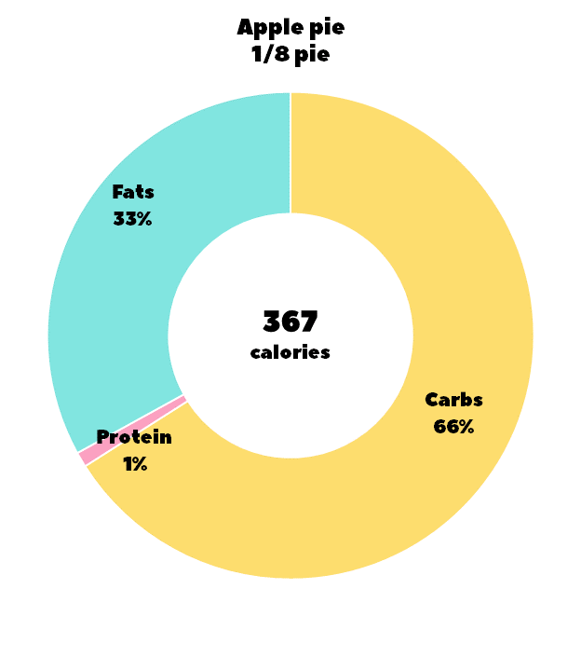
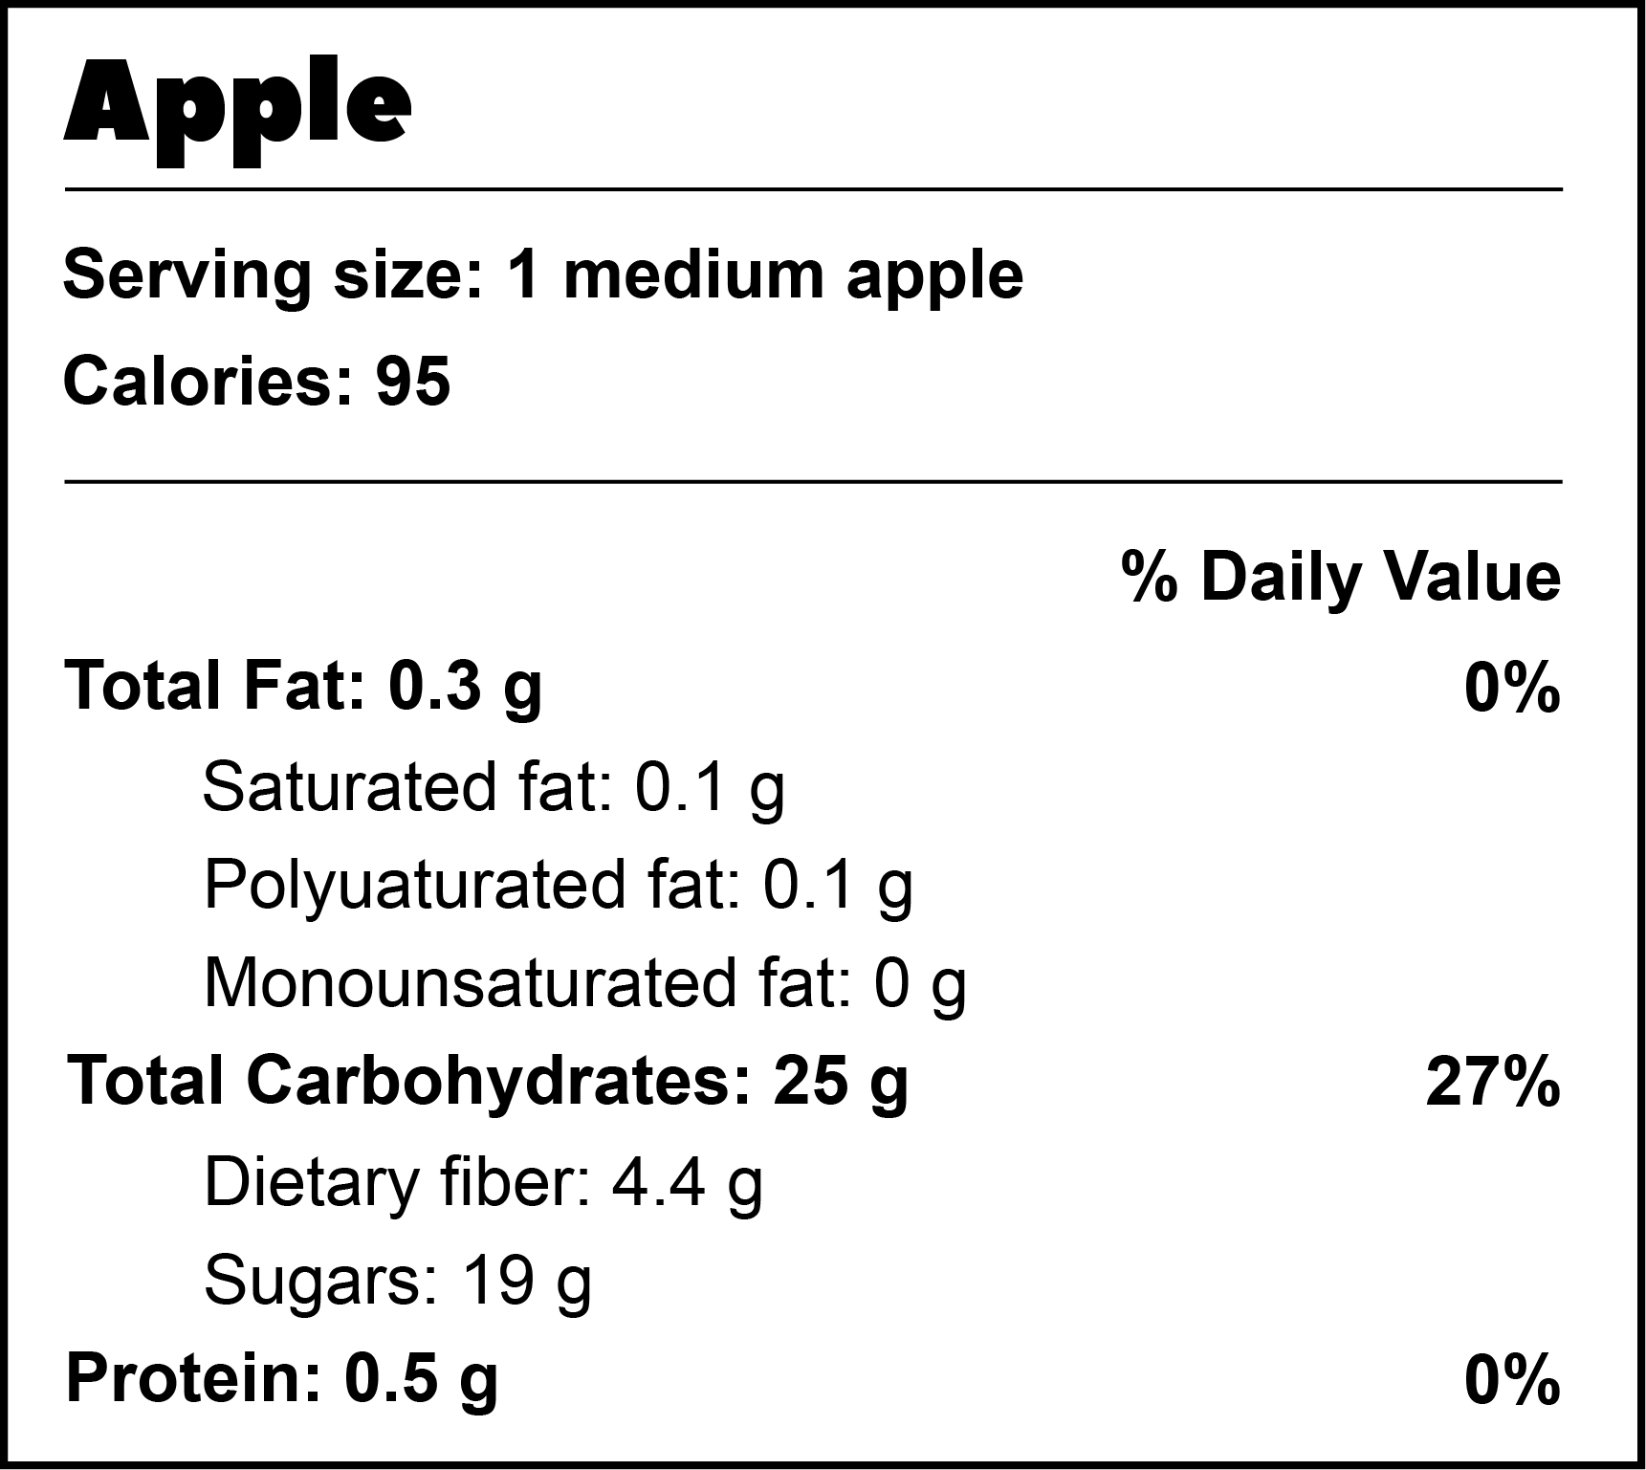
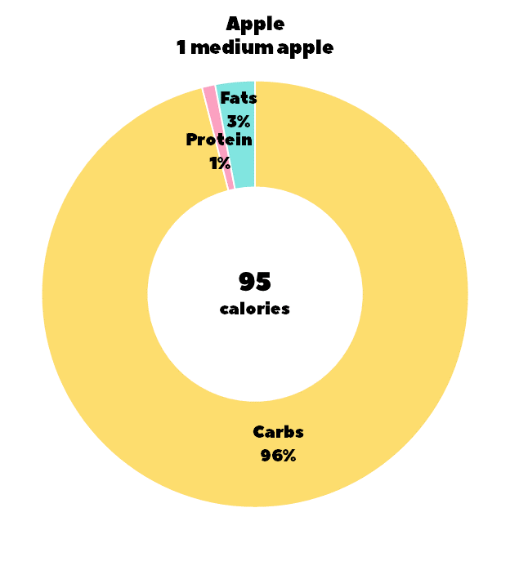
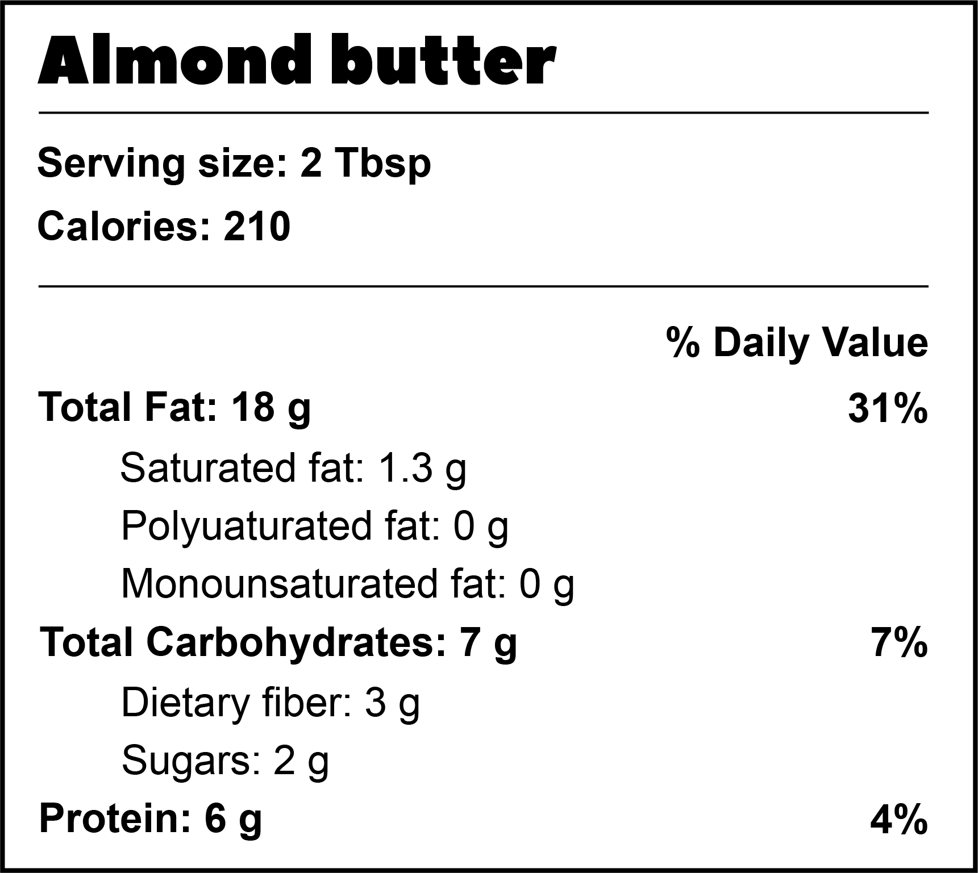
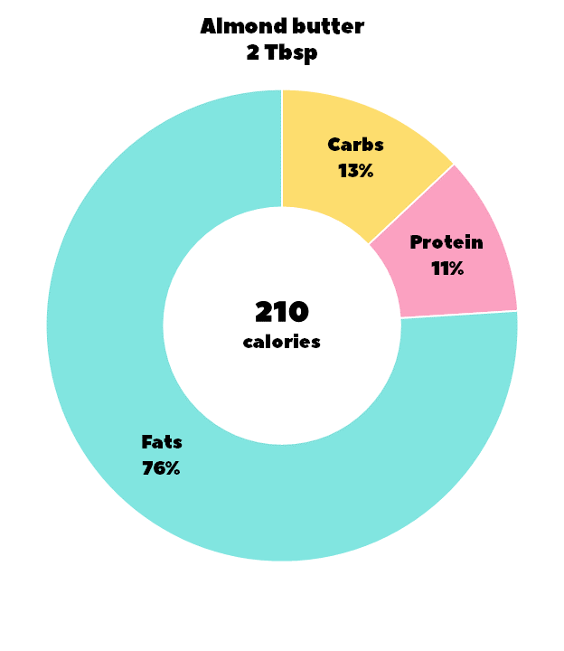
Tip: It’s no secret that pie is not a nutritious food. When you add sugar and butter, you’re adding carbs and fats. Apple pie contains more than 2/3 of your daily allowance of carbohydrates and 1/4 of your daily fats. Whole fruits are high in healthy carbs because the sugars in an apple come from natural fruit sugars instead of processed sugars. If you need fat, consider dipping your apple slices in almond butter. It has less saturated fat and sugars and adds some protein too.

Slide 3
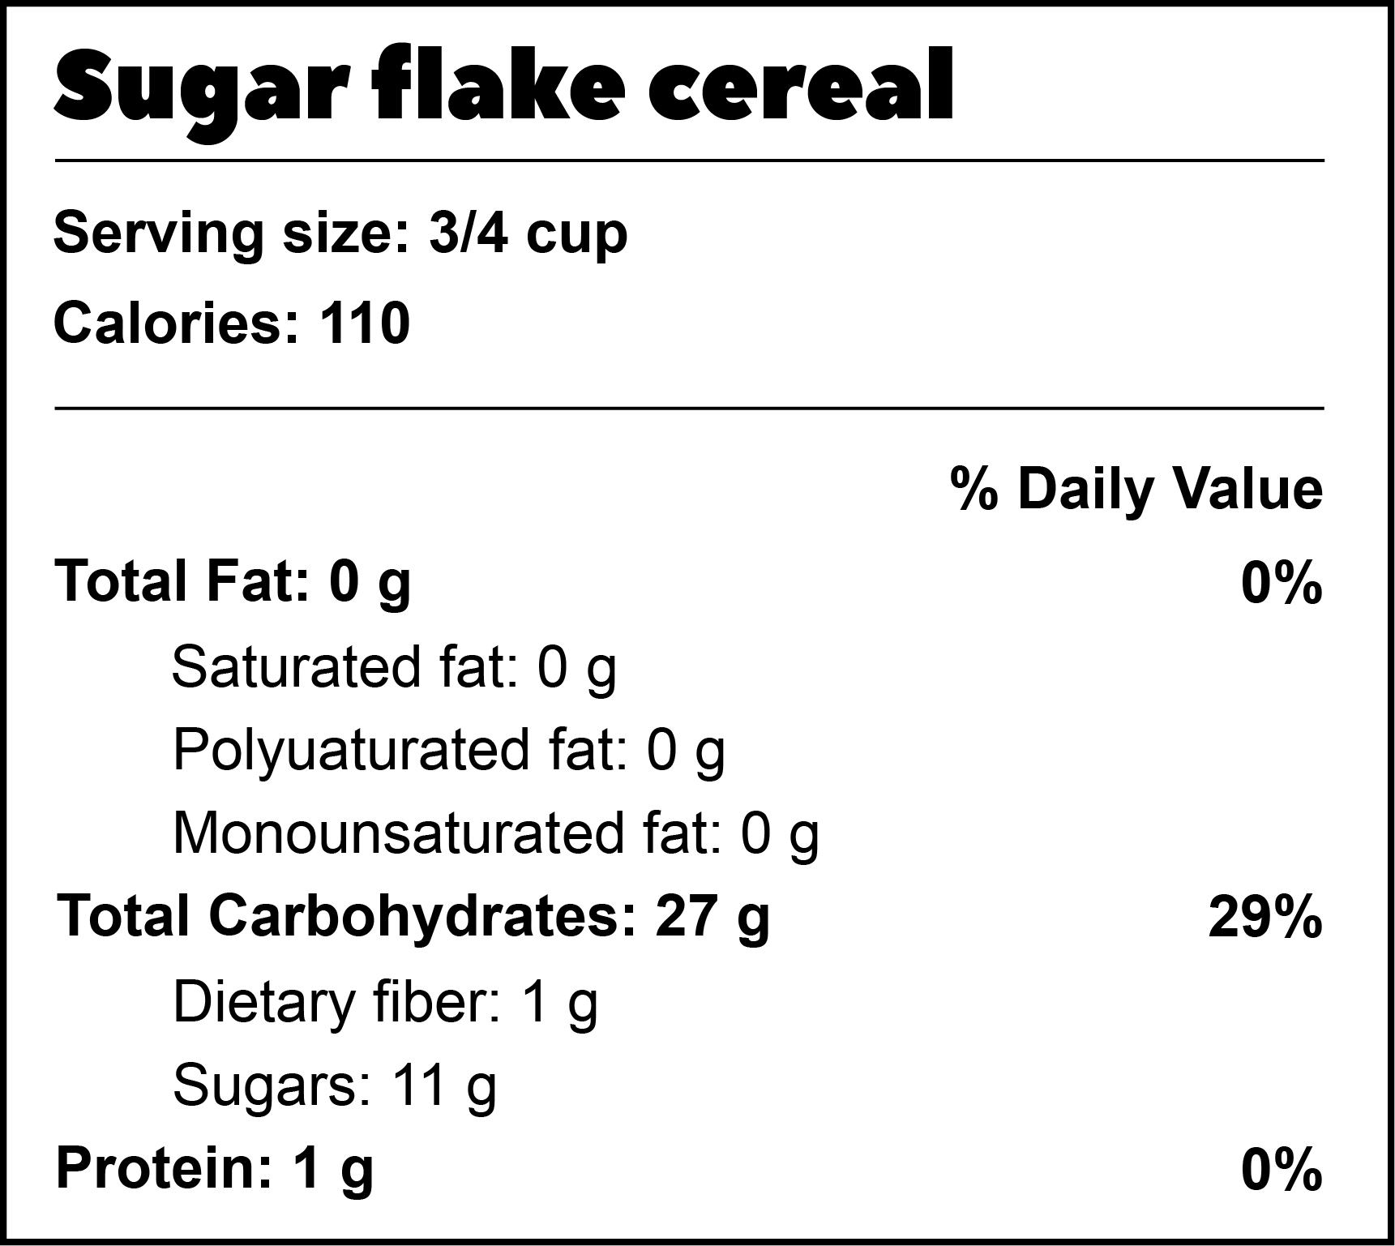
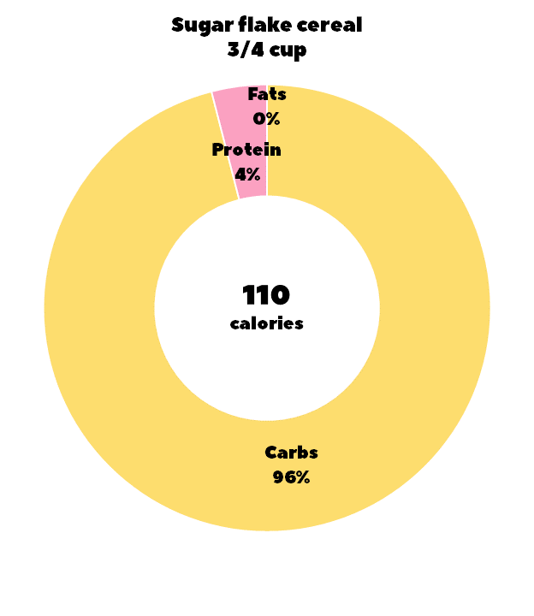
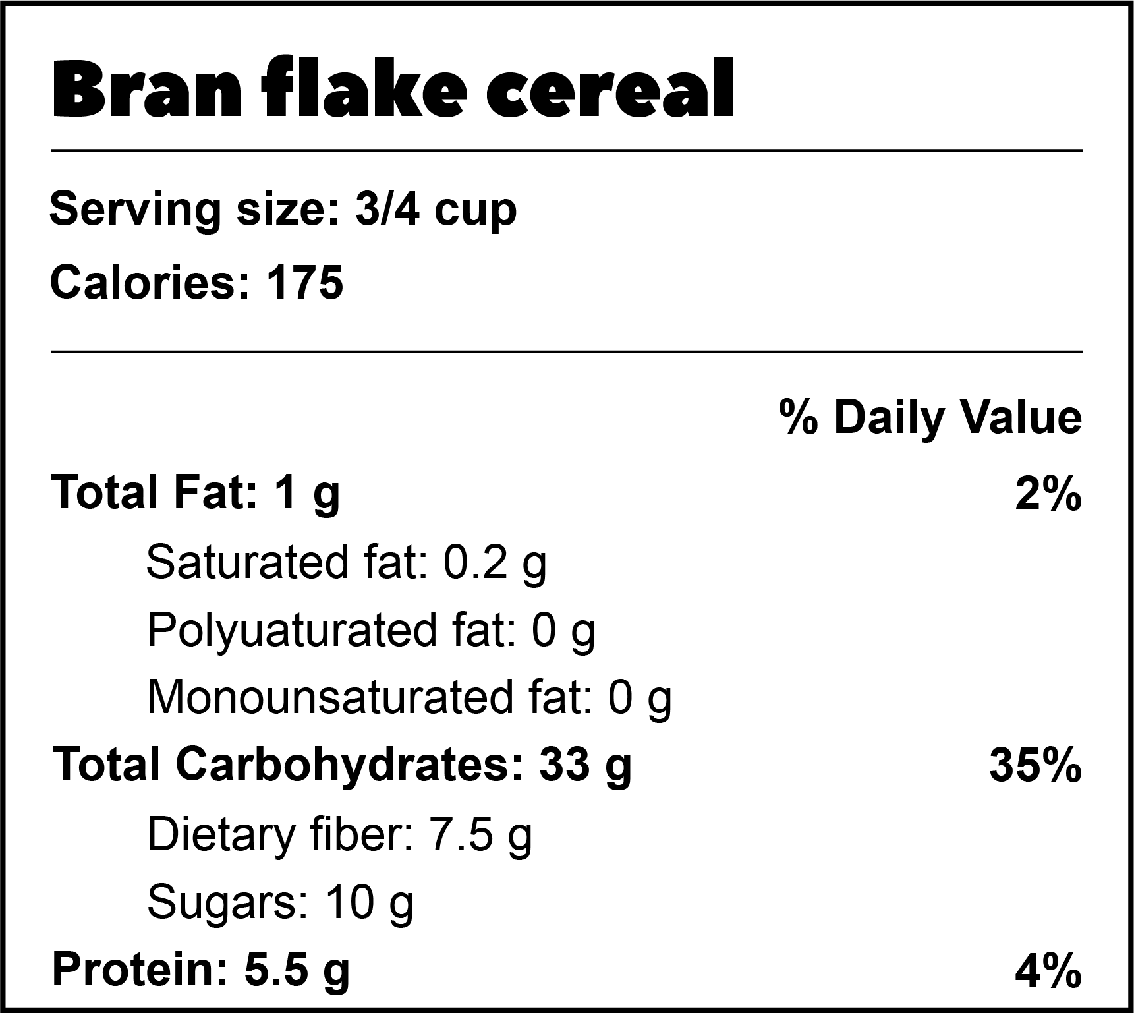
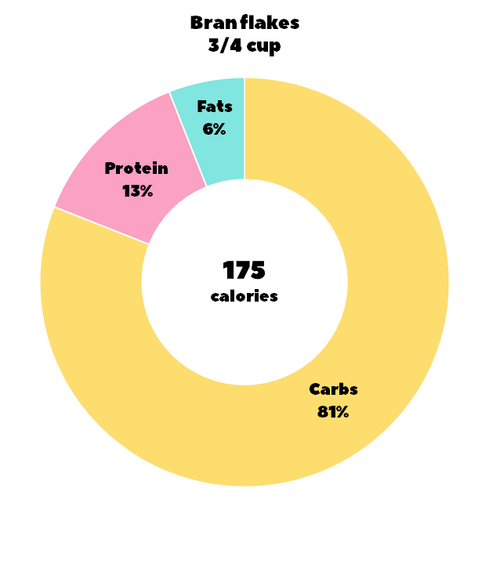
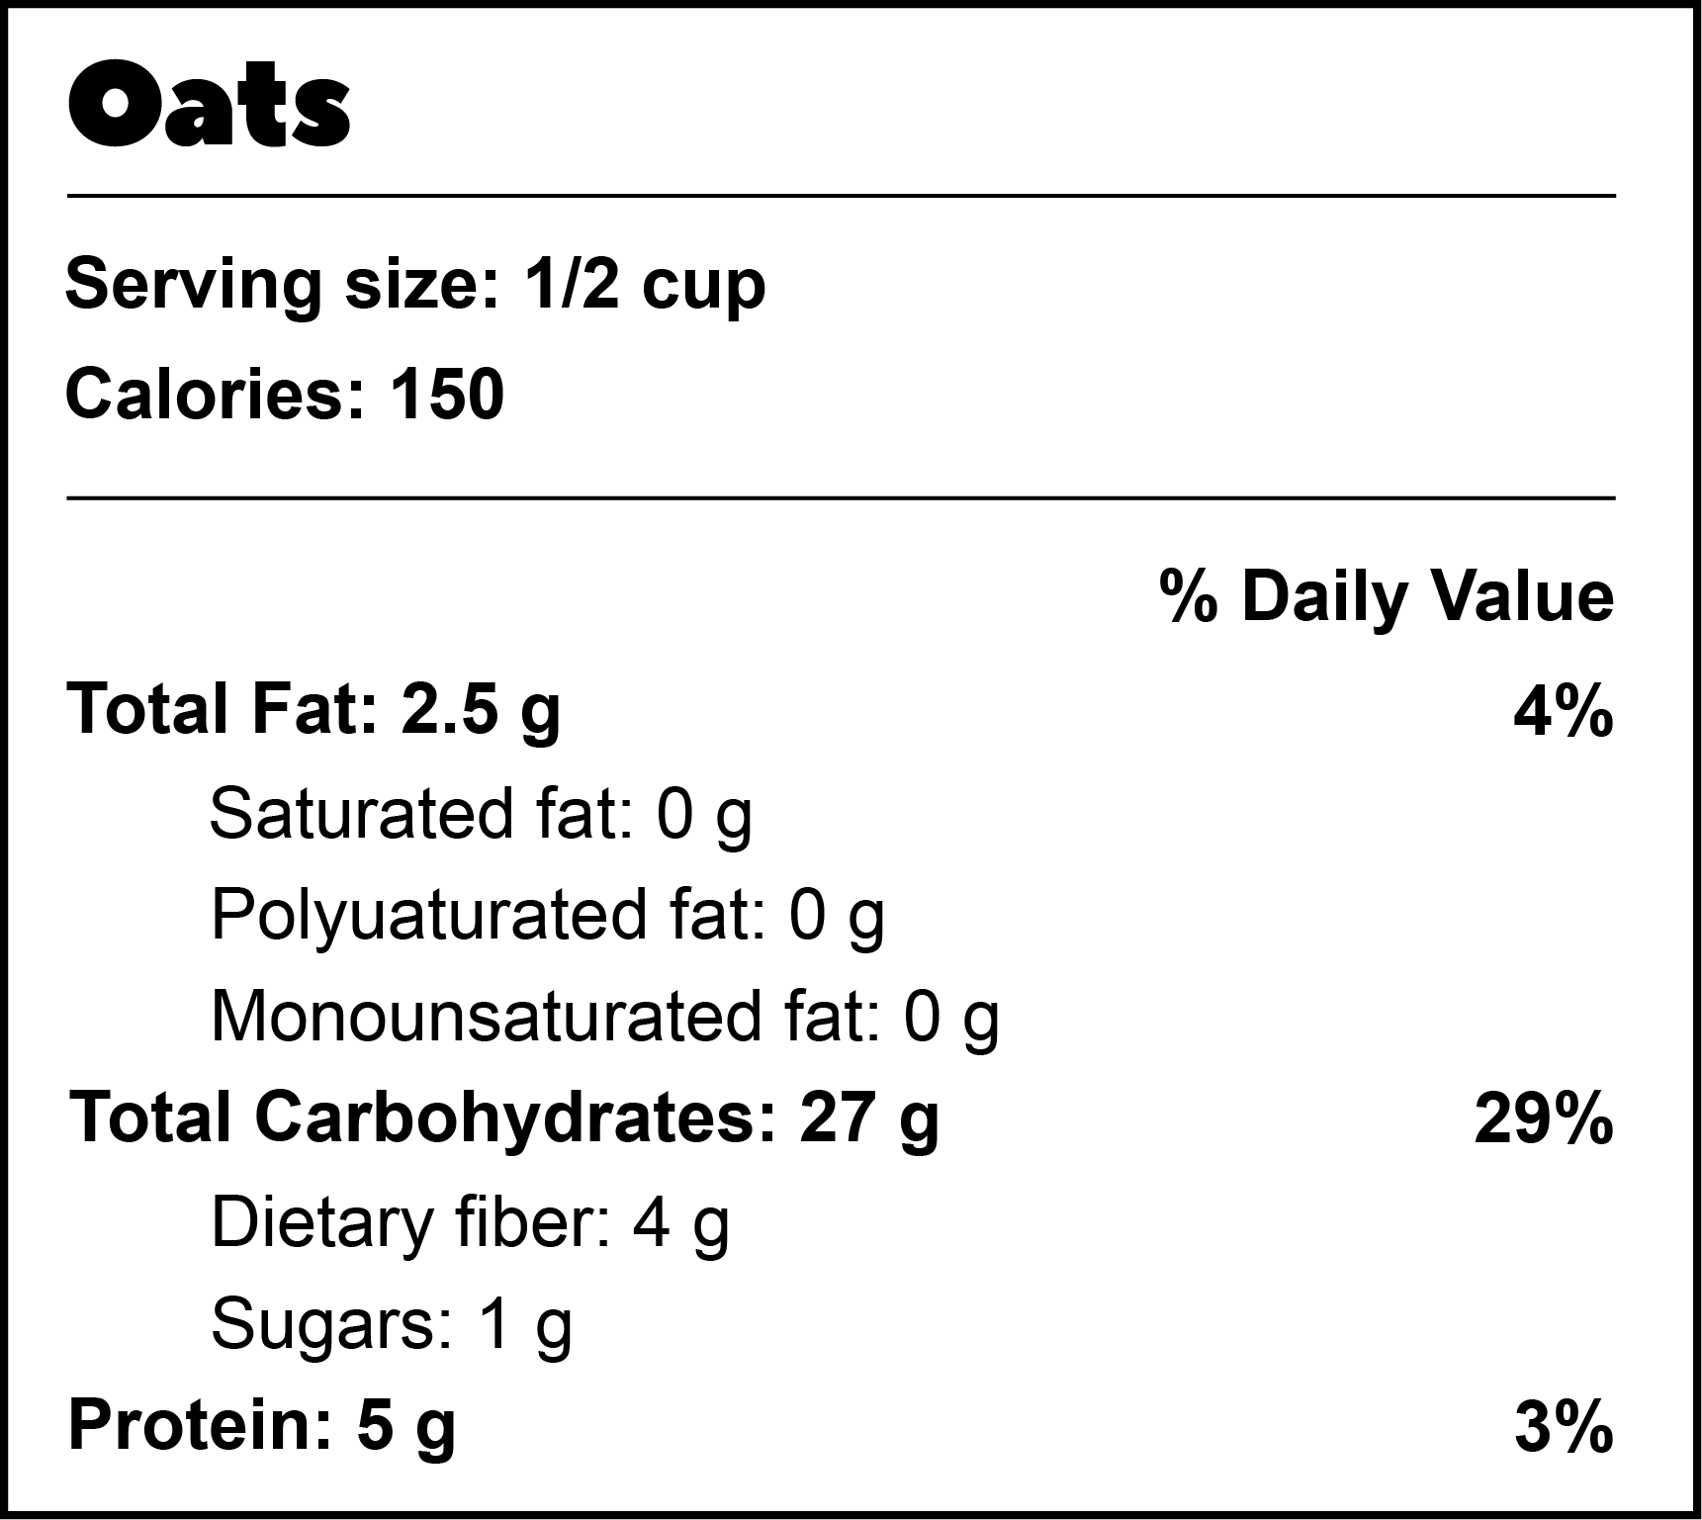
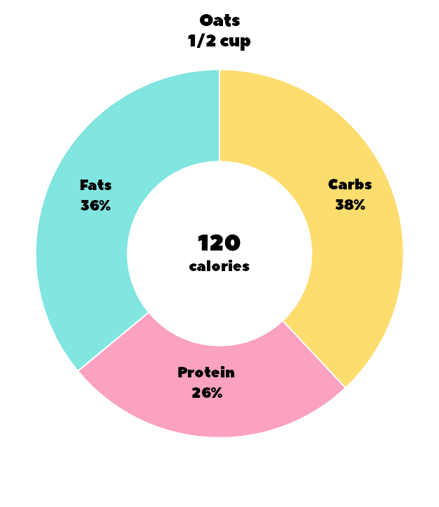
Tip: Cereal is naturally high in carbohydrates because grains are plants and plants tend to have a carb macro that’s higher in percentage than fats and proteins. When you’re choosing a cereal, keep in mind that sugar is a carb, and it’s not a healthy one. When dealing with packaged foods, one way to tell if it’s healthy is to look at the ratio of dietary fiber to sugars. If the sugars number is higher than the fiber, you could make a healthier choice.

Slide 4
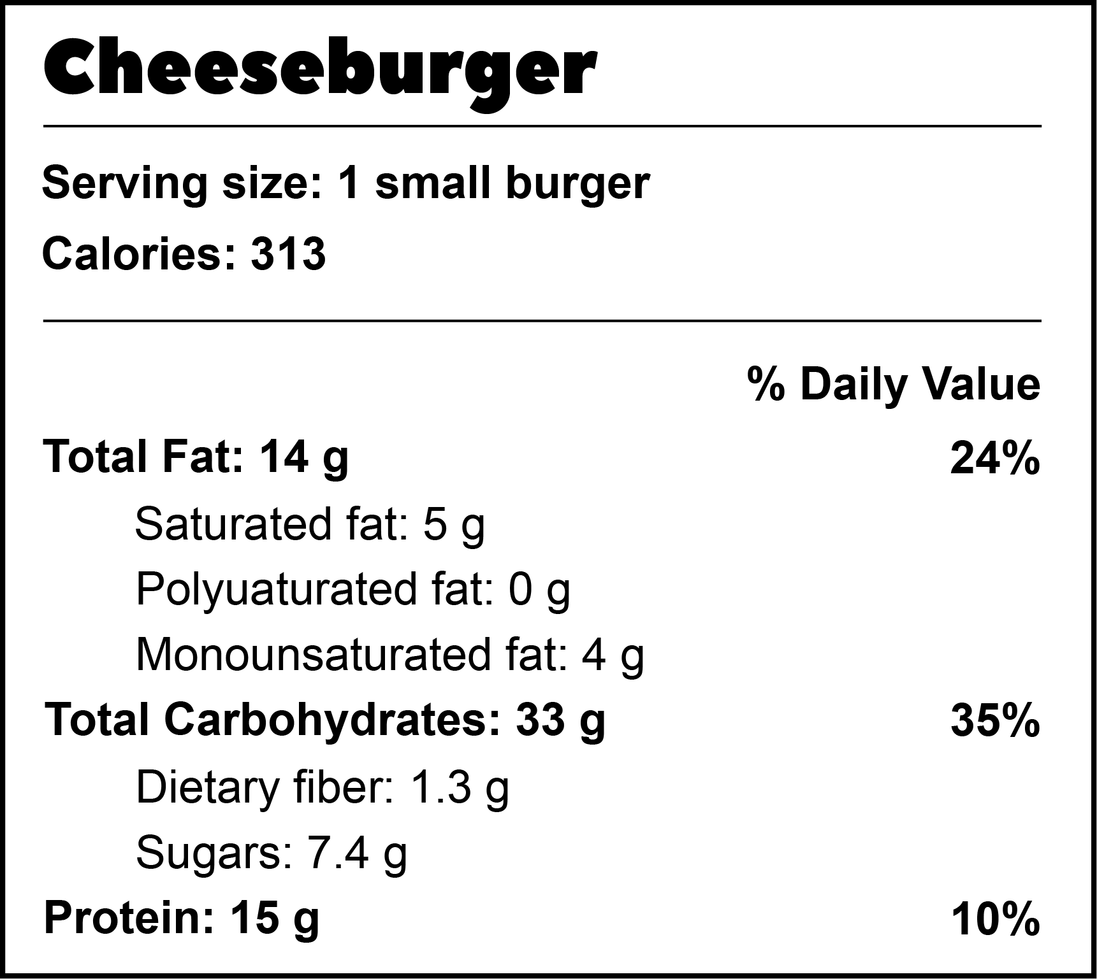
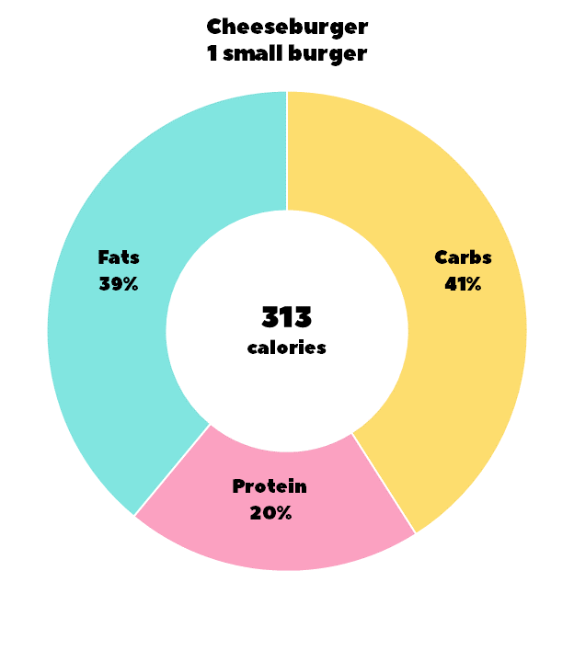
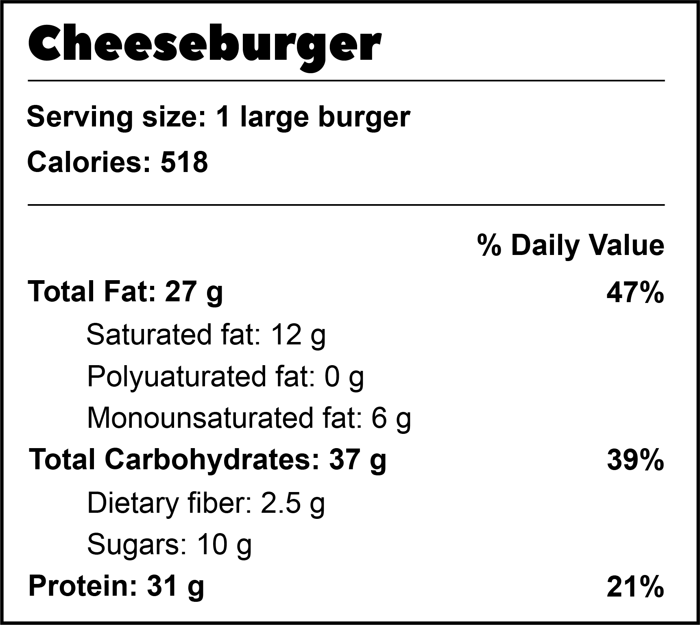
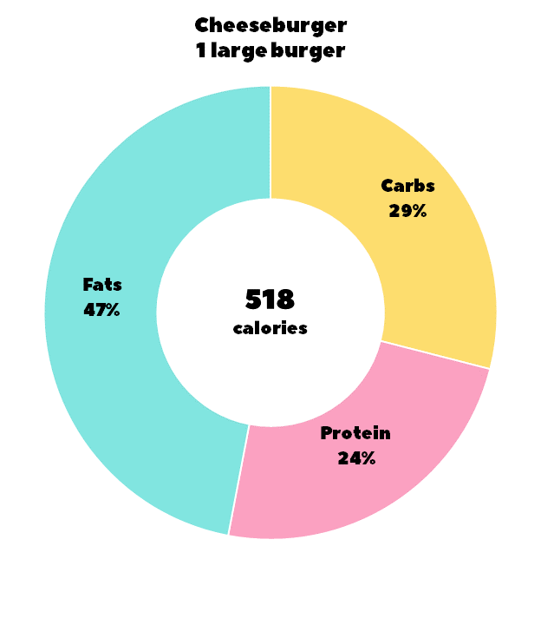
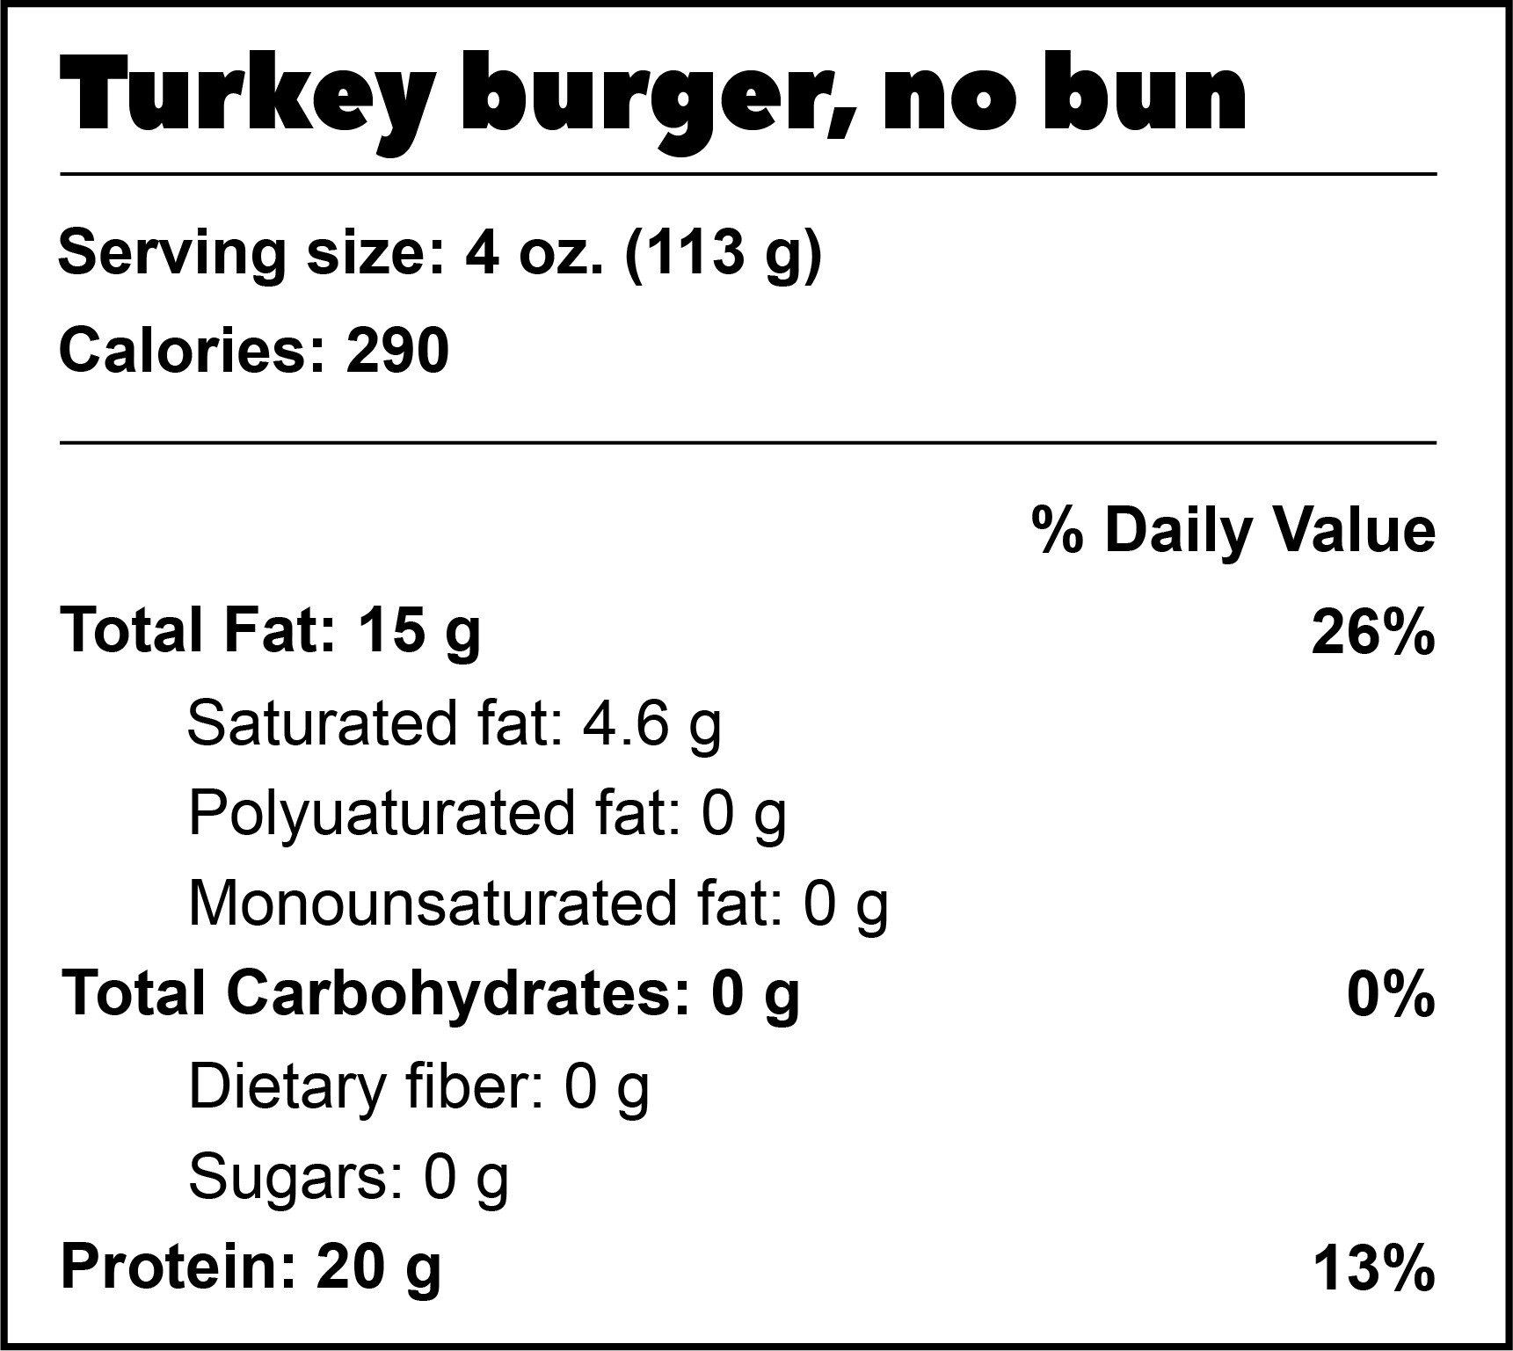
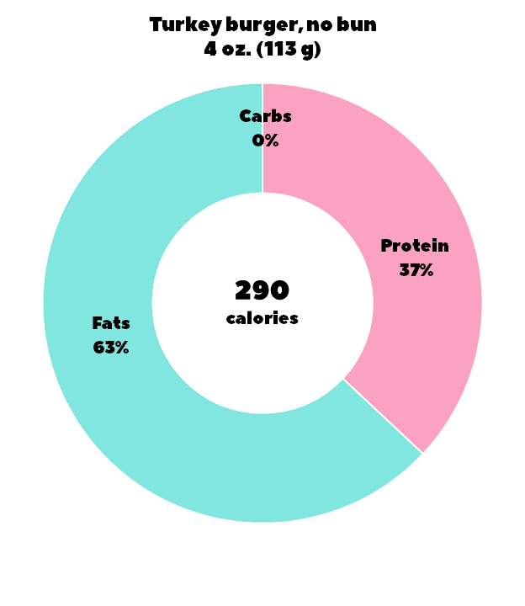
Tip: Most burgers you get at restaurants are not small burgers, so you have to account for that in your overall daily intake of carbs and fats. One alternative is to get a turkey burger, and skip the bun if you’re trying to watch that carb macros because of other choices you’ve made throughout the day. A turkey burger without a bun has half as much fat as a large burger, an none of the carbs.

Slide 5
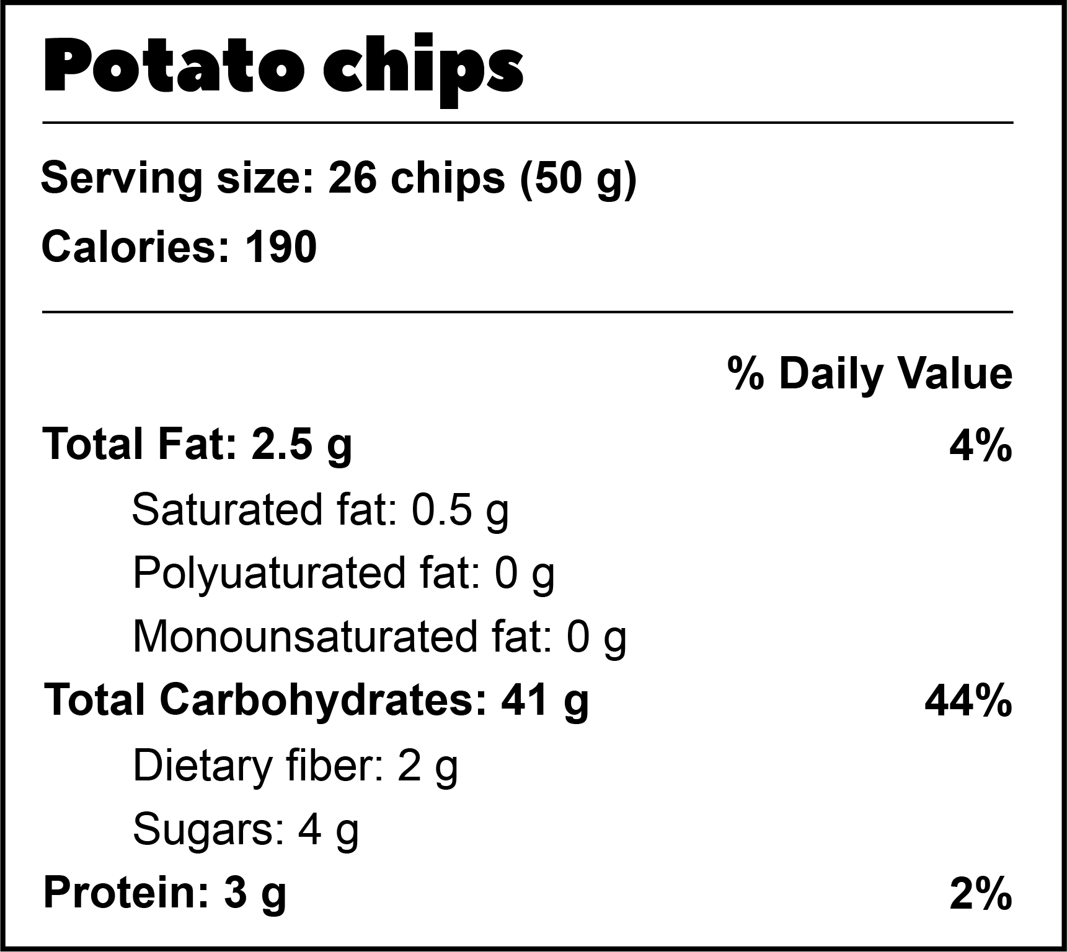
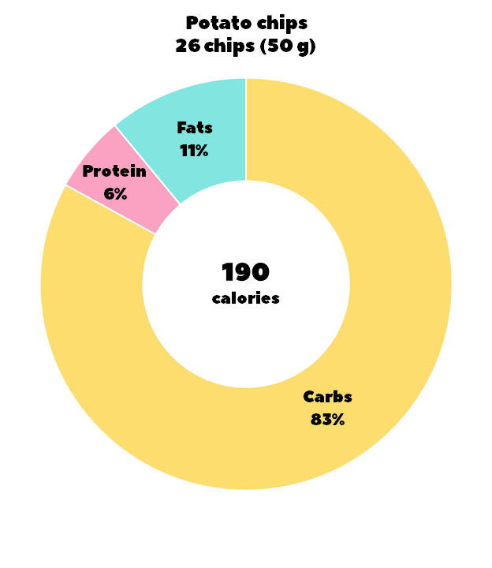
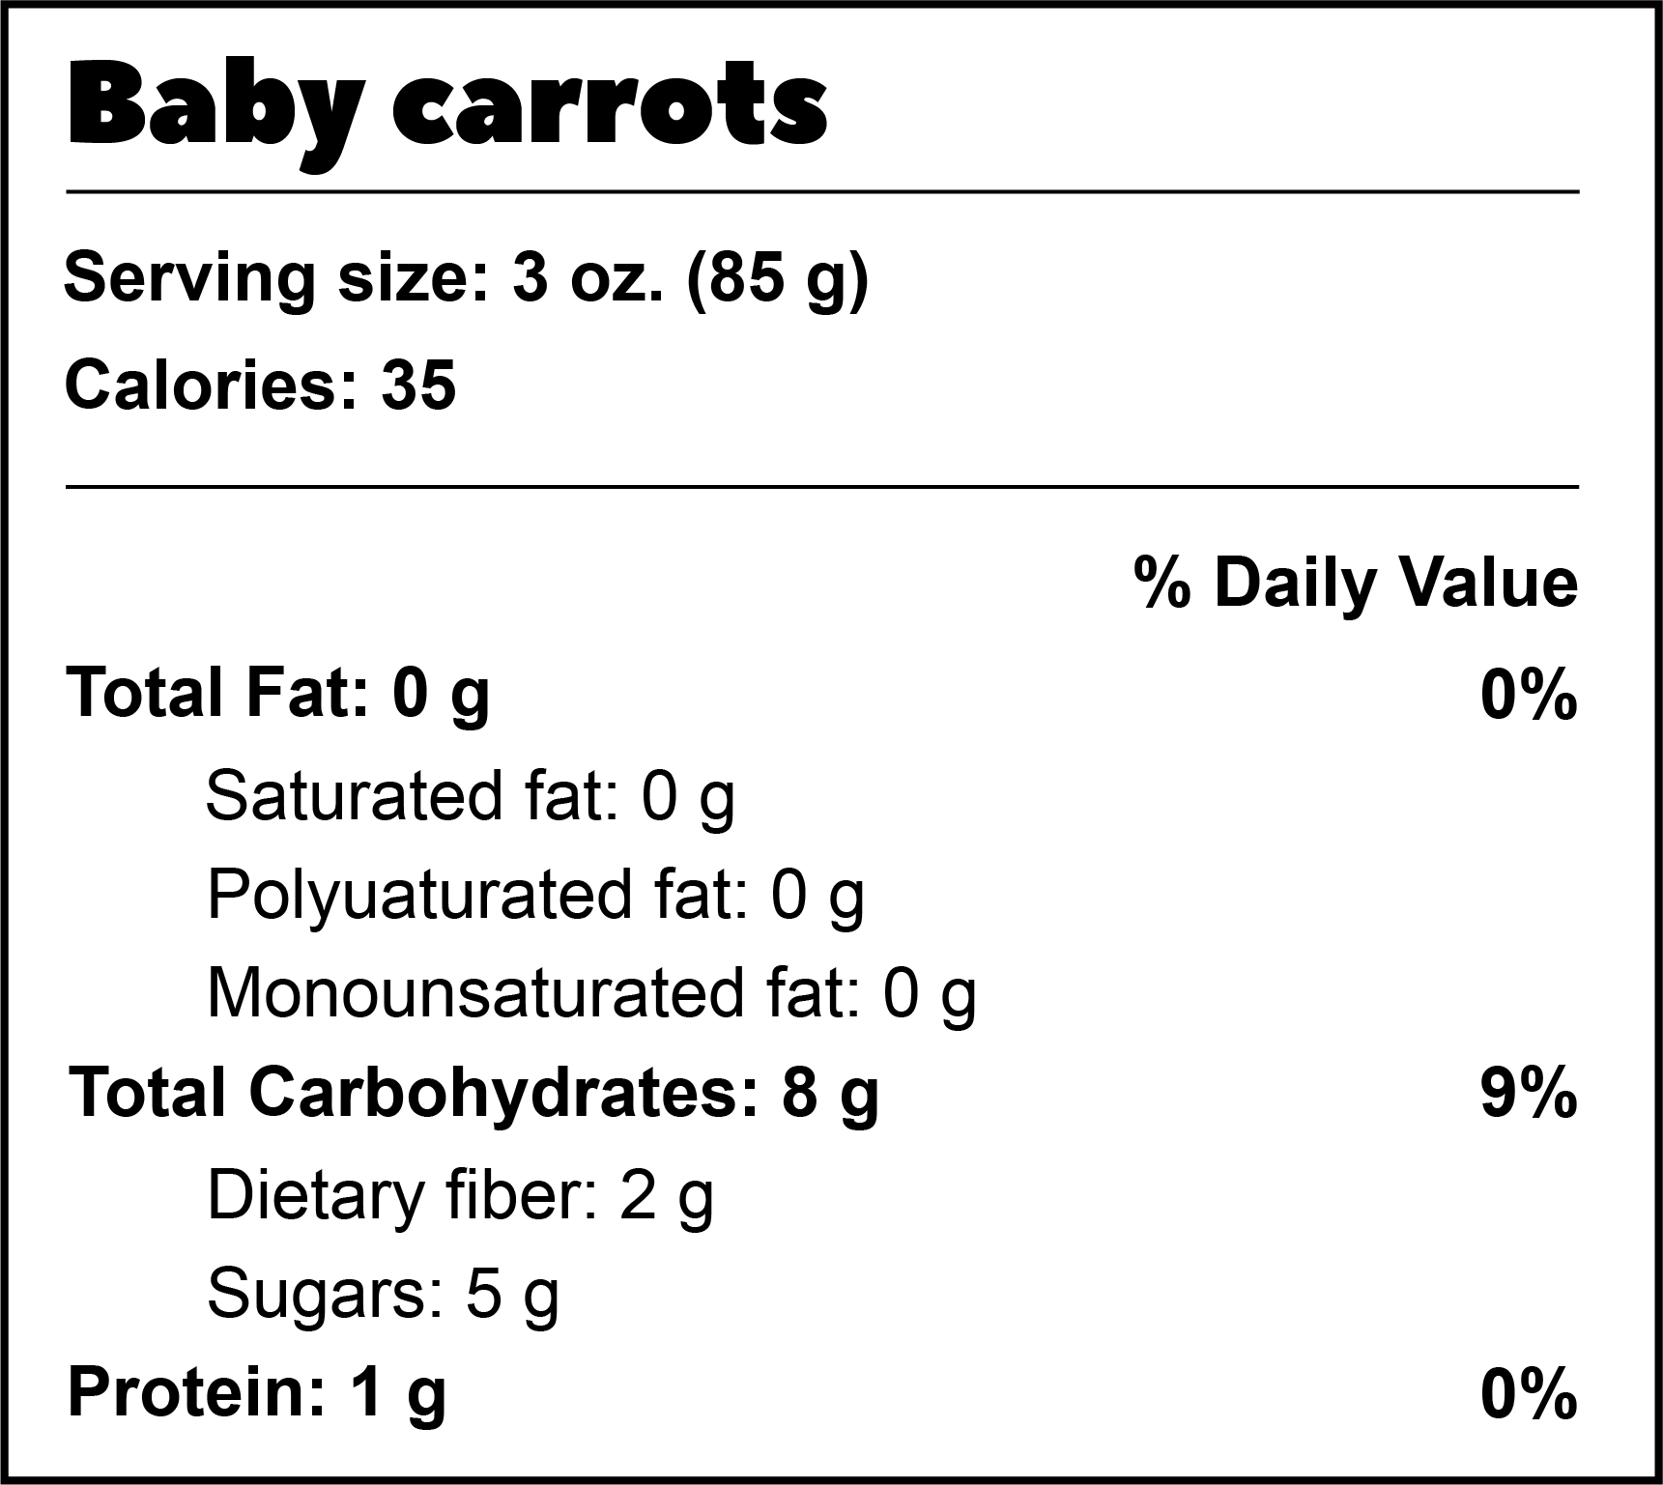
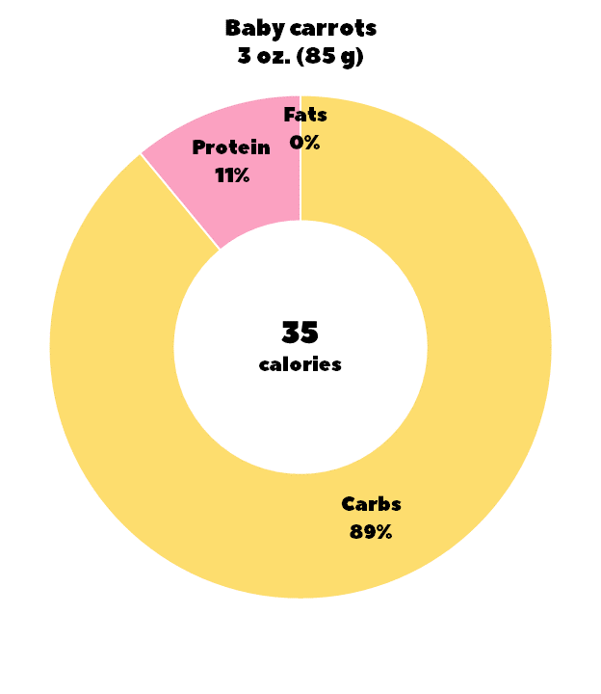
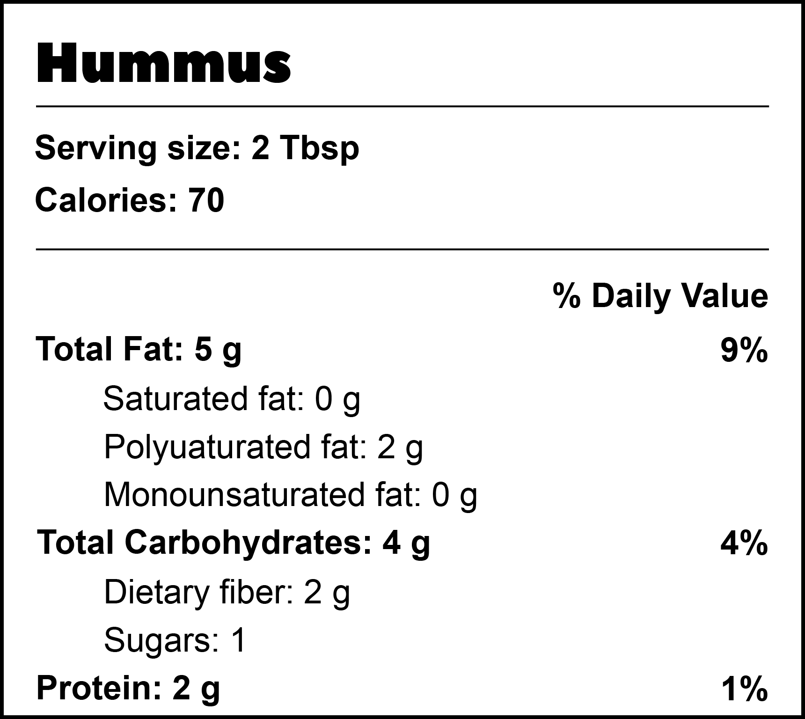
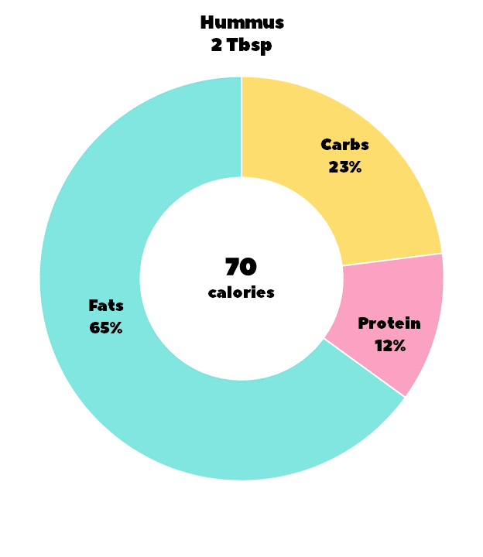
Tip: It’s easy to guess that potato chips aren’t a healthy snack. They’re mostly low-nutrition carbohydrates. A better alternative for a crunchy snack is veggies and hummus. You’ll get about the same amount of protein, but a lot less carbs, adding some fiber, and getting in two veggies too!

Slide 6
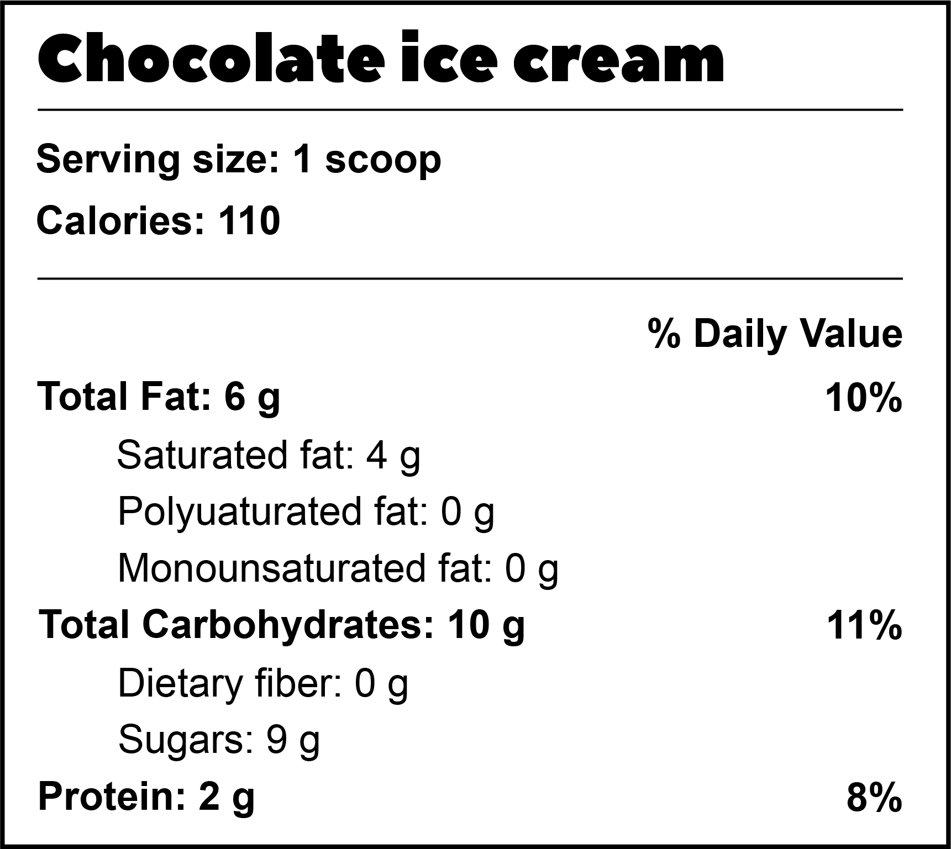
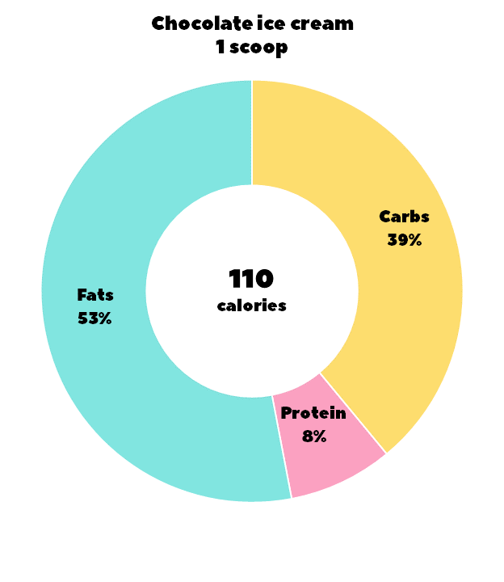


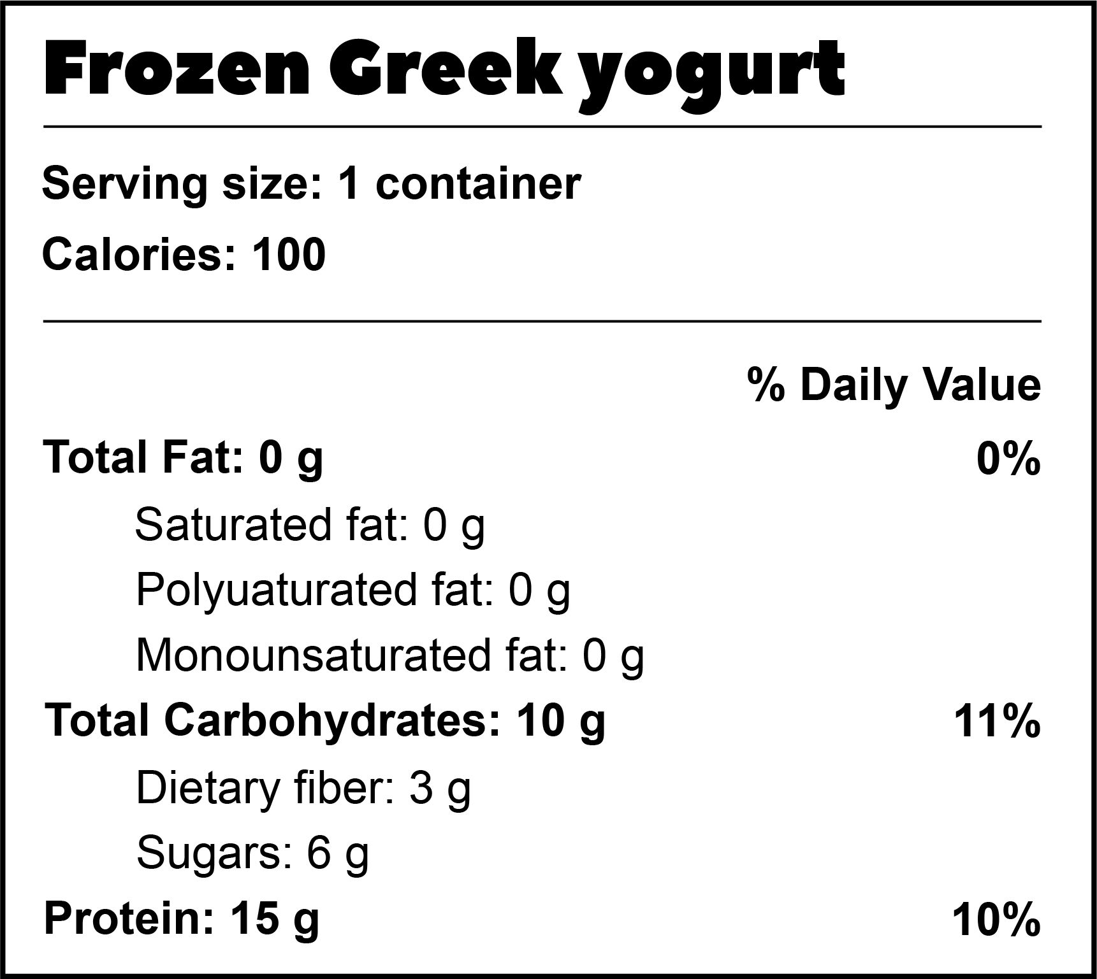
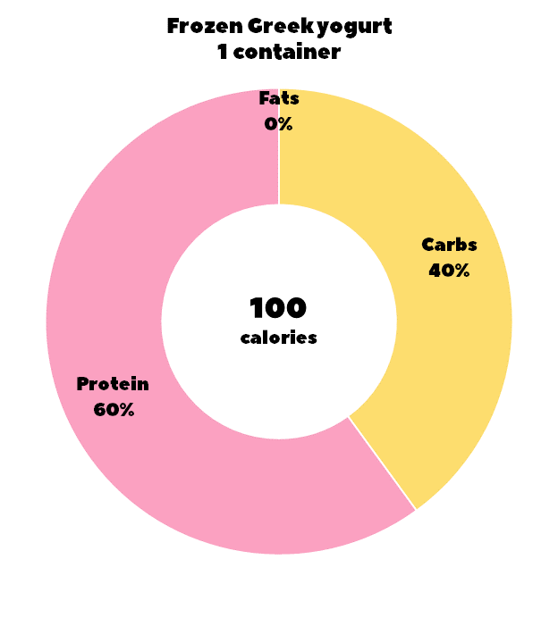
Tip: Ice cream is a weakness for most of us. It doesn’t seem all that bad if you’re having a scoop—but consider that most ice cream shops serve double scoops when you order a single. That doubles the amount of fat and carbss toward your recommended daily allowance. Anything you add changes the macros. Adding chocolate will add more carbs and some fat. You can get the satisfaction of a frozen treat by freezing a container of Greek yogurt. It’s high in protein and low in fat.

Slide 7
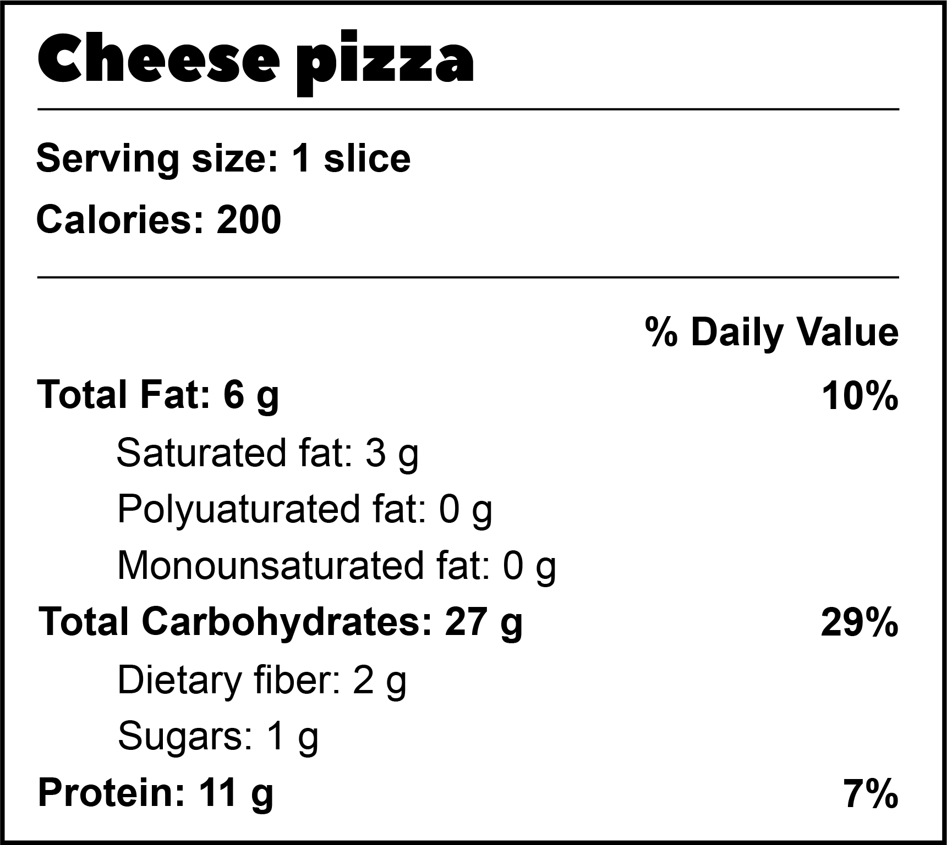
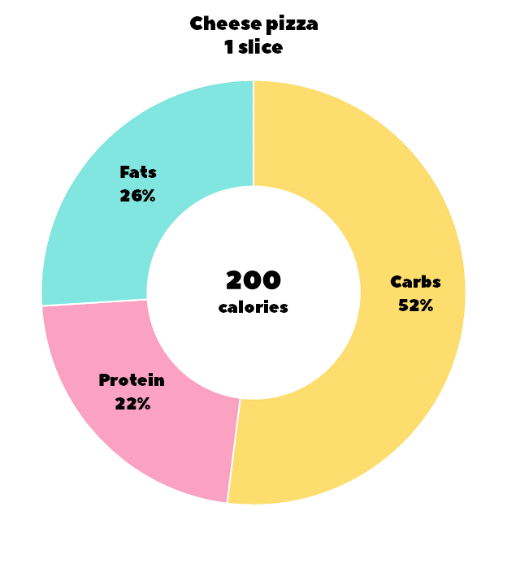
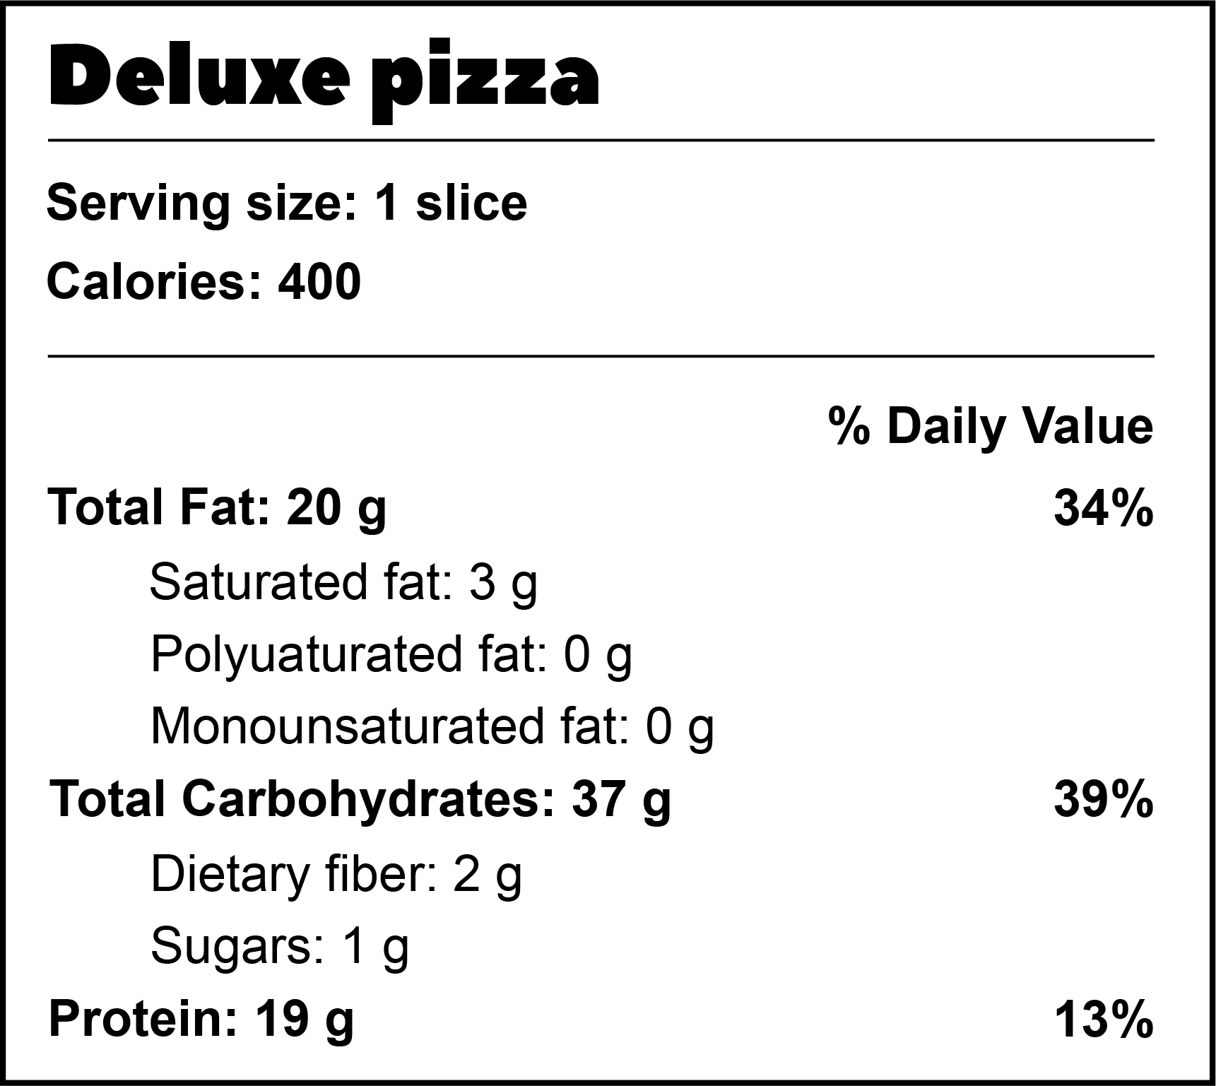
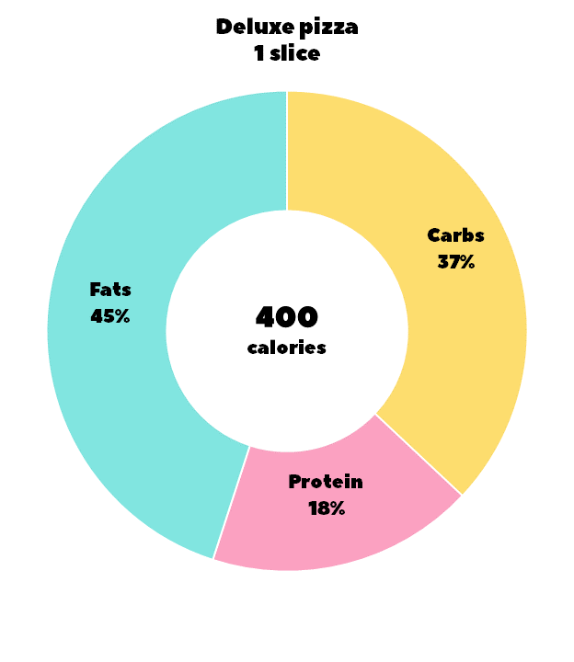
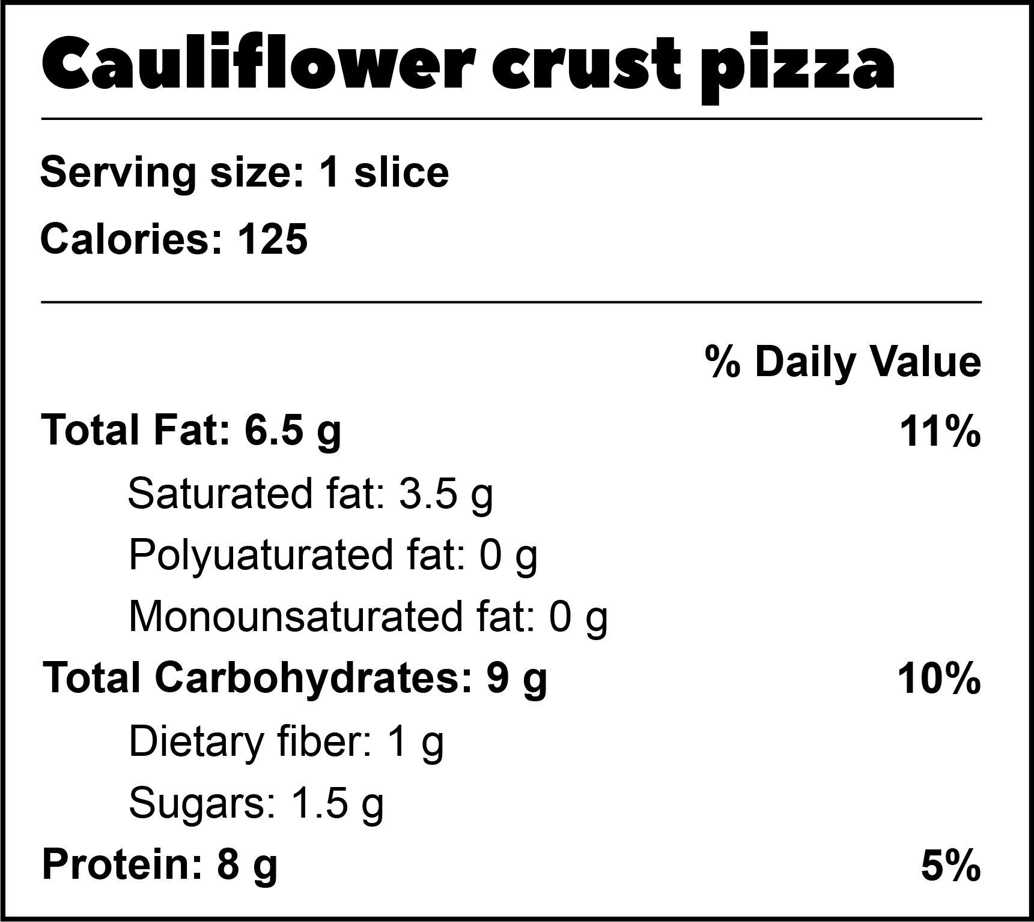
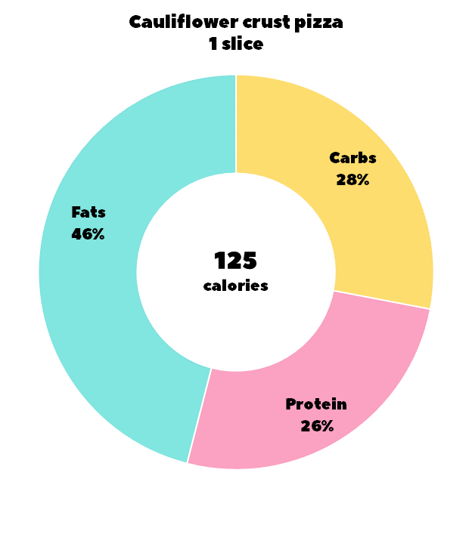
Tip: Toppings can really change the macro percentages for pizza. Compare a slice of cheese pizza with a slice of deluxe pizza. You can see that adding toppings like sausage and pepperoni can add a lot of fat. A lot of restaurants and stores are selling a lower-carb alternative to traditional pizza made with a cauliflower crust. It won’t save you on the fat because of the cheese, but it will cut the carbs by as much as 40% and you get an extra veggie.

