Slide 1
FUEL Learning Poster
Tags: Motion Planning, Flying Robots
(Reference: Zhou, Boyu, et al. "Fuel: Fast uav exploration using incremental frontier structure and hierarchical planning." IEEE Robotics and Automation Letters 6.2 (2021): 779-786.)

Slide 2

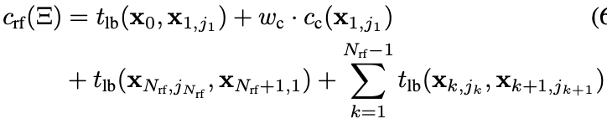
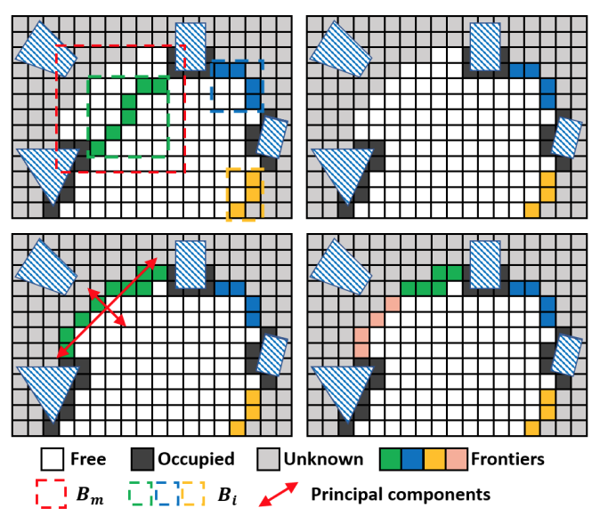
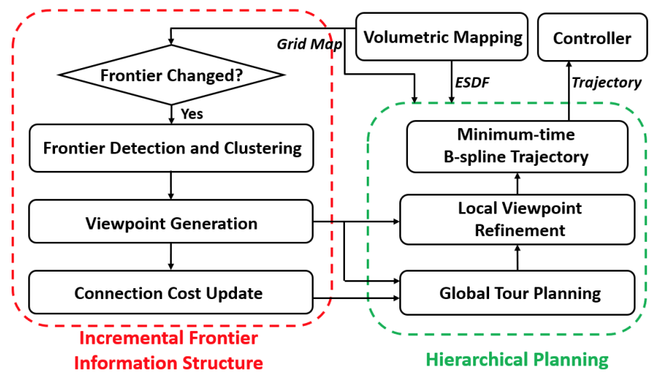
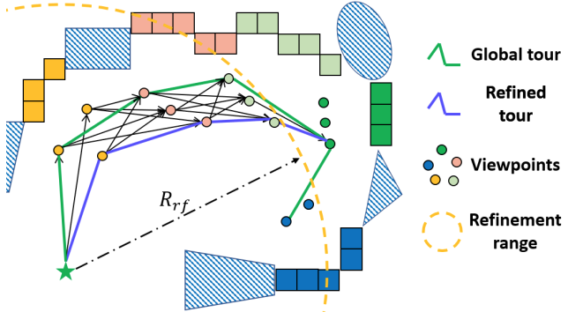
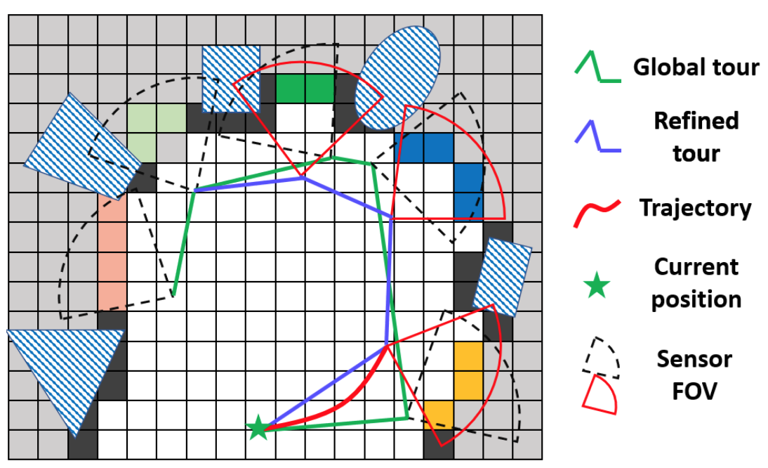
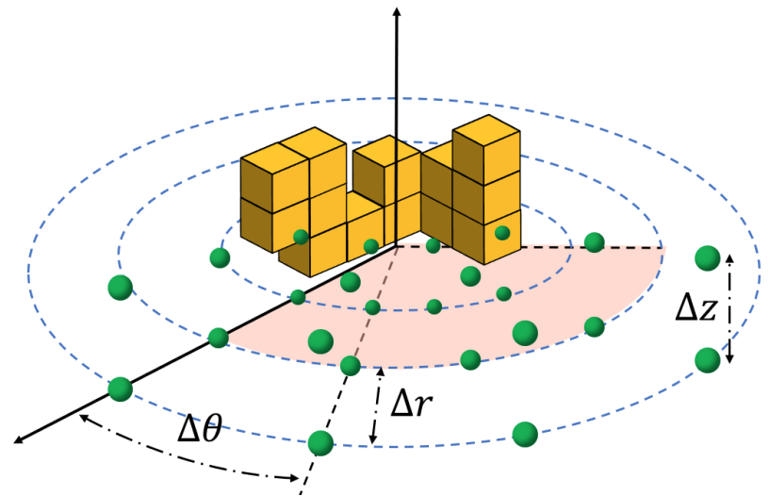



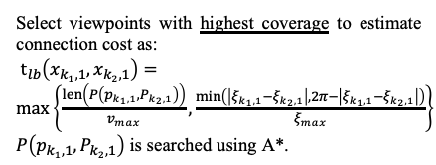
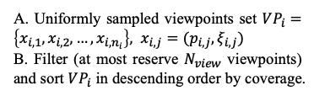
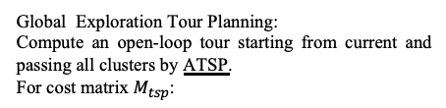
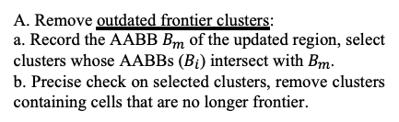
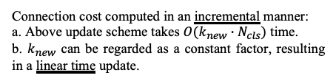
Problems
1. Greedy exploration leads to local optimality, and most methods are conservative.
2. Low-speed exploration, disallows fully exploit dynamic capability to fulfill the mission.
3. Due to high computational overhead, quadrotor can not respond quickly and frequently to environmental changes.
Solved by hierarchical planning.
Solve
Local Viewpoint Refinement:
Only a single viewpoint of each cluster -> a richer set of viewpoints on a truncated segment of the global tour.
Use Dijkstra to find optimal local tour by min:
Solve
Eliminate unaffected clusters in a fast way, significantly reduce number of expensive precise checks.
Solve
A. Remove outdated frontier clusters:
a. Record the AABB $B_{m}$ of the updated region, select clusters whose AABBs ($B_{i}$) intersect with $B_{m}$.
b. Precise check on selected clusters, remove clusters containing cells that are no longer frontier.
Minimum-time B-Spline Trajectory:
Generate smooth, safe and dynamically feasible B-spline trajectories
Updating when new frontiers are detected, leads to more frequent and faster speed exploration.
B. Frontier Detection:
Search and cluster new frontier clusters by region growing algorithm, ignore small ones (typically from noise).
C. Clustering:
Recursively conduct PCA until all large clusters are divided into small ones.
coarse-to-fine steps
Select viewpoints with highest coverage to estimate connection cost as:
$t_{lb}\left(x_{k_{1},1},x_{k_{2},1}\right)=\max\left\{\frac{len\left(P\left(p_{k_{1},1},P_{k_{2},1}\right)\right)}{v_{max}},\frac{\min\left(\left|ξ_{k_{1},1}−ξ_{k_{2},1}\right|,2π−\left|ξ_{k_{1},1}−ξ_{k_{2},1}\right|\right)}{ξ_{max}}\right\}$
$P\left(p_{k_{1},1},P_{k_{2},1}\right)$ is searched using A*.
Global Exploration Tour Planning:
Compute an open-loop tour starting from current and passing all clusters by ATSP.
For cost matrix $M_{tsp}$:
A. Uniformly sampled viewpoints set $VP_{i}=\left\{x_{i,1},x_{i,2},…,x_{i,n_{i}}\right\}, x_{i,j}=(p_{i,j},ξ_{i,j})$
B. Filter (at most reserve $N_{view}$ viewpoints) and sort $VP_{i}$ in descending order by coverage.
Connection cost computed in an incremental manner:
a. Above update scheme takes $O(k_{new}∙N_{cls})$ time.
b. $k_{new}$ can be regarded as a constant factor, resulting in a linear time update.

Slide 3
Summarization and Personal Thinking
Summarization:
1. Innovation:
a. Maintained FIS (Frontier Incremental Structure) for hierarchical planning:
Due to this incremental updated structure, quadrotor makes decisions at high frequency
to respond quickly to environmental changes.
b. Coarse-to-fine hierarchical planner for global coverage and reducing conservation:
b.1 For global optimality, it firstly finds efficient global tours (coarse).
b.2 Then selecting a local set of optimal viewpoints for refinement.
b.3 Minimum-time B-spline local trajectories are generated at last to guarantee safety and dynamical feasibility.
2. Limitation:
Error in state estimation should not be ignored.
Future Work and Personal thinking:
1. Consider state estimation uncertainty, and evaluate under pose drifts (mentioned in paper).
2. Consider about methods which model planner as learned dynamics (using reinforcement
learning or neural-network with mathematical constraints), FUEL can be combined with
these “learning” related methods.
3. Expert demonstration learning and intervention learning could be applied in this scenario,
and “trial and error” methods are also suitable in fast UAV motion planning.

