Slide 1
LMTD-RRT Learning Poster
Tags: Bridging Learning and Motion Planning
(Reference: Knuth, Craig, et al. "Planning with learned dynamics: Probabilistic guarantees on safety and reachability via lipschitz constants." IEEE Robotics and Automation Letters 6.3 (2021): 5129-5136.)

Slide 2


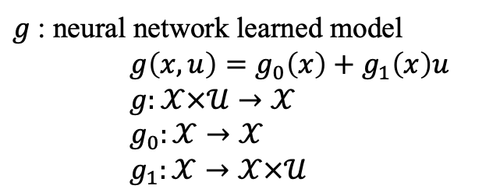

1. Benchmark Dataset
$$S={\{\left(x_{i},u_{i}\right),f(x_{i},u_{i})\}}_{i=1}^{N}$$
Training Set
i.i.d.
Data
Label
Validation Set
$$Ψ={\{\left(x_{j},u_{j}\right),f(x_{j},u_{j})\}}_{j=1}^{M}$$
f: true unknown dynamics
2. Obtain Learned Dynamics
$g$: neural network learned model
$g\left(x,u\right)=g_{0}\left(x\right)+g_{1}\left(x\right)u$
$g:𝒳×𝒰→𝒳$
$g_{0}:𝒳→𝒳$
$g_{1}:𝒳→𝒳×𝒰$
Train
$$S$$

Slide 3
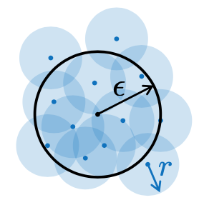

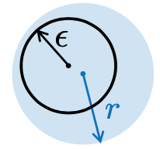



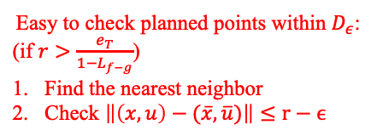

3. Bound Model Error in Trusted Domain
Initialization:
$S_{D}=\left\{\left(\overline{x},\overline{u}\right)∈S | \left\|f\left(\overline{x},\overline{u}\right)−g\left(\overline{x},\overline{u}\right)\right\|≤μ+aσ\right\}$
$r=$ $μ+aσ$
Loop:
$D=\bigcup_{(\overline{x},\overline{u})⊂S_{D}}{B_{r}(\overline{x},\overline{u})}$
$D∩Ψ$ $N_{s}$ pairwise sample sets, each set has $N_{L}$pairs of i.i.d.:
${\{z_{j}\}}_{j=1}^{N_{s}}={\{z_{1,j},…,z_{i,j},…,z_{N_{L},j}\}}_{j=1}^{N_{s}}$, ${ z}_{i,j}=\left\{z_{1}^{i,j},z_{2}^{i,j}\right\}=\{{\left(x,u\right)}_{1}^{i,j},{\left(x,u\right)}_{2}^{i,j}\}$
${\{z_{j}\}}_{j=1}^{N_{s}}$->Lipschitz Constants-> ${\{L_{f−g}^{j}\}}_{j=1}^{N_{s}}$->L Converge to Reverse Weibull-> ${\{γ_{j}\}}_{j=1}^{N_{s}}$
->Maximum Likehood to $N_{s}$ Sets->$\hat{γ},ξ$
if KS-test($\hat{γ}$):
${L_{f−g}=\hat{L}}_{f−g}=$ $\hat{γ}+Φ^{−1}(ρ)ξ$
$L_{f−g}≥1→fail$
$ε=L_{f−g}b_{T}+e_{T}$
if $r>ε$: return r and D
else: $r←ε+α$
Use $D∩Ψ$ to obtain $L_{g_{0}}$ and $L_{g_{1}}$
Divide
Estimate Lipschitz Constant
1st Upper Bound
2nd Upper Bound
Overestimate
$${\hat{L}}_{f−g}$$
Somehow
Conservative
Overestimate with Probability $ρ$
Determine Trusted Domain
Difficult to check when planning:
Hard to check planned points within $D_{ε}$
Easy to check planned points within $D_{ε}$:
(if $r>\frac{e_{T}}{1−L_{f−g}}$)
Find the nearest neighbor
Check $\left\|\left(x,u\right)−(\overline{x},\overline{u})\right\|≤r−ϵ$

Slide 4

4. Motion Planning with One Step Feedback Law
Build RRT Tree in Loop (Then construct path after building the tree):
1. Sample new state $x_{new}$
2. Check staying inside trusted domain：
a. Find the nearest neighbor $x_{neighbor}$ in $S_{x}$
b. Check distance between $x_{new}$ and $x_{neighbor}$ no more than $r−ε$
c. Find nearest neighbor ${x=x}_{near}$ of $x_{new}$ in RRT tree $𝒯$
d. For each $\tilde{u}$, find the “NN” $(x_{neighbor},\tilde{u})$ in $S_{D}$, check distance between $\left(x_{near},\tilde{u}\right)$ and $(x_{neighbor},\tilde{u})$ no more than $r−ε$
e. For each $x_{next}$ and it’s “NN” neighbor in $S_{x}$, check distance $≤$ $r−ε$
3. Next state prediction in $N_{samples}$ times loop:
a. Sample $\tilde{u}$
b. Check current state-action pair staying inside trusted domain
c. Check one step feedback law:
c.1 Perturbed linear equation:
$x_{next}=g\left(\tilde{x},\tilde{u}\right)=\left(g_{0}\left(x\right)+∆_{0}\right)+\left(g_{1}\left(x\right)+∆_{1}\right)\tilde{u}$, $\left\|∆_{0}\right\|≤$ $L_{g_{0}}ε$, $\left\|∆_{1}\right\|≤$ $L_{g_{1}}ε$
c.2 $A=g_{1}\left(x\right)+∆_{1}$, $b=x_{next}−(g_{0}\left(x\right)+∆_{0})$
-> Constrained least squares: $\min_{\tilde{u}∈u}{{\left\|A\tilde{u}−b\right\|}_{2}^{2}}$
c.3 Bound $\tilde{u}$ to satisfy $\left\|u−\tilde{u}\right\|≤\frac{\left\|{g_{1}\left(x\right)}^{+}\right\|(\left\|∆_{1}\right\|\left\|u\right\|+\left\|∆_{0}\right\|)}{1−\left\|{g_{1}\left(x\right)}^{+}\right\|\left\|∆_{1}\right\|}$
d. Check next state staying inside trusted domain
e. Check $x_{next}$ within $X_{safe}$
f. Check newly predicted $x_{next}$ closer to $x_{G}$, replace old prediction if true
g. $𝒯←$ $𝒯∪\{x_{best}\}$
ensuring safety and invariance about the goal

Slide 5
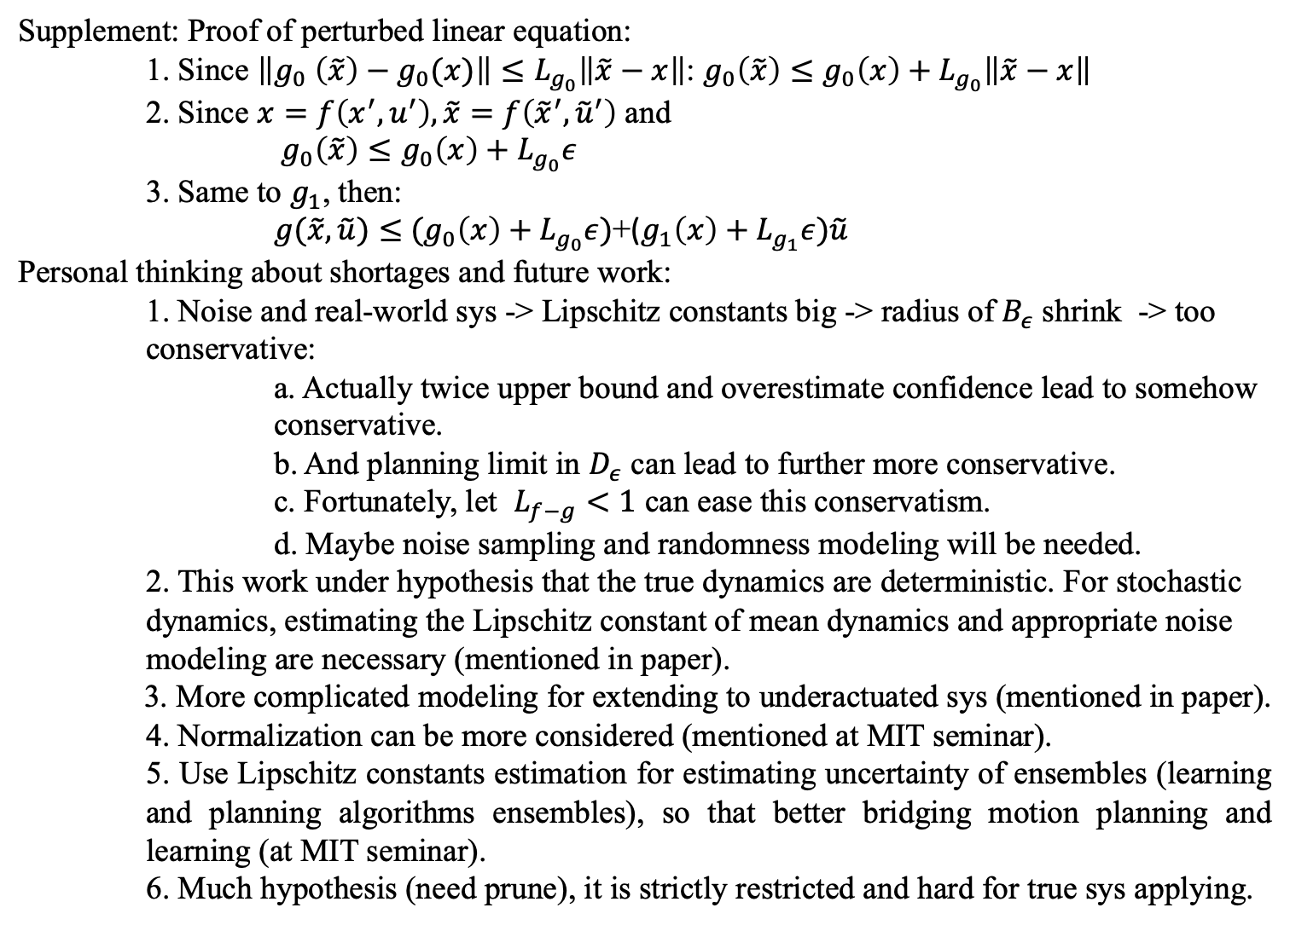
5. Supplements and Personal Thinking
Supplement: Proof of perturbed linear equation:
1. Since $\left\|g_{0} \left(\tilde{x}\right)−g_{0}(x)\right\|≤L_{g_{0}}\left\|\tilde{x}−x\right\|$: $g_{0}\left(\tilde{x}\right)≤g_{0}\left(x\right)+L_{g_{0}}\left\|\tilde{x}−x\right\|$
2. Since $x=f\left(x^{′},u^{′}\right), \tilde{x}=f\left({\tilde{x}}^{′},{\tilde{u}}^{′}\right)$ and
$g_{0}\left(\tilde{x}\right)≤g_{0}\left(x\right)+L_{g_{0}}ε$
3. Same to $g_{1}$, then:
$g(\tilde{x},\tilde{u})≤$ ${(g}_{0}\left(x\right)+L_{g_{0}}ε)$+($g_{1}\left(x\right)+L_{g_{1}}ε)\tilde{u}$
Personal thinking about shortages and future work:
1. Noise and real-world sys -> Lipschitz constants big -> radius of $B_{ε}$ shrink -> too conservative:
a. Actually twice upper bound and overestimate confidence lead to somehow conservative.
b. And planning limit in $D_{ε}$ can lead to further more conservative.
c. Fortunately, let $L_{f−g}<1$ can ease this conservatism.
d. Maybe noise sampling and randomness modeling will be needed.
2. This work under hypothesis that the true dynamics are deterministic. For stochastic dynamics, estimating the Lipschitz constant of mean dynamics and appropriate noise modeling are necessary (mentioned in paper).
3. More complicated modeling for extending to underactuated sys (mentioned in paper).
4. Normalization can be more considered (mentioned at MIT seminar).
5. Use Lipschitz constants estimation for estimating uncertainty of ensembles (learning and planning algorithms ensembles), so that better bridging motion planning and learning (at MIT seminar).
6. Much hypothesis (need prune), it is strictly restricted and hard for true sys applying.

