Slide 1
VIMA Learning Poster
Tags: Robot Learning
(Reference: Jiang, Yunfan, et al. "Vima: General robot manipulation with multimodal prompts." arXiv preprint arXiv:2210.03094 (2022).)

Slide 2
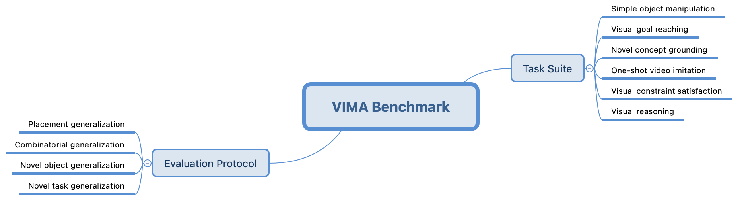
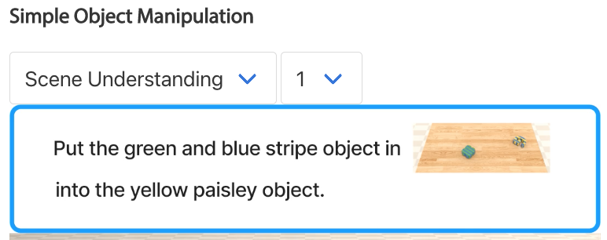
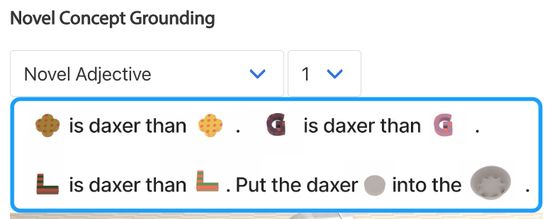
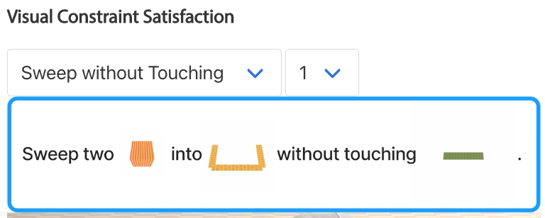
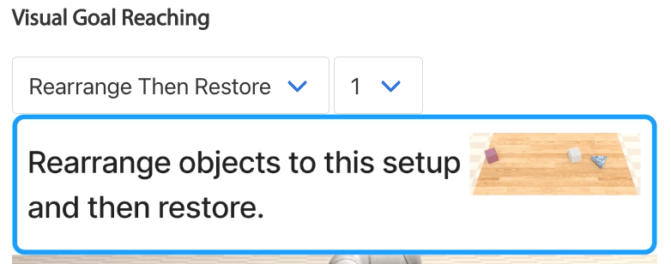
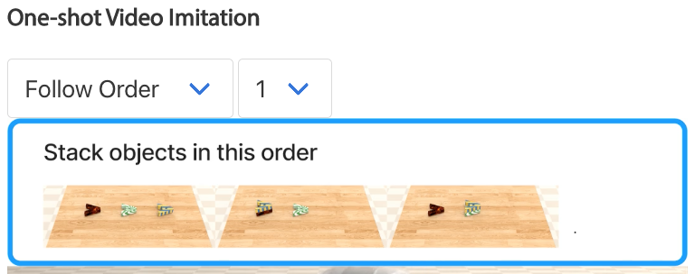
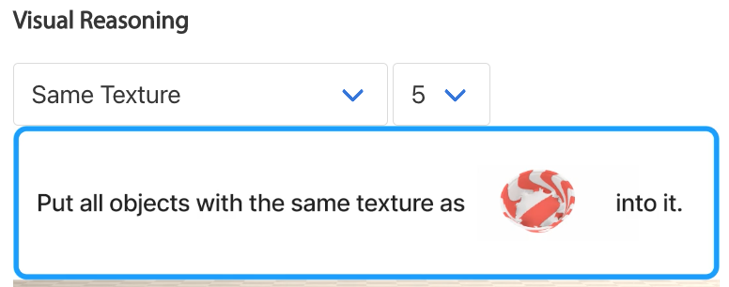
Problem: Generalist Robot Agent for A Wide Spectrum Task Specifications
Algorithm Architecture: VIMA – Minimalistic Multi-task Encoder-Decoder Architecture with
Object-centric design.
Encoder: Generate prompt tokens.
Decoder: Generate actions from history objects condition on prompts.
Benchmark:
Examples

Slide 3


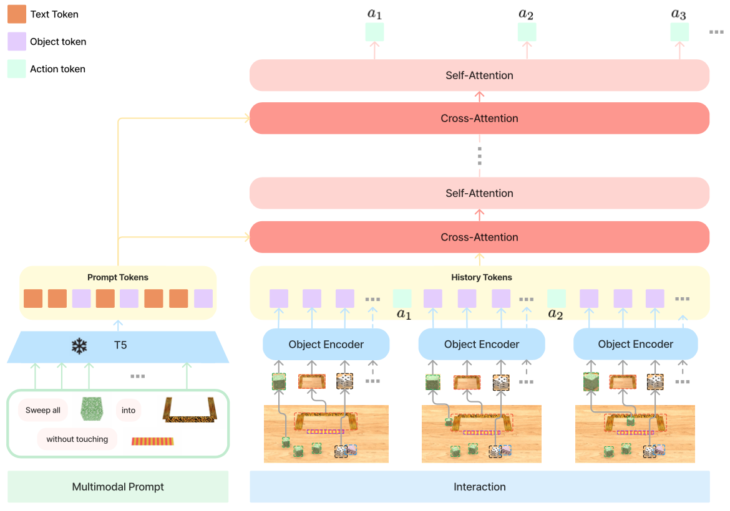


Tokenization
Cross-Attention:
$$H^{′}=softmax(\frac{Q_{H}K_{P}^{T}}{\sqrt{d}})V_{p}$$
1. Strengthened connection to prompt.
2. Intact and deep flow of the original prompt tokens.
3. Better computational efficiency.
Object-centric Design
T5 tokenizer (frozen)
+
word embedding
Text
Object Encoder
Image：
Mask R-CNN
+
bounding box encoder
+
ViT
Single
Object
Full
Scene
1. Tokenization
P
Decoder Training:
a. Object augmentation (reject FP randomly)
b. Adam W optimizer
c. Learning-rate warm
up
P
H
2. Absolute and learnable position embedding

Slide 4
Summarization and Personal Thinking
Summarization of innovations:
1. Prompt-based Generalist Robot Agent for A Wide Spectrum Task Specification:
a. Generalization: Frozen T5 as encoder for generating prompt tokens with multimodal
inputs (interleaving textual and visual inputs).
b. Task Specification: Decoder consists of alternating cross-attention and self-attention
layers for specific tasks learning.
c. Cross-Attention: History tokens attend to prompt tokens to condition history on prompt.
2. Encoder-Decoder Architecture based Generalist Robot Agent
3. Objects as Tokens
4. Object-centric design (by object detection) for more accurate object-based manipulation
learning.
Personal thinking:
1. Since all experiments are simulated, noise sampling and randomness modeling should be
considered when applying this architecture in real-world scenes.
2. Upgrade encoder to multitask learning based architecture may achieve better generalization
since the variety of robot task types in reality.

