Slide 1
VPT-TOB Learning Poster
Tags: Robot Behavior Modeling, Multi-Agent Learning (MAL)
(Reference: Chen, Boyuan, et al. "Visual perspective taking for opponent behavior modeling." 2021 IEEE International Conference on Robotics and Automation (ICRA). IEEE, 2021.)

Slide 2
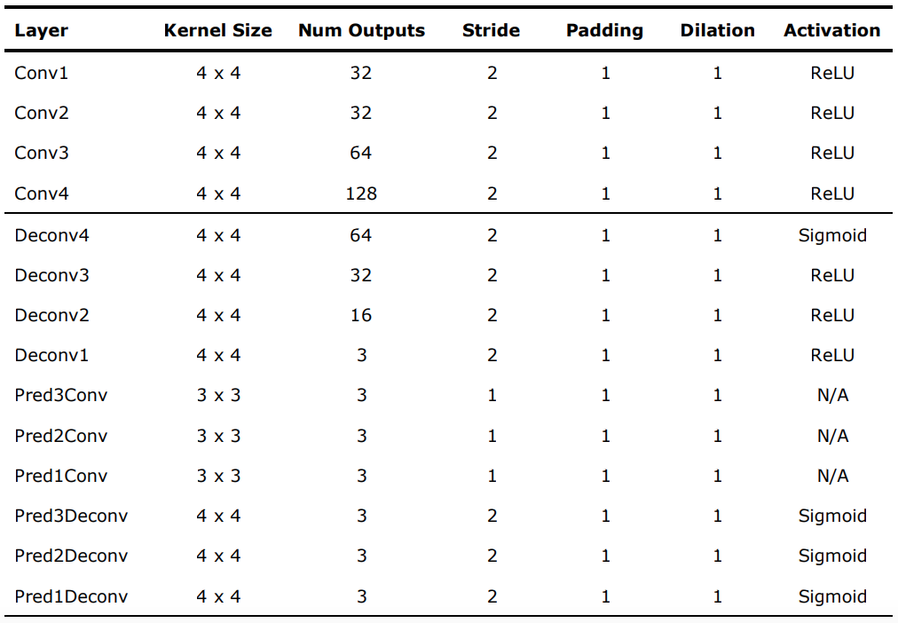
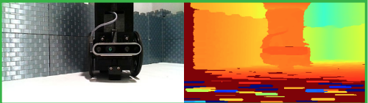
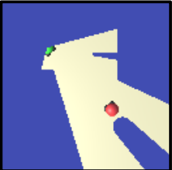
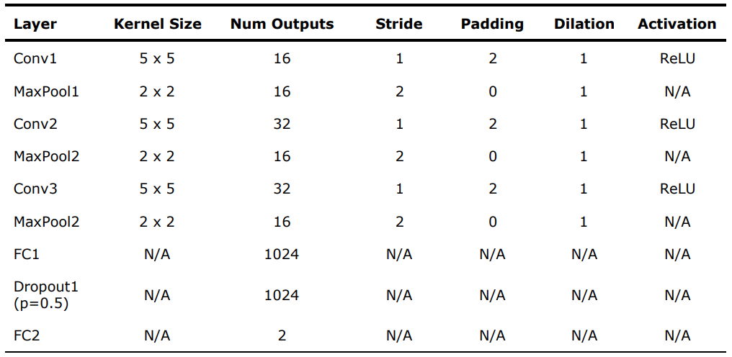
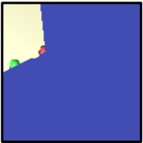
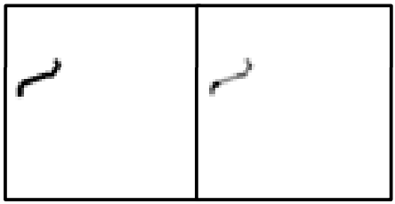


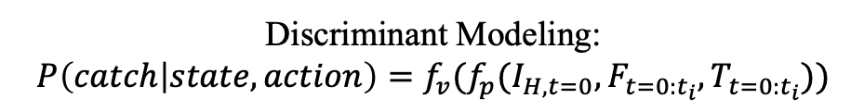


VPT-TOB Framework
(for hider learning)
Hider’s Observation
Discriminant Modeling
RGB-D Img
$$I_{H,t=0}$$
Top-Down Visual Embedding
Concat
VPT-TOB Network
VPN
$$P_{catched}$$
Visitation Map: $F_{t=0:t_{i}}$
Perspective Prediction Model
Value Prediction Model
Trajectory Seq
(Action Plan)
Traversal Order Map: $T_{t=0:t_{i}}$
Top-Down Img:
Future Perspective of Opponent
Top-Down Time-Abstracted Action Embedding
Input
Discriminant Modeling:
$$P\left(catch | state,action\right)={f_{v}(f}_{p}(I_{H,t=0},F_{t=0:t_{i}},T_{t=0:t_{i}}))$$
Output

Slide 3

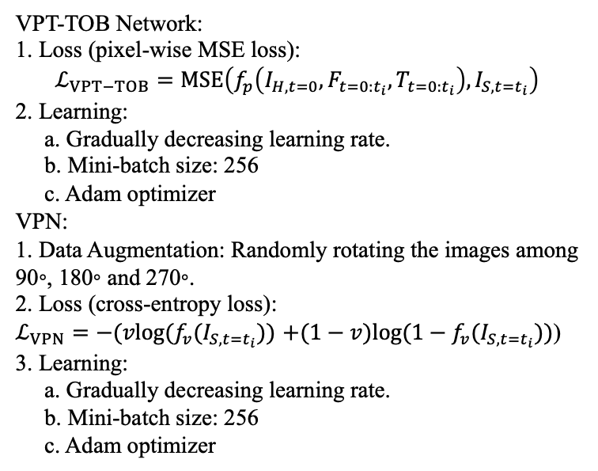
Benchmark Dataset
Random Policy
Data Collection
Hider’s Trajectory
Human Expert Demonstration
(Mainly)
Training
Inference and Planning
VPT-TOB Network:
1. Loss (pixel-wise MSE loss):
$$ℒ_{VPT−TOB}=MSE\left(f_{p}\left(I_{H,t=0},F_{t=0:t_{i}},T_{t=0:t_{i}}\right),I_{S,t=t_{i}}\right)$$
2. Learning:
a. Gradually decreasing learning rate.
b. Mini-batch size: 256
c. Adam optimizer
VPN:
1. Data Augmentation: Randomly rotating the images among 90◦, 180◦ and 270◦.
2. Loss (cross-entropy loss):
$ℒ_{VPN}=−(vlog(f_{v}(I_{S,t=t_{i}}))$ $+(1−v)log({1−f}_{v}(I_{S,t=t_{i}}))$)
3. Learning:
a. Gradually decreasing learning rate.
b. Mini-batch size: 256
c. Adam optimizer
1. Action Plans Proposal:
Propose a set of action plans with a low-level controller
policy (e.g., A*).
2. Determine:
Observation
+
VPT-TOB
+
VPN
$$P_{1}$$
…
$$P_{n}$$
Sort Desc
Choose Best Action Plan
Proposed Actions
Action 1
…
Action n
+
Seeker’s Policy
A heuristic expert policy:
a. If the hider is visible, the seeker will navigate towards it with A*.
b. If the hider is not visible, the seeker navigate to the last known position of the hider and then continuously explore.

Slide 4
Summarization and Personal Thinking
Summarization:
1. Innovation:
a. Proposal and Determine Paradigm:
a.1 Action plans proposal with a low-level controller policy (time efficient).
a.2 Construct observation-action pairs, modeling as a classification and ranking problem
using discriminant VPT-TOB and VPN.
b. Top-down visual perspective taking for opponent behavior modeling in MAL.
2. To Improve:
Mainly focus on VPT but don’t consider explicitly about TOB and behavior modeling.
Future Work and Personal thinking:
1. Explore the generalization to more robots and study swarm robot (mentioned in paper).
2. Consider scenarios where the seeker policy might change, and thus stochastic optimization
with few-shot learning algorithms should be taken into consideration (mentioned in paper).
3. Explicitly consider about behavior modeling and TOB (not purely base on VPT).
4. Online expert intervention and correction when training to make up for the insufficiency of
expert demonstration dataset.

