Slide 1
SAILOR Learning Poster
Tags: Robot Learning, Imitation Learning
(Reference: Nasiriany, Soroush, et al. "Learning and Retrieval from Prior Data for Skill-based Imitation Learning." arXiv preprint arXiv:2210.11435 (2022).)

Slide 2
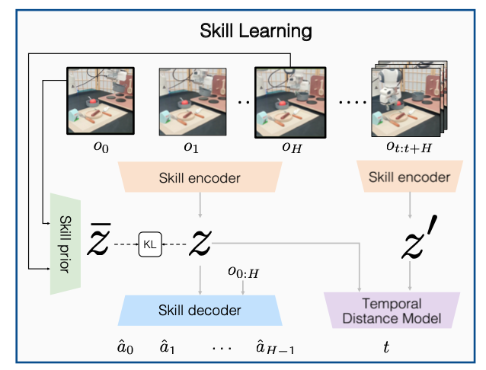








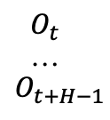
Problem: Data-efficient Imitation Learning for Target Task by Utilizing Prior Robotic Dataset
Algorithm:
For MDP problem $ℳ\left(𝒮,𝒜,𝒫,ℛ,γ,ρ_{0}\right)$, learn policy $π: \hat{z}=π(o_{fs})$ to maximize the discounted sum of rewards ($𝔼\left[\sum_{t=0}^{∞}{γ^{t}R\left(s_{t},a_{t},s_{t+1}\right)}\right]$) for the task.
Pretrain and finetune paradigm:
Predictable Skills Representation Learning from Prior Data
Model Architecture:
Observation 1:
image+low-dim
Sequence
Sequence
Observation
Encoder
$$O_{0}$$
…
$$O_{H−1}$$
$$O_{t}$$
…
$$O_{t+H−1}$$
…
Observation n:
image+low-dim
(ResNet-18 for image and MLP for low-dim)
(2-layer LSTM + 2-layer MLP)
Skill
Decoder
latent
Skill
Encoder
$$Z^{′}$$
$$Z$$
(2-layer LSTM + 2-layer MLP)
$${\hat{a}}_{0},…,{\hat{a}}_{H−1}$$
Training Loss:
Actually $l_{2}$ loss
Sequence
TD Model
(2-layer MLP)
$$t$$
Learned VAE prior (2-layer MLP) to encourage sub-trajectories with similar starting and ending observations to have similar latent representations.
Encourage the learned latent space to predict the temporal difference between two sub-trajectories
KL divergence: encourage learned skills to be predictable.

Slide 3
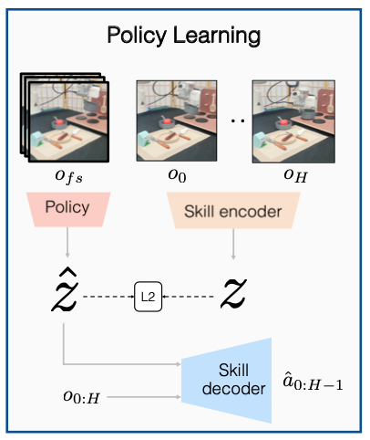
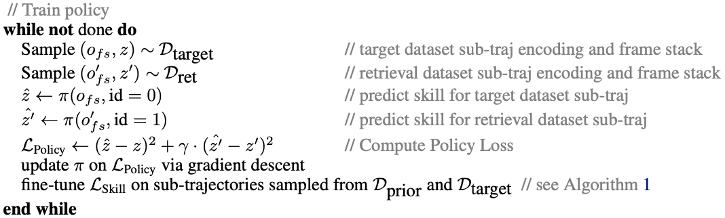
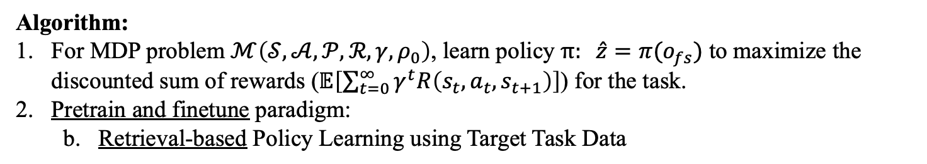
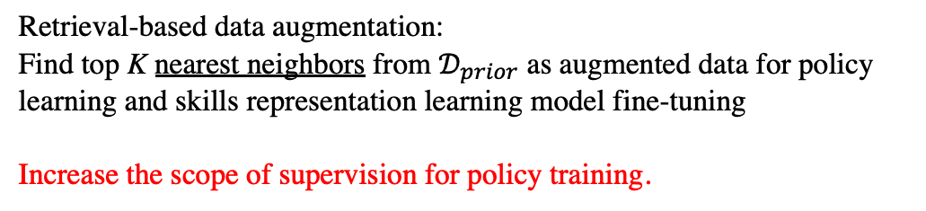
Problem: Data-efficient Imitation Learning for Target Task by Utilizing Prior Robotic Dataset
Algorithm:
For MDP problem $ℳ\left(𝒮,𝒜,𝒫,ℛ,γ,ρ_{0}\right)$, learn policy $π: \hat{z}=π(o_{fs})$ to maximize the discounted sum of rewards ($𝔼\left[\sum_{t=0}^{∞}{γ^{t}R\left(s_{t},a_{t},s_{t+1}\right)}\right]$) for the task.
Pretrain and finetune paradigm:
Retrieval-based Policy Learning using Target Task Data
Retrieval-based data augmentation:
Find top K nearest neighbors from $𝒟_{prior}$ as augmented data for policy learning and skills representation learning model fine-tuning
Increase the scope of supervision for policy training.
(2-layer LSTM)

Slide 4
Summarization and Personal Thinking
Summarization of innovations:
1. Pretrain and finetune paradigm:
a. Compared with pretraining policy model on prior task data and then finetuning on target
task data, pretraining predictable skills representations as downstream policy model’s
augmented training data can eliminate harmful effects (harmful effects due to conflicts
and divergence between prior and target data when naively training policy on prior and
target data).
b. Nearest pretrained skills representations can increase the scope of supervision for policy
learning, thus lead to better generalization.
2. Data-efficient retrieval-based data augmentation:
a. Target task data’s nearest neighbors from learned skills as data augmentation is data-
efficient especially when target data set is small.
b. Retrieval-based data augmentation also considers about relevance property and utilizes
this property.
Personal thinking of future work:
1. Multi task imitation learning and merging two phases into one-stage for better computation
efficiency.
2. Changing RNN-based encoders and decoders to transformer-based ones for computation
efficiency.
3. Investigate the effectiveness of this approach with various forms of prior data at different
scales (mentioned in paper).

