Slide 1
“Data-Efficient LTL Translators” Learning Poster
Tags: Human-Robot Interaction
(Reference: Pan, Jiayi, Glen Chou, and Dmitry Berenson. "Data-Efficient Learning of Natural Language to Linear Temporal Logic Translators for Robot Task Specification." arXiv preprint arXiv:2303.08006 (2023).)

Slide 2
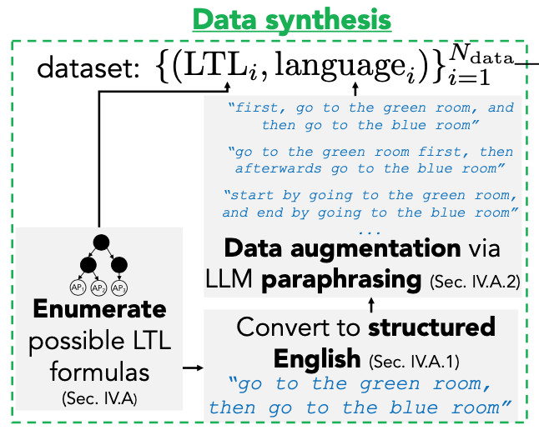
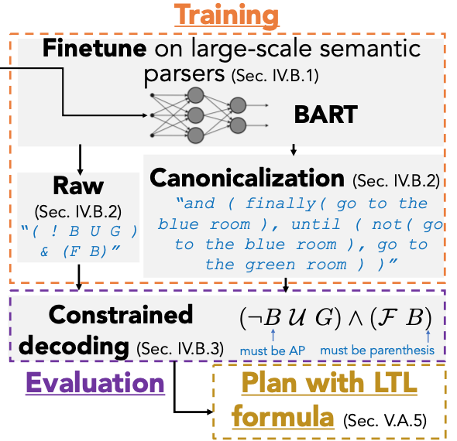
3. Extend to Canonical Form:
Train set 1 (raw label)
+
Train set 2 (canonical label)
2. Data Augmentation:
Paraphrasing using GPT-3
1. Back-translation
Summarization of Innovations:
1. Generalization in Data Augmentation:
GPT-3 as paraphrasing model can generate more generation features, thus better help improve later finetuned BART’s ability of generalization on “natural language to LTL”tasks.
2. Data-efficient: Based on 1, much handful human labor work can be reduced.
1. Fine-tuning Bart
2. Constrained Decoding:
Constrain to next-token
prediction in certain out-sets

Slide 3
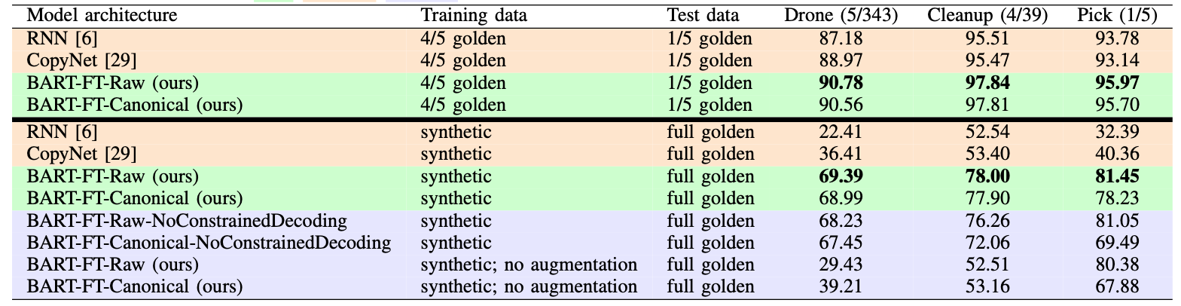
Questions:
Q1: Whether deep model or LLMs is suitable for this low-resource scenario?
a. Since deep model or LLMs need lots of data for training so that they can have ability to generate to unseen data, low-resource scenario may have less data and lead to shortage of generalization and sometimes may lead to overfitting.
b. BART is a LLM for general language but not for general LTL specifications since these two forms are somehow different, thus may lead to degrade on generalization when applying it on generating LTL specifications.
c. A tree-based model may be more suitable since the structures of LTL formula are more similar to trees.
Ideas about Future Work:
Exploit LM’s uncertainty by grounding them to environment, and uncertainty-aware planning (paper mentioned).
Automatic synthesis to generate to unseen LTL structures.
Specific LTL-generating models, such as (deep) tree-based models or LLMs using lots of language-LTL corpus when pre-training.
Training Down-stream structures attached to pre-trained model during fine-tuning period may somehow help improve generalization on generating LTL specifications.

