Slide 1

Logstash
Everything you need to know
And a lot You dont

Slide 2
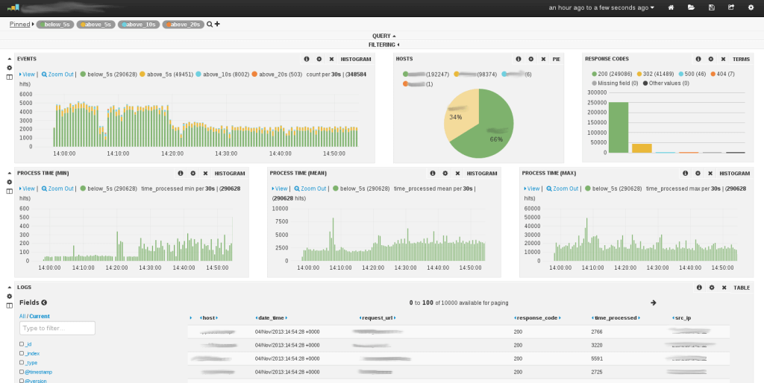
Logstash origins
Have logs, will ETL
Log ingester, generalized to other tasks
Elasticsearch + Logstash + Kibana = ELK
You are here

Slide 3
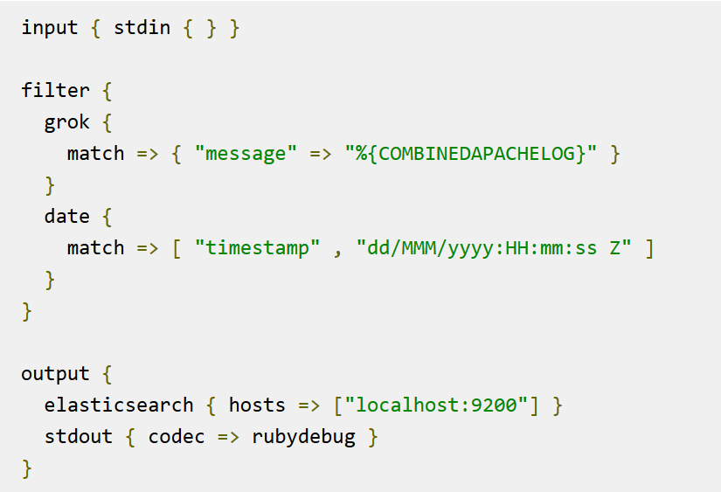
Gist
(Its just plugin-based pipe-and-filter)

Slide 4
Nuts and bolts of ETL
Example config
Config+plugin driven architecture
Input+Filter+Output = Logstash
Write config, run as service

Slide 5
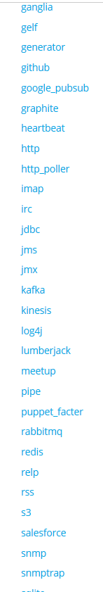
Many Plugins
Inputs: Twitter, github, sqlite, kafka, ruby, elastic beats…
Filters: Grok and custom plugins
Outputs: Twitter, github, sqlite, kafka, ruby, elastic beats…

Slide 6
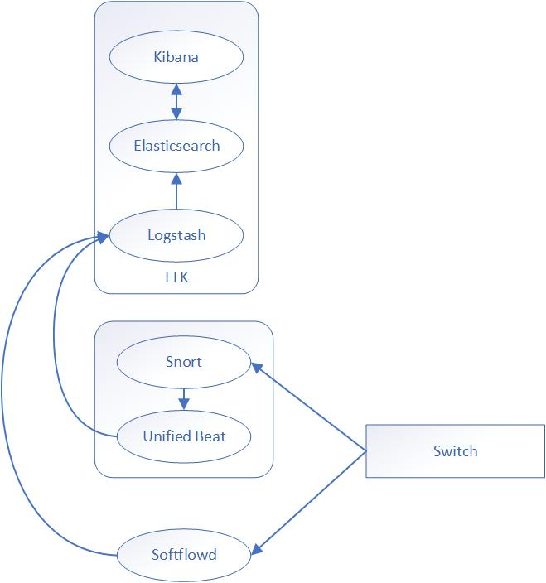
Application Use cases
Site administration: user activity, other logs
Security: ‘Beats’, strong open source community
Search: Social/document ingestion
Data warehousing: monitoring and ETL
Active-pull-active-push tasks

Slide 7
Poor use cases
Realtime sensor data
Heavier than a message queue
Too light for a Horizon monitor
ELK is great, but… too document-oriented

Slide 8
Lessons Learned
Plugins and configs encourages compact, reusable components
Monitors vs. Logstash
Write services, not code?

