Slide 1
CS 6320: Project 2
Named Entity Recognition

Slide 2
Named Entity Recognition
Subtask in Information Extraction
Extract and classify concepts from unstructured text
Some examples include names of persons, locations, organizations, time mentions, quantities, monetary values, etc.

Slide 3
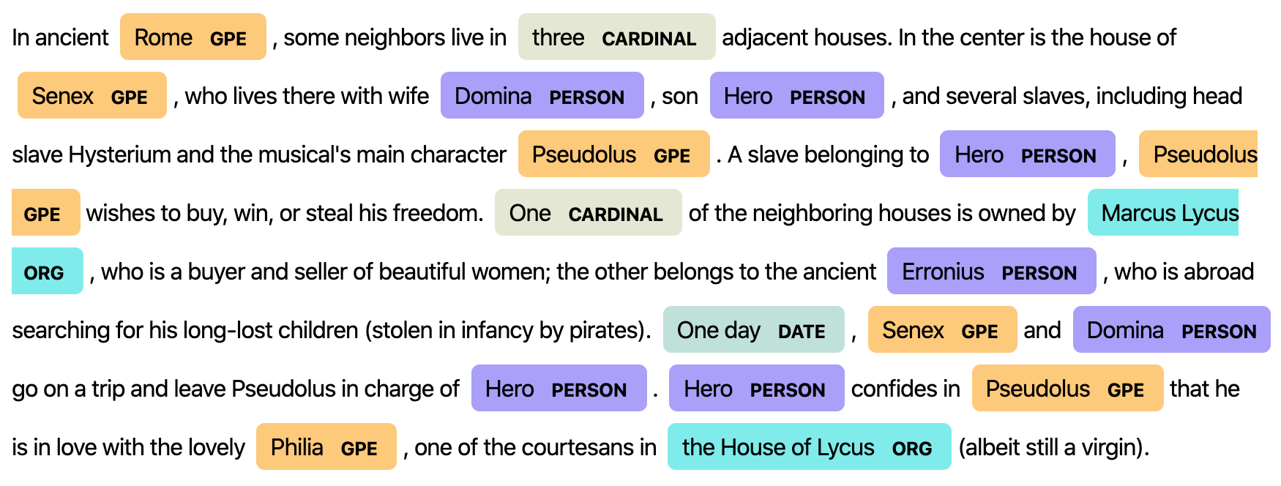
Example

Slide 4
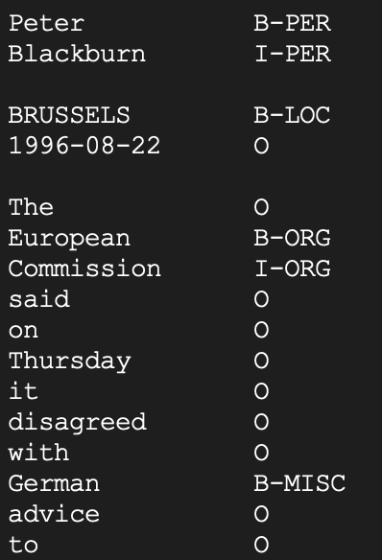
CoNLL 2003 dataset
4 types of concepts: Person, Location, Geo-political entity and Miscellaneous
CoNLL format
BIO – Tagging

Slide 5
Feature Engineering
Extract lemmas of all words. The lemma of a word is its root.
Example:
racing -> race flowers -> flower
unfortunately -> unfortunate
Get POST for all words. Pass the entire sentence to the method.
Example:
The horse will race tomorrow.
Race for outer space

Slide 6
Vocabulary
Generate a vocabulary of all lemmas from the previous step.
Add a special UNK token to the vocabulary to handle unseen words seen during testing.
Represent lemmas and POST as one-hot vectors.
Example:
races/NNS for/IN outer/JJ space/NN
race -> [1 0 0 0] NNS -> [1 0 0 0]
for -> [0 1 0 0] IN -> [0 1 0 0]
outer -> [0 0 1 0] JJ -> [0 0 1 0]
space -> [0 0 0 1] NN -> [0 0 0 1]

Slide 7
Learning
Use your favorite machine learning model to predict NER tag for each token.
Recall Assignment – 2: sklearn provides you with several ML algorithms (Naïve Bayes, Regression, SVMs, Random Forest, etc.)
Example:
For the word ‘races’ from previous example:
Input vector: [1 0 0 0 1 0 0 0]
Output label: O or 0

Slide 8
BIO Tag violations
Token True label Predicted label Post-process# 1
The O O O
University B-GPE B-GPE B-GPE
Of I-GPE I-GPE I-GPE
Texas I-GPE I-LOC I-GPE
At I-GPE I-LOC I-GPE
Dallas I-GPE I-LOC I-GPE

Slide 9
BIO Tag violations
Token True label Predicted label Post-process# 2
The O O O
University B-GPE B-GPE B-LOC
Of I-GPE I-GPE I-LOC
Texas I-GPE I-LOC I-LOC
At I-GPE I-LOC I-LOC
Dallas I-GPE I-LOC I-LOC

Slide 10
Statistics to be reported
Precision, recall, F-score
Time taken to make predictions
Throughput:
size of test CoNLL file / time taken to make predictions

