Slide 1

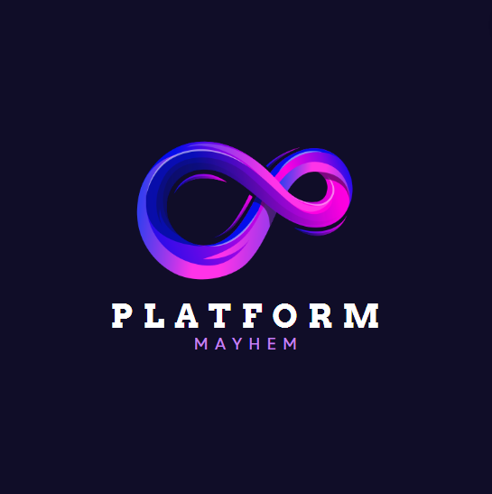
PLATFORM MAYHEM
AHMED YUSUF
SIYAN ALLI-BALOGUN
CHARLES PERKINS

Slide 2
Intro to Platform Mayhem
Platform Mayhem is a Jetpack Joyride inspired game which is remixed to our liking. The aim of the game is to avoid the platforms and collect as many gold coins as possible for benefits.

Slide 3

Storyline of Jetpack Man
Jetpack Man was ambushed by ‘colleagues’ who envied him in a construction site where he luckily finds a jetpack (hence the name). He has to navigate himself out of the site whilst also avoiding the falling platforms and collecting the gold coins which could benefit him later on. Those said colleagues would make an appearance later on the boss level, which is why Jetpack Man has to collect the gold coins to purchase boosts for an easier interaction.

Slide 4

Characters of Platform Mayhem
Jetpack Man is the main character of our game and the hero who was chosen to represent Barry Steakfries.
The enemy in our game would be the falling platforms which could lead to the demise of our beloved hero Jetpack Man.
More enemies are encountered on the boss levels. Those enemies are the colleagues of Jetpack Man who have a vendetta against him.

Slide 5
Features of Platform Mayhem
Starting Menu which indicates that you can start the game by pressing SPACE.
Falling Platforms that can collide with the player to bring an end to the game.
Player can move both horizontally and vertically to avoid the platforms.
Gold coins which can be collected and used in the store to buy boosts for clearing harder levels.
Different variations of platforms (shapes and sizes) to avoid in higher levels.
Background music to compliment the game.
Sound effects for when the player collects the gold coins.
Custom character with a jetpack to symbolize Barry Steakfries from the original Jetpack Joyride game.
A Game Over menu which pops up once you collide with the platforms and indicates that you can restart by pressing SPACE.
A Well Done menu which pops up once you collect the required coins and ready to move on to the next level.
The Music Volume can be increased or decreased by using the UP and DOWN arrow keys.
A constant background with (moving) stars.

Slide 6
Design of Platform Mayhem
The main classes of Platform Mayhem include Jetpack Man, the gold coins and the falling platforms.
It is set around a construction site during night time where Jetpack Man has to escape hence the pitch black sky, the shining stars and the falling platforms. Jetpack Man was designed to have a jetpack which can be seen on his back within the game.

Slide 7
Development of Platform Mayhem
We encountered quite a number of issues during the development of the game.
Some of the issues were fixed whereas others weren’t;
- Setting up Music and SFX
- Transitioning of Levels
- Creation of a Shop
- Player animation
- Closed walls
- Importing custom character
- Setting up frame rates

Slide 8
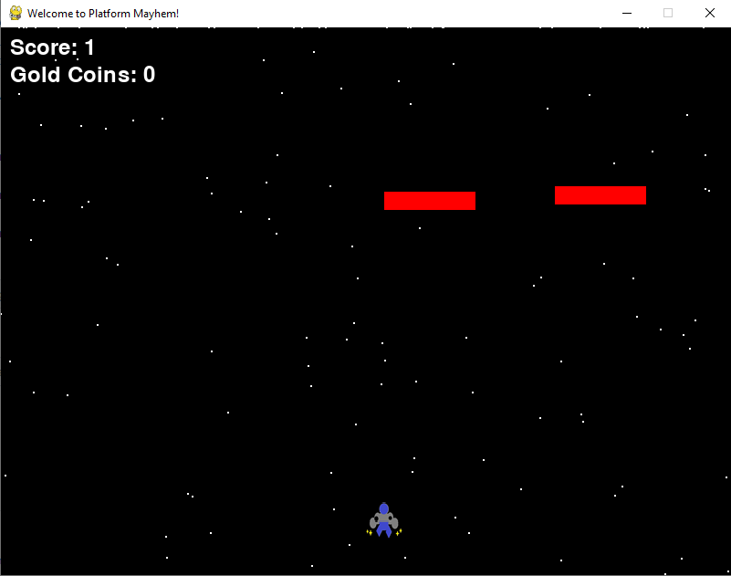
Demo of Platform Mayhem

Slide 9
Evaluation of Platform Mayhem
We learnt a number of things during the development of this game including how to import music, sound fx and images vial file path while using python, how to make objects move at a certain speed and disappear once they get to a certain position on the screen and how to set up menu screens for games on Pygame.
Another important lesson we learnt is how citations work and how to reference properly using the Harvard method. We used the Harvard method in our work to cite references.

