Slide 1

Auto Schedule Allocator
Nichele Liong
Supervisor: Dr Vidya Sudarshan
Co-Supervisor: Dr Ku Cheng Yeaw
Start
Notes:
Good afternoon professors, I am Nichele Liong and I will be presenting my project of an auto schedule allocator

Slide 2
University Instructor Scheduling
Graduate Student Teaching Allocation
Complex and time-consuming administrative task
Traditional manual methods are inefficient, prone to human error, and fail to optimize assignments
Necessary internal departmental process that is a subset of the university instructor scheduling problem
Notes:
University instructor scheduling remains a complex administrative task that requires balancing multiple constraints and preferences. These scheduling tasks are “exhausting and time consuming” when performed manually, particularly as the number of variables and constraints increases. Traditional manual scheduling methods are inefficient, prone to human error, and fail to optimize instructor workload and course assignments effectively.
More specifically, this project focuses on the teaching allocation of graduate students to labs in CCDS which is a necessary internal departmental process that is a subset of the university instructor scheduling problem. Although smaller in scope, this problem presents its own unique set of constraints and challenges and is equally critical to the smooth functioning of the department and thus warrants exploration to improve efficiency and reduce administrative burden.

Slide 3
Graduate Student Lab Allocation System (GSLAS)
Notes:
This project proposes the development of the Graduate Student Lab Allocation System, which is a web-based portal designed to streamline and automate the lab allocation process for graduate students.

Slide 4
Existing System
Communication Management
Data Collection & Consolidation
Communication with >100 students via Email
Manually downloading & compiling Spreadsheets
Scalability
Lack of Input Validation
Administrative workload increases significantly with the no. of students
Students fail to adhere to clear instructions
Notes:
The current manual workflow at CCDS presents several challenges.
Firstly, the process involves communication with over 100 graduate students for their teaching preferences and constraints via emails. This large volume of emails could result in information fragmentation and potential for oversight.
Secondly, the administrative staff is required to manually download and compile information from a large number of spreadsheets. This process is highly time-consuming, tedious, and susceptible to data transfer errors.
Thirdly, despite clear instructions being given for the format of indicating their teaching preferences, graduate students often fail to adhere to them. This lack of standardization makes it difficult for the administrator to process the data efficiently and accurately.
Lastly, the current system is not scalable, as the administrative workload increases significantly with the number of students and lab sessions.

Slide 5
Project Objectives
Centralized Data Management
Input Validation
Automated Allocation Algorithm
GSLAS
Notes:
The primary objective of this project is to reduce manual effort, improve accuracy, and enhance the overall efficiency of the allocation process that occurs every semester. The system will address the challenges of the existing system by providing the following key features.
To avoid information fragmentation & oversight, all lab information and student preferences will be submitted and stored in a single platform, minimising the need for manual data compilation.
To ensure data consistency, the portal will enforce standardized input formats. Lastly, an allocation algorithm that considers the various constraints will be incorporated to generate optimal assignments. Furthermore, to maintain administrative flexibility, the administrator will have the ability to prioritize different constraints and mix manual and automated allocation as they wish.

Slide 6
Workflow
01
02
03
04
05
06
07
08
Admin uploads Course & Lab information
Admin manages Student accounts
Admin clears previous records & notifies Students
Students submit information
& preferences
Admin reviews special requests
Admin performs lab allocation
Admin finalizes & communicates allocations
Students view &
swap allocations
Notes:
Here is an overview of the workflow for the system that will occur at the start of each semester.
Firstly, the admin will update the portal with the accurate course and lab details for the upcoming semester that are open for teaching allocation for graduate students. Then, they will register new graduate students or delete accounts for those who have graduated. After clearing the database of records only relevant for the previous semester, the admin notifies the students to start entering their information and preferences into the portal. Students will log into the portal and submit all necessary information and if needed, submit special requests as well. The admin will then review these special requests, and perform the lab allocation. Once the admin is satisfied with the allocations, they can send a mass email to students to communicate the final allocations. Students can then view their allocations and swap with other students if necessary.

Slide 7
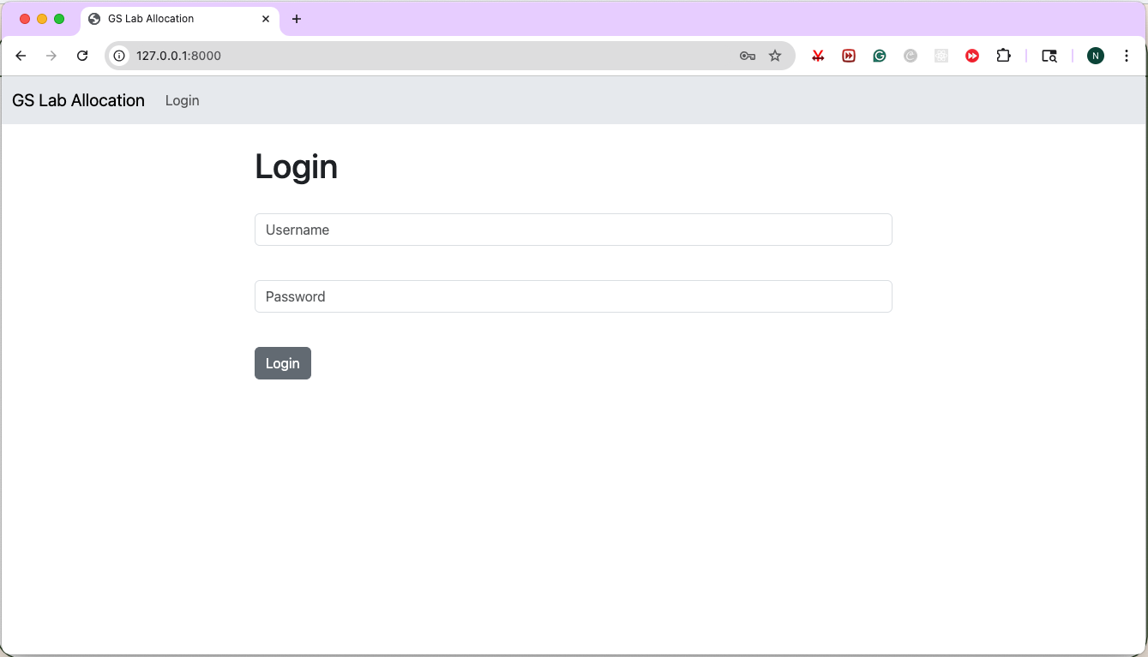
Implementation
Notes:
Now, more details will be given on the implementation while we follow the system’s workflow.

Slide 8
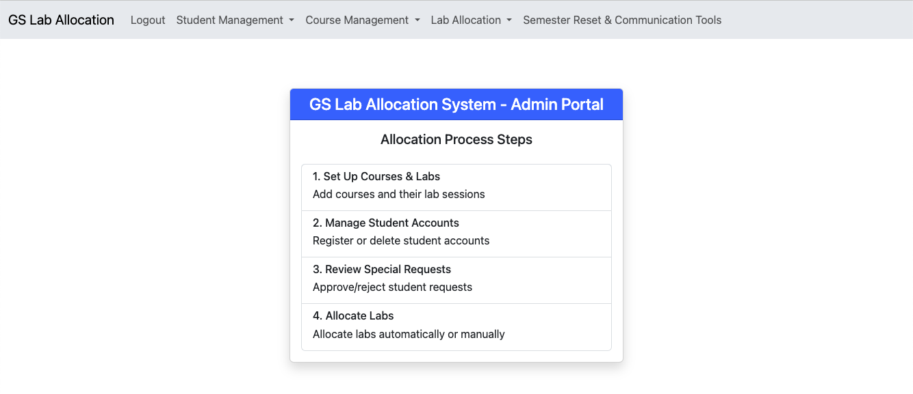
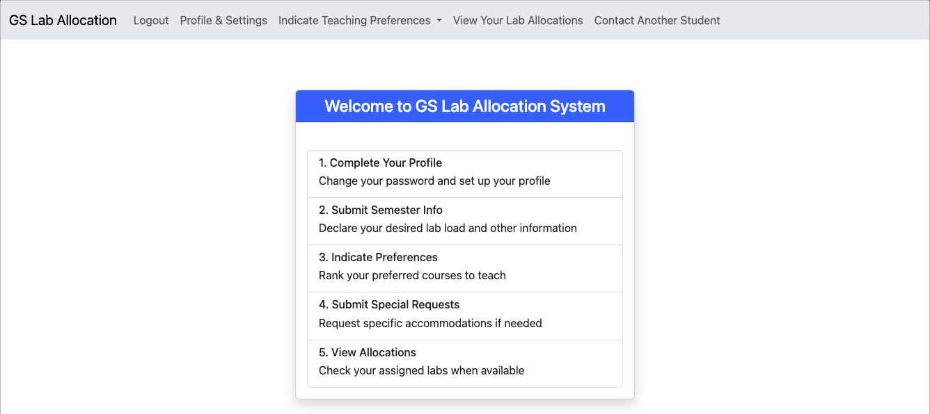
Home Page
Admin View
Student View
Notes:
The system is split into the admin and student view due to the distinctively different functions they can perform. The home pages for both views show the process steps of each party accordingly.

Slide 9
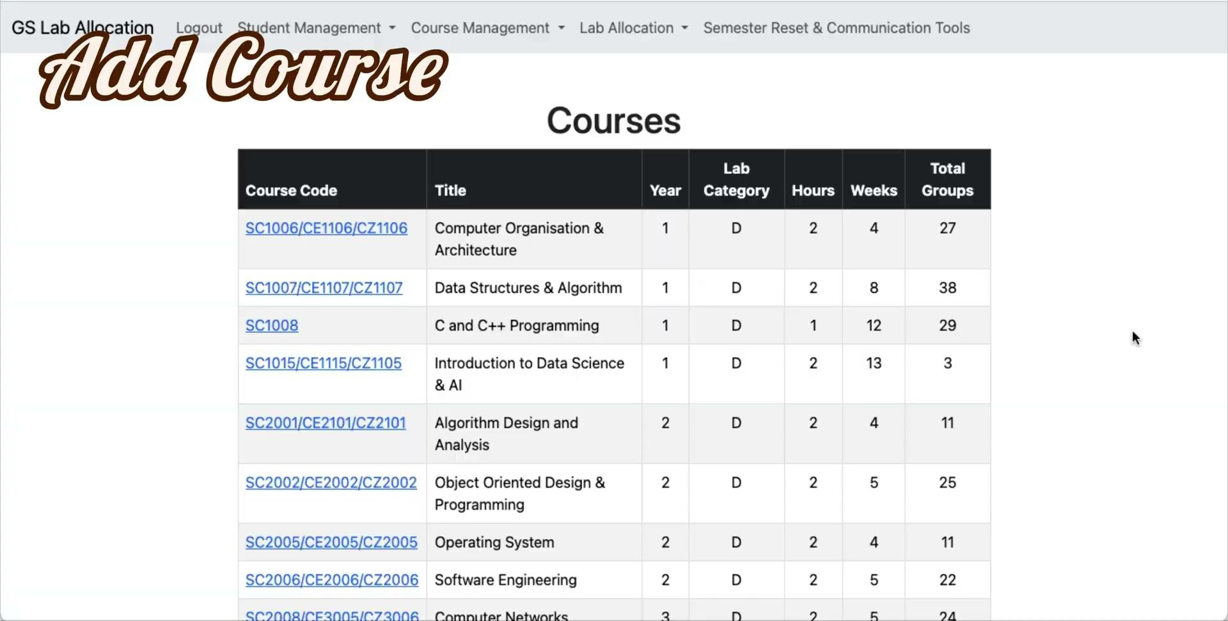
Course Management
Notes:
To start off, the admin can add a course by entering the course code, title, and other information as necessary. It will then be updated in the table. The admin can then click in to view the details. We add another course.. And then delete it as well. Admin can edit the course details as well.

Slide 10
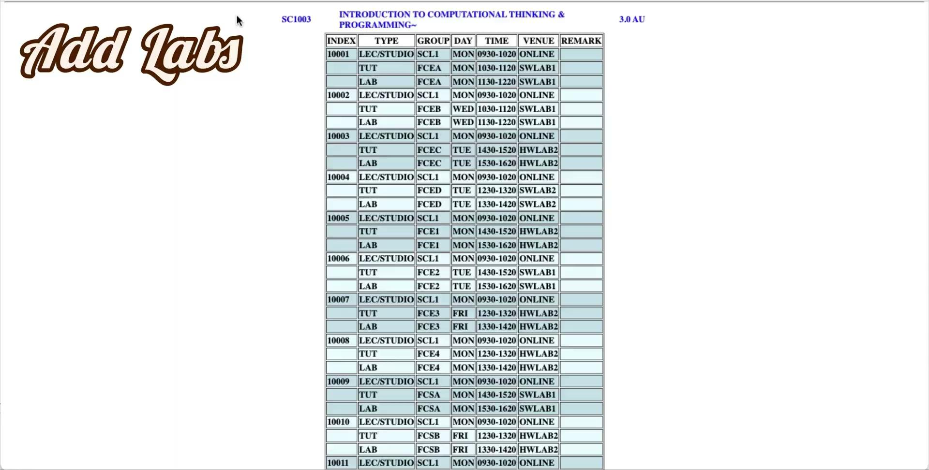
Lab Management
Notes:
Moving on to lab management, the admin can mass upload lab information directly from NTU’s course schedule website. The system will automatically extract out lab information. They simply have to copy and paste the table into an excel sheet, rename the sheets according to the course code, and upload this file onto the portal. The lab information will then be populated into the respective course’s details.

Slide 11
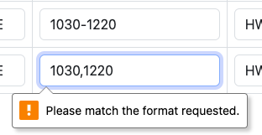
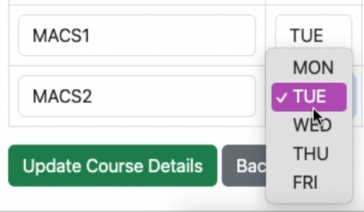
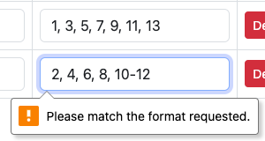
Lab Management
Edit Lab Details – Input Validation
Time
Day
Teaching Week
Notes:
When editing lab details, input validation was also implemented for necessary fields, in the form of dropdown boxes for the days of the week, as well as regex pattern matching for time and teaching week fields.

Slide 12
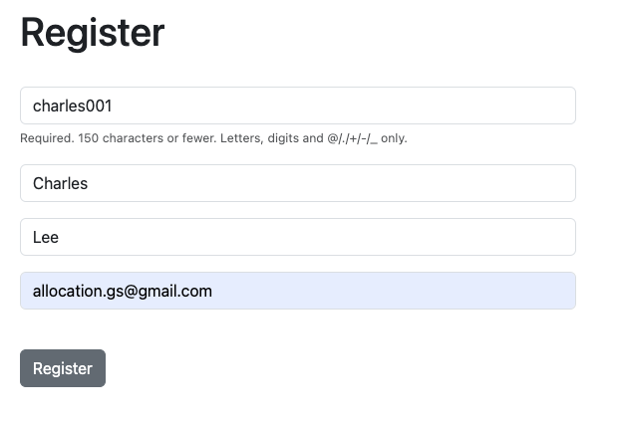
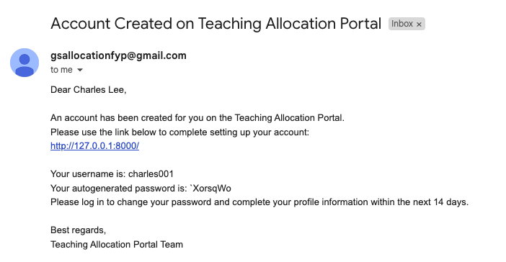
Student Management
Admin registers new graduate student
Student receives email notification
Notes:
After the course and lab information has been set up, the admin can proceed to update the list of students in the database. The admin can register a new student by providing their username, first and last name, as well as student email. The system will generate a random password and attach it along with the username that is then sent to the student’s email.

Slide 13
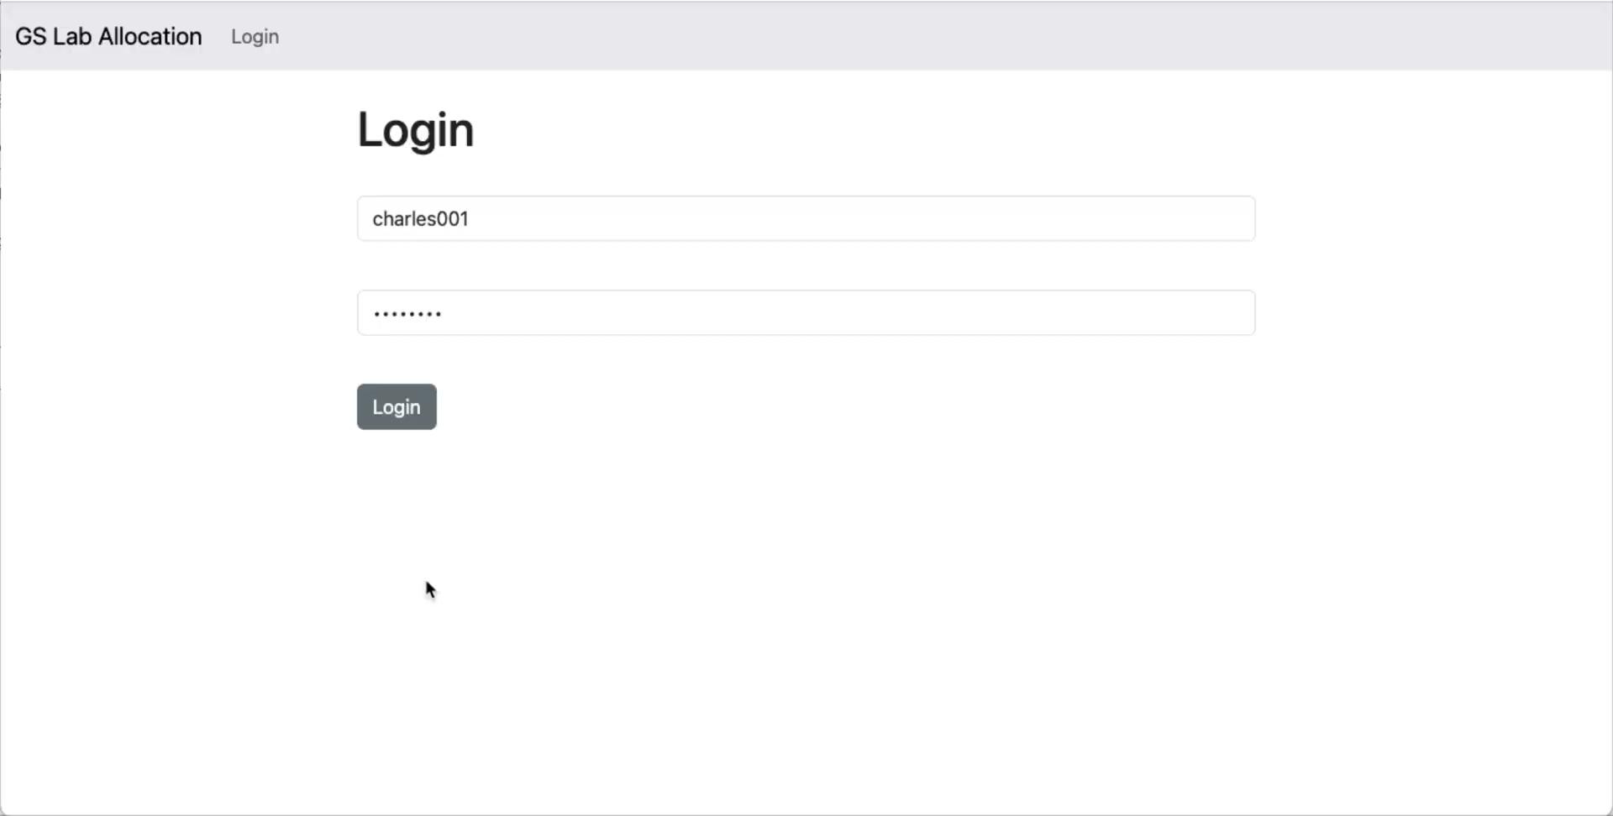
Student Management
Notes:
The student logs in and sets up their profile by changing their password to one of their choice, and add in extra information such as their supervisor, bachelor degree, and matriculation date. These information may assist the administrator in lab allocation. Note that this change is reflected in the admin view of all students as well.

Slide 14
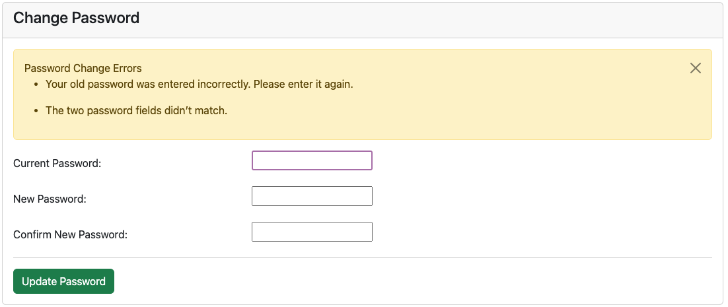
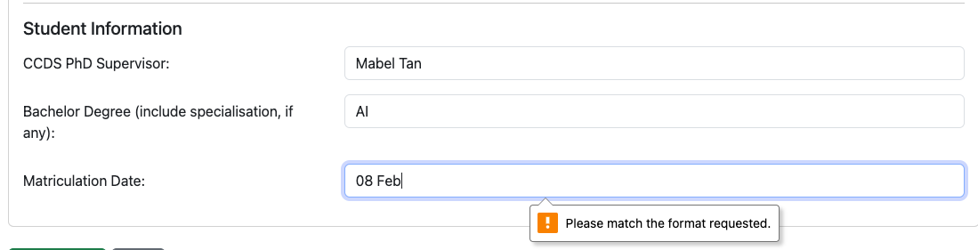
Student Management
Required format: MM/YYYY
Notes:
Note that there is input validation implemented as well. The system checks that the old password was entered correctly, and that the 2 new password fields match, as per usual basic website requirements. We also have input validation for the matriculation date as well where it only accepts a certain format using regex matching.

Slide 15
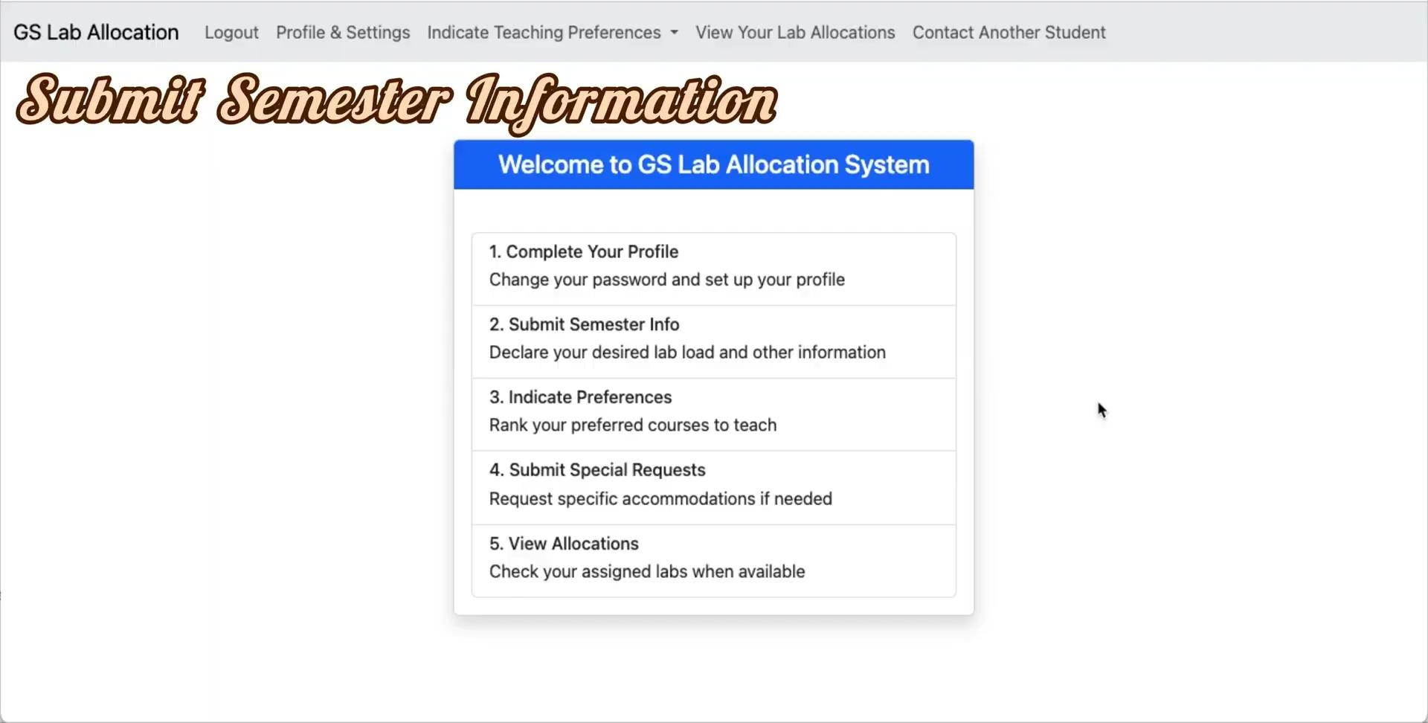
Semester Information & Teaching Preferences
Notes:
After setting up their profile, the student can proceed to submit their semester information as well as teaching preferences. This is the demo, and I will go into detail after this video. As you can see, there is input validation for each error that has been made for teaching preferences.

Slide 16
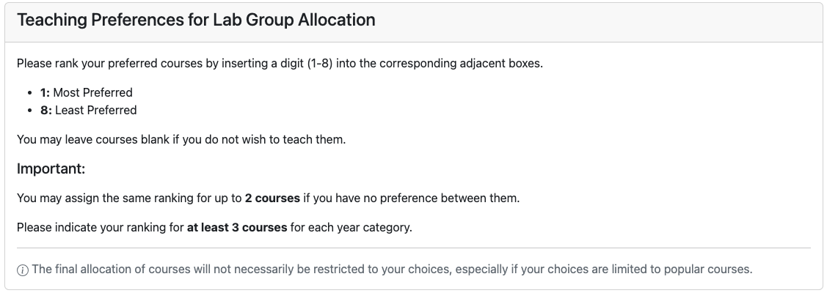
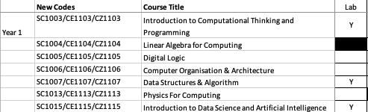



Semester Information & Teaching Preferences
Example of data inconsistency in existing system
Notes:
As you saw in the demo previously, there was a section at the top to provide students with clear instructions of the requirements for their inputs. These are actually derived from the current instructions given to students. Students should be ranking from 1 to 8, with 1 being the most preferred. They are required to rank at least 3 courses for each year category. I have added an extra requirement to only allow 2 courses indicated for each ranking to prevent cases where students simply put everything they want as 1st choice.
This is the portion where almost all students did not follow the instructions given. Many of them entered alphabets or emojis in all the fields, some of them indicated up till ranking 13. This data inconsistency would have made it more difficult for the administrator to assign the labs to students. Implementing input validation in this step was the most crucial for this system and would greatly benefit the administrator in the allocation process.

Slide 17
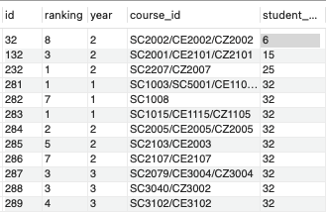

Semester Information & Teaching Preferences
Student
TeachingPreferences
Student_PastAssignments
Notes:
After we have entered everything correctly, we see the changes reflected in the database for this student that has a user id of 32. The gs_duty and lab_load are stored in the Student table, the courses that they have indicated to have taught in the past semesters are stored in the Student_PastAssignments table that maps student id to the course id. Similarly, the teaching preferences are being stored in the database as well. For each unique course id and student id combination, we store the ranking that the student has assigned to each course.

Slide 18
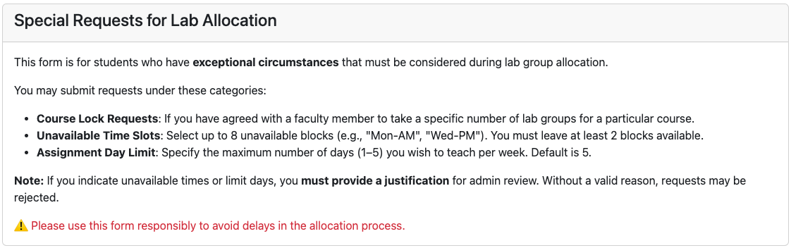
Special Requests
Notes:
Moving on to Submitting special requests. This is the instructional section at the top of the page. Students may submit requests to lock a certain number of lab groups to them for a particular course as agreed with a faculty member. They may also submit declarations of the time slots that they are unavailable for. These time slots are in the format of Monday to Friday, AM and PM. The system has ensured that they leave at least 2 blocks available, for example they are only available for Monday AM and Wednesday PM. The last category of special requests are to put a limit on the number of days they wish to have labs on. For example, a student may stay really far away and they only wish to come to school on a maximum of 2 days a week, then they can indicate this as well. For both the special requests regarding time restrictions, students are required to provide a justification if they have requested for either of these special considerations. This justification will be reviewed by the administrator to ensure that this feature is not being misused. Note that all of these restrictions are actual requests that have came up in the existing system, and are usually communicated via email which may make it difficult for the administrator to keep track of.

Slide 19
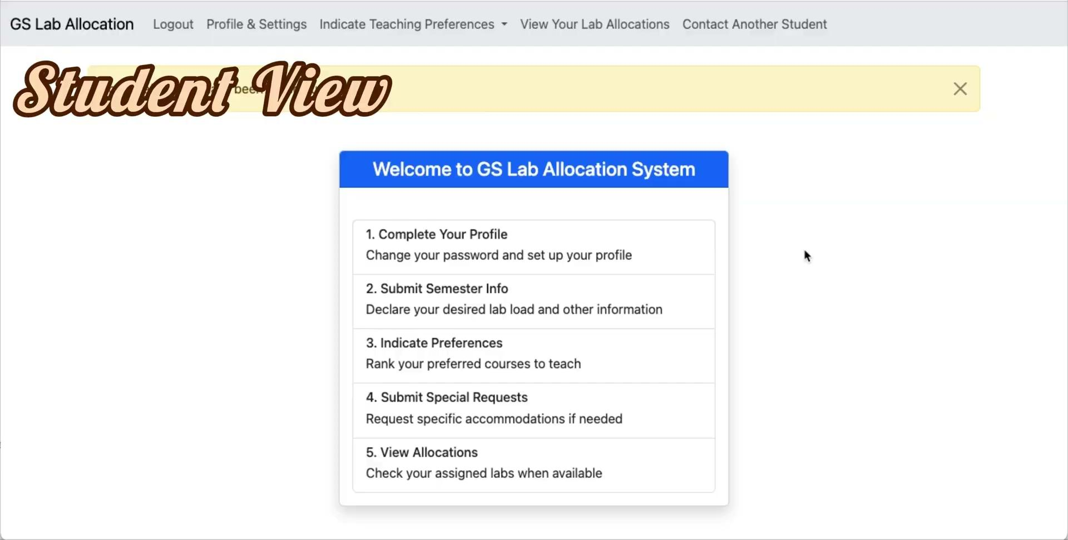
Special Requests
Notes:
Here is the demo for the input validation. We see that we are required to provide the exact details for the course lock requests, and we see that there is checking to ensure the student leaves at least 2 slots open. We also see that it is compulsory for the student to input a reason if there was a request for time restrictions. Now in the admin view, we can review the special requests. The newest request we just submitted is at the bottom and indicated as pending. We can approve the course lock and time constraints separately. If the admin decides to reject one of them, they can choose to enter the reason in the textbox, and the details will be sent to the student’s email to notify them of the rejection along with the reason provided.

Slide 20
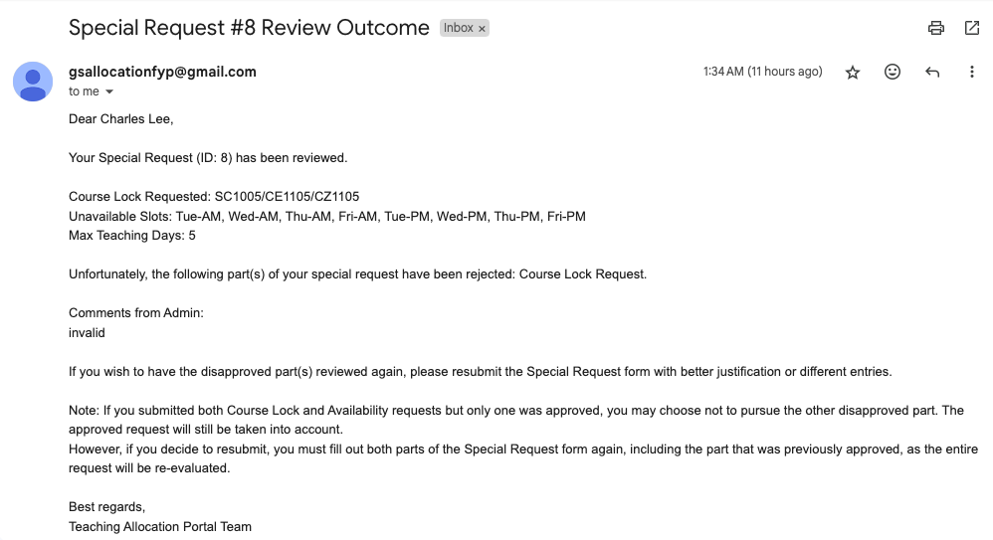
Special Requests
Notes:
This is the email that contains information of the rejection along with instructions on how to proceed.

Slide 21
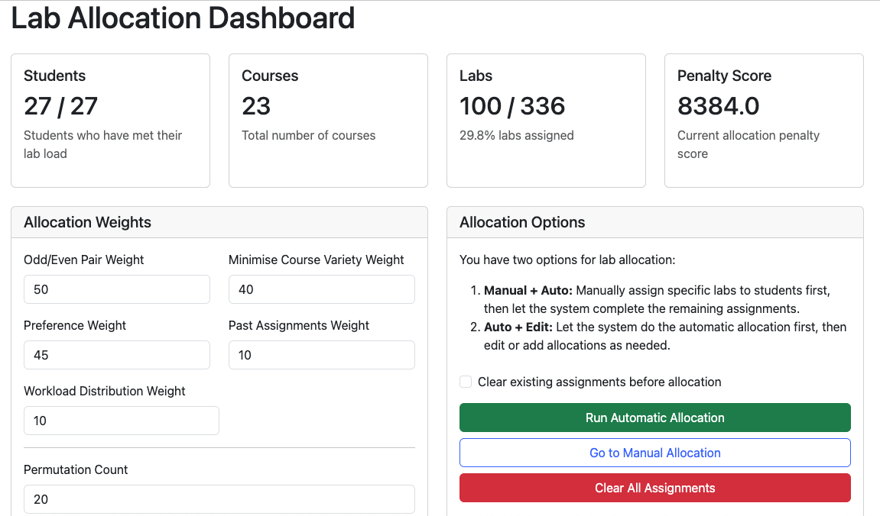
Lab Allocation
Notes:
Moving on to the actual lab allocation dashboard. The top will show the summary statistics of the number students that have met their lab load, the total number of courses, number and percentage of labs assigned, as well as the penalty score of the current allocations displayed in the table at the bottom of the page. There is also the section for the admin to customise the allocation weights, which I will go into detail in the next slide. And then there is the section for the various Allocation functions. The admin can choose to do both manual and automatic allocation in whichever order they would like, and they can also choose whether they wish to clear all assignments before proceeding with the automatic allocation, or if they wish to keep whatever is there and just autofill the rest of the slots. A demo will be shown later on as well.

Slide 22
Lab Allocation
Factor | Default Weights | Calculation
Odd/Even Penalty | 40 | Count of odd/even week pairs assigned to different students
Course Variety Penalty | 30 | Sum for each student of (number of unique courses -1)
Preference Penalty | 25 | Sum of (preference rankings -1) for assigned courses
Workload Distribution Penalty | 15 | Standard deviation of (workload/lab_load) ratios across students
Past Assignments Bonus | 20 | Count of past courses that were assigned (subtract from penalty)
Notes:
This is the breakdown of the parameters and how they are calculated.
Firstly, the odd/even penalty is to ensure that lab sessions for the same course that are occuring at the same day same time, but are just either all odd weeks or all even weeks are assigned to the same graduate student. This is a consideration that the administrator has communicated is something that she takes greatly into account when allocating the labs to the students, as this would allow students’ weekly schedules to look the same and make it easier for everyone.
Next, The course variety penalty is there to ensure that students are assigned to labs from the same course as much as possible to ensure that they do not have to learn the content for multiple courses unless necessary. Logistically, it would also make it easier for the course coordinator as well as there will be minimal number of graduate students for the course to handle. However, a downside to this penalty being highly prioritised is that if there are not enough students to cover all the labs, the allocations will all be grouped to the same few courses instead of them being spread out across all courses. So some courses will have no graduate students assigned to them as well. However, this does not seem to be much of an issue as there are usually more than enough graduate students.
Next, the preference penalty is to ensure that student’s teaching preferences are respected as much as possible.
The workload distribution penalty is to ensure fairness in the distribution of the workload to students. This is calculated by taking into account the number of hours and weeks that the labs have. So for example, even when 2 students have the same lab load of 4 labs, it would be considered unfair if student A is allocated 4 labs that are all 1 hour and 4 weeks only, while student B is allocated 4 labs that are all 2 hours and 8 weeks. To calculate this penalty, we calculate the workload to lab load ratio to account for varying lab loads as well.
Lastly, the past assignments bonus is given if a student assigned a course that they have indicated in the semester information that they have taught this course before. Similarly to the course variety penalty, this is to minimise the effort it would take for a graduate student to teach a lab as they would already be familiar with the content of the course if they have taught it before.

Slide 23
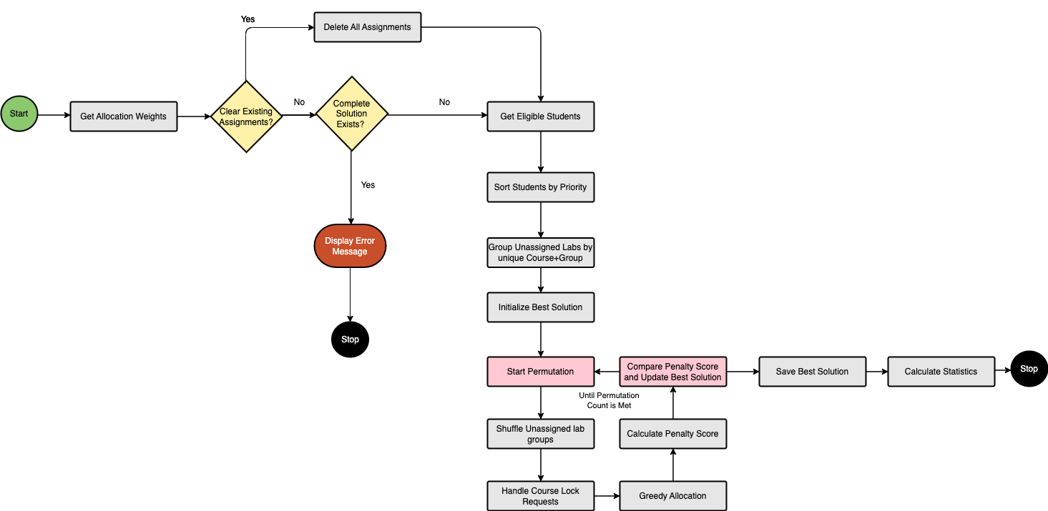
Lab Allocation
Notes:
This is the flowchart for the allocation algorithm. You start by getting the allocation weights that have been set by the administrator, and then clear existing assignments if the checkbox to do so has been ticked. If not all students have been assigned their maximum lab load, carry on with the algorithm; else display an error message.
For initialization, students will be sorted by priority, prioritising those with availability constraints and higher lab loads. We also extract out the labs that are unassigned and shuffle this list of unique lab groups every permutation until the permutation count is met.
Approved course lock requests take priority in this algorithm and then followed by the greedy allocation. We then store the best solution with the lowest penalty score from all the permutations and then display this on the dashboard.

Slide 24
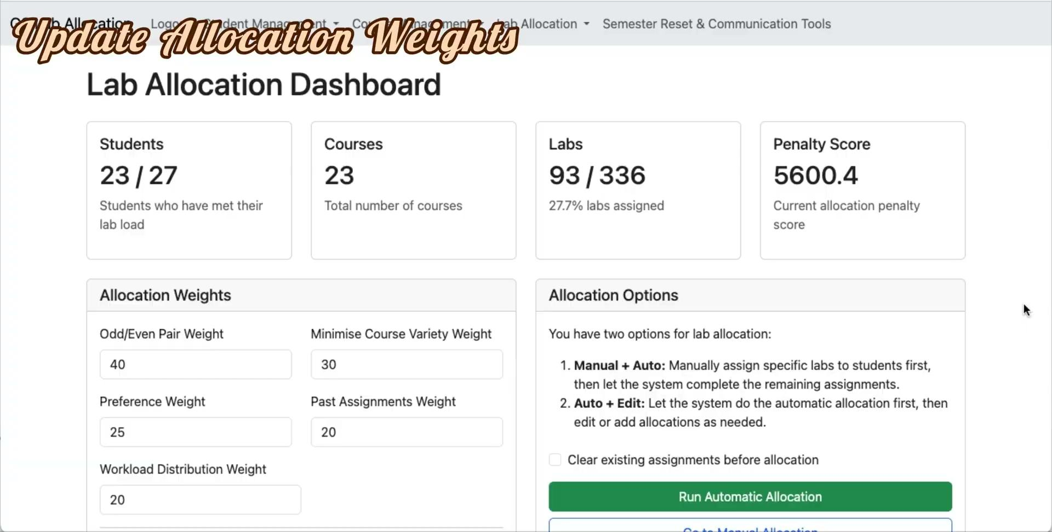
Lab Allocation
Notes:
Here is the demo for the lab allocation process.
First, we update the allocation weights and see that the change is reflected in the penalty score.
Scrolling to the bottom, we have the assignments that can be viewed in both student and course views.
Now, we try to edit the assignments. Here we are trying to assign a course to a student that already has met their maximum lab load, which raises an error as expected.
And then now we try to delete an assignment from Charles to try to assign a course that will clash with something that they are already assigned to. An error is raised as well.
We clear everything and start from scratch. Lets say we just assign one lab to Charles on wednesday withthe group FCEA, and then we run the automatic allocation to fill in the rest. We check that the manually allocated lab is still there as expected.
After everything is done, we can export the allocation to csv file. And then we confirm and notify students of the allocations
The students will receive an email that has the csv file attached. And they can access their allocations on the portal as well.
Lastly, if they see anything that they wish to swap with other students, they can do so using this function.

Slide 25
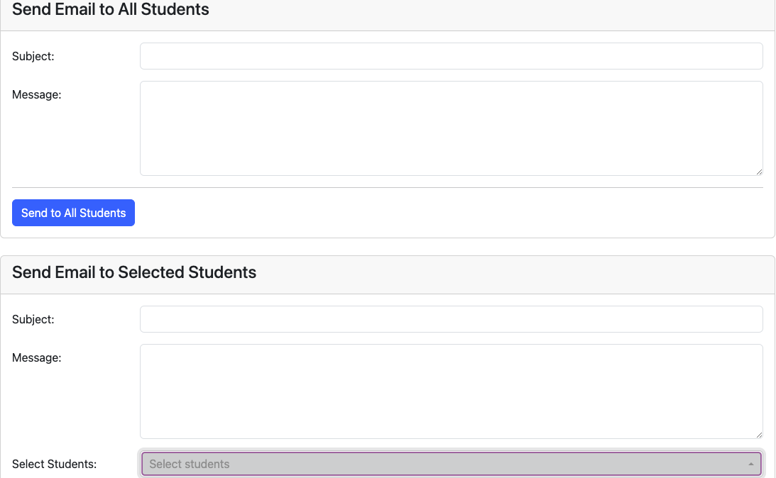
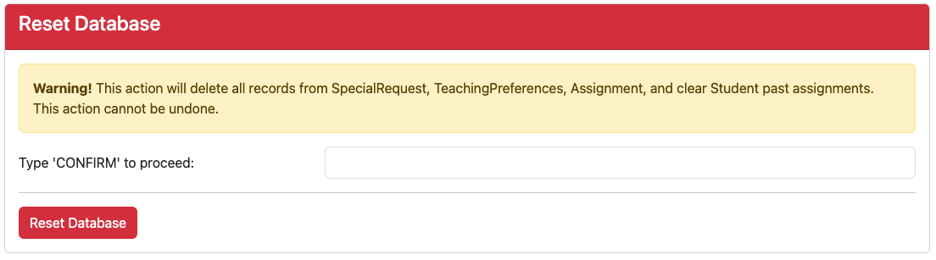
Semester Reset & Communication
Notes:
Last but not least, we have the function for the admin to communicate with students, and also reset the database to clear out the semester-specific student information.

Slide 26
Conclusion
Limitations & Future Enhancements
Go
Cancel
Notes:
Overall, although the implementation was successful, there are still several limitations and opportunities for future enhancements.

Slide 27
Limitations
Limited Testing
Manual Inputs
Rigid Input Requirements
Larger workloads untested
Only handles lab allocation
Standalone system
Steep learning curve for first-time users
Require extensive instructions which may overwhelm users
Notes:
In terms of scalability, it was difficult for me to test out the system with many students that are representative of the actual size in reality because it takes a lot of effort for the data entry. Thus, the system’s performance under the actual or even larger workloads remain untested. In addition, the system does not integrate a closely-related administrative task of assigning tutorials and only does lab allocation.
Currently, this is a standalone system that requires many manual inputs. Future integration with university timetabling or student record systems could automate data synchronization and reduce manual entry.
Due to the system’s automated nature, strict formatting rules are needed for user inputs. While these constraints ensure error-free algorithm processing, they create a steep learning curve for first-time users. Administrative guides and form labels currently require extensive explanations, which may overwhelm users accustomed to flexible manual systems. This trade-off between automation robustness and user-friendliness remains an ongoing challenge.

Slide 28
Future Enhancements
Visual Conflict Detector
Student Self-Swapping
Calendar-style overlay would help admin spot and resolve clashes easily
Reduce post-allocation adjustments for admin
Predictive Analytics
Feedback
Machine learning to predict future demand for specific courses or time slots
Portal for course coordinators to provide feedback on graduate students
Notes:
Many future enhancements could be incorporated into the system to bring about more benefits. We could use a visual conflict detector such as a calendar-style overlay that will help administrators spot and resolve scheduling clashes more intuitively. Self-swapping among students on the portal itself that is subject to admin approval could help reduce post-allocation adjustments for the admin while still maintaining control. Machine learning could also be added to predict future demand for specific courses or time slots, and lastly, we could allow for course coordinators to provide feedback on the assigned students as well to close the loop between allocation and teaching quality assessment.

Slide 29
Thank You
Auto Schedule Allocator

