Slide 1
OCCUPATIONAL HEALTH · INTERNAL SOFTWARE
PME Care
Periodic medical examination tracking for an industrial workforce — who is due, who examined them, and what was decided.
4
ROLES
23
ENDPOINTS
118
TESTS PASSING
5
SCHEMA VERSIONS

Slide 2
THE PROBLEM
A lapsed examination is silent
Periodic medical examinations are periodic by law. The failure mode is not dramatic — nobody refuses an examination. Someone simply falls off the schedule, and nothing says so.
A register of past examinations cannot answer the only question that matters: who is overdue right now? Answering it from paper means reading every record and doing arithmetic on every date.
BEFORE
A record of the past
Examinations are filed after the fact. Compliance is asserted at audit time and reconstructed by hand.
AFTER
A queue for today
The system computes when each next examination falls due and puts the people behind that date on one screen, worst first.

Slide 3
WHO USES IT
Four roles, four different screens
HEALTH TEAM
Keeps the schedule
Registers employees, sees who has lapsed, books examinations, cancels with a reason. Cannot record a clinical decision.
DOCTOR
Makes the decision
Works a list of booked examinations and records the outcome against the person's history. Cannot register or cancel.
EMPLOYEE
Sees only themselves
One screen: am I fit, when is my next examination, what was said. No lists, and no way to reach another person's record.
ADMINISTRATOR
Accounts and accountability
Creates and revokes staff accounts, and reads the audit trail. Cannot lock themselves out.
Every role's permissions are enforced by the server on each request. The interface simply stops offering what would be refused.

Slide 4
THE CYCLE
One loop, and it closes itself
Register
Health Team
Falls due
computed
Book
Health Team
Examine
Doctor
Record outcome
Fit / unfit
Next due date
automatic
Completing an examination is what starts the next cycle. A Fit outcome is good for a year and the employee leaves the queue; a provisional one returns them within months.
An Unfit outcome sets no due date at all. That is a case to manage, not a booking to make — inventing a routine recall would quietly downgrade a serious finding.

Slide 5
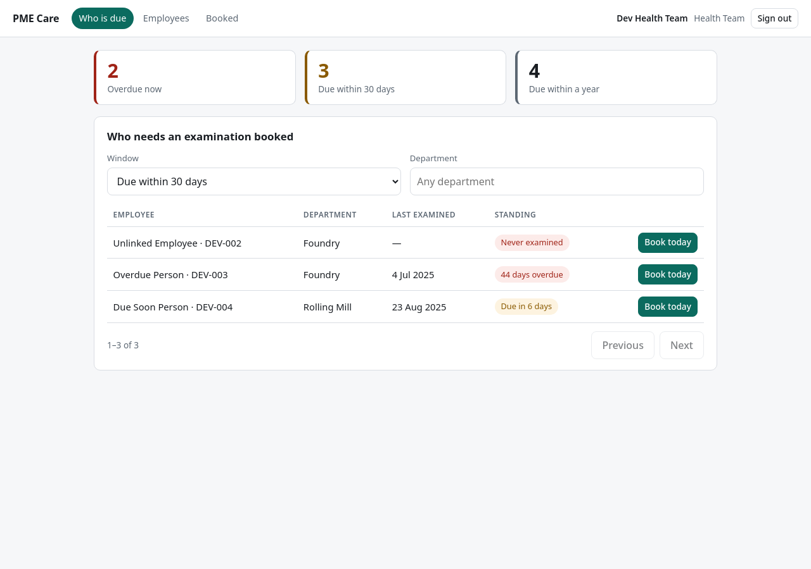
HEALTH TEAM · THE LANDING SCREEN
Who needs an examination booked
The first screen is the work, not a search box. Counts across the top, the people behind them below, and Book today on every row — booking someone removes them from the list, so what remains is what is left to do.

Slide 6
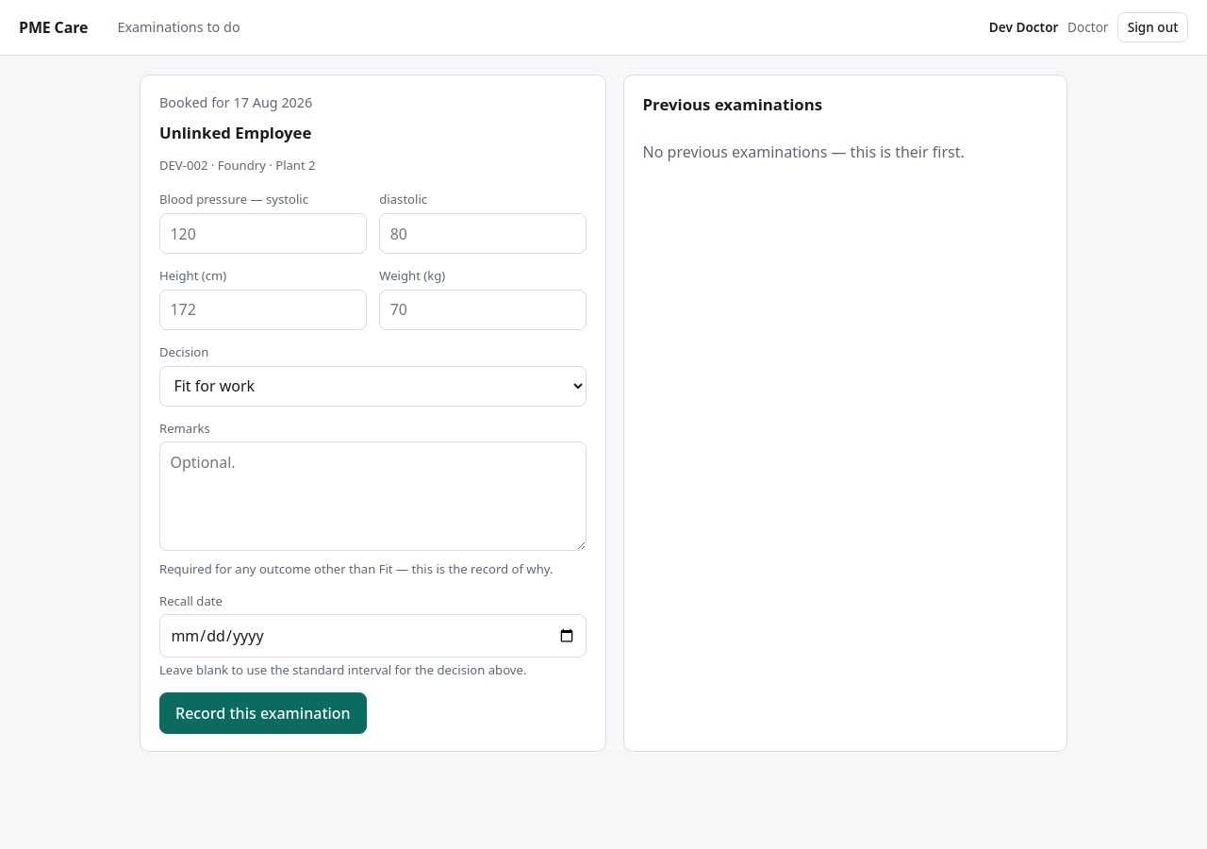
DOCTOR · RECORDING AN OUTCOME
The decision, beside the trend
Previous readings sit beside the form, not behind a click — a fitness decision is a judgement about a trend. Remarks become mandatory the moment the decision is anything other than Fit.

Slide 7
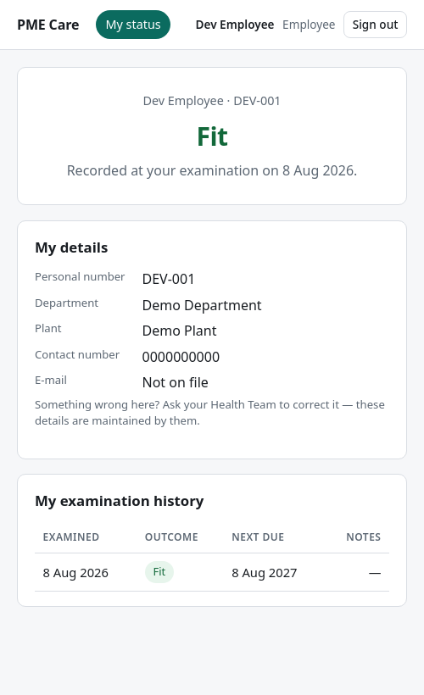
EMPLOYEE · THE WHOLE INTERFACE
One question, answered
Am I cleared for work? The answer is the first thing on the screen, in words, before any detail. Below it: their own particulars and their own history.
Deliberately absent: any list, any search, any other person, and any identifier they would have to type. An employee is shown their record because the system already knows whose it is.
"Not yet examined" is worded distinctly from "Fit" — the two mean very different things to someone about to start a shift.

Slide 8
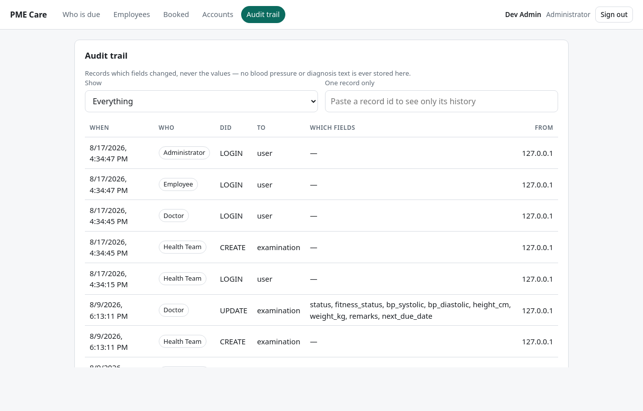
ADMINISTRATOR · ACCOUNTABILITY
Every change, and no clinical values
The trail records which fields changed, never what they changed to. A blood-pressure reading in an audit table would be medical data sitting outside the controls that protect the examination itself.

Slide 9
RULES THE SOFTWARE ENFORCES
Refusals are the feature
ATTEMPT
ANSWER
WHY
Book a second open examination for one person
Refused
Two open examinations make “their current status” ambiguous. Enforced by the database, not a check two clicks could race past.
Record Unfit with no remarks
Refused
An outcome with consequences has to carry the reason for it.
Cancel an examination without a reason
Refused
A cancellation is a gap in the record that someone must be able to explain.
Employee opens another employee's record
Not found
Not “forbidden” — that would confirm the record exists.
Administrator deactivates their own account
Refused
That is how a deployment ends up with nobody able to administer it.
Re-open a completed examination
Refused
What was decided, and when, stays fixed. A new examination is booked instead.

Slide 10
HOW IT IS BUILT
Boring on purpose
— Python and PostgreSQL — chosen for longevity, not novelty.
— No build step in the interface. Deploying it is copying files; there is no toolchain to break in two years.
— One process serves the interface and the data together, on one port.
— Runs entirely on your own hardware. No data leaves the site.
Schema changes are versioned
Every change is a numbered migration, tested to apply and to reverse. A change that cannot be undone is a deployment that cannot be rolled back.
History outlives the record
Nothing is hard-deleted. Retiring an employee keeps their examinations and their audit trail intact.

Slide 11
WHERE IT STANDS
Verified, and honestly incomplete
WORKING AND TESTED
NOT BUILT YET
— The full cycle, end to end, against a real database.
— 118 automated tests, run on every change, including the database migrations in both directions.
— Every screen driven in a real browser as all four roles.
— Accounts, roles, revocation, and the audit trail.
— Sign-in from a browser. The server verifies credentials correctly; the login page that obtains them is not finished. This is the one thing between here and real users.
— Reminders. Due dates are computed and visible, but nothing sends anything to anybody yet.
— Attachments, and a richer set of recorded measurements.

Slide 12
WHAT I NEED FROM YOU
Three decisions, then it ships
DECISION ONE · HIGHEST PRIORITY
Are the examination intervals correct?
The software recalls a fit employee after 12 months and a provisionally fit one after 3. I chose those numbers. For a hazardous process they may be set by regulation — and they should be right before real records exist. They are configuration, not code.
DECISION TWO
How do people sign in?
Sign-in currently depends on an external service, so an internet connection is needed to log in to an otherwise self-contained system. Using the existing plant directory instead would remove that, and mean no new passwords for anyone.
DECISION THREE
Who owns backups?
On your own hardware this is nobody's job until it is named as somebody's. A nightly copy is scripted; a restore has never been performed. An untested backup is not a backup.
Source, documentation and deployment runbook: github.com/nichepah/pme-care

