Slide 1
Renewable Energy Pathways to Support Carbon Neutrality in China
William Gao

Slide 2
To achieve carbon neutrality in China, how much renewable resources should be built? Where, and when?

Slide 3
Outline
Optimization model for power system planning at large
Original paper: China’s renewable energy pathways toward carbon neutrality
Decadal snapshot model

Slide 4
Optimization Models for power system planning at large

Slide 5
Optimization Methods
Given constraints and an objective, how should we tune the variables of interest (decision variables) such that the objective is maximized (or minimized)?
Example: Factory production. A factory wants to produce two types of widgets, A and B, to maximize its profit.
Widget A generates $150 revenue per widget
Widget B generates $175 revenue per widget
Producing one unit of A requires 7 units of material M
Producing one unit of B requires 11 units of material M
The supply of M is limited to 77 units in total
Credit: Power System Optimization , Davidson & Jenkins

Slide 6
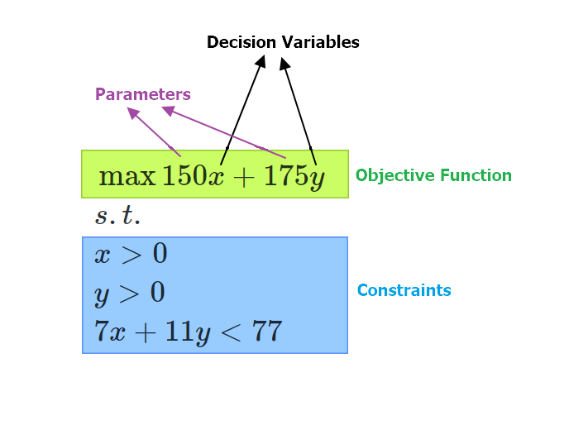

Slide 7
Why use optimization models in general?
“All models are wrong but some are useful”
Modeling is not meant to capture every single details of the real world
Analogy: dimensionality reduction
Reduce the real-world complexity; highlight selected aspects of the reality and study their relations
Make explicit the assumptions and how the assumptions will impact the result.

Slide 8
Why use optimization models on power system planning?
Optimization is widely used in operations of power system (e.g. electricity dispatch), but here I am focusing on planning alone
Increasingly, pressure from climate change and emission targets – system-level planning is critical
Provide a concrete scaffold for policymakers
Anticipate potential constraints and challenges

Slide 9
Original paper: China’s renewable energy pathways toward carbon neutrality

Slide 10
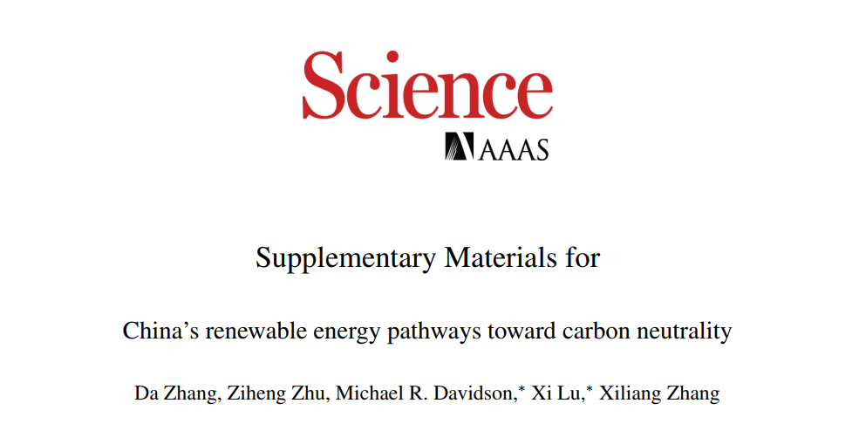

Slide 11
At the year 2060, how much renewable energy resources, transmission capacity, and energy storage should China have to meet the carbon neutrality goal?

Slide 12
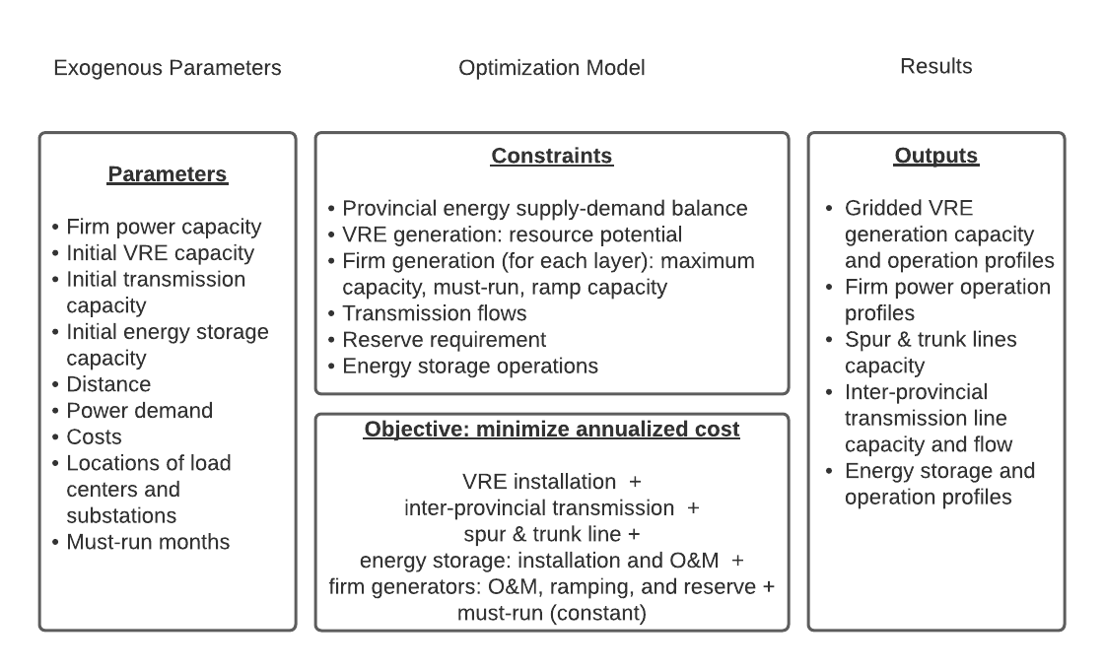

Slide 13
Firm power as exogenous parameters
Taking firm power as exogenous parameters/inputs
250 GW Combined Heat and Power (CHP) with carbon capture and sequestration (CCS) [heating]
110 GW of Bioenergy with CCS (BECCS) [negative sink]
218 GW nuclear
580 GW hydro
320 GW natural gas with CCS (NGCCS)

Slide 14
Decision variables: renewable, transmission, storage
Tuning for decision variables:
Wind
on-shore
off-shore
Solar PV
Supporting infrastructures
Transmission
Inter-provincial high voltage transmission line capacity
Intra-provincial spur and trunk lines
Energy storage
Pumped hydro storage (PHS), utility-scale batteries

Slide 15
Model feature 1: spatially-explicit RE resources
Renewable energy buildouts at a grid cell level
Spatial resolution: 0.3125° lon x 0.25° lat
Wind energy potential
Utility-scale solar energy potential
Distributed solar PV
Land suitability
Slope
Land type + suitability factor

Slide 16
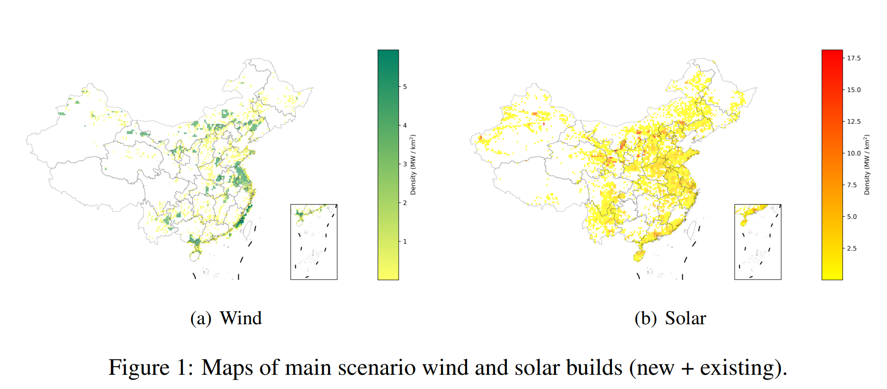

Slide 17
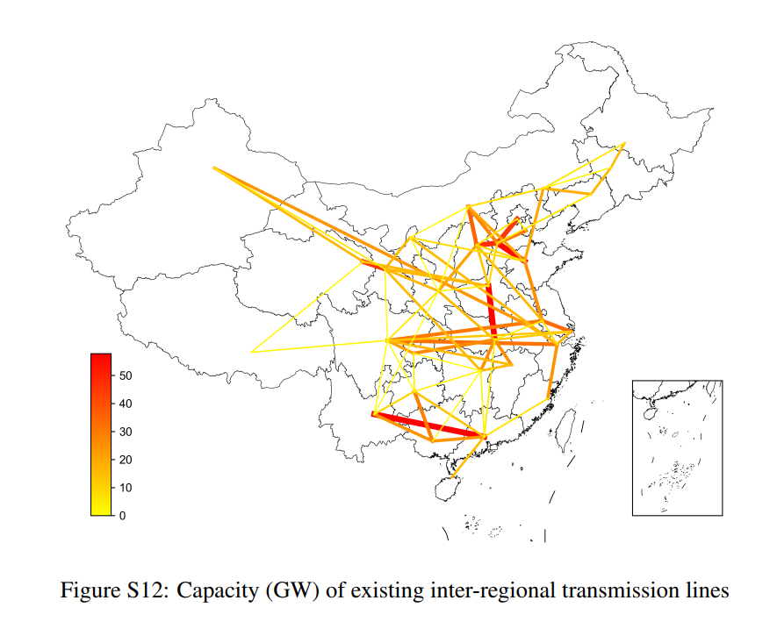
Model feature 2: Provincial focus
Supply-demand balance maintained at a provincial level
Allowing inter-regional transmission through high-voltage transmission line

Slide 18
Decadal Snapshots Adaptation

Slide 19
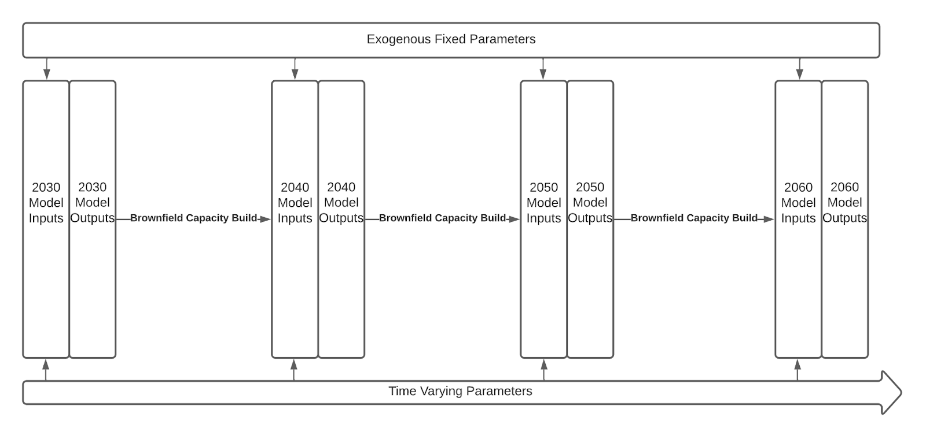

Slide 20
Core Ideas
Run model four times sequentially at 2030, 2040, 2050, and 2060.
At the snapshot years, the outputs (brownfield capacity build) will be used as the inputs for the next model.
Hold exogenous fixed parameters constant for each model across all years.
Project time varying parameters into the future, before feeding them into models as inputs.

Slide 21
Exogenous Fixed Parameters
VRE potentials, locations, energy specific specifications
Firm power with CCS parameters
Power loss
CO2 capture rate
Energy storage parameters
Pump hydro capacity
Charge & discharge efficiency
Round trip efficiency
Self-discharge rate
VRE parameters
Hourly capacity factor
Reserve requirement
Firm generation
VRE generation
Transmission line parameters
Power loss rate
VRE maximum potentials
Location of load center and substations
Life spans
Firm power parameters
Ramp up & down cost
Ramp up & down rate
Reserve cost
Max generation capacity
Capacity factor (for hydro)
Min generation

Slide 22
Time-Varying Parameters
Electricity demand, O&M cost, fuel cost, CapEx, firm power capacity
Hourly electricity demand
Cost of non-VRE generation resources
CapEx
Fuel cost
O&M cost
Cost of VRE generation resources
LCOE
Cost of batteries
CapEx
O&M cost
Cost of transmission lines
CapEx
Firm power capacity
Coal, Coal CHP, Coal CHP CCS
Gas, Gas CCS
BECCS
Nuclear
Hydro

Slide 23
Brownfield Capacity Build
RE Generation capacity, storage capacity, transmission capacity
Gridded Solar generation capacity
Distributed solar
Utility-scale solar
Gridded Wind generation capacity
Onshore
Offshore
Transmission capacity
Trunk & spur line
Inter-provincial
Storage capacity

Slide 24
Challenge: unabated firm power phaseout, especially coal

Slide 25
Specifically…
The 2060 model assumes exogenous firm power capacity, and all unabated coal and gas are phased out by 2060.
But China now has over 10,000 GW of total coal generation capacity.
For the decadal snapshots, how should we adjust firm power capacity?

Slide 26
Emission-guided early retirement approach (for coal)
Core idea: bounded by an emission trajectory for the power sector, decide which coal plants should enter early retirement after accounting for natural retirement.
Data: Global Energy Monitor – Coal plants tracker
Assumptions:
All permitted power plants will be built
All plants under construction will be operational
Planned lifetime of a power plant is between 20 to 30 years
Except for mentioned plants, no new coal plants will be built.

Slide 27
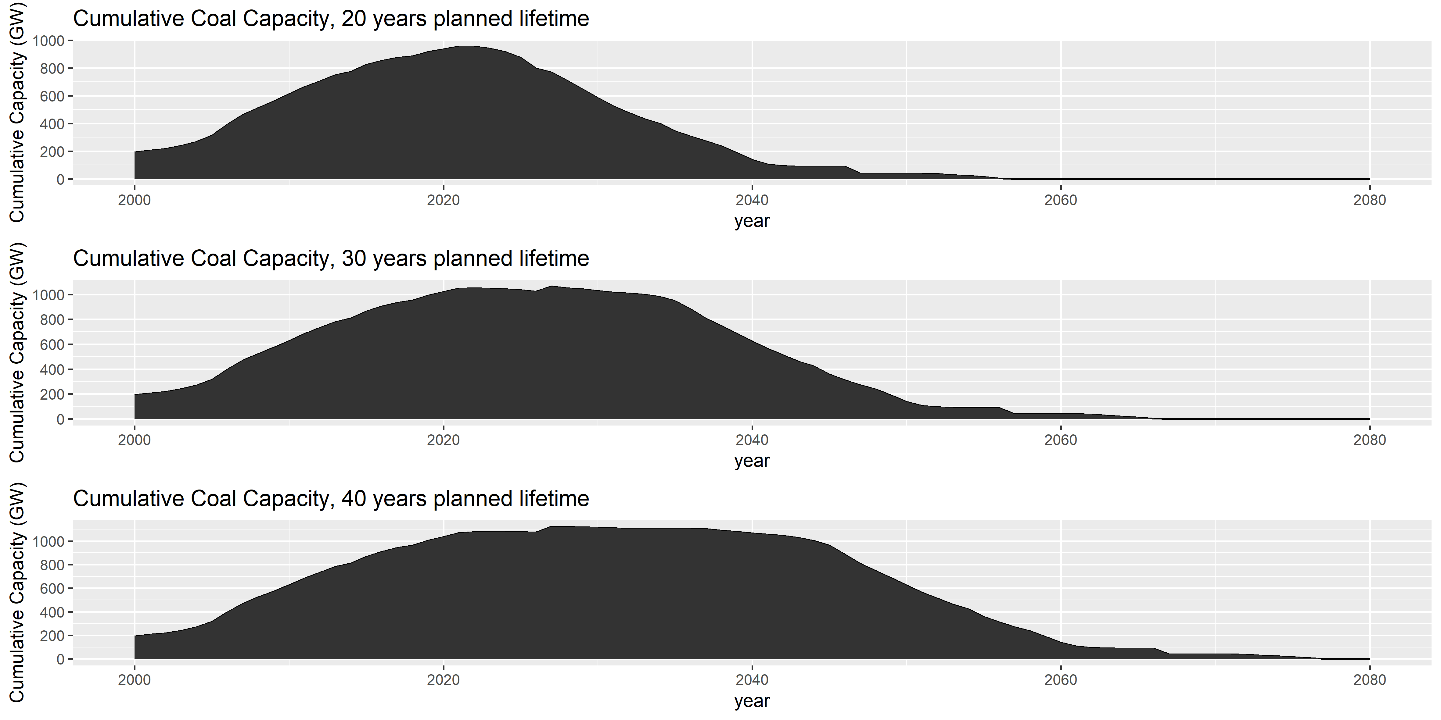
Natural Retirement

Slide 28
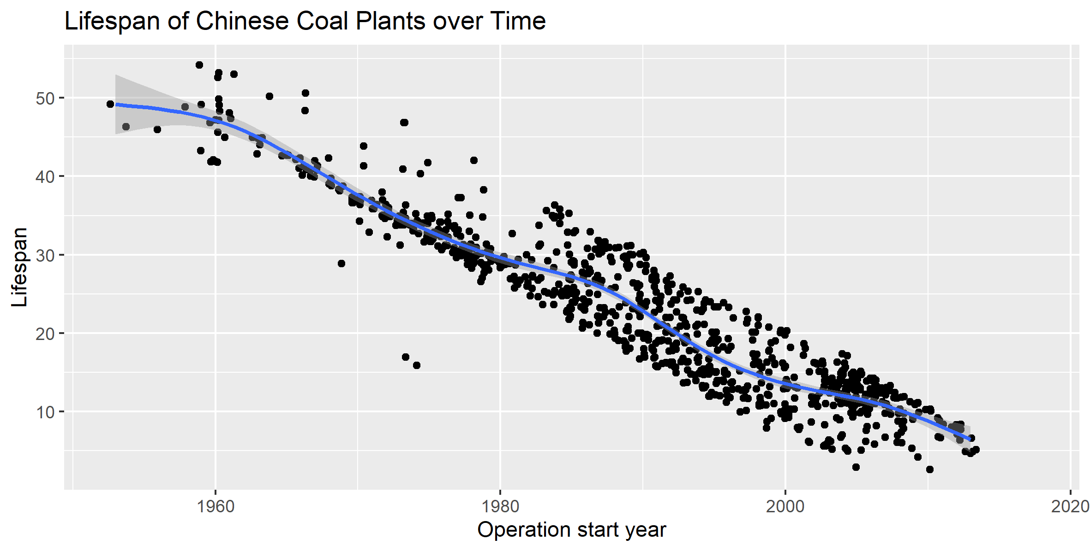
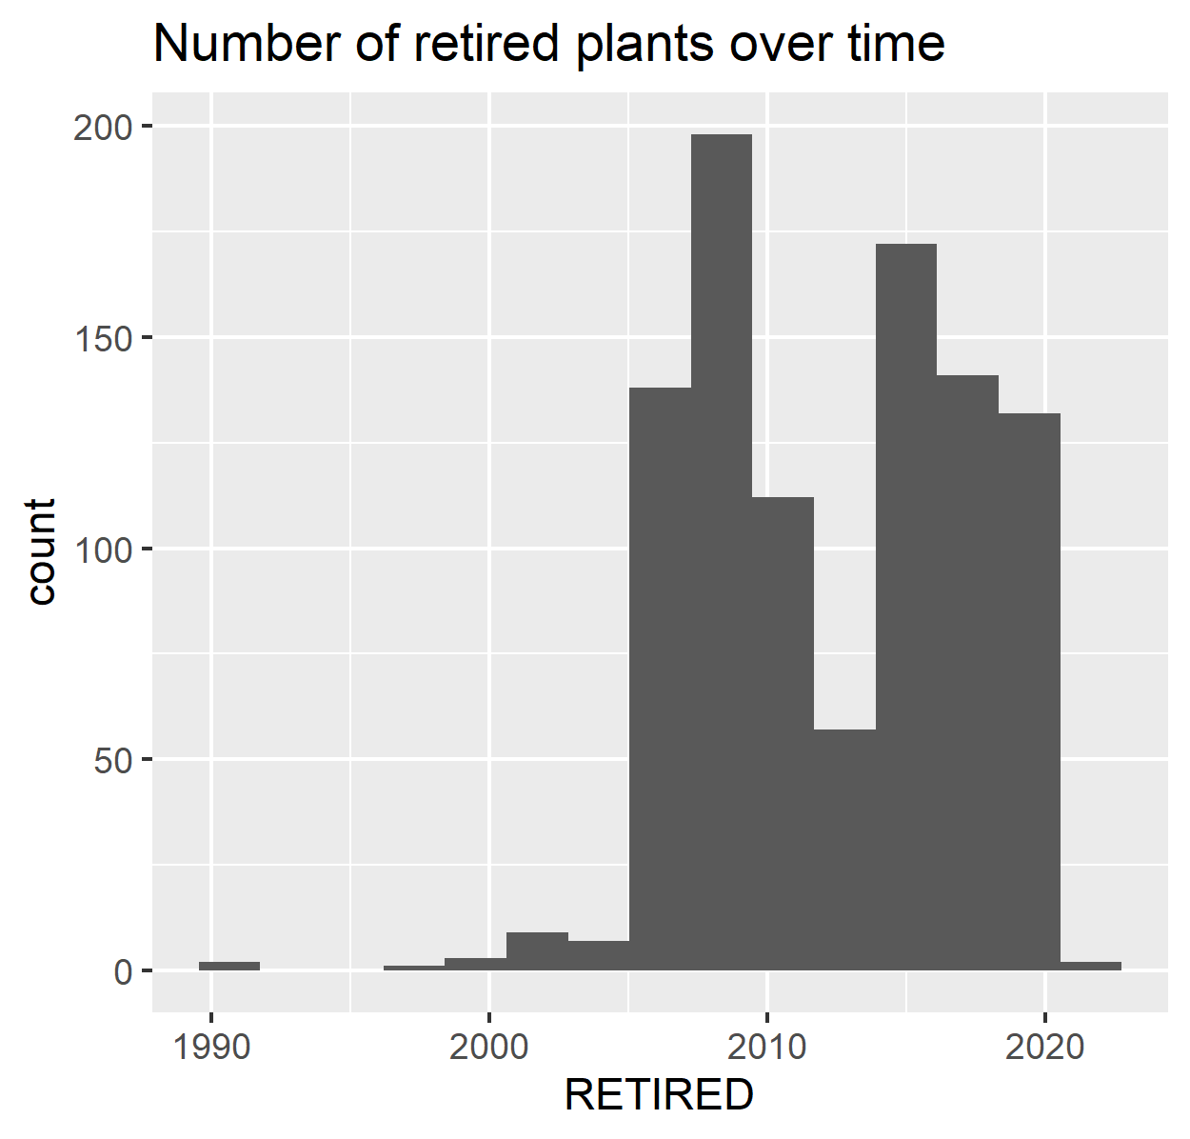

Some wrinkles… data availability
Some retired plants has operation start year but no retirement year
Use operation start year to predict the lifetime of retired plants ($R^{2}=0.87)$

Slide 29
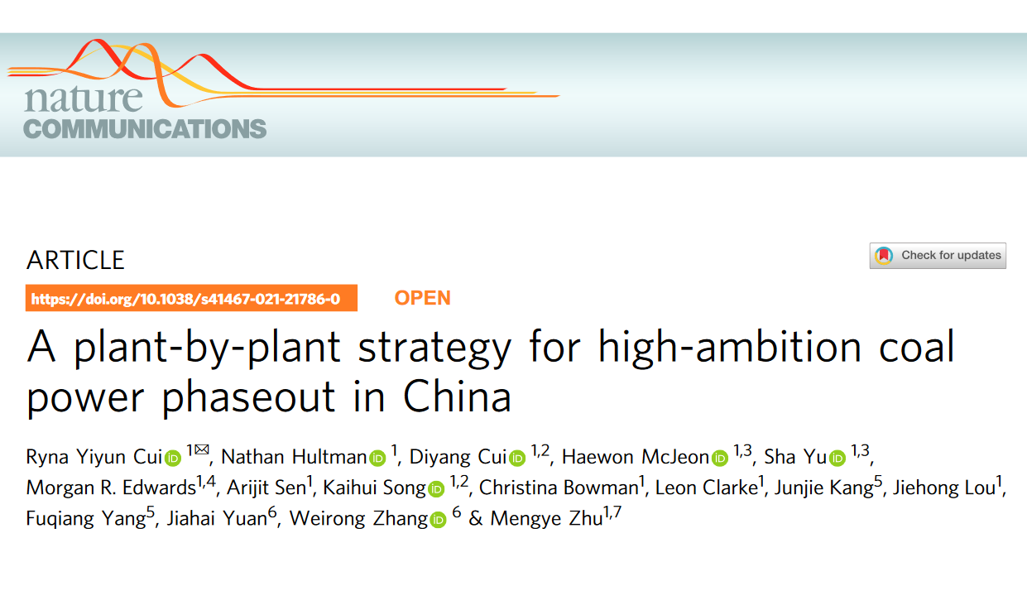
Early Retirement
Created combined retirement score
Consider three aspects when deciding which plants should retire first
Technical attributes
Profitability
Environmental impacts
Score for each GEM plants

Slide 30
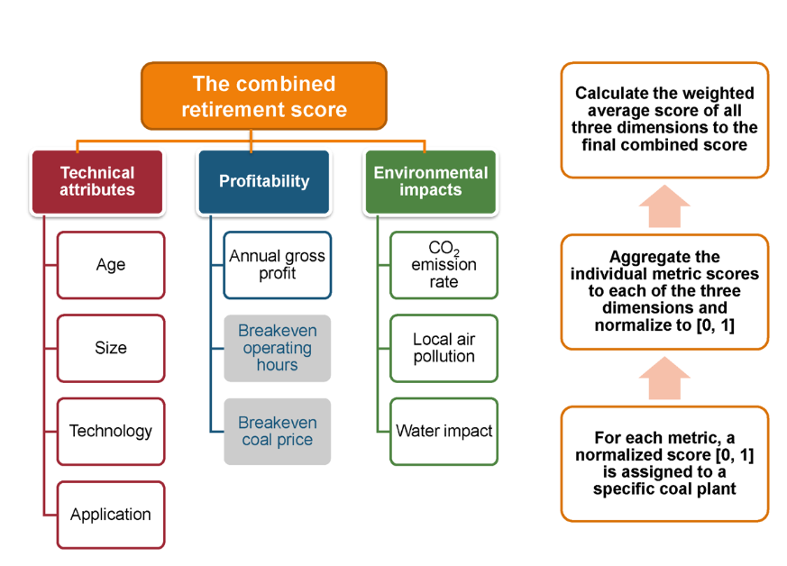
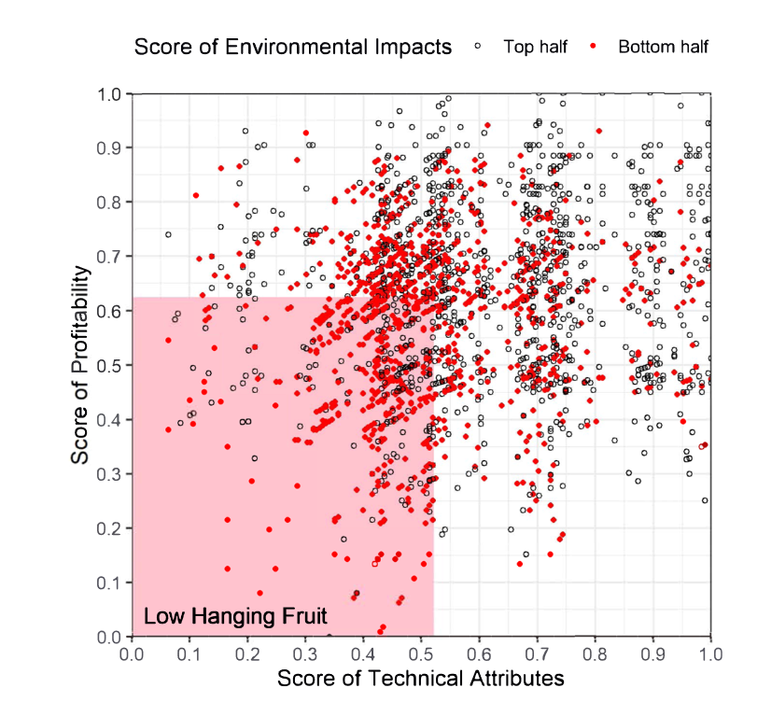
Evaluation details
Credits: Cui et al.

Slide 31
Putting everything together
emission gap = projected emission in power sector – reduction in emission from coal plants natural retirement
Decide early retirement: keep retiring plants with the lowest combined retirement score, until the sum of emission reduction from early retirement covers the emission gap

Slide 32
Thank you! What are your questions and feedbacks?

