Slide 1
Web Scraping
Nichita Trifan

Slide 2
WHY Web scraping?
Sell Collected Information.
Steal Information.
Machine Learning projects.

Slide 3
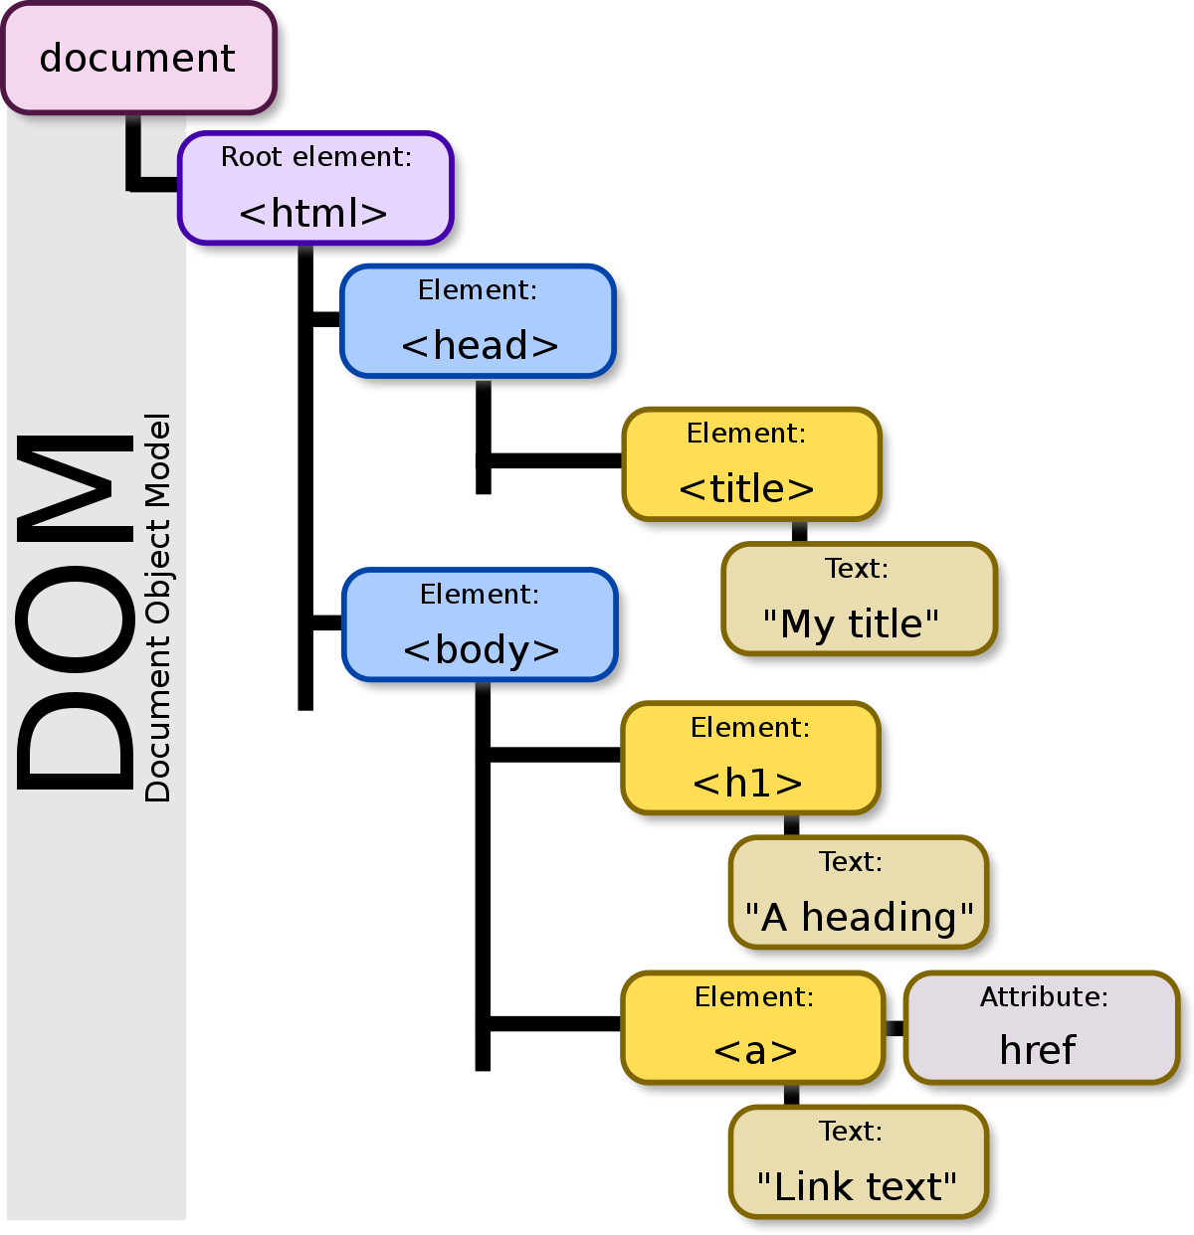
THE DOM (Document object model)

